Slide 1
Game physics in JavaScript

Slide 2
What’s the plan
2D: PhysicsJS, p2.js
Main components
Forces and interaction
Compound objects and constraints
Explosions and destruction

Slide 3
Main components
World
Bodies
Interaction rules/behaviors
Renderer
tick()

Slide 4

World, bodies

Slide 5
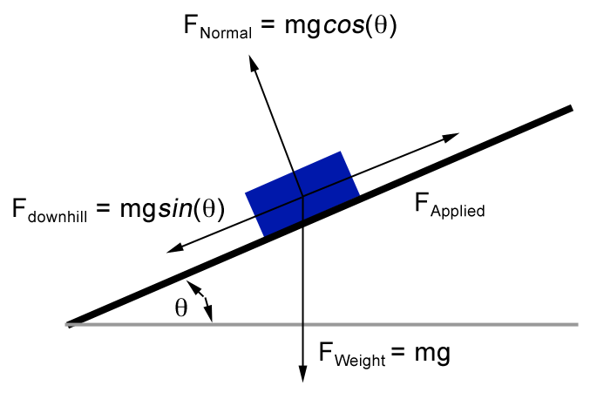
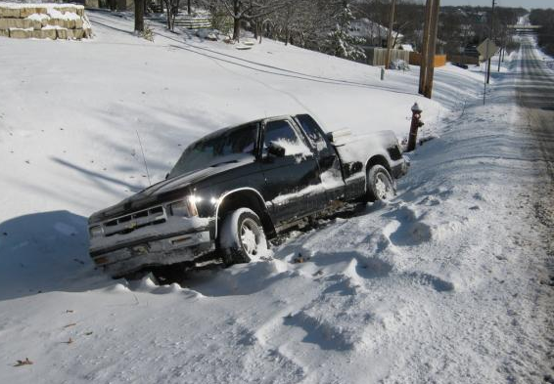
Renderer

Slide 6
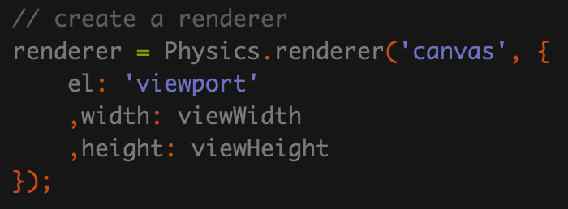
Renderer in p2.js & PHYSICS
p2.js – none
PhysicsJS – embedded, extensible

Slide 7
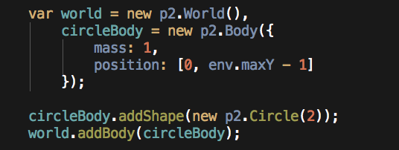
HELLO “WORLD”

Slide 8
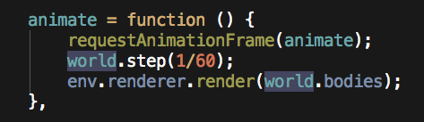
HELLO “RENDERER”

Slide 9
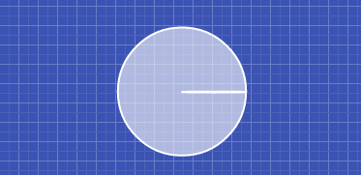
DEMO: HELLO WORLD

Slide 10

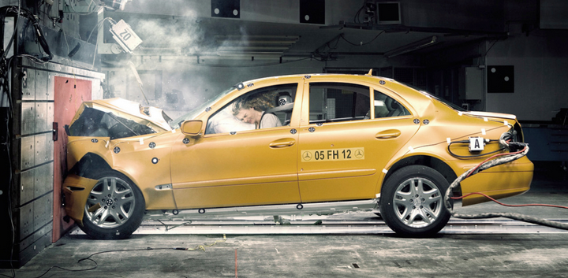
Forces and interaction
Gravitation
Impulse
Collision
Friction
Restitution

Slide 11
gravitation

Slide 12
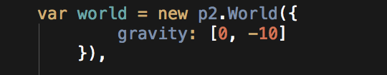
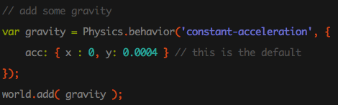
Gravitation in P2.js & physics.js

Slide 13
collision

Slide 14
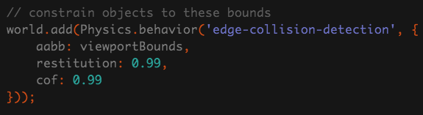
Collisions in p2.js & PHYSICS.JS
p2.js – comes for free
PhysicsJS – needs to be enabled

Slide 15
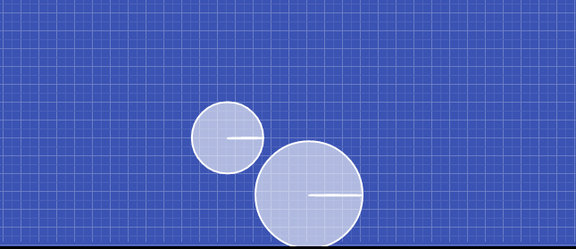
demo: collision

Slide 16
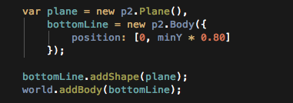
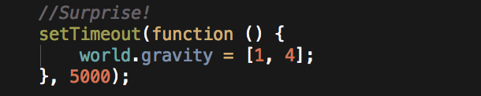
demo: collision what’s inside

Slide 17
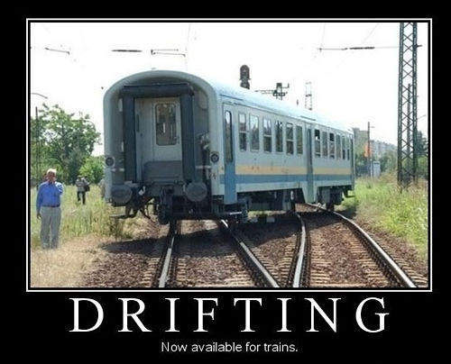
friction

Slide 18
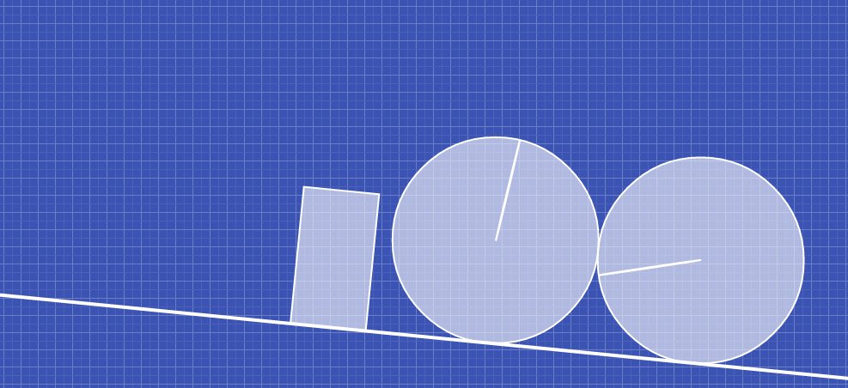
demo: friction

Slide 19

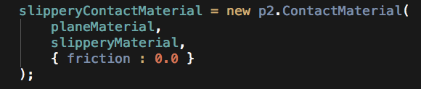
demo: friction what’s inside

Slide 20
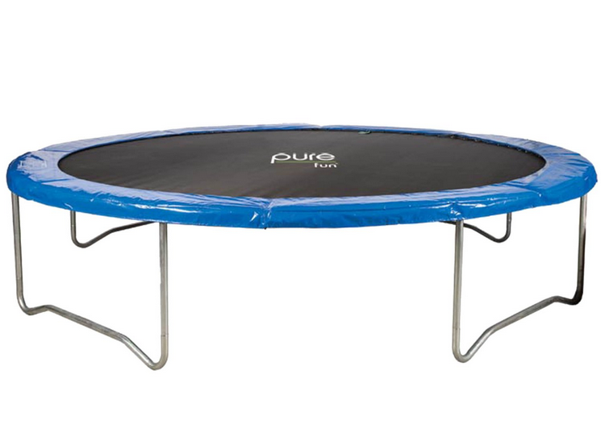
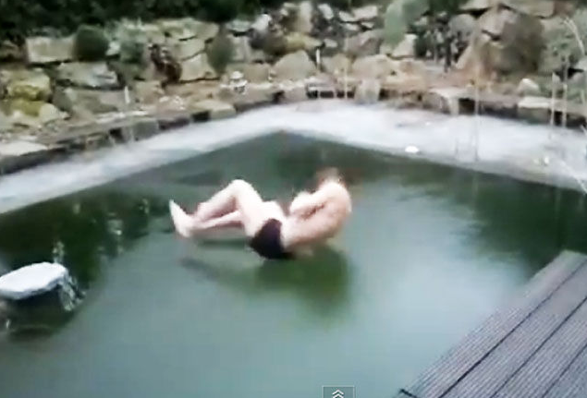
restitution

Slide 21
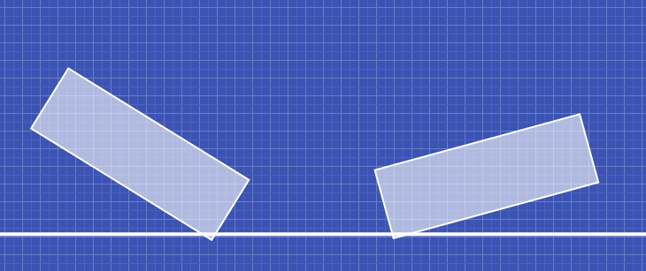
demo: restitution

Slide 22
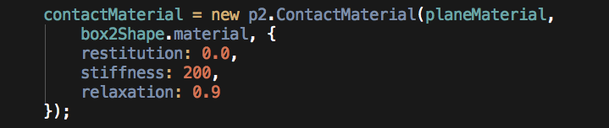
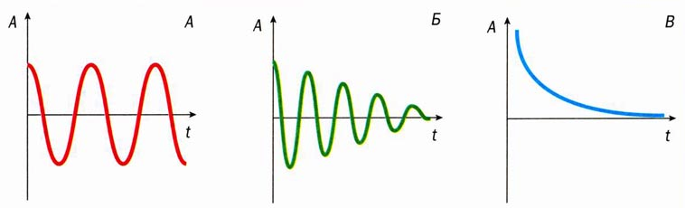
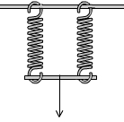
demo: restitution what’s inside
stiffness
relaxation

Slide 23
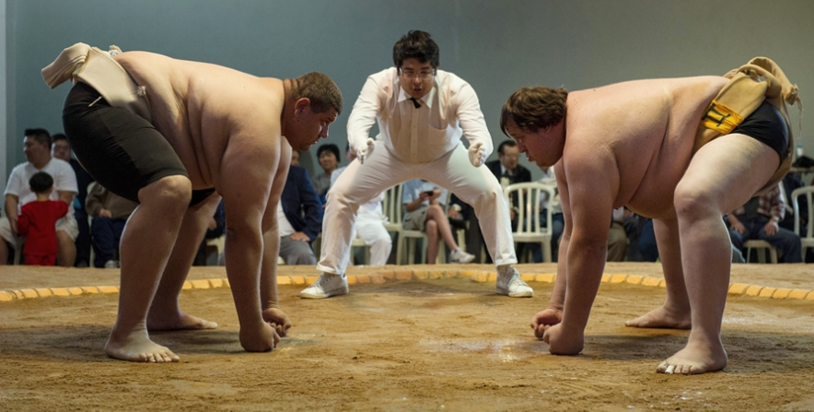
impulse

Slide 24
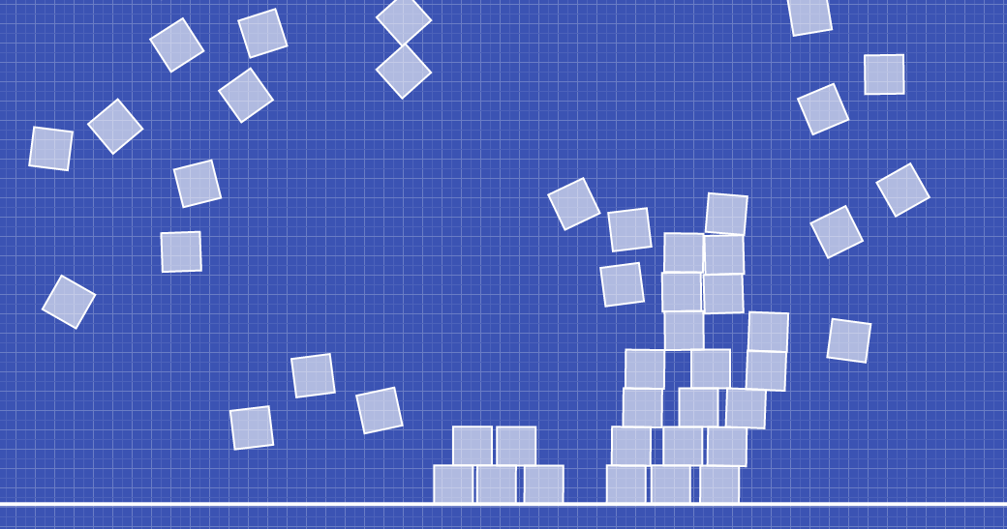
demo: explosion

Slide 25
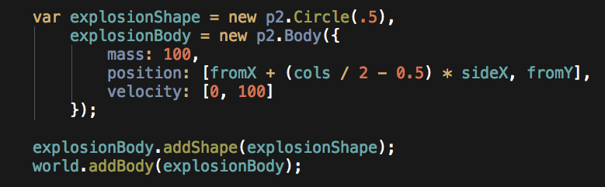
demo: explosion what’s inside

Slide 26
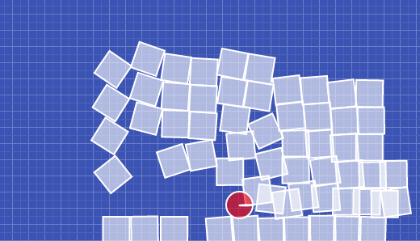
demo: cannon

Slide 27
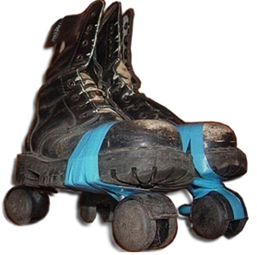
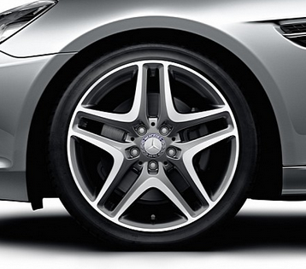

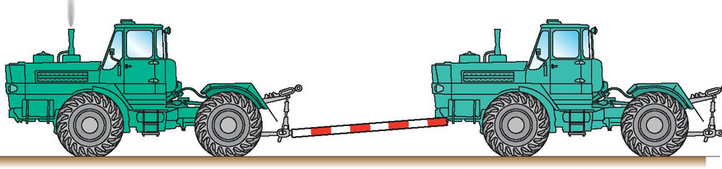
Joints and constraints
Lock
Revolute
Gear
Distance/Prismatic

Slide 28
Joints/constraints in p2.js & physics.js
physics.js – NONE!
p2.js: all mentioned; destroyable

Slide 29
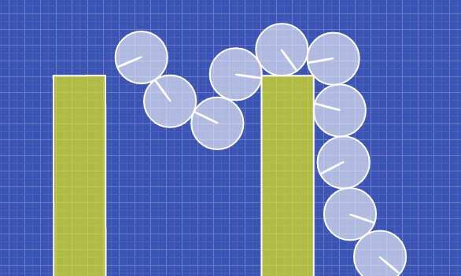
demo: distance constraint

Slide 30
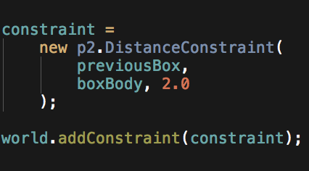
Distance constraint. what’s inside

Slide 31
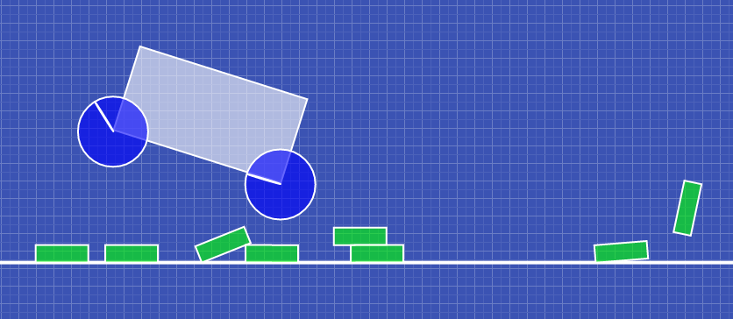
Demo: vehicle

Slide 32
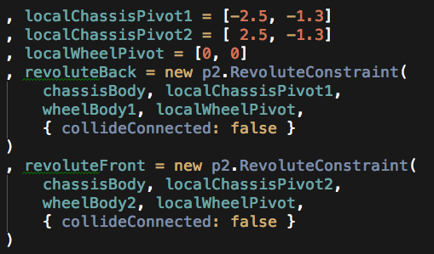
demo: vehicle what’s inside

Slide 33
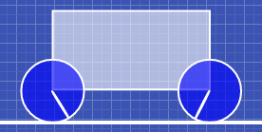
vehicle: what else’s inside
pivot points
+
2 constraints

Slide 34
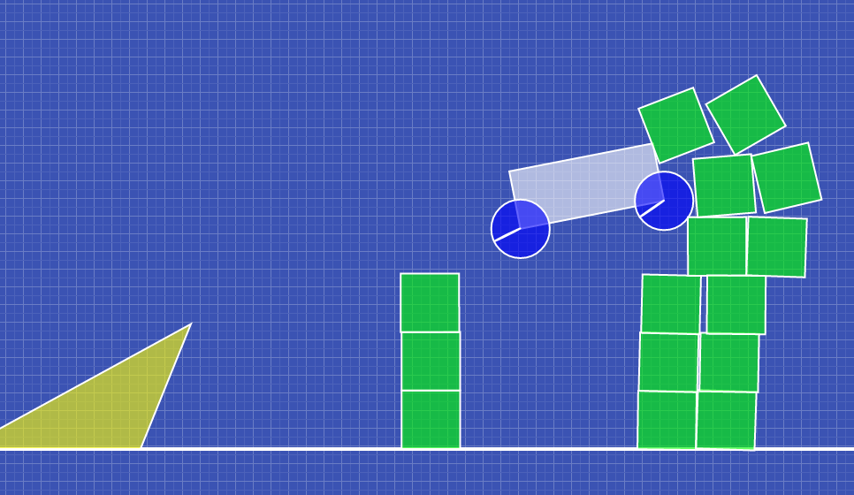
…and one more vehicle. Yippee!

Slide 35
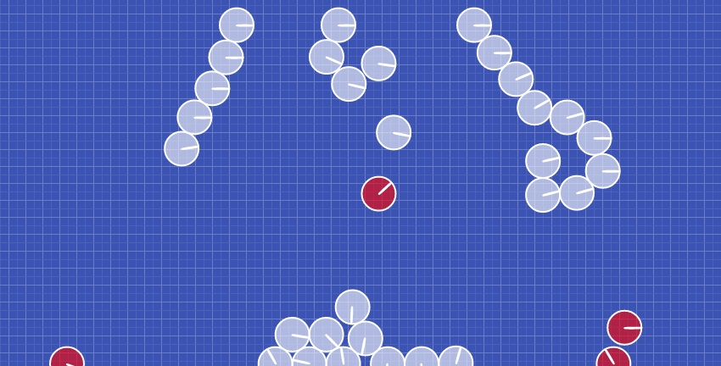
demo: cannon with constraints destruction

Slide 36
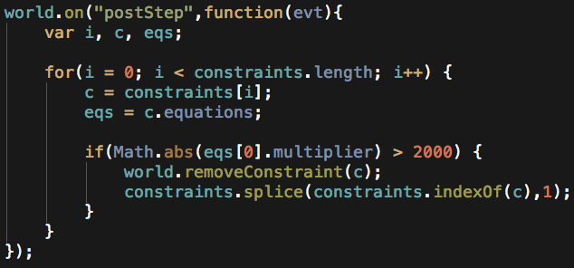
Constraints destruction. What’s inside

Slide 37


Thank you! questions?
About me:
/pasha.klimenkov
Examples:
/ /pavel-klimiankou/physics-talk.git

