Slide 1

An AI-Powered Car Towing Management System using Automatic Number Plate Recognition
Presented by:
Sheikh Tareq Ahmed
Advisor: Dr. Ahmed Ahmed
College of Engineering
Department of Computer Science
MSc Computer Science, Prairie View A&M University, Texas
Dec 4, 2020

Slide 2
MOTIVATION OF THE PROJECT
To solve existing regional issues related to Number Plate Detection.
To develop new system with it to solve vehicle related issues like: Smart Towing Management, Smart Parking System, Smart toll System etc.
Android App.
Internet of things
Sever-client based communication.

Slide 3
GOAL OF THE PROJECT
A UNIVERSAL PLATE DETECTOR THAT WORK FOR ALL REGIONS.
SOLVE THE EXISTING TOWING SYSTEM WITH IT

Slide 4
ISSUES REGADING THE PLATE DETECTION
MOST OF THE METHODS ARE VERY COMPLEX [1]
RESULTING HIGH COMPUTATIONAL TIME [1]
ONLY WORK FOR SPECIFIC NUMBER PLATES.[1]

Slide 5
ISSUES REGADING EXISTING TOWING SYSTEM
Manual process
Lack of communication between authority and customer

Slide 6
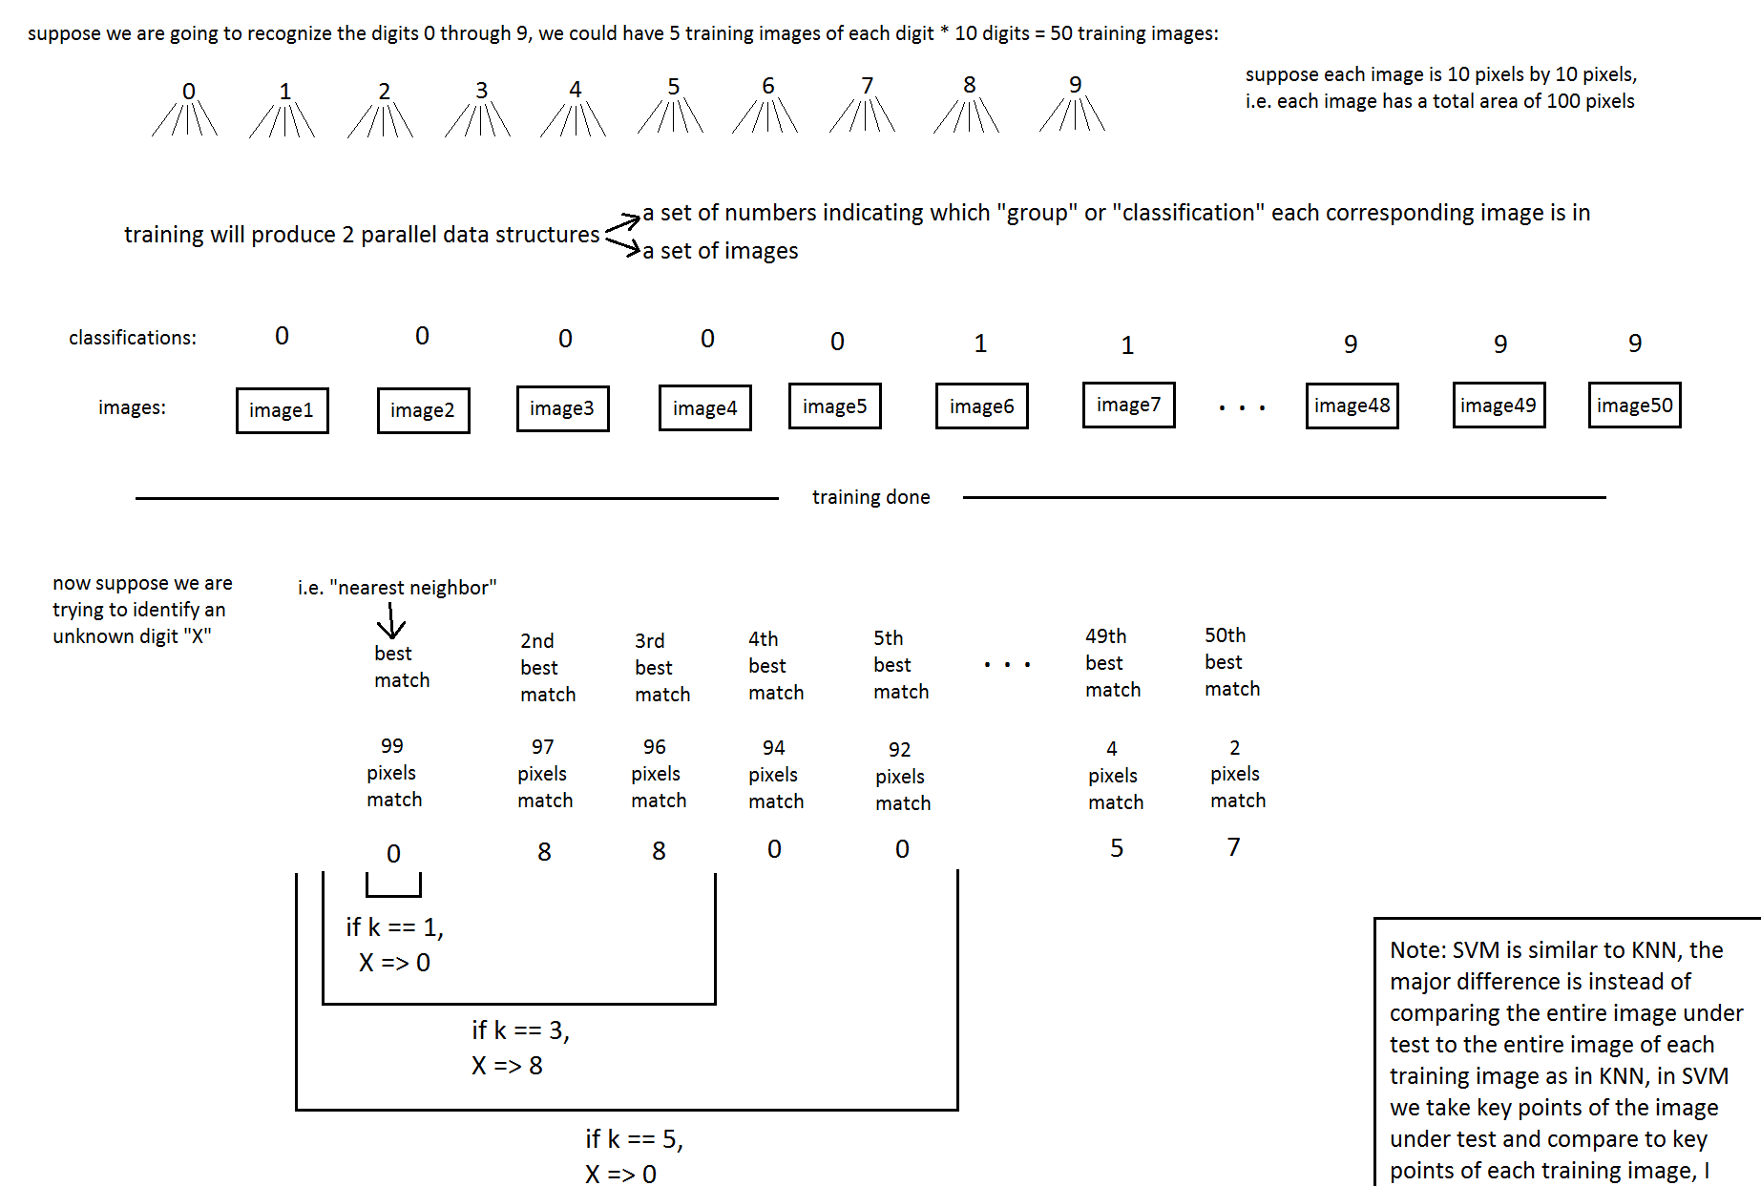
KNN Overview in Character Recognition

Slide 7
Morphological Transformation
Erosion
Dilation
Opening
Closing
Gradient

Slide 8


Erosion
Source: http://docs.opencv.org/master/d9/d61/tutorial_py_morphological_ops.html

Slide 9

Dilation
Source: http://docs.opencv.org/master/d9/d61/tutorial_py_morphological_ops.html

Slide 10

Opening
A erosion then dealation
Source: http://docs.opencv.org/master/d9/d61/tutorial_py_morphological_ops.html

Slide 11

Closing
A dilation then erosion
Source: http://docs.opencv.org/master/d9/d61/tutorial_py_morphological_ops.html
Source: https://arxiv.org/abs/1703.06870v3

Slide 12
Module for Detecting Number Plates
Detecting the license plate/ Find plate.
01
Detecting the characters within the plate.
02

Slide 13
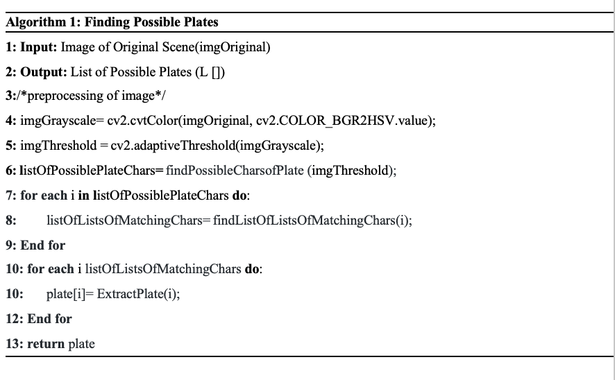
Proposed Algorithm for Detecting the Number Plate

Slide 14
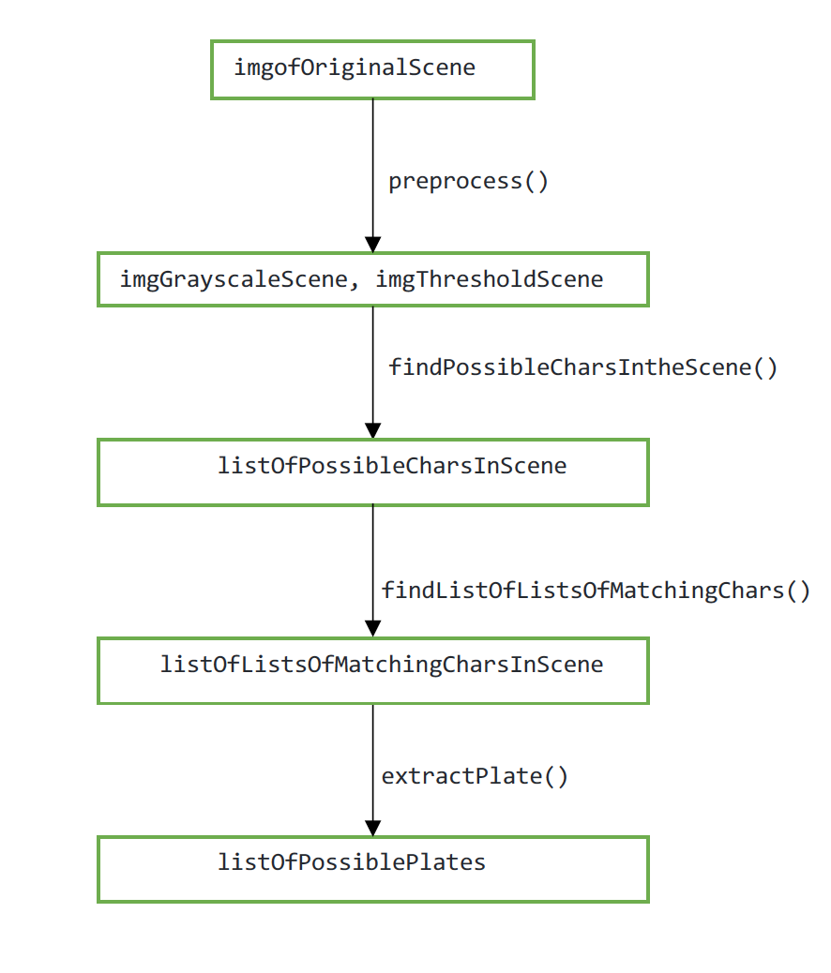
Steps of Finding a number plate

Slide 15
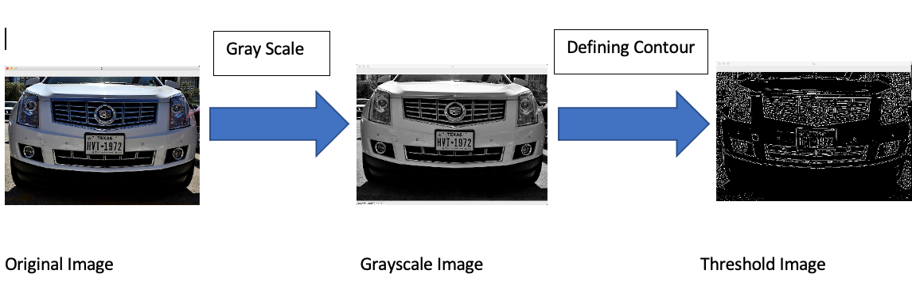
Step 1: Image Preprocessing

Slide 16
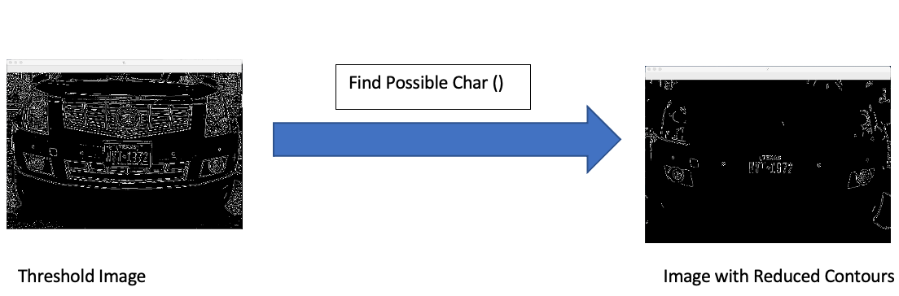
Step 2: Finding Possible Characters

Slide 17
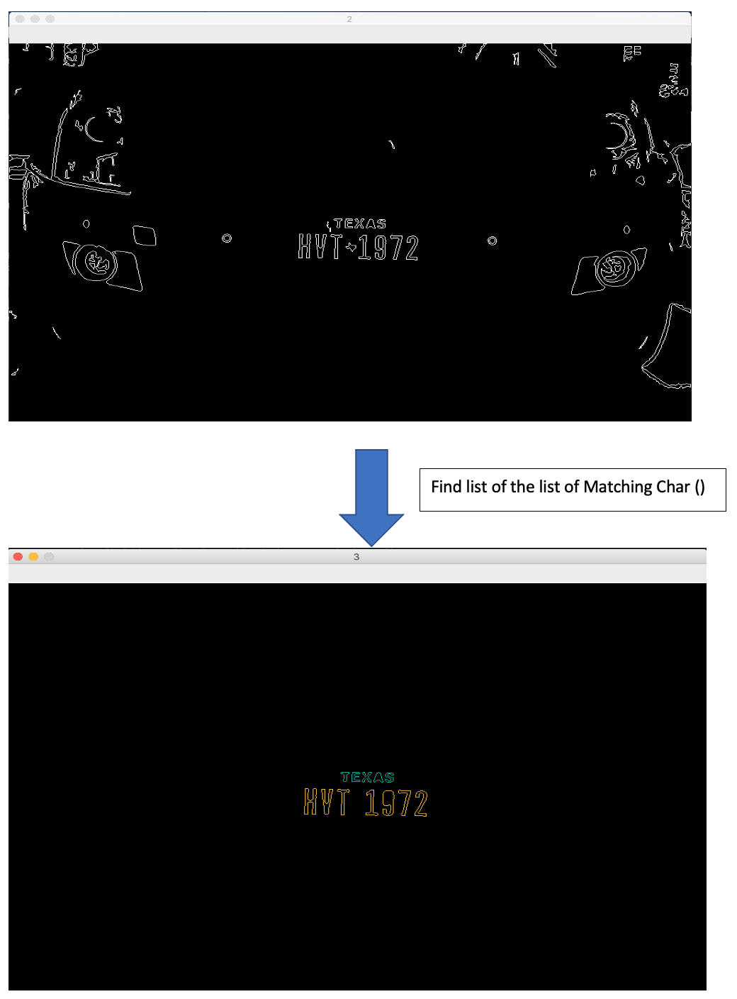
Step 3: Finding list of the list of Matching Character

Slide 18
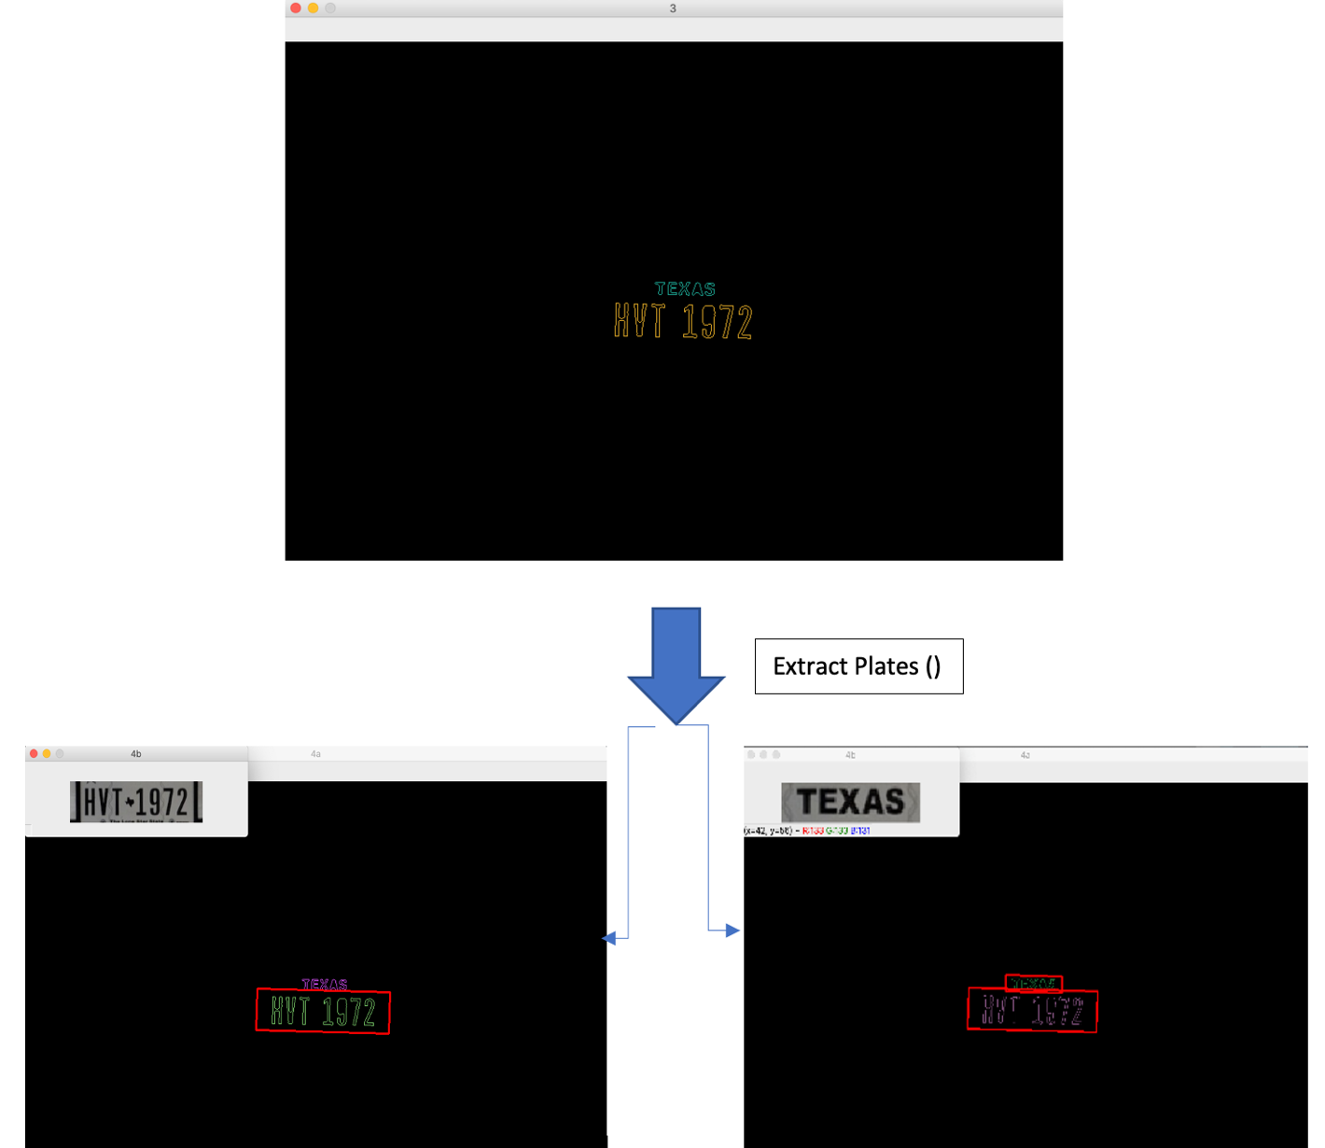
Step 4: Extract Possible Plates:

Slide 19
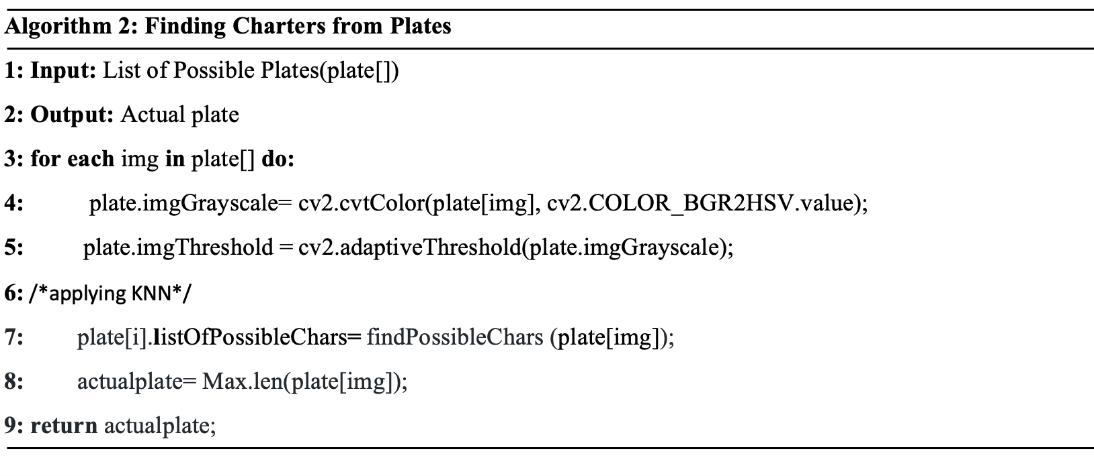
Finding Charters from Plates

Slide 20
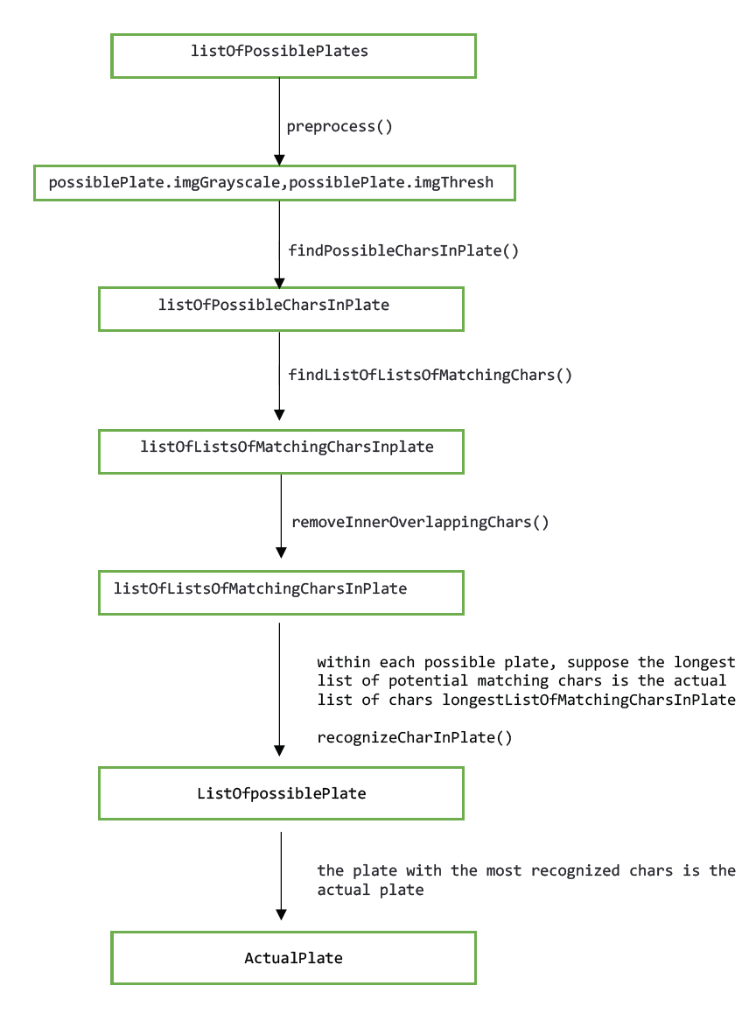
Steps of finding Characters within plates

Slide 21
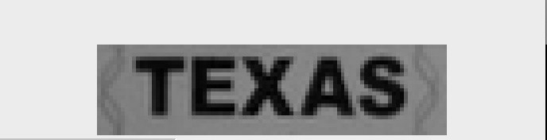

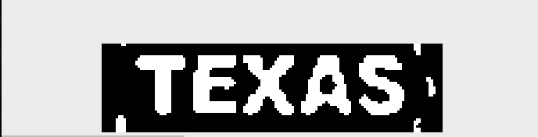

Step 1:
Preprocess ()

Slide 22
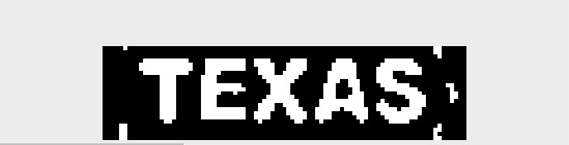
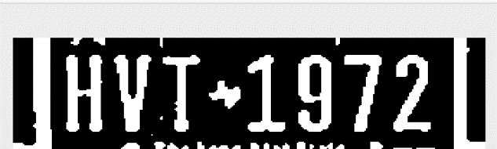
Step 2:
Find possible char in plate ()

Slide 23
Step 3:
Remove Overlapping ()

Slide 24
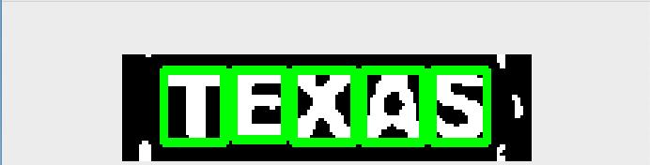
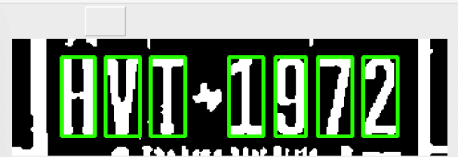
Step 3:
Recognize Plate ()

Slide 25
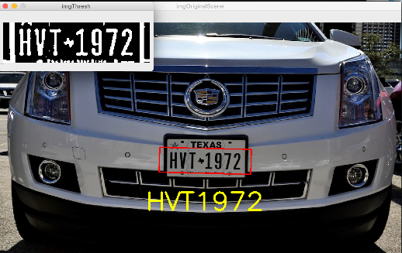
Final Output:

Slide 26
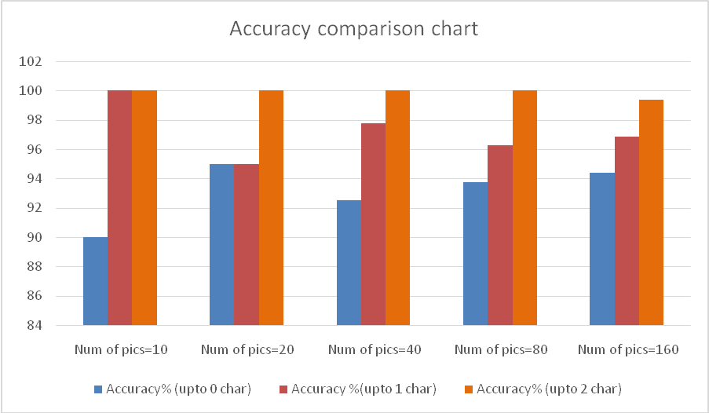
Result Evaluation (Overall Accuracy)

Slide 27
Accuracy chart:
Plate Detection (Front side) | 100%
Plate Detection (Back side) | 100%
Character Recognition (KNN) | 95%

Slide 28
Comparison between execution times

Slide 29
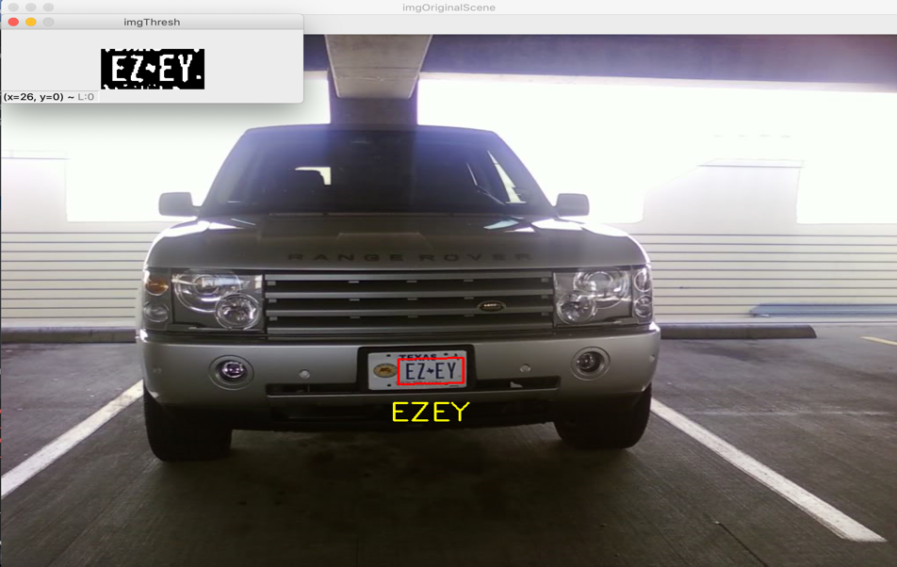
Image with noise:

Slide 30
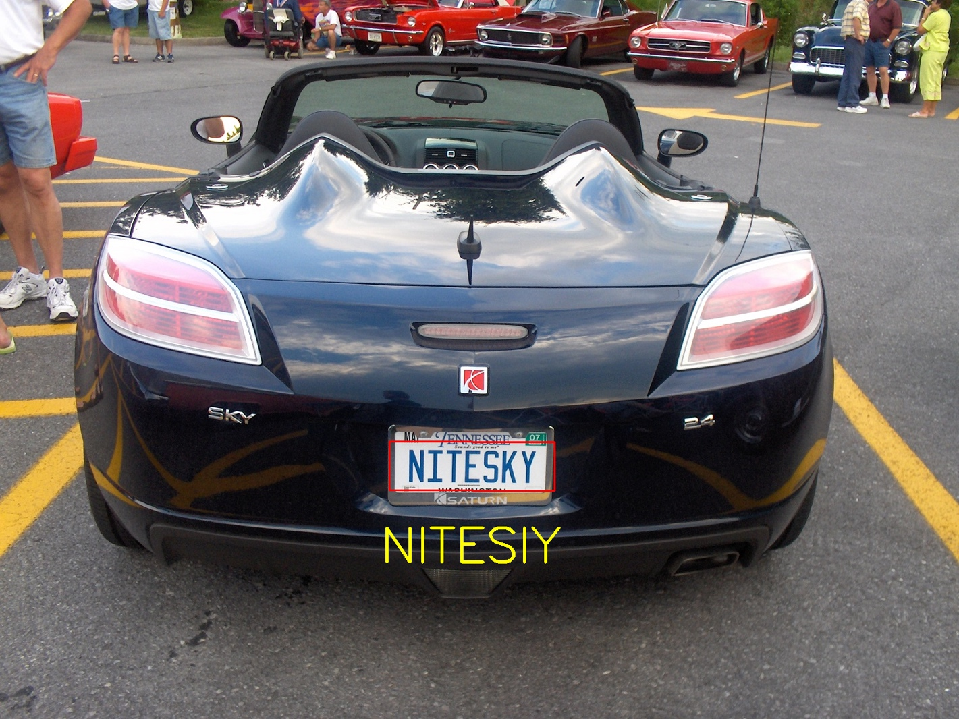
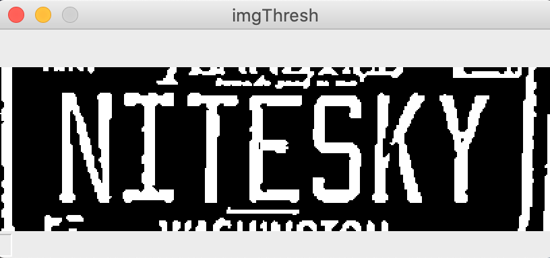
Failed cases:

Slide 31
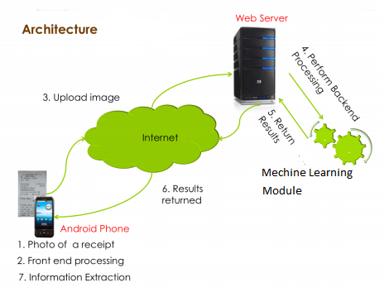
System Architecture of Smart Towing app

Slide 32
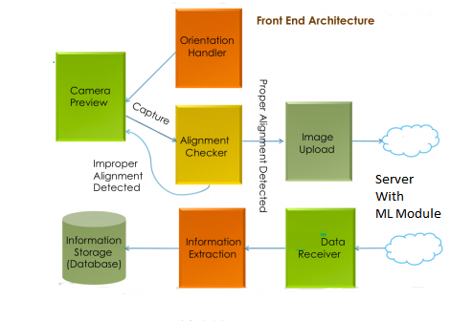
Front End Architecture:

Slide 33
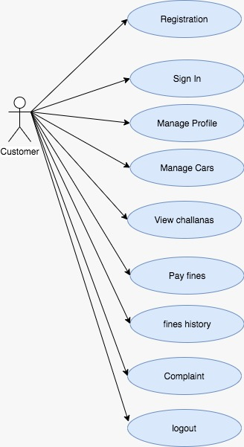
User Use Case Diagram

Slide 34
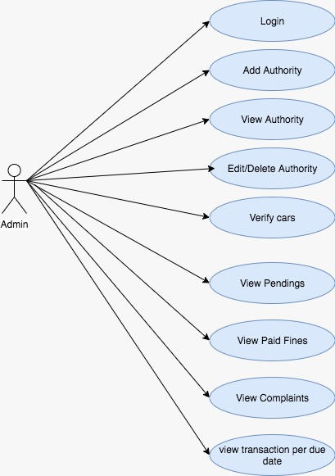
Admin Use Case Diagram

Slide 35
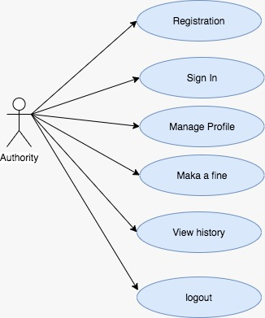
Authority Use Case Diagram

Slide 36
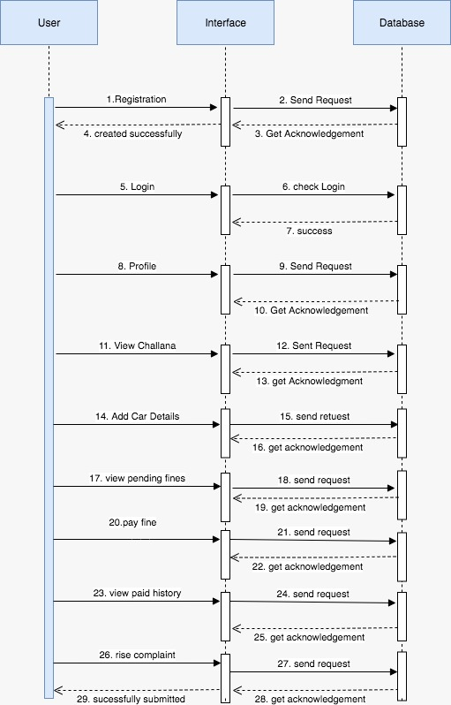
Sequence Diagram for User Actions

Slide 37
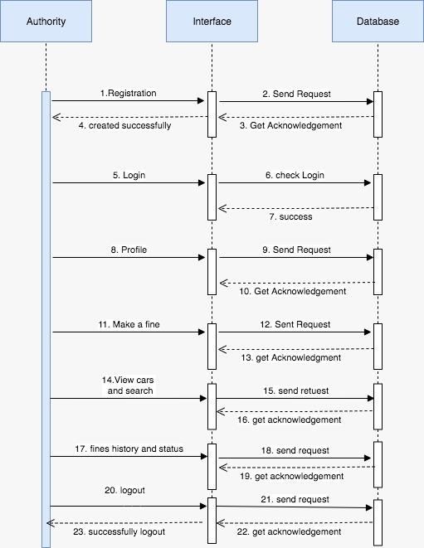
Sequence Diagram for Authority Actions

Slide 38
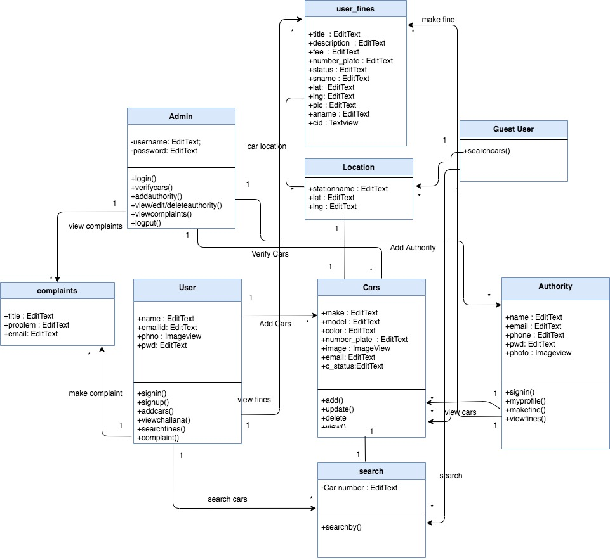
Class Diagram

Slide 39
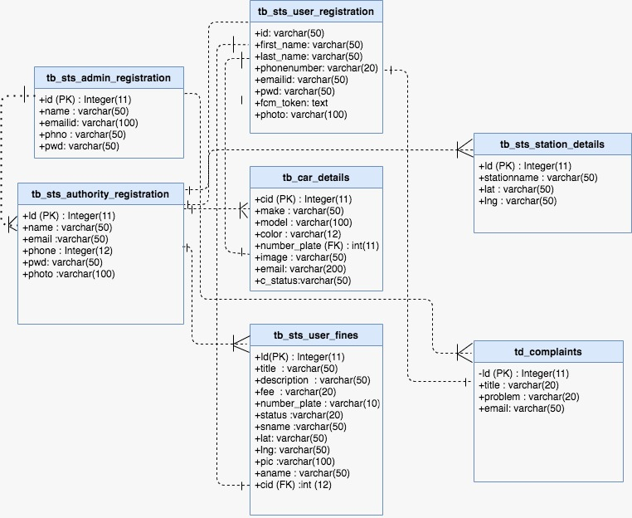
Database Schema

Slide 40
Conclusion
We found out that, our proposed model outperforms in both Execution time and accuracy.
We have shown, the real life use of the module in the smart towing app where we have overcome the short comings and manual process of existing towing system by creating the smart towing app and sending the notification to the users with Google “Firebase Cloud Messaging(FCM).
Finally, our module can be furthermore used in solving various social issues all well.

Slide 41
Future work
Creating support for various embedded devices
Creating support for live Number Plate detection using Video stream
Support for Plates that are not English
More Support for tilted Images

Slide 42
DEMO!

Slide 43
Q&A!

