Slide 1
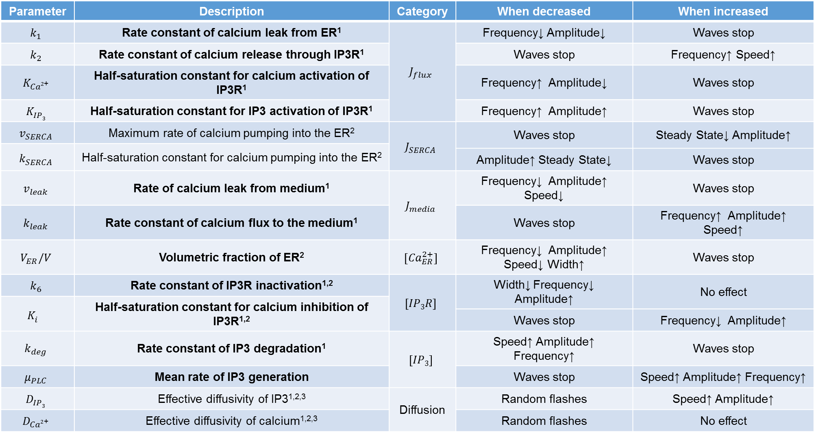
Parameter sensitivity results
Parameter | Description | Category | When decreased | When increased
$$k_{1}$$ | Rate constant of calcium leak from ER¹ | $$J_{flux}$$ | Frequency↓ Amplitude↓ | Waves stop
$$k_{2}$$ | Rate constant of calcium release through IP3R¹ |  | Waves stop | Frequency↑ Speed↑
$$K_{Ca2\text{+}}^{}$$ | Half-saturation constant for calcium activation of IP3R¹ |  | Frequency↑ Amplitude↓ | Waves stop
$$K_{IP3}^{}$$ | Half-saturation constant for IP3 activation of IP3R¹ |  | Frequency↑ Amplitude↑ | Waves stop
$$v_{SERCA}$$ | Maximum rate of calcium pumping into the ER² | $$J_{SERCA}$$ | Waves stop | Steady State↓ Amplitude↑
$$k_{SERCA}^{}$$ | Half-saturation constant for calcium pumping into the ER²
 |  |  | Amplitude↑ Steady State↓ | Waves stop
$$v_{leak}$$ | Rate of calcium leak from medium¹ | $$J_{media}$$ | Frequency↓ Amplitude↑ Speed↓ | Waves stop
$$k_{leak}$$ | Rate constant of calcium flux to the medium¹ |  | Waves stop | Frequency↑ Amplitude↑ Speed↑
$$V_{ER}/V$$ | Volumetric fraction of ER² | $$\left[{Ca}_{ER}^{2+}\right]$$ | Frequency↓ Amplitude↑ Speed↓ Width↑ | Waves stop
$$k_{6}$$ | Rate constant of IP3R inactivation^{1,2} | $$\left[IP3R\right]$$ | Width↓ Frequency↓ Amplitude↑ | No effect
$$K_{i}^{}$$ | Half-saturation constant for calcium inhibition of IP3R^{1,2}
 |  |  | Waves stop | Frequency↓ Amplitude↑
$$k_{deg}$$ | Rate constant of IP3 degradation¹ | $$\left[IP3\right]$$ | Speed↑ Amplitude↑ Frequency↑ | Waves stop
$$μ_{PLC}$$ | Mean rate of IP3 generation |  | Waves stop | Speed↑ Amplitude↑ Frequency↑
$$D_{IP3}$$ | Effective diffusivity of IP3^{1,2,3} | Diffusion | Random flashes | Speed↑ Amplitude↑
$$D_{Ca2\text{+}}$$ | Effective diffusivity of calcium^{1,2,3} |  | Random flashes | No effect
Notes:
X means effect was observed.
- means no effect was observed.
Parameters were varied by 30% up and down.
Amplitude is the concentration of calcium at the maximum.
Steady state concentration is the concentration of calcium at the minimum.
Frequency is the number of wavefronts occurring per time.
Speed is the slope of the position/time curve of the wavefronts.

Slide 2
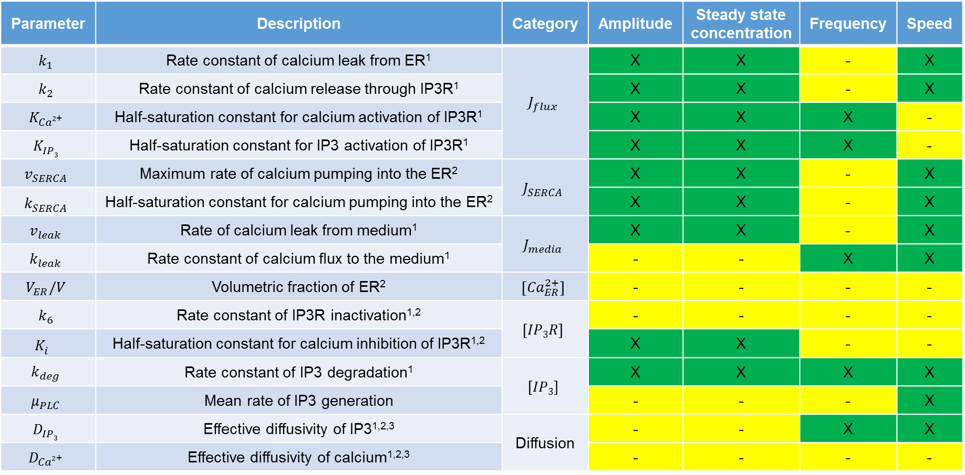
Parameter sensitivity results
2,
Parameter | Description | Category | Amplitude | Steady state concentration | Frequency | Speed
$$k_{1}$$ | Rate constant of calcium leak from ER¹ | $$J_{flux}$$ | X | X | - | X
$$k_{2}$$ | Rate constant of calcium release through IP3R¹ |  | X | X | - | X
$$K_{Ca2\text{+}}^{}$$ | Half-saturation constant for calcium activation of IP3R¹ |  | X | X | X | -
$$K_{IP3}^{}$$ | Half-saturation constant for IP3 activation of IP3R¹ |  | X | X | X | -
$$v_{SERCA}$$ | Maximum rate of calcium pumping into the ER² | $$J_{SERCA}$$ | X | X | - | X
$$k_{SERCA}^{}$$ | Half-saturation constant for calcium pumping into the ER² |  | X | X | - | X
$$v_{leak}$$ | Rate of calcium leak from medium¹ | $$J_{media}$$ | X | X | - | X
$$k_{leak}$$ | Rate constant of calcium flux to the medium¹ |  | - | - | X | X
$$V_{ER}/V$$ | Volumetric fraction of ER² | $$\left[{Ca}_{ER}^{2+}\right]$$ | - | - | - | -
$$k_{6}$$ | Rate constant of IP3R inactivation^{1,2} | $$\left[IP3R\right]$$ | - | - | - | -
$$K_{i}^{}$$ | Half-saturation constant for calcium inhibition of IP3R^{1,2} |  | X | X | - | -
$$k_{deg}$$ | Rate constant of IP3 degradation¹ | $$\left[IP3\right]$$ | X | X | X | X
$$μ_{PLC}$$ | Mean rate of IP3 generation |  | - | - | - | X
$$D_{IP3}$$ | Effective diffusivity of IP3^{1,2,3} | Diffusion | - | - | X | X
$$D_{Ca2\text{+}}$$ | Effective diffusivity of calcium^{1,2,3} |  | - | - | - | -
1. Höfer, Thomas, Laurent Venance, and Christian Giaume. "Control and plasticity of intercellular calcium waves in astrocytes: a modeling approach." The Journal of neuroscience 22.12 (2002): 4850-4859.
2. Sneyd, J. A. M. E. S., et al. "Intercellular calcium waves mediated by diffusion of inositol trisphosphate: a two-dimensional model." American Journal of Physiology-Cell Physiology 268.6 (1995): C1537-C1545.
3. Keener, James P., and James Sneyd. Mathematical physiology. Vol. 1. New York: Springer, 1998.
Notes:
X means effect was observed.
- means no effect was observed.
Parameters were varied by 30% up and down.
Amplitude is the concentration of calcium at the maximum.
Steady state concentration is the concentration of calcium at the minimum.
Frequency is the number of wavefronts occurring per time.
Speed is the slope of the position/time curve of the wavefronts.

Slide 3








Molecular mechanism of calcium propagation
Ca²⁺
P
PLC-γ
P
PIP₂
P
$$J_{media}$$
$$v_{PLC}$$
P
P
P
IP₃
P
P
Ca²⁺
P
P
IP₃
P
$$D_{IP3}∇^{2}\left[IP3\right]$$
IP₃
$$D_{Ca2\text{+}}∇^{2}\left[Ca2\text{+}\right]$$
P
P
$$J_{flux}$$
+
+
SERCA
-
IP₃R
Ca²⁺
$$\left[IP3R\right]$$
Gap Junction
Ca²⁺
$$J_{SERCA}$$
$${Ca}_{ER}^{2+}$$
ER

Slide 4







Boundary and initial conditions
No-flux boundary conditions:
$$D_{IP3}∇^{2}\left[IP3\right]=0 at x=\{0,L\}$$
$$D_{Ca2\text{+}}∇^{2}\left[Ca2\text{+}\right]=0 at x=\{0,L\}$$
Steady-state initial conditions:
$$at t=0:$$
$$\left[Ca2\text{+}\right]=0.05 μM$$
$$\left[IP3\right]=0.15 μM$$
$$\left[{Ca}_{ER}^{2+}\right]=80 μM$$
$$\left[IP3R\right]=1$$

Slide 5
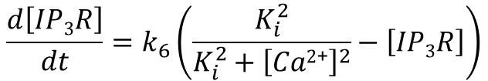

PDE model (Version 1)
$$\frac{∂\left[Ca2\text{+}\right]}{∂t}=\frac{\left(k_{1}+k_{2}\left[IP3R\right]{\left[Ca2\text{+}\right]}^{2}{\left[IP3\right]}^{2}\right)\left(\left[{Ca}_{ER}^{2+}\right]−\left[Ca2\text{+}\right]\right)}{\left(K_{Ca2\text{+}}^{2}+\left[Ca2\text{+}\right]2\right)\left(K_{IP3}^{2}+\left[IP3\right]2\right)}−\frac{v_{SERCA}{\left[{Ca}^{2+}\right]}^{2}}{{k_{SERCA}^{2}+\left[{Ca}^{2+}\right]}^{2}}+\left(v_{leak}−k_{leak}\left[Ca2\text{+}\right]\right)+D_{Ca2\text{+}}∇^{2}\left[Ca2\text{+}\right]$$
$$\frac{d\left[{Ca}_{ER}^{2+}\right]}{dt}=−\frac{V}{V_{ER}}\left(\frac{\left(k_{1}+k_{2}\left[IP3R\right]{\left[Ca2\text{+}\right]}^{2}{\left[IP3\right]}^{2}\right)\left(\left[{Ca}_{ER}^{2+}\right]−\left[Ca2\text{+}\right]\right)}{\left(K_{Ca2\text{+}}^{2}+\left[Ca2\text{+}\right]2\right)\left(K_{IP3}^{2}+\left[IP3\right]2\right)}−\frac{v_{SERCA}{\left[{Ca}^{2+}\right]}^{2}}{{k_{SERCA}^{2}+\left[{Ca}^{2+}\right]}^{2}}\right)$$
$$\frac{∂\left[IP3\right]}{∂t}=Γ\left(1,μ_{PLC}\right)−k_{deg}\left[IP3\right]+D_{IP3}∇^{2}\left[IP3\right]$$
$$\frac{d\left[IP3R\right]}{dt}=k_{6}\left(\frac{K_{i}^{2}}{{K_{i}^{2}+\left[Ca2\text{+}\right]}^{2}}−\left[IP3R\right]\right)$$
Notes:
Formal separate PLCg term

Slide 6
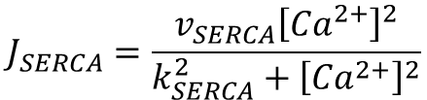

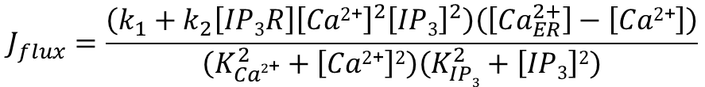
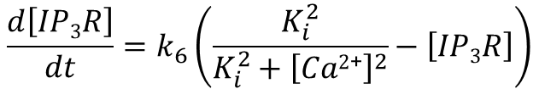




PDE model (Version 2)
$$\frac{∂\left[Ca2\text{+}\right]}{∂t}=J_{flux}−J_{SERCA}+J_{media}+D_{Ca2\text{+}}∇^{2}\left[Ca2\text{+}\right]$$
$$J_{flux}=\frac{\left(k_{1}+k_{2}\left[IP3R\right]{\left[Ca2\text{+}\right]}^{2}{\left[IP3\right]}^{2}\right)\left(\left[{Ca}_{ER}^{2+}\right]−\left[Ca2\text{+}\right]\right)}{\left(K_{Ca2\text{+}}^{2}+\left[Ca2\text{+}\right]2\right)\left(K_{IP3}^{2}+\left[IP3\right]2\right)}$$
$$\frac{d\left[IP3R\right]}{dt}=k_{6}\left(\frac{K_{i}^{2}}{{K_{i}^{2}+\left[Ca2\text{+}\right]}^{2}}−\left[IP3R\right]\right)$$
$$J_{SERCA}=\frac{v_{SERCA}{\left[{Ca}^{2+}\right]}^{2}}{{k_{SERCA}^{2}+\left[{Ca}^{2+}\right]}^{2}}$$
$$\frac{d\left[{Ca}_{ER}^{2+}\right]}{dt}=−\frac{V}{V_{ER}}\left(J_{flux}−J_{SERCA}\right)$$
$$J_{media}=v_{leak}−k_{leak}\left[Ca2\text{+}\right]$$
$$\frac{∂\left[IP3\right]}{∂t}=v_{PLC}−k_{deg}\left[IP3\right]+D_{IP3}∇^{2}\left[IP3\right]$$
$$v_{PLC}=Γ\left(1,μ_{PLC}\right)$$
Notes:
Formal separate PLCg term

Slide 7
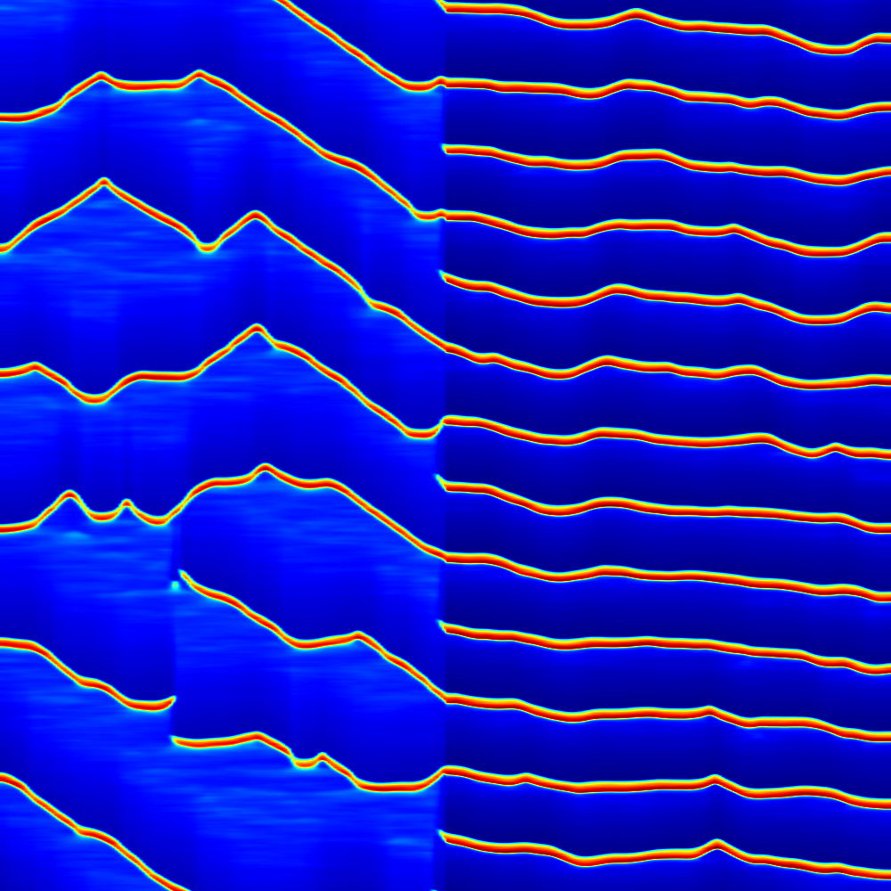
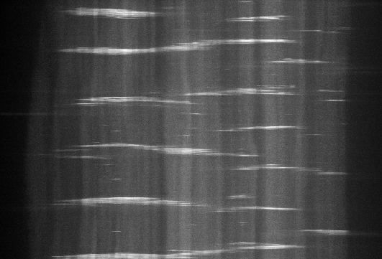
Boundary penetrance may be explained by differential cell properties in compartments
K_{Ca} = 0.20
K_{Ca} = 0.14
Time
Anterior
Posterior
Anterior
Posterior
Position
Notes:
If refractory period of one compartment is different, sometimes a wave will move through the A/P boundary and sometimes not, resulting in variable frequency. This was observed ex vivo as well.

Slide 8

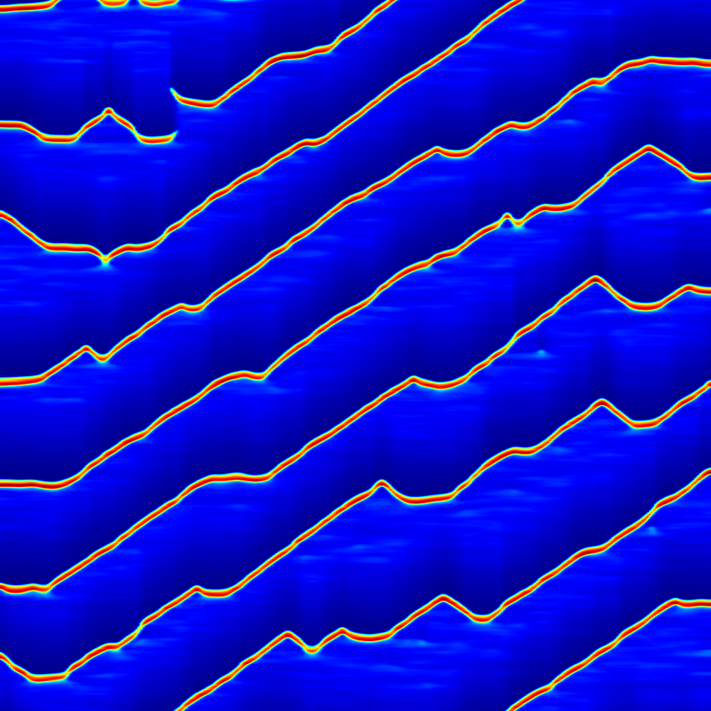
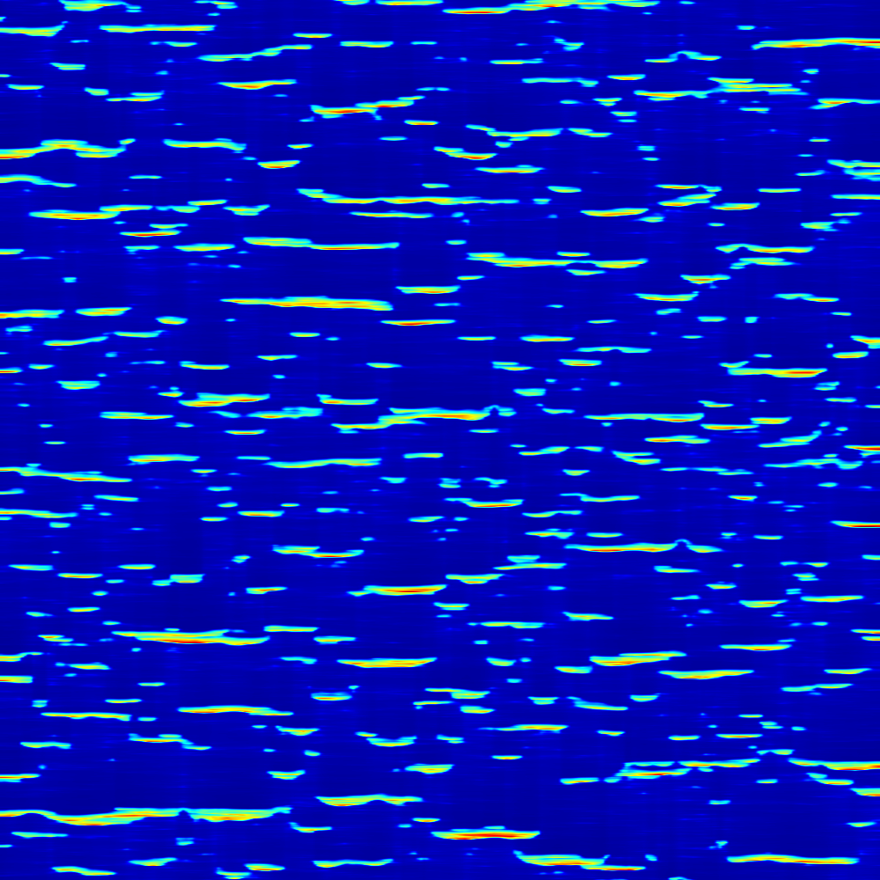






Signal variance may explain pulse to wave transition
Variance
$$σ^{2}=0.00$$
$$σ^{2}=μ_{PLC}^{2}$$
$$σ^{2}=100μ_{PLC}^{2}$$
Time (s, 8000-10000)
$$v_{PLC}=Γ\left(0.01,\frac{μ_{PLC}}{0.01}\right)$$
$$v_{PLC}=μ_{PLC}$$
$$v_{PLC}=Γ\left(1,μ_{PLC}\right)$$
Position (𝜇m, 0-300)
t = 8000s to 10000s
Notes:
Variance of gamma distribution is alpha/theta^2 where alpha is the first input, and theta is the second input

Slide 9
OTHER SLIDES:

Slide 10
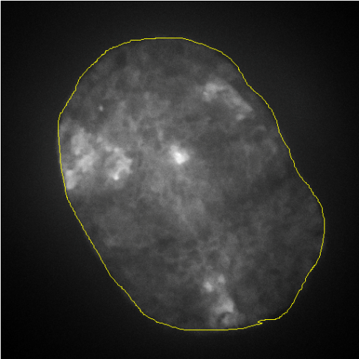
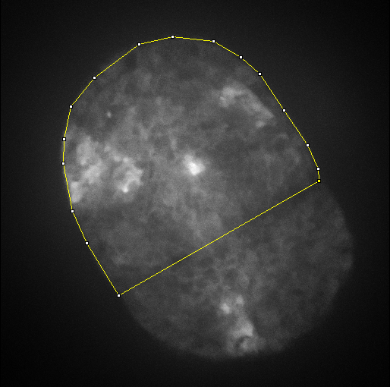
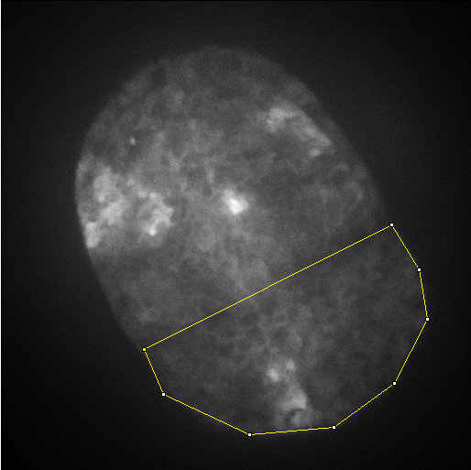
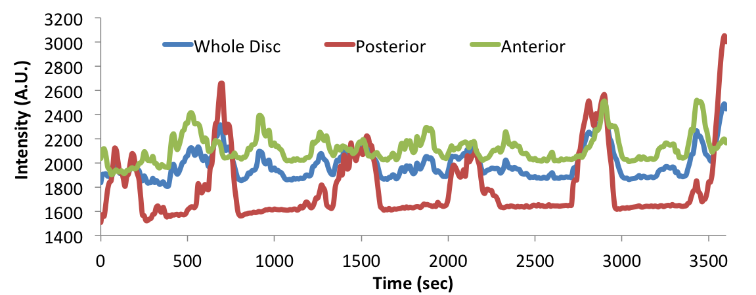
Domain specificity of Ca²⁺ transients
Whole disc
Anterior
Posterior

Slide 11

Molecular mechanism of calcium propagation
Ca²⁺
Mechanical
Stimulation
PLC-γ
PIP₂
+
TRPN Channel
(2)
(9)
(3)
IP₃
IP₃
(4)
Ca²⁺
IP₃
(1)
(6)
(8)
+
+
(7)
Ca²⁺
SERCA
-
IP₃R
Gap Junction
Ca²⁺
(5)
$${Ca}_{ER}^{2+}$$
ER

Slide 12









Probability density functions
$$v_{PLC}=Γ\left(0.01,\frac{μ_{PLC}}{0.01}\right)$$
$$v_{PLC}=μ_{PLC}$$
$$v_{PLC}=Γ\left(1,μ_{PLC}\right)$$
$$σ^{2}=0.00$$
$$σ^{2}=μ_{PLC}^{2}$$
$$σ^{2}=100μ_{PLC}^{2}$$
$$μ_{PLC}$$
$$μ_{PLC}$$
$$μ_{PLC}$$
Represents an IP₃ generation signal with no noise.
Represents variable IP₃ generation signal where very high production rates can rarely occur, but production on average is the same as in pdf 1.
IP₃ signal with even higher variance than pdf 2. Here production rates will generally be very low but a greater frequency of high-rate events results in an average generation equal to pdf 1 and 2.

Slide 13
