Slide 1
Machine Learning and Stock Market Returns
Idea and First Results

Slide 2
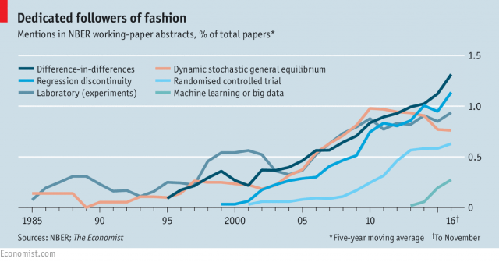

Slide 3
ML Methods in Finance
Chinco, A., Clark-Joseph, A. D., and M. Ye.„Sparse Signals in the Cross-Section of Returns“. Journal of Finance (forthcoming)
Feng, Guanhao, and Stefano Giglio, 2017, Taming the Factor Zoo, SSRN Electronic Journal, 1–69. (Under Revision)
Freyberger, Joachim, Andreas Neuhierl, and Michael Weber, 2017, Dissecting Characteristics Nonparametrically. RFS (R&R)
Gu, Shihao, Bryan T. Kelly, and Dacheng Xiu, 2018, Empirical Asset Pricing via Machine Learning, Ssrn.
Brogaard, Jonathan, and Abalfazl Zareei, 2018, Machine Learning and the Stock Market, SSRN Electronic Journal, 1–57.
Kozak, Serhiy, Stefan Nagel, and Shrihari Santosh, 2017, Shrinking the Cross Section, Ssrn, 1–69.
Chinco, Alex, Andreas Neuhierl, and Michael Weber, 2018, Estimating the Anomaly Baserate, , 1–30.

Slide 4
ML Methods for Inference
Belloni, A., Chen, D., Chernozhukov, V., and C. Hansen (2012). „Sparse Models and Methods for Optimal Instruments with Application to Eminent Domain“. Econometrica 80(6), 2269-2429
Belloni, A., Chernozhukov, V., Fernandez-Val, I., and C. Hansen (2017). „Program Evaluation and Causal Inference with High-Dimensional Data“. Econometrica 85(1), 233-298
Belloni, A., Chernozhukov, V., and C. Hansen (2014). „Inference on Treatment Effects after Selection among High-Dimensional Controls“. Review of Economic Studies 81, 608-650
Chernozhukov, V., Chetverikov, D., Demirer, M., Duflo, E., Hansen, C., Newey, W., and J. Robins (2018). „Double/Debiased Machine Learning for Treatment and Structural Parameters“. Econometrics Journal 21, 1-68

Slide 5
Prediction vs. Inference
Breiman, Leo, 2001, Statistical Modeling: The Two Cultures, Statistical Science 16, 199–231.
Shmueli, Galit, 2010, To Explain or to Predict?, Statistical Science 25, 289–310.
Kleinberg, Jon, Jens Ludwig, Sendhil Mullainathan, and Ziad Obermeyer, 2015, Prediction Policy Problems, American Economic Review 105, 491–495.

Slide 6
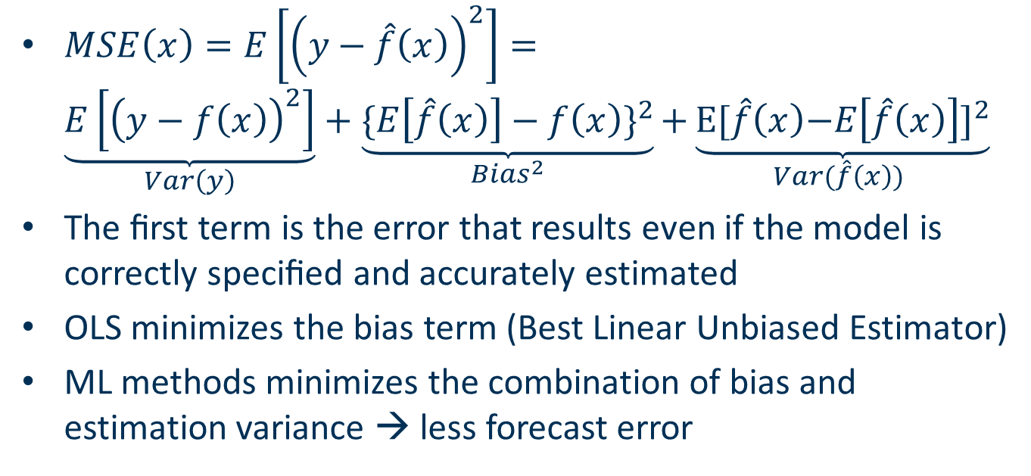
Bias-Variance Tradeoff
$MSE\left(x\right)=E\left[{\left(y−\hat{f}\left(x\right)\right)}^{2}\right]=$ $\underset{Var\left(y\right)}{\underbrace{E\left[{\left(y−f\left(x\right)\right)}^{2}\right]}}+\underset{{Bias}^{2}}{\underbrace{{\{E\left[\hat{f}\left(x\right)\right]−f\left(x\right)\}}^{2}}}\text{+}\underset{Var(\hat{f}\left(x\right)) }{\underbrace{{\text{E}\text{[}\hat{f}\left(x\right)\text{−}E\left[\hat{f}\left(x\right)\right]\text{]}}^{2}}}$
The ﬁrst term is the error that results even if the model is correctly speciﬁed and accurately estimated
OLS minimizes the bias term (Best Linear Unbiased Estimator)
ML methods minimizes the combination of bias and estimation variance → less forecast error

Slide 7
Predicting Equity Premium
Rapach, David, and Guofu Zhou, 2013, Forecasting Stock Returns Handbook of Economic Forecasting. Vol. 2 (Elsevier B.V.).
Rapach, David E., Jack K. Strauss, and Guofu Zhou, 2010, Out-of-sample equity premium prediction: Combination forecasts and links to the real economy, Review of Financial Studies 23, 821–862.
Neely, Christopher J., David E. Rapach, Jun Tu, and Guofu Zhou, 2014, Forecasting the Equity Risk Premium: The Role of Technical Indicators, Management Science 60, 1772–1791.

Slide 8
Methods Outline
Parametric Predictors
Subset Selection via AIC/BIC
Lasso
Ridge
Elastic Net
Nonparametric Predictors
Regression Trees
Random Forest
Nearest Neighbors
Kernel Regression

Slide 9
Mixed Predictors
Neural Nets
Splines
Combined Predictors
Bagging
Boosting
Ensemble

Slide 10
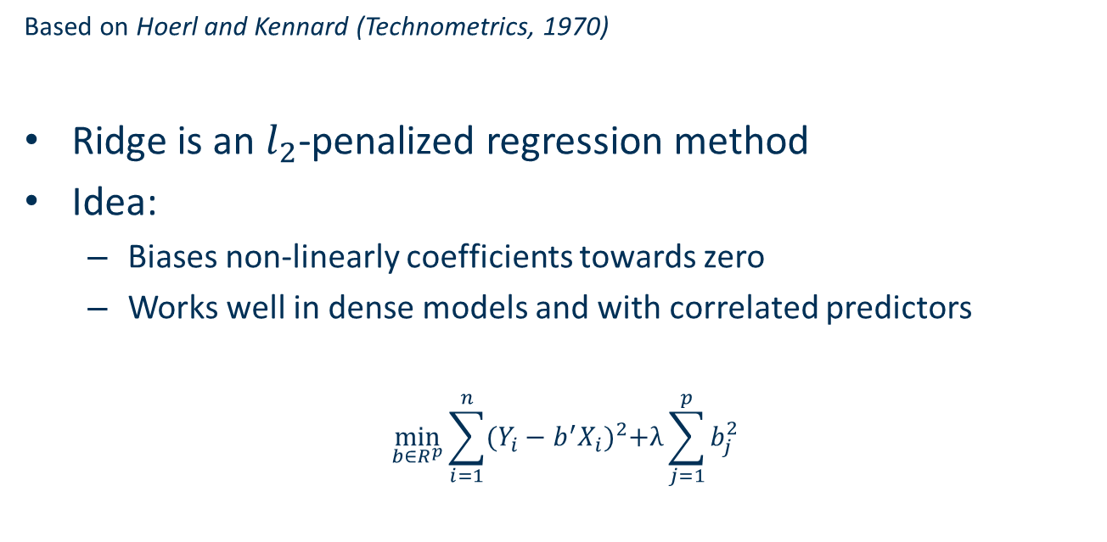
Ridge
Based on Hoerl and Kennard (Technometrics, 1970)
Ridge is an $l_{2}$-penalized regression method
Idea:
Biases non-linearly coefficients towards zero
Works well in dense models and with correlated predictors
$$\min_{b∈R^{p}}{\sum_{i=1}^{n}{{(Y_{i}−b^{′}X_{i})}^{2}+λ\sum_{j=1}^{p}{b_{j}^{2}}}}$$

Slide 11
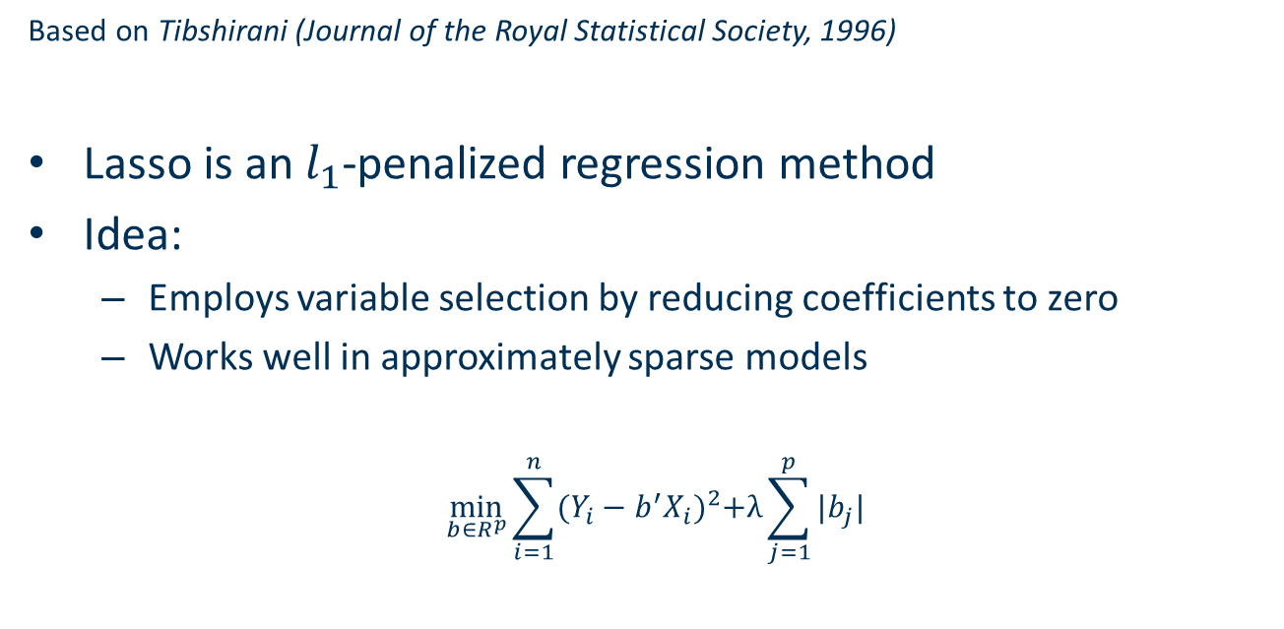
Lasso (Least absolute shrinkage and selection operator)
Based on Tibshirani (Journal of the Royal Statistical Society, 1996)
Lasso is an $l_{1}$-penalized regression method
Idea:
Employs variable selection by reducing coefficients to zero
Works well in approximately sparse models
$$\min_{b∈R^{p}}{\sum_{i=1}^{n}{{(Y_{i}−b^{′}X_{i})}^{2}+λ\sum_{j=1}^{p}{|b_{j}|}}}$$

Slide 12
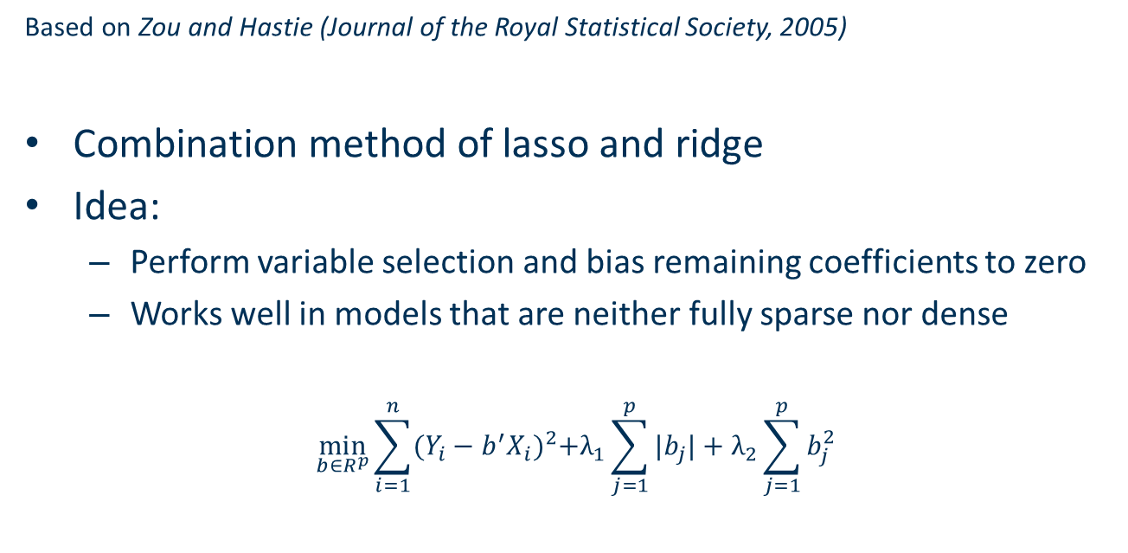
Elastic Net
Based on Zou and Hastie (Journal of the Royal Statistical Society, 2005)
Combination method of lasso and ridge
Idea:
Perform variable selection and bias remaining coefficients to zero
Works well in models that are neither fully sparse nor dense
$$\min_{b∈R^{p}}{\sum_{i=1}^{n}{{(Y_{i}−b^{′}X_{i})}^{2}+λ_{1}\sum_{j=1}^{p}{|b_{j}|}+λ_{2}\sum_{j=1}^{p}{b_{j}^{2}}}}$$

