Slide 1
Machine Learning and Stock Market Returns
Idea and First Results

Slide 2
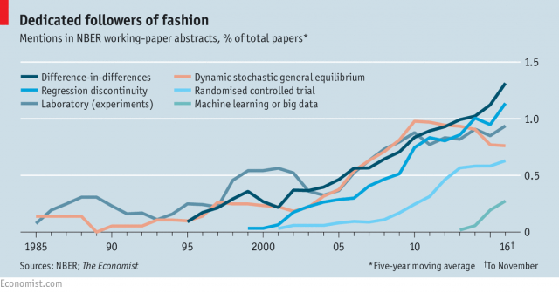

Slide 3
Explanatory vs Predictive Modelling
Breiman, Leo, 2001, Statistical Modeling: The Two Cultures, Statistical Science 16, 199–231.
Shmueli, Galit, 2010, To Explain or to Predict?, Statistical Science 25, 289–310.
Kleinberg, Jon, Jens Ludwig, Sendhil Mullainathan, and Ziad Obermeyer, 2015, Prediction Policy Problems, American Economic Review 105, 491–495.
Mullainathan, Sendhil, and Jann Spiess, 2017, Machine Learning: An Applied Econometric Approach, 31, 87–106.

Slide 4
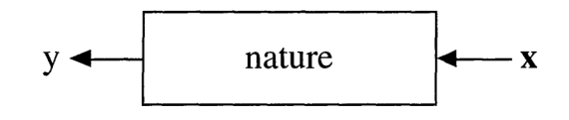
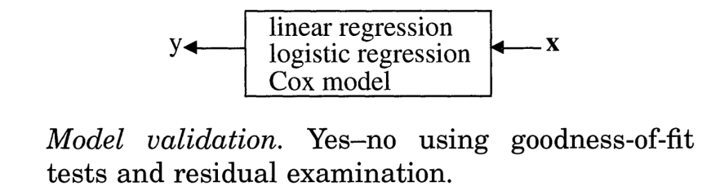
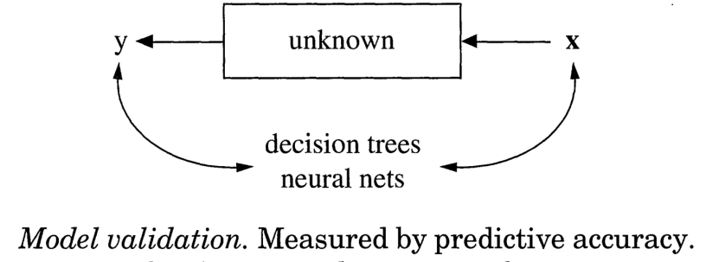
Different Modelling Cultures
Process:
Explanatory Modelling:
Predictive Modelling:

Slide 5
ML Methods for Explanatory Modelling (Inference)
Belloni, A., Chen, D., Chernozhukov, V., and C. Hansen (2012). „Sparse Models and Methods for Optimal Instruments with Application to Eminent Domain“. Econometrica 80(6), 2269-2429
Belloni, A., Chernozhukov, V., Fernandez-Val, I., and C. Hansen (2017). „Program Evaluation and Causal Inference with High-Dimensional Data“. Econometrica 85(1), 233-298
Belloni, A., Chernozhukov, V., and C. Hansen (2014). „Inference on Treatment Effects after Selection among High-Dimensional Controls“. Review of Economic Studies 81, 608-650
Chernozhukov, V., Chetverikov, D., Demirer, M., Duflo, E., Hansen, C., Newey, W., and J. Robins (2018). „Double/Debiased Machine Learning for Treatment and Structural Parameters“. Econometrics Journal 21, 1-68

Slide 6
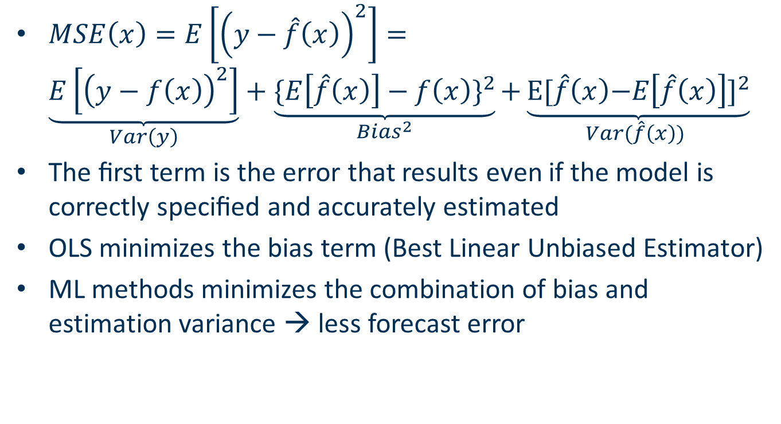
Bias-Variance Tradeoff
$MSE\left(x\right)=E\left[{\left(y−\hat{f}\left(x\right)\right)}^{2}\right]=$ $\underset{Var\left(y\right)}{\underbrace{E\left[{\left(y−f\left(x\right)\right)}^{2}\right]}}+\underset{{Bias}^{2}}{\underbrace{{\{E\left[\hat{f}\left(x\right)\right]−f\left(x\right)\}}^{2}}}\text{+}\underset{Var(\hat{f}\left(x\right)) }{\underbrace{{\text{E}\text{[}\hat{f}\left(x\right)\text{−}E\left[\hat{f}\left(x\right)\right]\text{]}}^{2}}}$
The ﬁrst term is the error that results even if the model is correctly speciﬁed and accurately estimated
OLS minimizes the bias term (Best Linear Unbiased Estimator)
ML methods minimizes the combination of bias and estimation variance → less forecast error

Slide 7
ML Methods in Finance
Cross-Sectional Asset Pricing:
Chinco, A., Clark-Joseph, A. D., and M. Ye.„Sparse Signals in the Cross-Section of Returns“. Journal of Finance (forthcoming)
Freyberger, Joachim, Andreas Neuhierl, and Michael Weber, 2017, Dissecting Characteristics Nonparametrically. (R&R Review of Financial Studies)
Moritz, Benjamin, and Tom Zimmermann, 2016, Tree-Based Conditional Portfolio Sorts: The Relation between Past and Future Stock Returns, Ssrn.(R&R Review of Financial Studies)
Feng, Guanhao, and Stefano Giglio, 2017, Taming the Factor Zoo, SSRN Electronic Journal, 1–69. (Under Revision)
Brogaard, Jonathan, and Abalfazl Zareei, 2018, Machine Learning and the Stock Market, SSRN Electronic Journal, 1–57.
Chinco, Alex, Andreas Neuhierl, and Michael Weber, 2018, Estimating the Anomaly Baserate, , 1–30.
Gu, Shihao, Bryan T. Kelly, and Dacheng Xiu, 2018, Empirical Asset Pricing via Machine Learning, Ssrn.
Kozak, Serhiy, Stefan Nagel, and Shrihari Santosh, 2017, Shrinking the Cross Section, Ssrn, 1–69.
Han, Yufeng, Ai He, David E Rapach, and Guofu Zhou, 2018, What Firm Characteristics Drive US Stock Returns?, Baruch CUNY.

Slide 8
Predicting Equity Premium
Welch, Ivo, and Amit Goyal, 2008, A Comprehensive Look at The Empirical Performance of Equity Premium Prediction, Review of Financial Studies 21, 1455–1508.
None of exhisiting predictors are able to outperform the simple historical average benchmark
Rapach, David E., Jack K. Strauss, and Guofu Zhou, 2010, Out-of-sample equity premium prediction: Combination forecasts and links to the real economy, Review of Financial Studies 23, 821–862.
Models combining many individual variables together yield superior predictive performance and outperform the benchmark.
Neely, Christopher J., David E. Rapach, Jun Tu, and Guofu Zhou, 2014, Forecasting the Equity Risk Premium: The Role of Technical Indicators, Management Science 60, 1772–1791.
Technical indicators contain complementary information to macroeconomic variables
Numerous papers with new predictors [Kelly and Jiang (2014), Møller and Rangvid (2015), Huang and Kilic (2016),Rapach, Ringgenberg, and Zhou (2016), Atanasov (2018),]
Use ML methods for predicting equity premium
Start with simple analysis:
Start with Neely et al. (2014) + add variables
Compare ML methods to the PCA method employed in the paper
Can ML methods improve prediction accuracy of market returns?

Slide 9
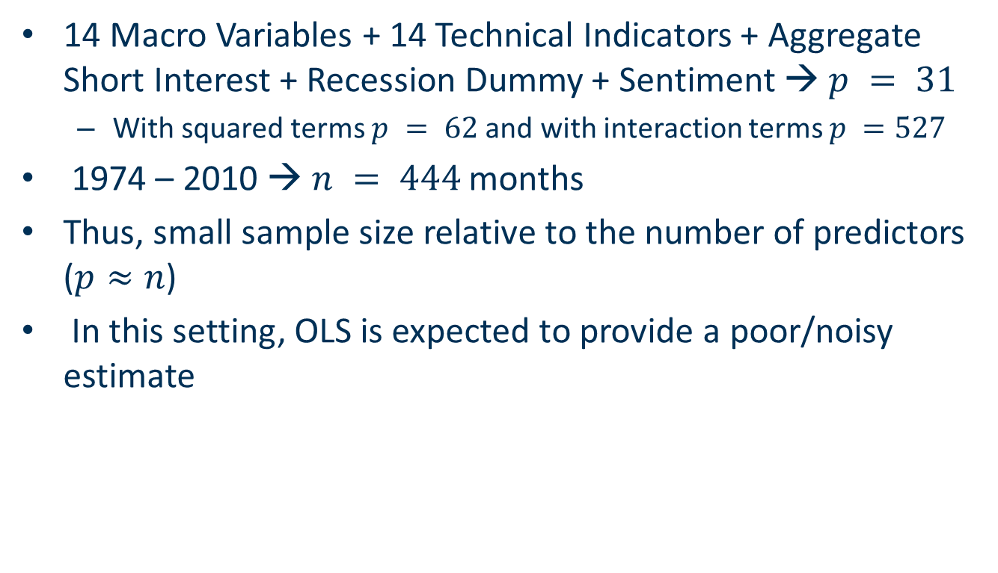
High Dimensional Setting
14 Macro Variables + 14 Technical Indicators + Aggregate Short Interest + Recession Dummy + Sentiment → $p = 31$
With squared terms $p = 62$and with interaction terms $p =527$
1974 – 2010 → $n = 444$months
Thus, small sample size relative to the number of predictors ($p≈n$)
In this setting, OLS is expected to provide a poor/noisy estimate

Slide 10
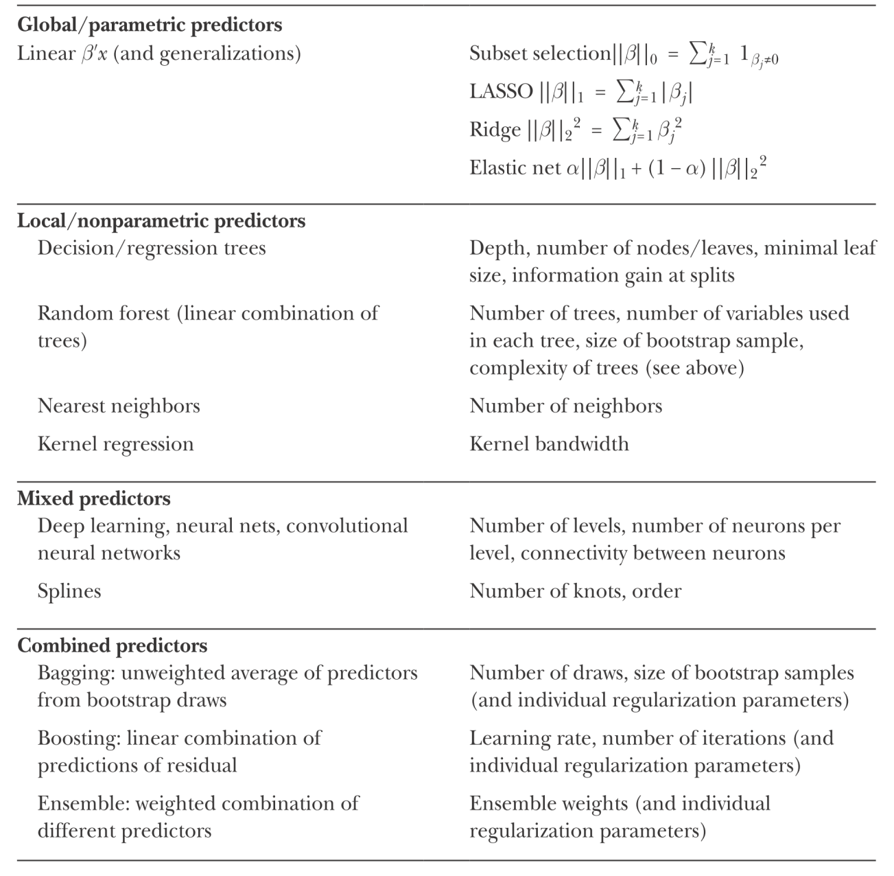
Some Machine Learning Methods
Source: Mullainathan and Spiess (2017)

Slide 11
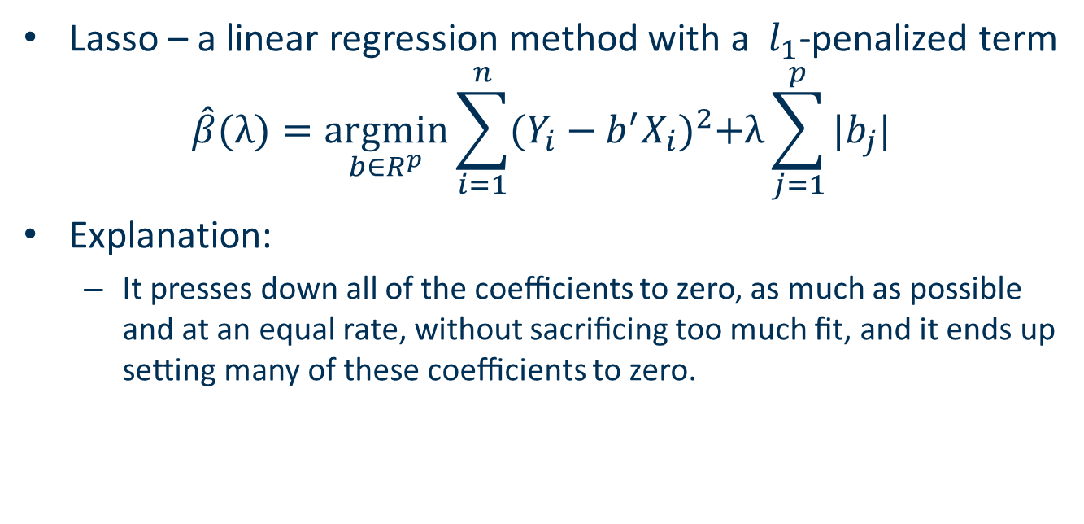
Lasso
Lasso – a linear regression method with a $l_{1}$-penalized term
$$\hat{β}(λ){=\underset{b∈R^{p}}{argmin}\sum_{i=1}^{n}{{(Y_{i}−b^{′}X_{i})}^{2}+λ\sum_{j=1}^{p}{|b_{j}|}}}$$
Explanation:
It presses down all of the coeﬃcients to zero, as much as possible and at an equal rate, without sacriﬁcing too much ﬁt, and it ends up setting many of these coeﬃcients to zero.
Pavel Lesnevski
06.12.2018

Slide 12
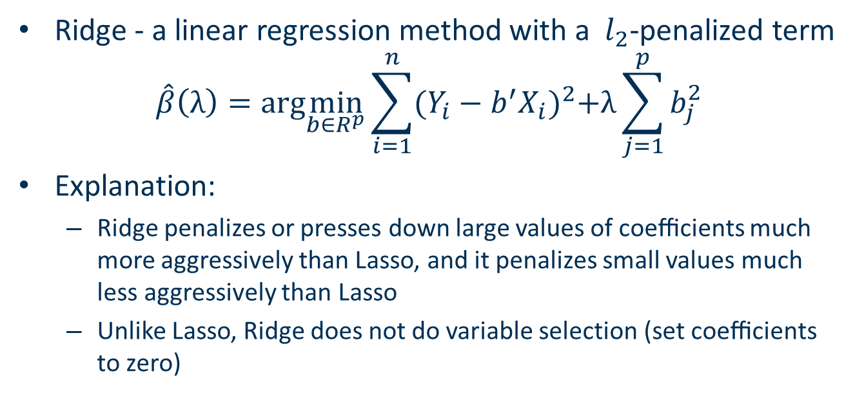
Ridge
Ridge - a linear regression method with a $l_{2}$-penalized term
$$\hat{β}\left(λ\right)=arg\min_{b∈R^{p}}{\sum_{i=1}^{n}{{(Y_{i}−b^{′}X_{i})}^{2}+λ\sum_{j=1}^{p}{b_{j}^{2}}}}$$
Explanation:
Ridge penalizes or presses down large values of coeﬃcients much more aggressively than Lasso, and it penalizes small values much less aggressively than Lasso
Unlike Lasso, Ridge does not do variable selection (set coeﬃcients to zero)

Slide 13
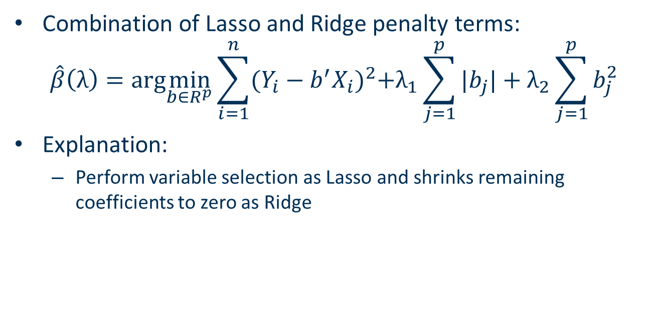
Elastic Net
Combination of Lasso and Ridge penalty terms:
$$\hat{β}\left(λ\right)=arg\min_{b∈R^{p}}{\sum_{i=1}^{n}{{(Y_{i}−b^{′}X_{i})}^{2}+λ_{1}\sum_{j=1}^{p}{|b_{j}|}+λ_{2}\sum_{j=1}^{p}{b_{j}^{2}}}}$$
Explanation:
Perform variable selection as Lasso and shrinks remaining coefficients to zero as Ridge
Pavel Lesnvski
06.12.2018

Slide 14
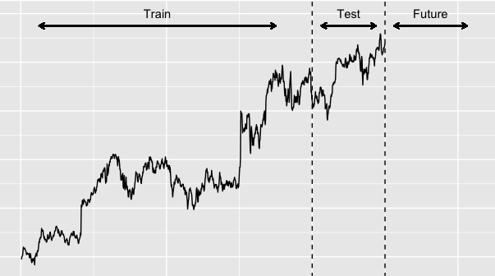
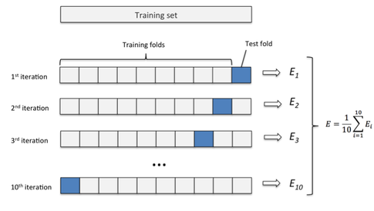
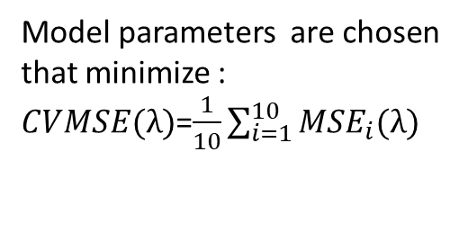
10-Fold Cross-Validation
414 months for training
Use the estimated model to predict future returns
30 months for testing
MSE on the test set as a measure of prediction accuracy
Validation
Model parameters are chosen that minimize :
$CVMSE(λ)$=$\frac{1}{10}\sum_{i=1}^{10}{{MSE}_{i}(λ)}$

Slide 15
Path for Lasso and Elastic Net

Slide 16
Estimated Coefficients

Slide 17
CV-MSE and Predict MSE

Slide 18
Results for interactions and squared terms

Slide 19
Caveats

Slide 20
Future Research

Slide 21
Conclusion

