Slide 1
Machine Learning
An introductory guide for applied researchers
Notes:
1,5h seminar, 15mins pause, 45mins seminar
Not typical seminar, not my work that I present
Overview on machine learning in academia, could fill a 1-week course with the material

Slide 2

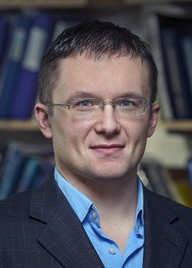
Disclaimer General Information
Two-weeks Machine Learning Course in St. Gallen
Two well-known Econometricians as Lecturers
Christian B. Hansen (Chicago)
Victor Chernozhukov (MIT)
Notes:
What makes me an expert?

Slide 3
Additional Information
Various Scientific Articles
25 articles read and referenced
About 50 articles browsed and considered
Simulated Examples self-developed and programmed
Generally you should use Python or R
Examples are programmed via Stata using the lassopack package

Slide 4

Table of Contents
Introduction
Prediction
Methods
Inference
Conclusion
Notes:
Introduction
Motivation, Prediction vs. Inference
Prediction
Assessment of good predictions, Advantage of ML, Applications
Methods
Parametric, Non-Parametric, Mixed, and Ensemble Methods
Inference
Many-Instruments, Many Confounders, Heterogeneous Treatment Effects
Conclusion
Summary, Outlook

Slide 5
Introduction Motivation
„In fact, my standard advice to graduate students these days is go to the computer science department and take a class in machine learning.“ – Hal R. Varian
„Well, certainly we can look forward to the idea that vacations will be longer at some point.“ – Bill Gates
Notes:
Third citations from Elon Musk:
The global arms race for Artificial Intelligence will cause World War III
Artificial Intelligence is a greater risk than North Korea
Artificial Intelligence is a fundamental risk to the existence of human civilization

Slide 6
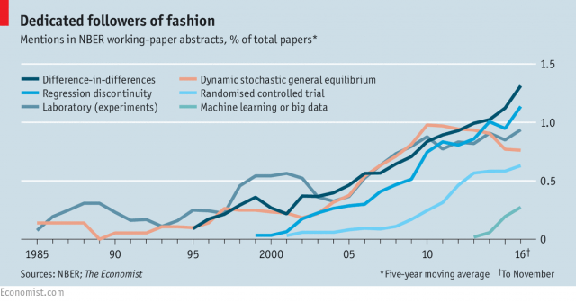

Slide 7
Terminology
Artificial Intelligence
„When a machine mimics cognitive functions […], such as learning and problem solving.“
Machine Learning = Statistical Learning = Supervised Learning
„Machine learning explores the study and construction of algorithms that can learn from and make predictions on data.“
High-Dimensional Data ≈ Big Data
„Studies data whose dimension is larger than dimensions considered in classical multivariate analysis.“
Data Mining ≈ Unsupervised Learning
„The machine learning task of inferring a function that describes the structure of unlabeled data.“

Slide 8
Prediction vs. Inference
Machine Learning is a tool for y not β
Why bother then?
Many Economic Problems are Prediction Problems
Many Inference Problems apply implicit prediction
Instrumental variables approach
Heterogeneous treatment effects
Flexibly control for confounders

Slide 9


Example: Kleinberg et al. (AER:PP 2015)

Slide 10
Umbrella Problem
Rain Dance Problem
Problem: Look at the clouds to determine whether an umbrella is warranted
Decision: Take umbrella if probability is sufficiently high
This is a problem of Prediction
Problem: Try to make it rain by conducting a rain dance
Decision: Start dancing if the probability of rain increases significantly through a rain dance
This is a problem of Inference

Slide 11
Prediction Outline
Performance Assessment
Cross-Validation
Problems with Conventional Methods
Solution from Machine Learning
Applications in Economics

Slide 12
Performance Assessment
Minimize the Mean-Squared-Error (MSE)
Out-of-Sample Performance
If p = n in-sample MSE will always be zero, which is not true for the population MSE
Training and testing sample
Time-lead for panel data

Slide 13
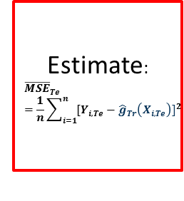
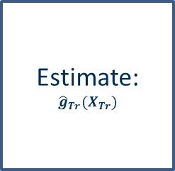
Step 1: Draw total sample
Step 2: Split sample
Total Sample
Training Sample
Test Sample
Step 3: Estimate predictor
Step 4: Estimate MSE
Estimate:
$${\hat{g}}_{Tr}(X_{Tr})$$
Test Sample
Training Sample
Estimate:
$${\overline{MSE}}_{Te}=\frac{1}{n}\sum_{i=1}^{n}{{[Y_{i,Te}−{\hat{g}}_{Tr}\left(X_{i,Te}\right)]}^{2}}$$

Slide 14
Cross-Validation
Refinement of the sample splitting idea
Leave-One-Out Cross-Validation (LOOCV)
Estimate model for all but one observation
Forecast outcome for this observation
Repeat for all observations
Problem: Computationally intensive
Current Standard is K-Fold CV (with K = 5 or 10)
Improving Performance
Regularization
Empirical Tuning

Slide 15
Problems with Conventional Methods
Ordinary Least Squares (OLS) is only the best linear unbiased estimator
Produces perfect in-sample predictions
Does not account for the variance of the estimates, which leads to overfitting
For p > n, OLS is not uniquely defined
Non-Parametric Methods are Unfit to deal with wide Data
Produces good estimates in low-dimensional settings
They suffer the curse of dimensionality

Slide 16
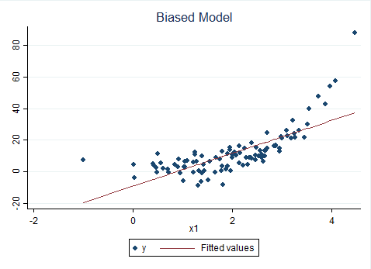
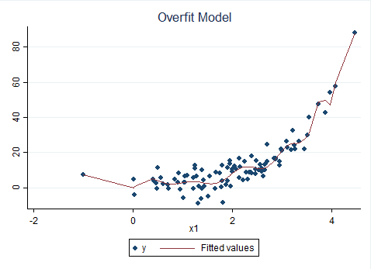


Example of OLS (Overfitting)
$y_{i}=e^{x_{i}}+ε_{i}$ with $ε_{i}\sim N(0, 5)$
$x_{i}=θ_{i}$ with $θ_{i}\sim N(3, 2)$
Model: $y_{i}=\hat{α}+\hat{β}x_{1i}+ε_{i}$
Model: $y_{i}=\hat{α}+\sum_{j=i}^{N=20}{{\hat{β}}_{j}x_{i}^{j}}+ε_{i}$

Slide 17
Example of Non-Parametrics (Curse of Dimensionality)
Wage data on 329,505 men from 1980 US Census
Characteristics are age (40-49), years of schooling (0-20), race (black, white), and married (yes, no)
3,360 categories (or cells)
Average of 98 observations per category
259 empty categories (7.7%)
670 categories with 0-2 observations (19.9%)

Slide 18
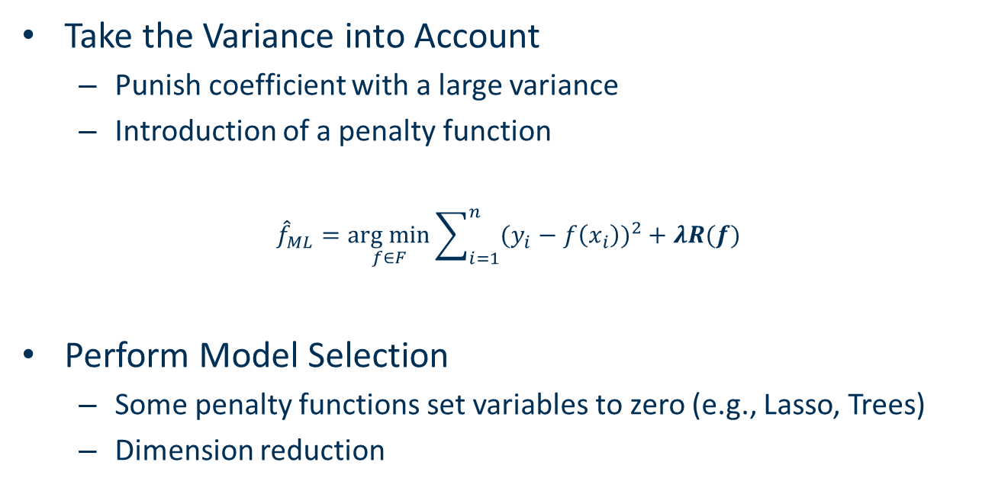
Solution from Machine Learning
Take the Variance into Account
Punish coefficient with a large variance
Introduction of a penalty function
$${\hat{f}}_{ML}=\underset{f∈F}{arg min}{\sum_{i=1}^{n}{{(y_{i}−f\left(x_{i}\right))}^{2}}+λR(f)}$$
Perform Model Selection
Some penalty functions set variables to zero (e.g., Lasso, Trees)
Dimension reduction

Slide 19
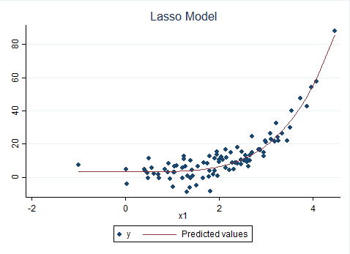
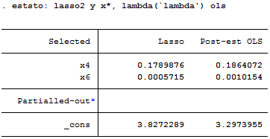
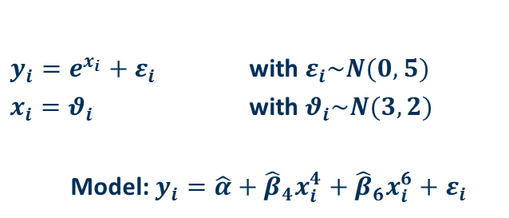
$y_{i}=e^{x_{i}}+ε_{i}$ with $ε_{i}\sim N(0, 5)$
$x_{i}=θ_{i}$ with $θ_{i}\sim N(3, 2)$
Model: $y_{i}=\hat{α}+{\hat{β}}_{4}x_{i}^{4}+{\hat{β}}_{6}x_{i}^{6}+ε_{i}$

Slide 20
Applications in Economics
Data Sources
Images and Language: High-dimensional observables
Rich Data: High-dimensional control and instrumental variables
Constructed Variables: Economic theory often does not specify exact relationship
Policy Applications
Kleinberg et al. (AER:PP 2015): Medical treatment allocation
Chinco, Clark-Joseph, Ye (JF forthcoming): Predicting stock returns
Kleinberg et al. (QJE 2018): Judges decision to release a defendant

Slide 21
Methods Outline
Parametric Predictors
Subset Selection
Lasso
Ridge
Elastic Net
Nonparametric Predictors
Regression Trees
Random Forest
Nearest Neighbors
Kernel Regression

Slide 22
Mixed Predictors
Neural Nets
Splines
Combined Predictors
Bagging
Boosting
Ensemble

Slide 23
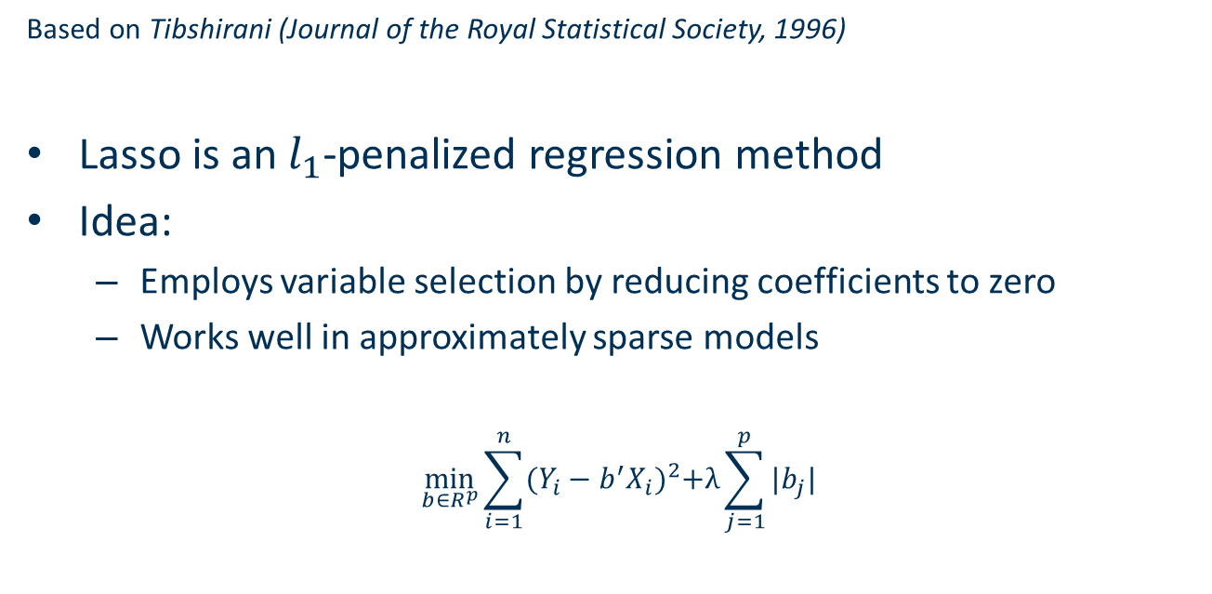
Lasso (Least absolute shrinkage and selection operator)
Based on Tibshirani (Journal of the Royal Statistical Society, 1996)
Lasso is an $l_{1}$-penalized regression method
Idea:
Employs variable selection by reducing coefficients to zero
Works well in approximately sparse models
$$\min_{b∈R^{p}}{\sum_{i=1}^{n}{{(Y_{i}−b^{′}X_{i})}^{2}+λ\sum_{j=1}^{p}{|b_{j}|}}}$$

Slide 24
Post-Lasso
Belloni and Chernozhukov (Bernoulli, 2013)
Idea:
Select variables in a lasso regression
Run OLS with the selected variables

Slide 25
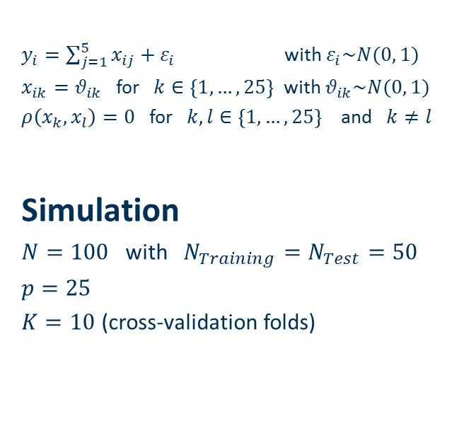
Model
$y_{i}=\sum_{j=1}^{5}{x_{ij}}+ε_{i}$ with $ε_{i}\sim N(0, 1)$
$x_{ik}=θ_{ik}$ for $k∈\left\{1, …, 25\right\}$ with $θ_{ik}\sim N(0, 1)$
$ρ\left(x_{k},x_{l}\right)=0$ for $k, l∈\left\{1, …, 25\right\}$ and $k≠l$
Simulation
$N=100$ with $N_{Training}=N_{Test}=50$
$p=25$
$K=10$ (cross-validation folds)
 |  | MSE (Training Sample) | MSE (Test Sample)
OLS | Average | 0.4318 | 2.6965
 | Standard Deviation | (0.0775) | (0.6408)
Lasso | Average | 0.6497 | 1.4822
 | Standard Deviation | (0.1038) | (0.2839)
Post-Lasso | Average | 0.8504 | 1.1489
 | Standard Deviation | (0.1472) | (0.2238)
Ridge | Average | 0.4628 | 2.0809
 | Standard Deviation | (0.0799) | (0.527)
Elastic Net | Average | 0.594 | 1.6334
 | Standard Deviation | (0.0981) | (0.3469)

Slide 26
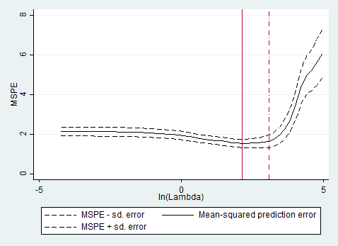

Slide 27
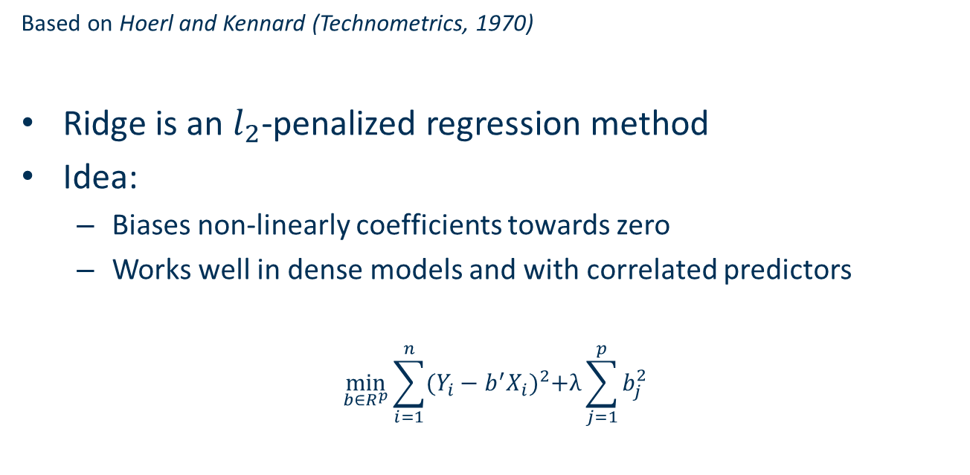
Ridge
Based on Hoerl and Kennard (Technometrics, 1970)
Ridge is an $l_{2}$-penalized regression method
Idea:
Biases non-linearly coefficients towards zero
Works well in dense models and with correlated predictors
$$\min_{b∈R^{p}}{\sum_{i=1}^{n}{{(Y_{i}−b^{′}X_{i})}^{2}+λ\sum_{j=1}^{p}{b_{j}^{2}}}}$$

Slide 28
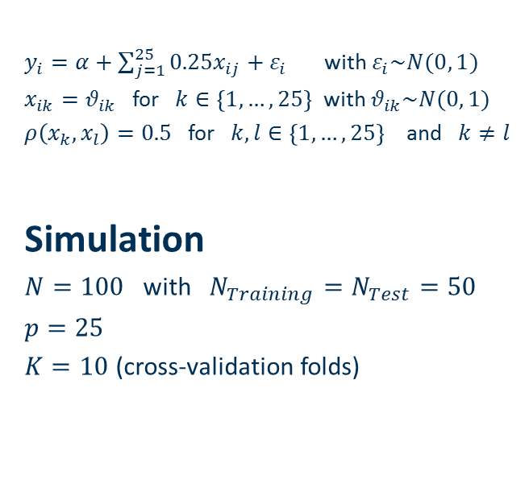
Model
$y_{i}=α+\sum_{j=1}^{25}{0.25x_{ij}}+ε_{i}$ with $ε_{i}\sim N(0, 1)$
$x_{ik}=θ_{ik}$ for $k∈\left\{1, …, 25\right\}$ with $θ_{ik}\sim N(0, 1)$
$ρ\left(x_{k},x_{l}\right)=0.5$ for $k, l∈\left\{1, …, 25\right\}$ and $k≠l$
Simulation
$N=100$ with $N_{Training}=N_{Test}=50$
$p=25$
$K=10$ (cross-validation folds)
 |  | MSE (Training Sample) | MSE (Test Sample)
OLS | Average | 0.5466 | 2.628
 | Standard Deviation | (0.1204) | (0.3702)
Lasso | Average | 0.566 | 2.3693
 | Standard Deviation | (0.1194) | (0.3754)
Post-Lasso | Average | 0.557 | 2.2693
 | Standard Deviation | (0.1163) | (0.3372)
Ridge | Average | 0.8133 | 1.626
 | Standard Deviation | (0.1552) | (0.2876)
Elastic Net | Average | 0.6811 | 1.9811
 | Standard Deviation | (0.1433) | (0.3558)

Slide 29
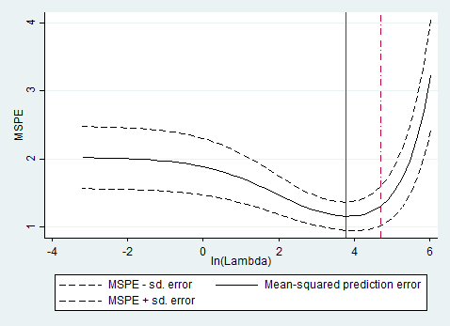

Slide 30
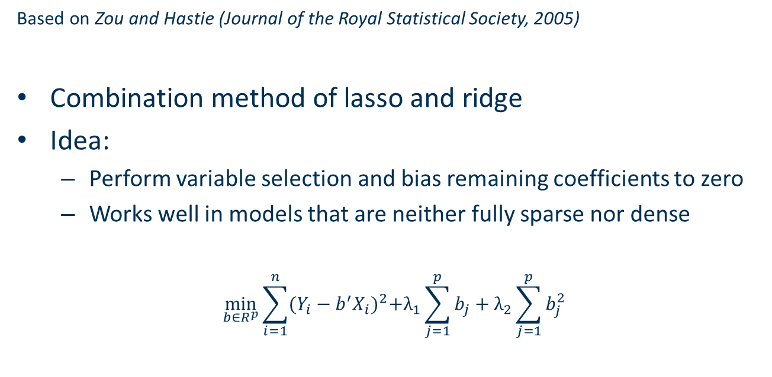
Elastic Net
Based on Zou and Hastie (Journal of the Royal Statistical Society, 2005)
Combination method of lasso and ridge
Idea:
Perform variable selection and bias remaining coefficients to zero
Works well in models that are neither fully sparse nor dense
$$\min_{b∈R^{p}}{\sum_{i=1}^{n}{{(Y_{i}−b^{′}X_{i})}^{2}+λ_{1}\sum_{j=1}^{p}{b_{j}}+λ_{2}\sum_{j=1}^{p}{b_{j}^{2}}}}$$

Slide 31

Model
$y_{i}=α+\sum_{j=1}^{15}{0.75x_{ij}}+ε_{i}$ with $ε_{i}\sim N(0, 1)$
$x_{ik}=θ_{ik}$ for $k∈\left\{1, …, 25\right\}$ with $θ_{ik}\sim N(0, 1)$
$ρ\left(x_{k},x_{l}\right)=0.25$ for $k, l∈\left\{1, …, 25\right\}$ and $k≠l$
Simulation
$N=100$ with $N_{Training}=N_{Test}=50$
$p=25$
$K=10$ (cross-validation folds)
 |  | MSE (Training Sample) | MSE (Test Sample)
OLS | Average | 0.4465 | 2.2768
 | Standard Deviation | (0.0846) | (0.588)
Lasso | Average | 0.5541 | 1.9348
 | Standard Deviation | (0.1136) | (0.4277)
Post-Lasso | Average | 0.5062 | 2.0065
 | Standard Deviation | (0.1011) | (0.4991)
Ridge | Average | 0.5018 | 1.9506
 | Standard Deviation | (0.0977) | (0.437)
Elastic Net | Average | 0.4899 | 1.9137
 | Standard Deviation | (0.1005) | (0.4461)

Slide 32
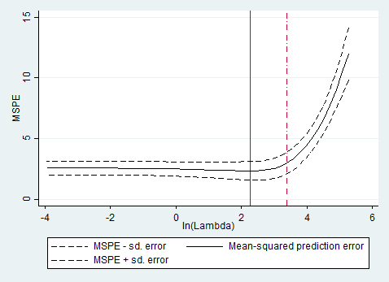

Slide 33
(Classification and Regression) Trees [CART]
Based on Breiman, Friedman, Olshen, and Stone (Book 1984)
Idea:
Assume no parametric relation in the data
Simply split the data according to the MSE criterion
Applicability:
Works well when data exhibit nonlinearities and interactions
Works well in large data sets

Slide 34
1
1
2
x₂
x₂
x₁
x₁
1
2
1
4
x₂
x₂
2
3
3
x₁
x₁

Slide 35
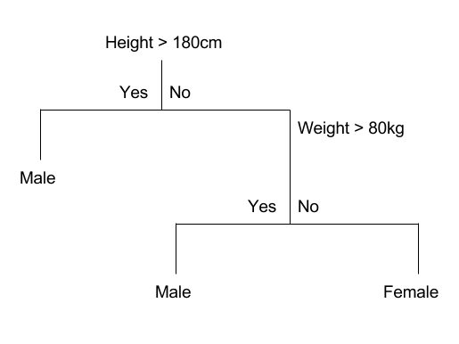

Slide 36
How to decide on Tree Complexity?
Pruning Trees
Grow tree until every leaf has one observation
Introduce complexity measure (e.g., number of leafs)
Prune back trees at node with least explanatory power
Apply cross-validation to choose complexity

Slide 37
Random Forests
Based on Breiman (Machine Learning, 1996) and Breiman (Machine Learning, 2001)
Caveat of Trees:
Trees can be influenced by large outliers
Tree structure can be driven by few influential variables
Idea:
Improve upon trees through bagging
Improve upon trees through variable selection

Slide 38
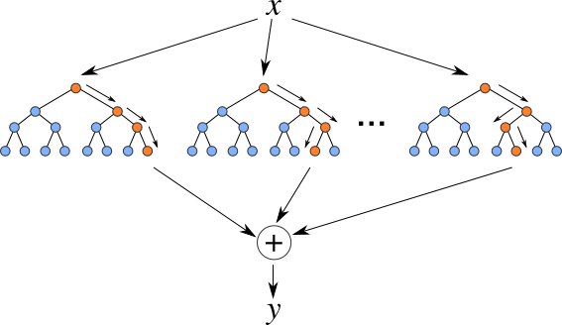
Approach:
Bootstrap sample from training data set
Select k < p variables at random
Grow T optimized trees
Average expected outcome across all those trees
Random Forests work extremely well in practice!

Slide 39
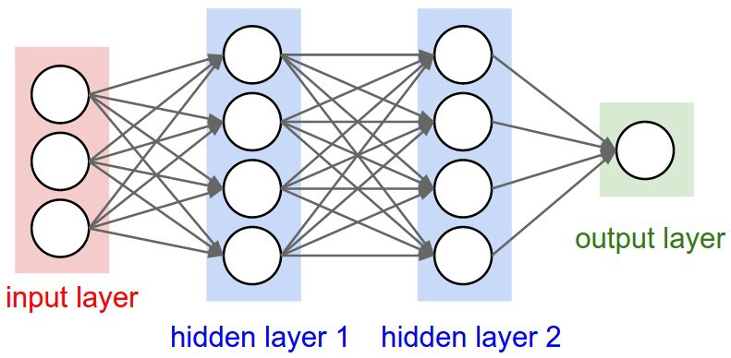
Neural Nets

Slide 40

Idea:
Create M constructed regressors (neurons) in one layer
$$Z_{m}=σ\left(α_{0m}+α_{m}^{T}X\right)$$
With the activation function $σ$ being, e.g., the sigmoid function:
$$σ\left(v\right)=\frac{1}{1+e^{−v}}$$

Slide 41
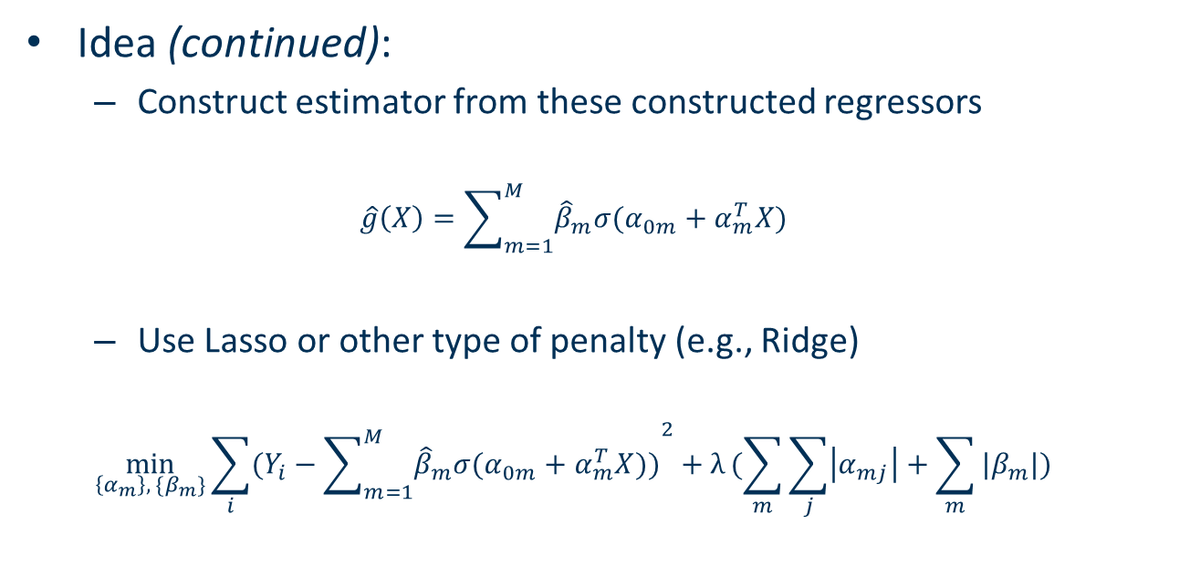
Idea (continued):
Construct estimator from these constructed regressors
$$\hat{g}\left(X\right)=\sum_{m=1}^{M}{{\hat{β}}_{m}σ(α_{0m}+α_{m}^{T}X)}$$
Use Lasso or other type of penalty (e.g., Ridge)
$$\min_{\left\{α_{m}\right\}, \{β_{m}\}}{\sum_{i}{{(Y_{i}−\sum_{m=1}^{M}{{\hat{β}}_{m}σ(α_{0m}+α_{m}^{T}X))}}^{2}}+λ}(\sum_{m}{\sum_{j}{\left|α_{mj}\right|}+\sum_{m}{|β_{m}|})}$$

Slide 42
Idea (continued):
Use gradient descent algorithms to find optimal estimator
Algorithm has various tuning parameters, number of layers, number of neurons, weights of neurons, penalty parameter(s)
Use cross-validation to optimize tuning parameters
Use multiple neural nets and average over the outcomes

Slide 43
Advantages:
Very flexible in capturing non-linearity
Neural Networks work extremely good in many cases!
Problems:
Requires Big Data
Hardly Understood Properties
Computing Power

Slide 44
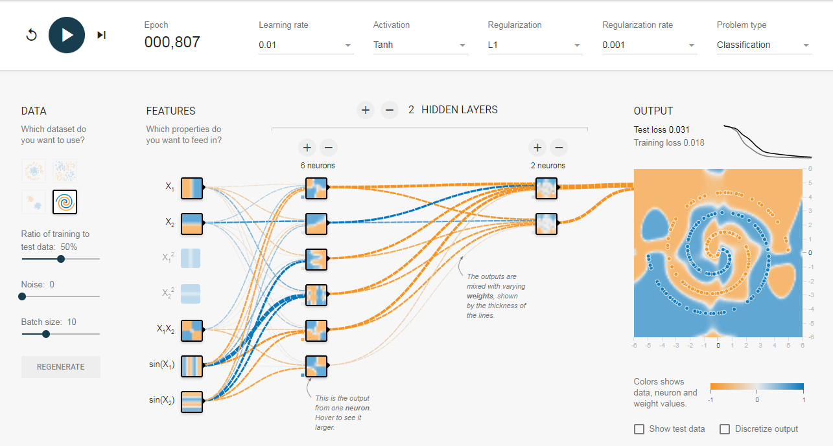
Source: playground.tensorflow.org

Slide 45
Bagging
Based on Breiman (Machine Learning, 1996)
Idea:
Improve upon predictive power by resampling
Bootstrap aggregating = Bagging
Repeated model estimation with bootstrapped samples
If the estimated model changes after small perturbations to the sample, then bagging improves predictions

Slide 46
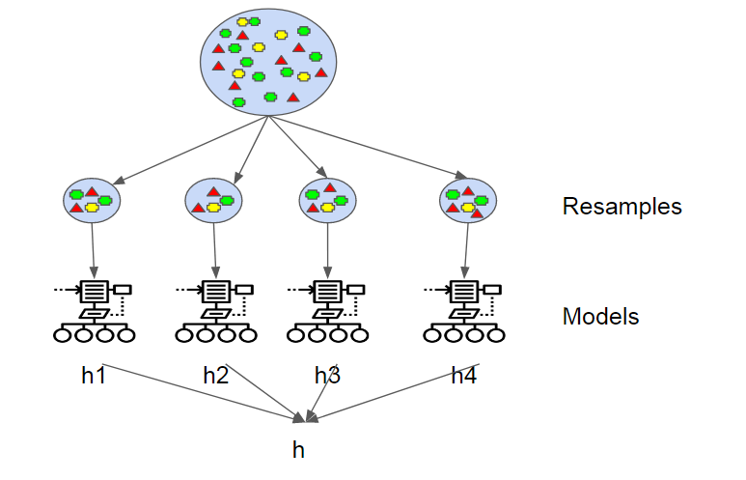

Slide 47
Boosting
Based on Friedman (The Annals of Statistics, 2001)
Idea:
Use „weak learners“ and improve them successively
Approach correct parameters by reweighting observations and correcting the errors of previous estimations

Slide 48
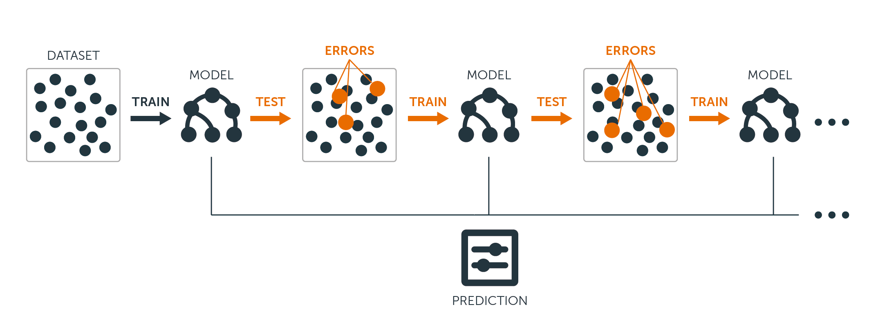

Slide 49
Ensemble
Ensemble Methods simply combine predictions from various applied Methodologies
Example: The Netflix Prize
$1 million prize for a 10% improvement over Netflix‘s movie recommender
Team 1: „Our final solution consists of blending 107 individual results.“
Team 3: „Our common team blends the result of team Gravity and team Dinosaur Planet.“

Slide 50
Inference Outline
Inference with Selection among Many Instruments
Inference with Selection among Many Controls
Heterogeneous Treatment Effects

Slide 51
Inference with Selection among Many Instruments
Sparse Models and Methods for Optimal Instruments
Based on Belloni, Chen, Chernozhukov, and Hansen (Econometrica, 2012)
Idea
First-stage regression in IV estimation is a prediction exercise
Apply model selection method (e.g., Lasso) to choose among high-dimensional instruments

Slide 52

Example:
Effect of Eminent domain decisions on house prices
Random allocation of three judges to decisions
Use judge characteristics as instruments
Many instruments case
N = 110-312; p = 138-147

Slide 53
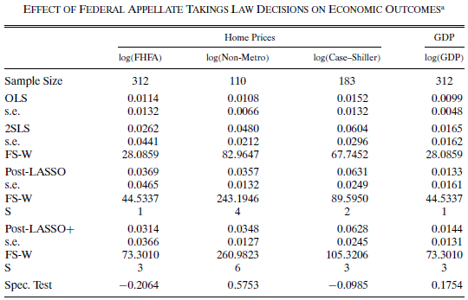

Slide 54
Inference with Selection among Many Controls
Post-Double Selection Method
Based on Belloni, Chernozhukov, and Hansen (Review of Economic Studies, 2014)
Idea
Economic intuition often suggests a set of variables but does not specify which ones exactly are important and their functional form
Apply model selection to vast set of (constructed) variables
Identify relevant variables by post-double selection

Slide 55
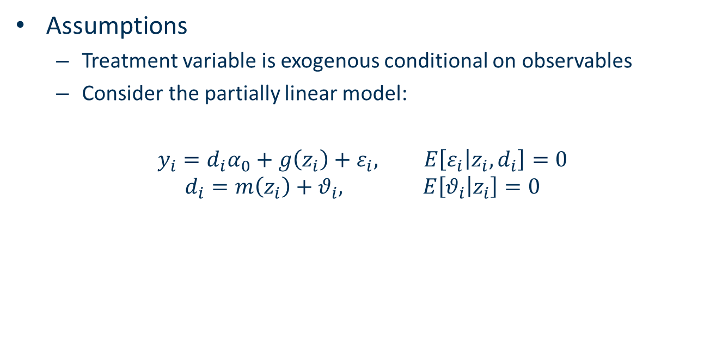
Assumptions
Treatment variable is exogenous conditional on observables
Consider the partially linear model:
$$y_{i}=d_{i}α_{0}+g\left(z_{i}\right)+ε_{i}, E\left[ε_{i} | z_{i}, d_{i}\right]=0$$
$$d_{i}=m\left(z_{i}\right)+θ_{i}, E\left[θ_{i} | z_{i}\right]=0$$

Slide 56

Example:
Effect of Abortion Rates on Crime
Assume that abortion rates are exogenous after controlling for confounders
Include higher order confounding variables, interactions, and time trends
N = 576; p = 284

Slide 57
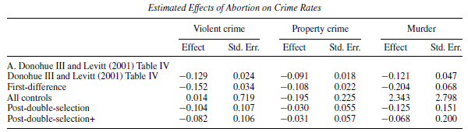

Slide 58
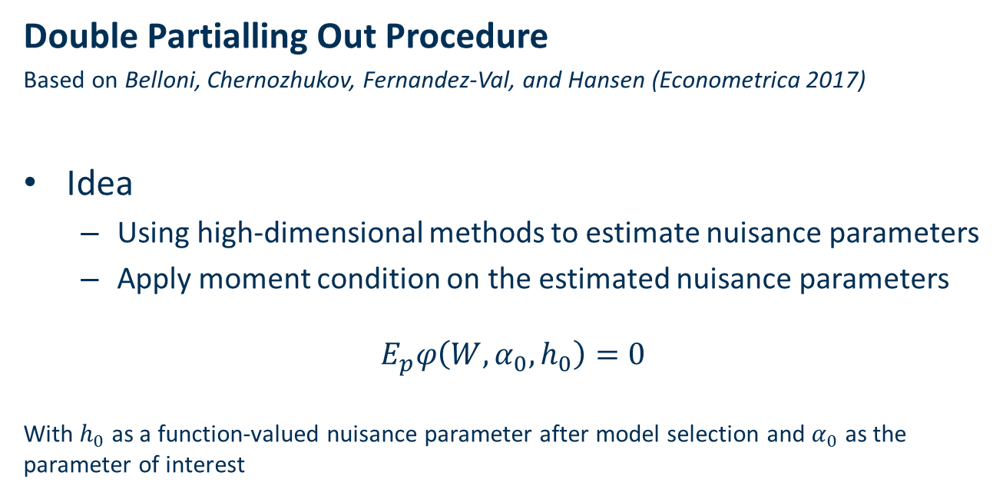
Double Partialling Out Procedure
Based on Belloni, Chernozhukov, Fernandez-Val, and Hansen (Econometrica 2017)
Idea
Using high-dimensional methods to estimate nuisance parameters
Apply moment condition on the estimated nuisance parameters
$$E_{p}φ\left(W, α_{0}, h_{0}\right)=0$$
With $h_{0}$ as a function-valued nuisance parameter after model selection and $α_{0}$ as the parameter of interest

Slide 59

Example:
Effect of 401k participation on financial assets
Use 401k eligibility as instrument
Include higher order splines of income as controls
N = 9,915, p = 1,526

Slide 60
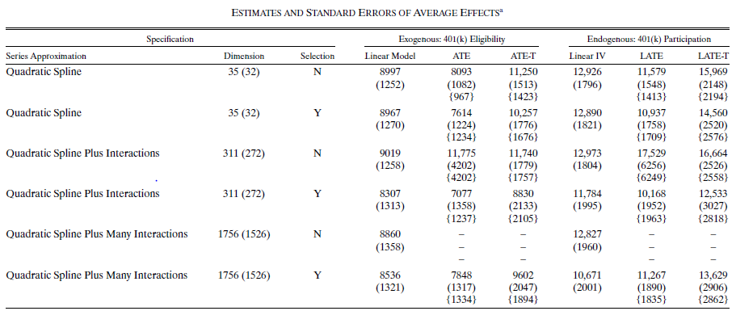

Slide 61
Double/Debiased Machine Learning
Based on Chernozhukov, Chetverikov, Demirer, Duflo, Hansen, Newey, and Robins (Econometrics Journal, 2018)
Idea:
Relax very strict assumption on approximate sparsity
High-complexity cases violate the Donsker condition that is required for consistency of previous estimators
Cross-fitting with two samples to reduce requirements on model complexity

Slide 62

Application:
Partially Linear Regression Model:
$$Y=Dθ_{j}+g_{j}\left(X\right)+U, E\left[U | X,D\right]=0$$
$$D=m_{j}\left(X\right)+V, E\left[V | X\right]=0$$

Slide 63
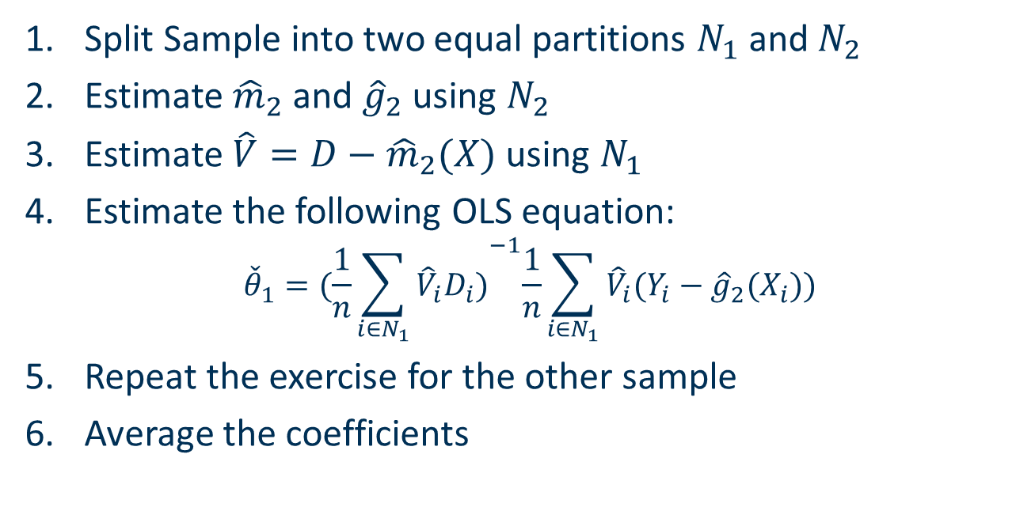
Split Sample into two equal partitions $N_{1}$ and $N_{2}$
Estimate ${\hat{m}}_{2}$ and ${\hat{g}}_{2}$ using $N_{2}$
Estimate $\hat{V}=D−{\hat{m}}_{2}(X)$ using $N_{1}$
Estimate the following OLS equation:
$${\check{θ}}_{1}={(\frac{1}{n}\sum_{i∈N_{1}}{{\hat{V}}_{i}D_{i})}}^{−1}\frac{1}{n}\sum_{i∈N_{1}}{{\hat{V}}_{i}(Y_{i}−{\hat{g}}_{2}(X_{i}))}$$
Repeat the exercise for the other sample
Average the coefficients

Slide 64
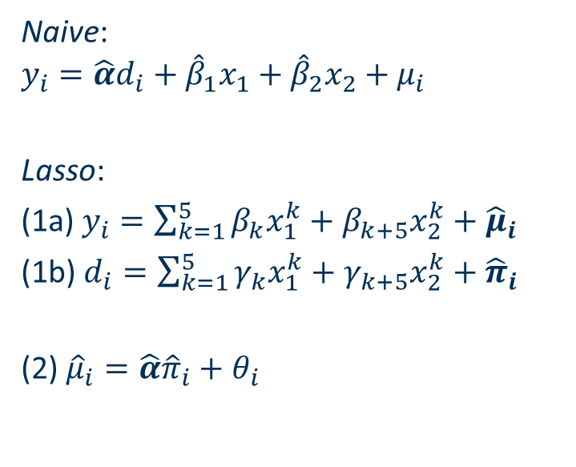
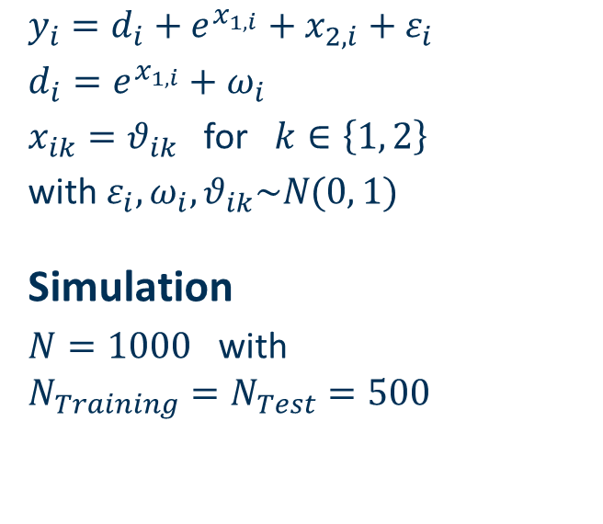
Model
Regression
$y_{i}=d_{i}+e^{x_{1,i}}+x_{2,i}+ε_{i}$
$d_{i}=e^{x_{1,i}}+ω_{i}$
$x_{ik}=θ_{ik}$ for $k∈\left\{1, 2\right\}$
with $ε_{i},ω_{i}, θ_{ik}\sim N(0, 1)$
Simulation
$N=1000$ with
$$N_{Training}=N_{Test}=500$$
Naive:
$$y_{i}=\hat{α}d_{i}+{\hat{β}}_{1}x_{1}+{\hat{β}}_{2}x_{2}+μ_{i}$$
Lasso:
(1a) $y_{i}=\sum_{k=1}^{5}{β_{k}x_{1}^{k}}+β_{k+5}x_{2}^{k}+{\hat{μ}}_{i}$
(1b) $d_{i}=\sum_{k=1}^{5}{γ_{k}x_{1}^{k}}+γ_{k+5}x_{2}^{k}+{\hat{π}}_{i}$
(2) ${\hat{μ}}_{i}=\hat{α}{\hat{π}}_{i}+θ_{i}$

Slide 65
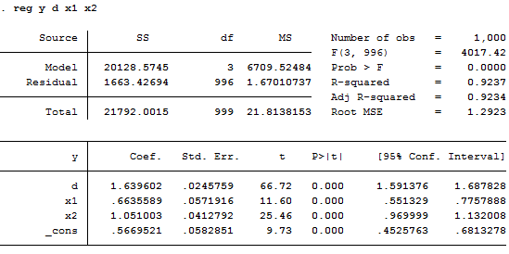
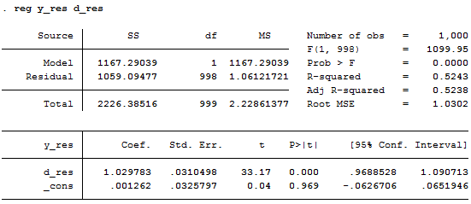
Naive
Lasso

Slide 66
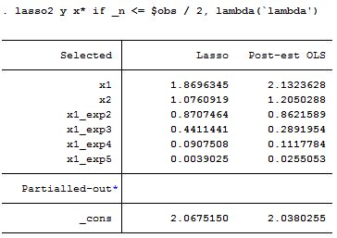
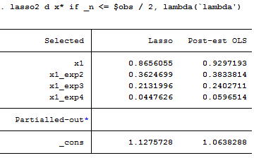
Lasso - Model Selection d
Lasso - Model Selection y

Slide 67
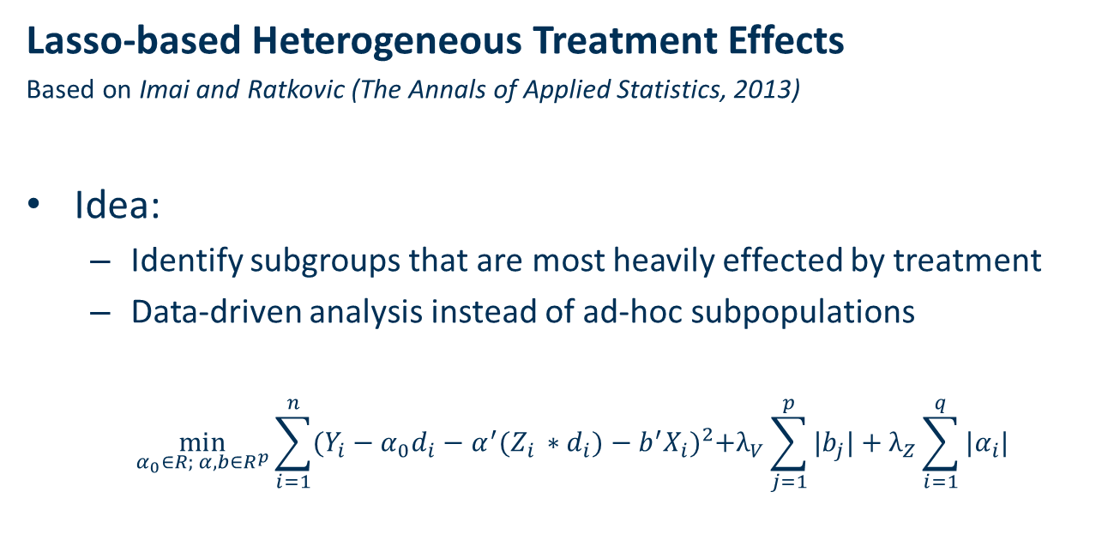
Heterogeneous Treatment Effects
Lasso-based Heterogeneous Treatment Effects
Based on Imai and Ratkovic (The Annals of Applied Statistics, 2013)
Idea:
Identify subgroups that are most heavily effected by treatment
Data-driven analysis instead of ad-hoc subpopulations
$$\min_{α_{0}∈R; α, b∈R^{p}}{\sum_{i=1}^{n}{{(Y_{i}−α_{0}d_{i}−α^{′}(Z_{i }∗d_{i})−b^{′}X_{i})}^{2}+λ_{V}\sum_{j=1}^{p}{|b_{j}|}+λ_{Z}\sum_{i=1}^{q}{|α_{i}|}}}$$

Slide 68
Tree-based Heterogeneous Treatment Effects
Based on Athey and Imbens (Proceedings of the National Academy of Sciences, 2016)
Idea:
Use of „causal trees“ that partition the treatment group into subpopulations
Calculation of „honest“ confidence intervals

Slide 69
Random Forest-based Heterogeneous Treatment Effects
Based on Wager and Athey (Journal of the American Statistical Association, 2018)
Idea:
Extension of causal trees to causal forests
Allows for more distinctive subgroups

Slide 70
Conclusion Summary
Prediction
Many economic problems are prediction problems
Machine learning is perfect for these problems
Methods
A „forest“ of different methods
Most prominent methods are Lasso, Random Forest, and Neural Net
Inference
Several applications to improve inference (such as robust SEs)
Very recent and active literature!

Slide 71

Outlook
Machine Learning will enter Mainstream Econometrics
Applicability to Prediction Problems will increase due to Data Availability and Computing Power
Inference based on standard Methods (e.g., Matching, DiD) will be supplemented with Machine Learning Robustness Tests

Slide 72
Literature
Reviews
Athey, S. and G. W. Imbens (2017). „The State of Applied Econometrics: Causality and Policy Evaluation“. Journal of Economic Perspectives 31(2), 3-32
Belloni, A., Chernozhukov, V. and C. Hansen (2014). „High-Dimensional Methods and Inference on Structural and Treatment Effects“. Journal of Economic Perspectives 28(2), 29-50
Mullainathan, S. and J. Spiess (2017). „Machine Learning: An Applied Econometric Approach“. Journal of Economic Perspectives 31(2), 87-106
Varian, H. R. (2014). „Big Data: New Tricks for Econometrics“. Journal of Economic Perspectives 28(2), 3-28

Slide 73
Prediction
Chinco, A., Clark-Joseph, A. D., and M. Ye (forthcoming). „Sparse Signals in the Cross-Section of Returns“. Journal of Finance (forthcoming)
Kleinberg, J., Lakkaraju H., Leskovec, J., Ludwig, J., and S. Mullainathan (2018). „Human Decisions and Machine Predictions“. The Quarterly Journal of Economics 113(1), 237-293
Kleinberg, J., Ludwig, J., Mullainathan, S., and Z. Obermeyer (2015). „Prediction Policy Problems“. American Economic Review: Papers & Proceedings 105(5), 491-495

Slide 74
Methods
Breiman, L. (1996). „Bagging Predictors“. Machine Learning 24(2), 123-140
Breiman, L. (2001). „Random Forests“. Maching Learning 24(1), 5-32
Breiman, L., Friedman, J. H., Olshen, R. A. and Stone, C. J. (1984). „Classification and Regression Trees“. Chapman & Hall/CRC, Boca Raton
Friedman, J. H. (2001). „Greedy Function Approximation: A Gradient Boosting Machine“. The Annals of Statistics 29(5), 1189-1232
Hoerl, A. E. and Kennard, R. W. (1970). „Ridge Regression: Biased Estimation for Nonorthogonal Problems“. Technometrics 12(1), 55-67
Tibshirani, R. (1996). „Regression Shrinkage and Selection via the Lasso“. Journal of the Royal Statistical Society 58(1), 267-288
Zou, H. and Hastie, T. (2005). „Regularization and Variable Selection via the Elastic Net“. Journal of the Royal Statistical Society 67(2), 301-320

Slide 75
Inference
Athey S. and G. Imbens (2016). „Recursive Partitioning for Heterogeneous Causal Effects“. Proceedings of the National Academy of Sciences
Belloni, A., Chen, D., Chernozhukov, V., and C. Hansen (2012). „Sparse Models and Methods for Optimal Instruments with Application to Eminent Domain“. Econometrica 80(6), 2269-2429
Belloni, A., Chernozhukov, V., Fernandez-Val, I., and C. Hansen (2017). „Program Evaluation and Causal Inference with High-Dimensional Data“. Econometrica 85(1), 233-298
Belloni, A., Chernozhukov, V., and C. Hansen (2014). „Inference on Treatment Effects after Selection among High-Dimensional Controls“. Review of Economic Studies 81, 608-650
Chernozhukov, V., Chetverikov, D., Demirer, M., Duflo, E., Hansen, C., Newey, W., and J. Robins (2018). „Double/Debiased Machine Learning for Treatment and Structural Parameters“. Econometrics Journal 21, 1-68
Imai, K., and M. Ratkovic (2013). „Estimating Treatment Effects Heterogeneity in Randomized Program Evaluation“. The Annals of Applied Statistics 7(1), 443-470
Wager, S., and S. Athey (2018). „Estimation and Inference of Heterogeneous Treatment Effects using Random Forests“. Journal of the American Statistical Association, 1-15

Slide 76
Thank you for your Attention!
Any Questions?

