Slide 1

Predicting Stock Market Returns for Fun and Profit
Pavel Lesnevski

Slide 2
Predicting Stock Market Returns
Predicting monthly S&P 500 index returns using historical macroeconomic data and technical indicators
Interesting from both academic and practical perspectives
A task with high noise-to-signal ratio
Very few models are able to outperform the simple historical mean return
High-dimensional setting with lack of data (number of predictors is comparable to the number of observations)
Use models that perform well in this setting

Slide 3
Project Highlights
A time-series predictive framework that features:
- Clear project structure based on cookiecutter data science template
- Usage of scikit-learn pipelines that simplify automation of the analysis
- New scikit-learn estimators
- New scikit-learn time-series cross-validation methods (nested cross-validation)
- Domain-tailored prediction accuracy statistical tests
- Jupyter notebooks and presentations that explain and visualize obtained findings

Slide 4
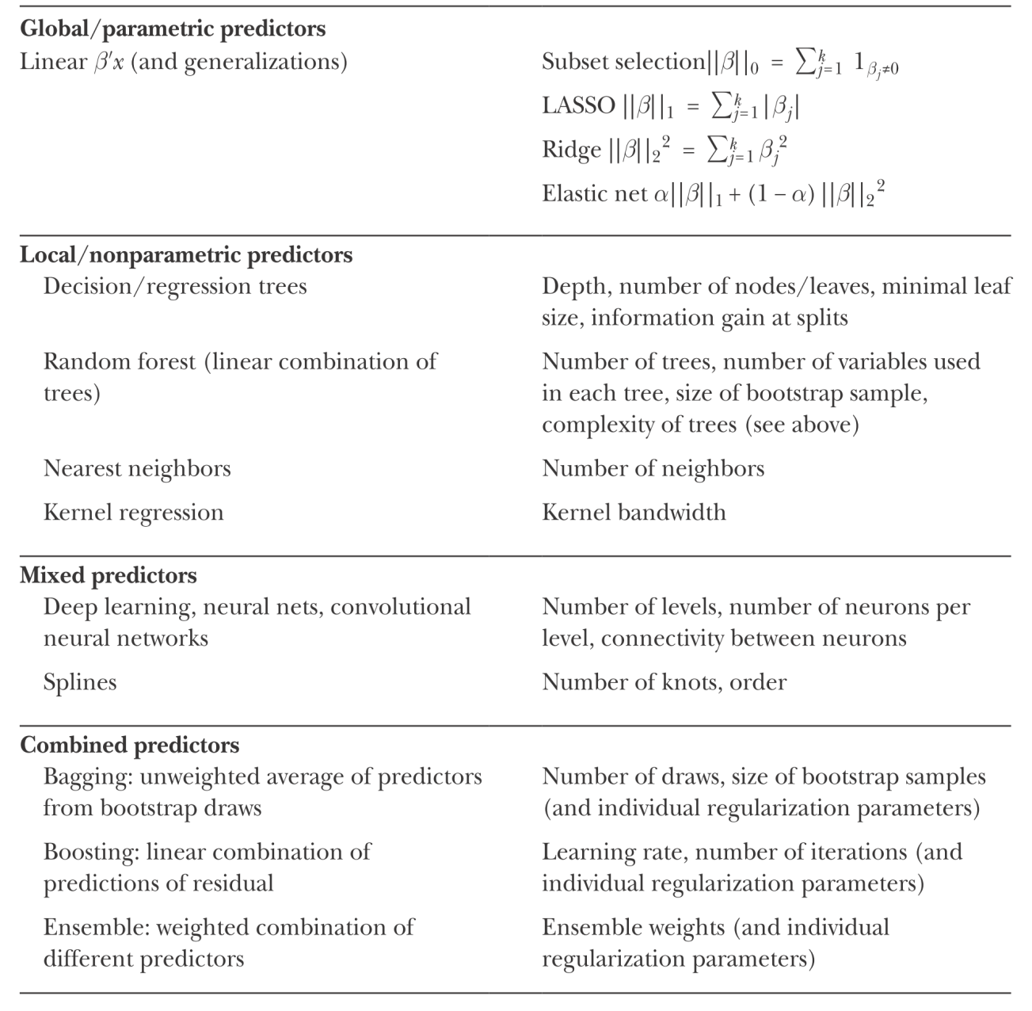
Machine Learning Methods
Source: Mullainathan and Spiess (2017)

Slide 5
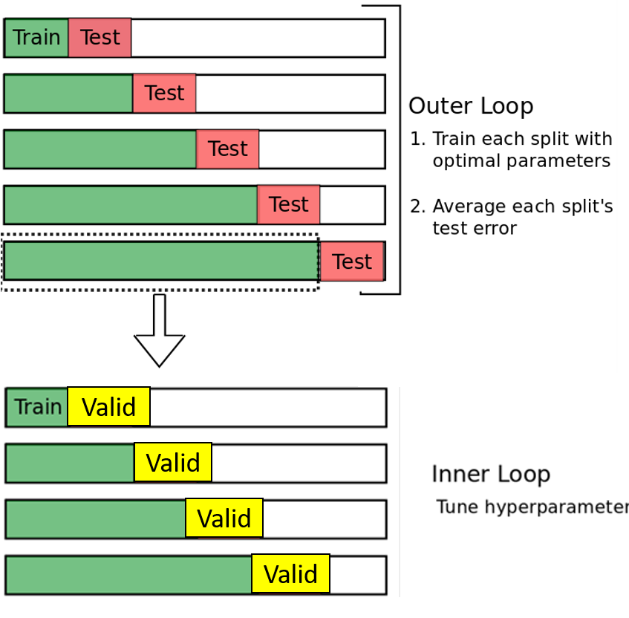
Nested Cross-Validation

Slide 6
Prediction Results
Baseline Predictors (p = 31)
Model | Mean | PCA | OLS | Ridge | Lasso | Enet
PMSE | 44.540 | 42.191 | 57.024 | 43.017 | 41.794 | 41.918
With Interaction Terms (p = 496)
Model | Mean | PCA | OLS | Ridge | Lasso | Enet
PMSE | - | - | - | 41.138 | 41.825 | 40.776
With Interaction and Squared Terms (p = 527)
Model | Mean | PCA | OLS | Ridge | Lasso | Enet
PMSE | - | - | - | 41.471 | 42.305 | 39.616
Machine learning techniques have a potential to improve the prediction accuracy of stock market returns

Slide 7
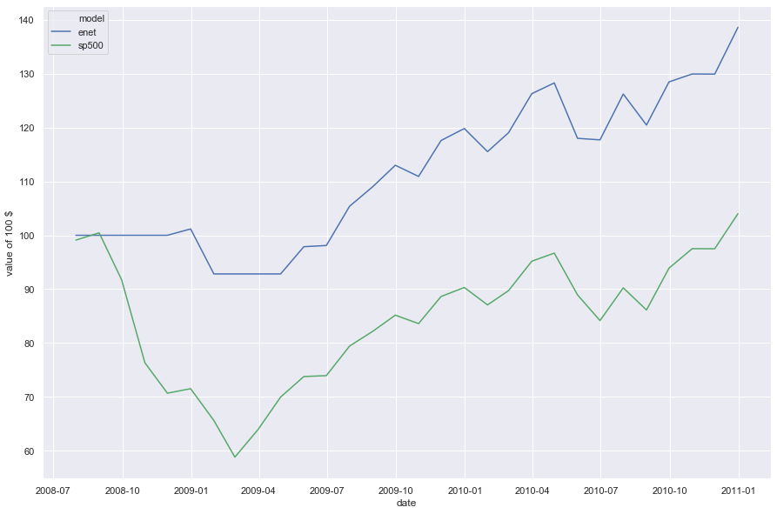
Strategy Performance - 2008 Crisis

Slide 8
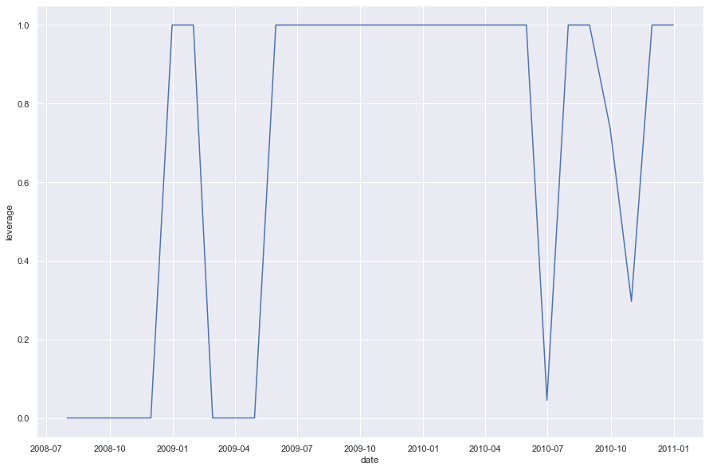
Position Dynamics

Slide 9


On GitHub Soon!
www.github.com/paveles

Slide 10
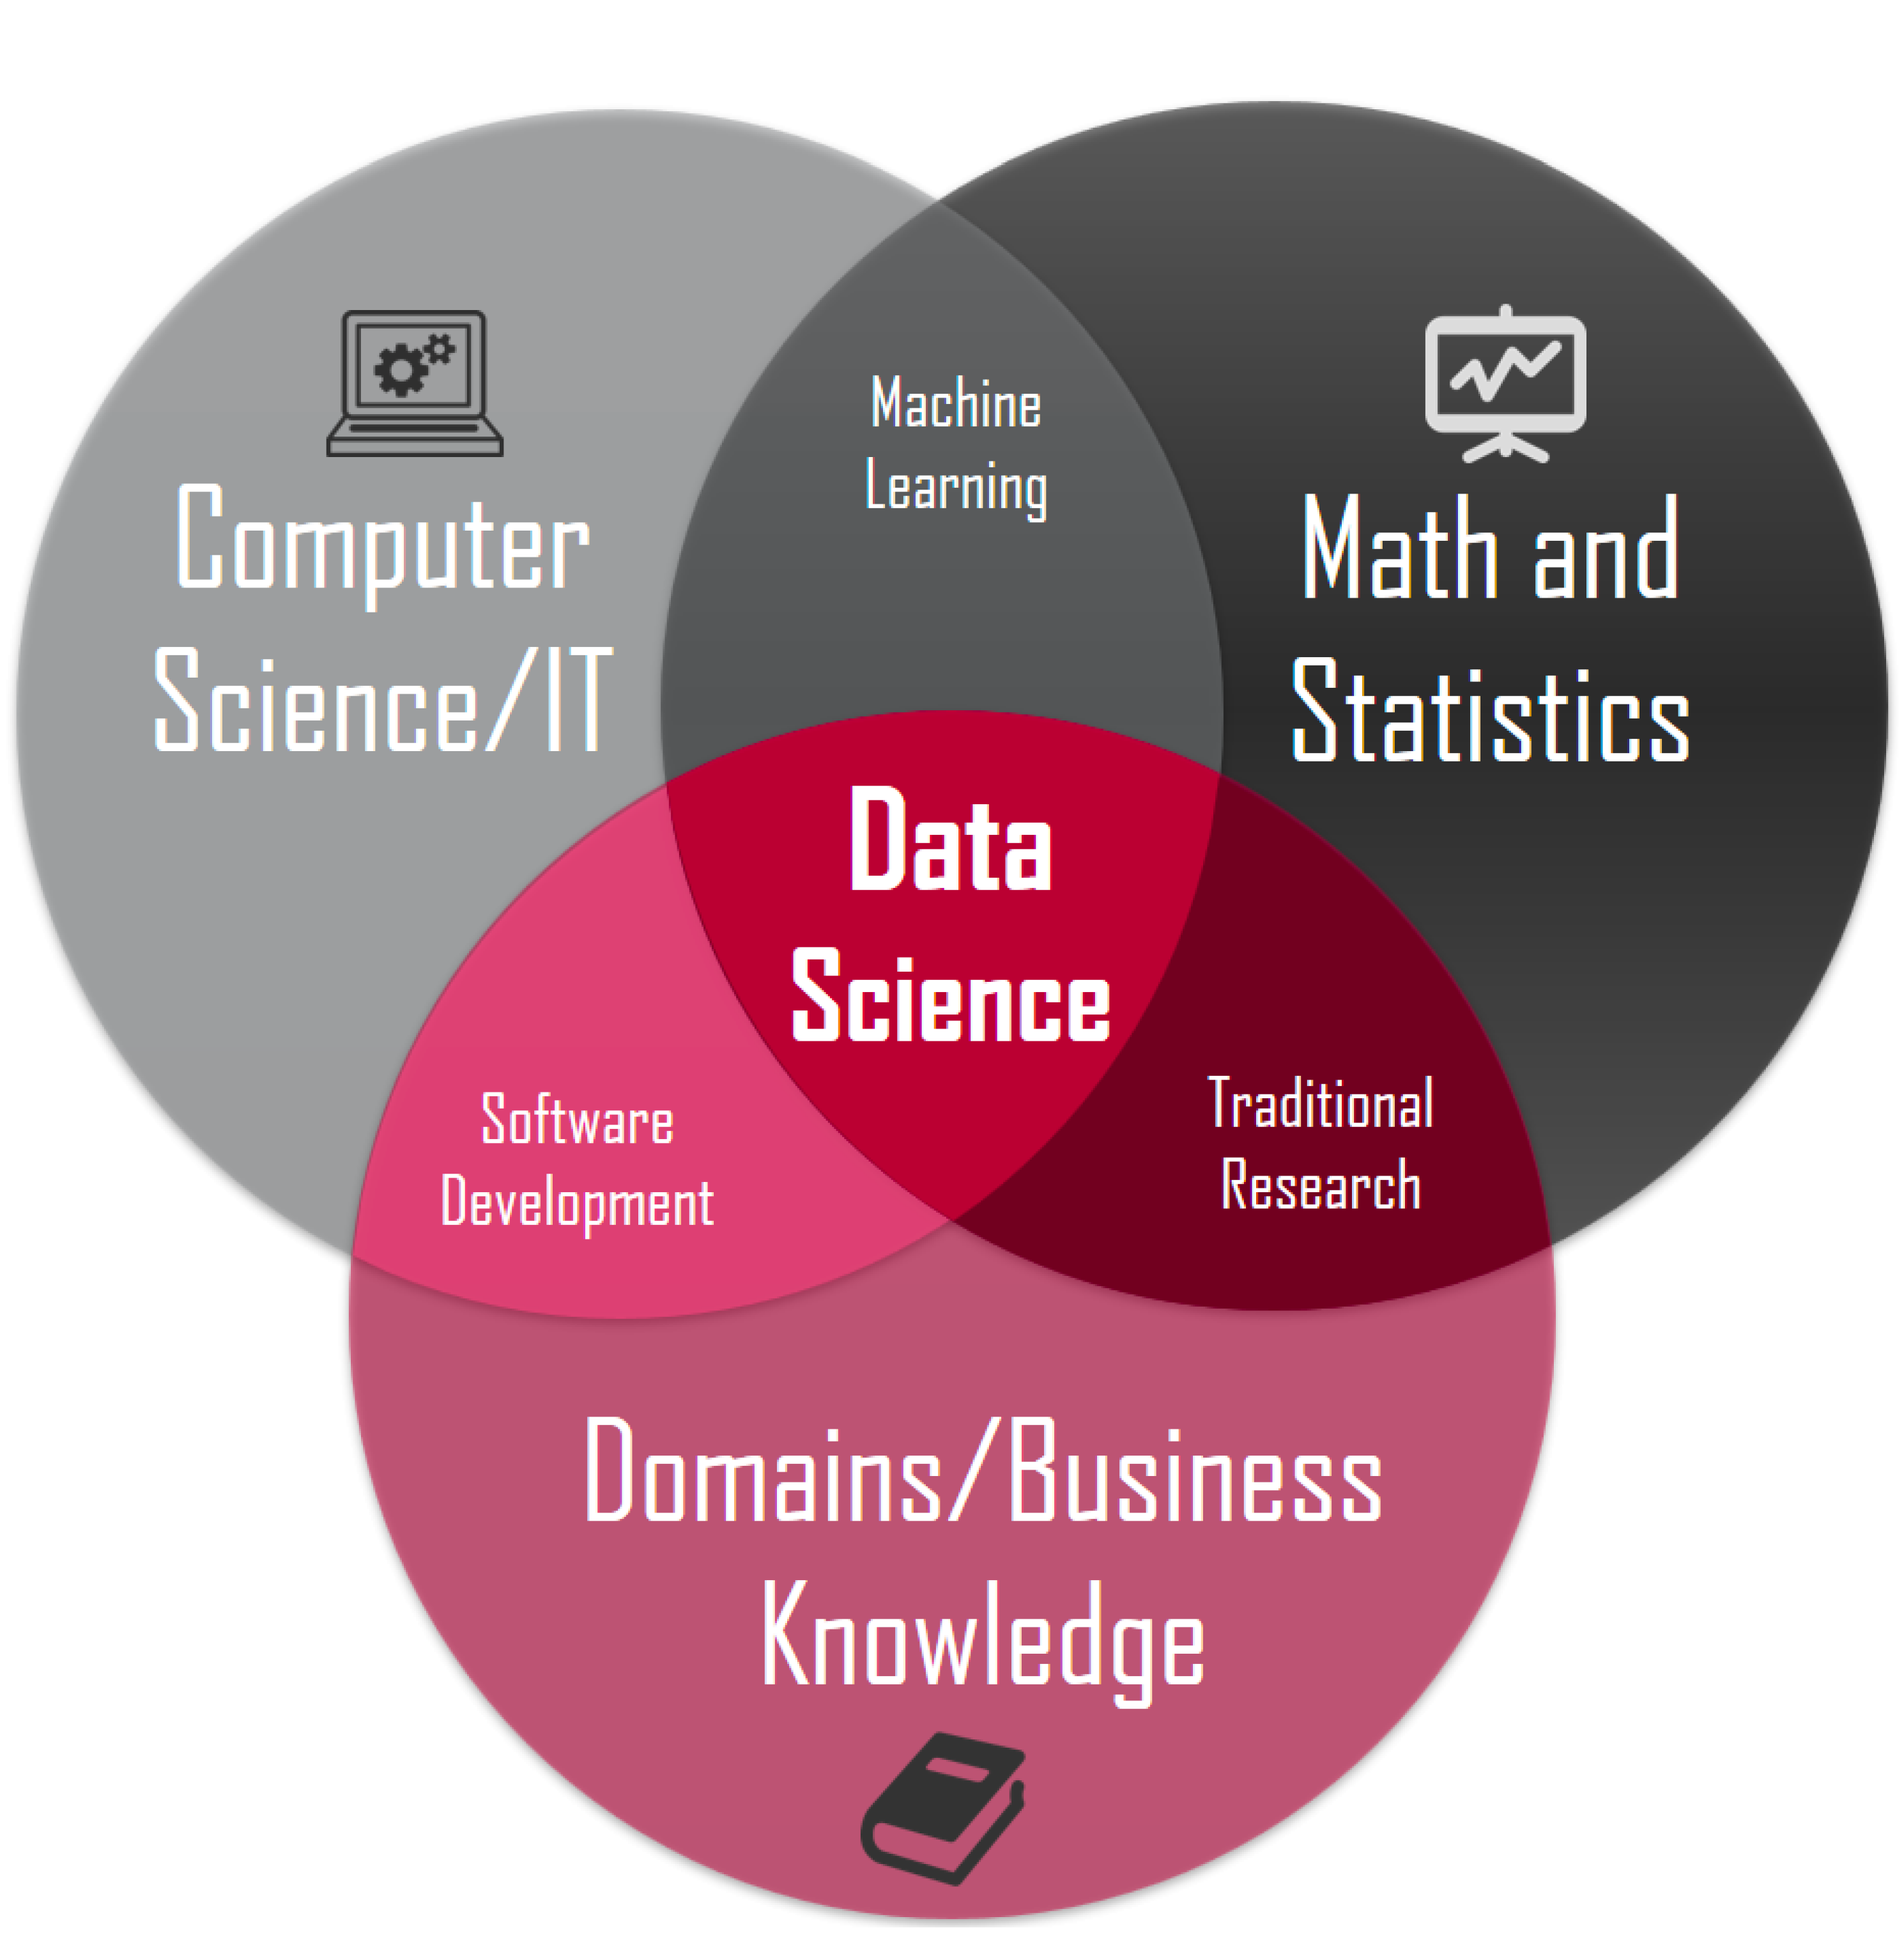
About Me
Python [numpy, pandas, seaborn, scikit-learn – advanced; tensorflow – intermediate; nltk, pyspark - basic]
Git - advanced
SQL - intermediate
Cluster computing (University Cluster – intermediate, Microsoft Azure - basic, AWS - basic)
B.Sc. in Applied Physics and Mathematics
Advanced Statistics, Econometrics and Machine Learning Coursework
Mathematical and statistical packages (Stata - advanced, Matlab - intermediate, R - basic)
PhD in Financial Economics (expected August 2019)
Internships in consumer goods analytics (Nielsen) and banking (RCI Bank)

Slide 11
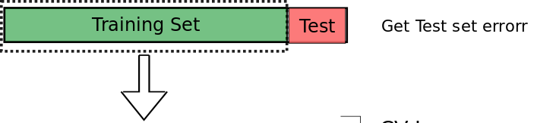
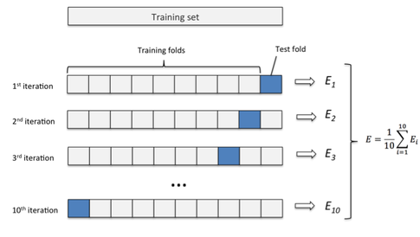

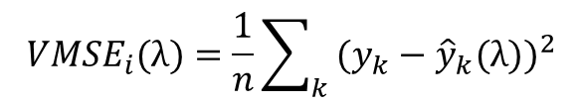
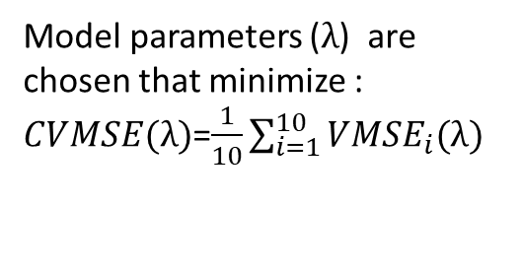
10-Fold Cross-Validation
414 months for training
Use the estimated model to predict future returns
30 months for testing
MSE on the test set as a measure of prediction accuracy
For each $λ:$
Validation
Model parameters ($λ$) are chosen that minimize :
$CVMSE(λ)$=$\frac{1}{10}\sum_{i=1}^{10}{{VMSE}_{i}(λ)}$
$${VMSE}_{i}(λ)=\frac{1}{n}\sum_{k}{{ (y_{k}−{\hat{y}}_{k}(λ))}^{2}}$$

Slide 12
Backup
Additional Slides

Slide 13
Conclusion
Machine learning techniques improve the prediction accuracy of stock market returns
Elastic Net shows the best predictive performance
Regression trees, random forest, xgboost have poor predictive performance

Slide 14
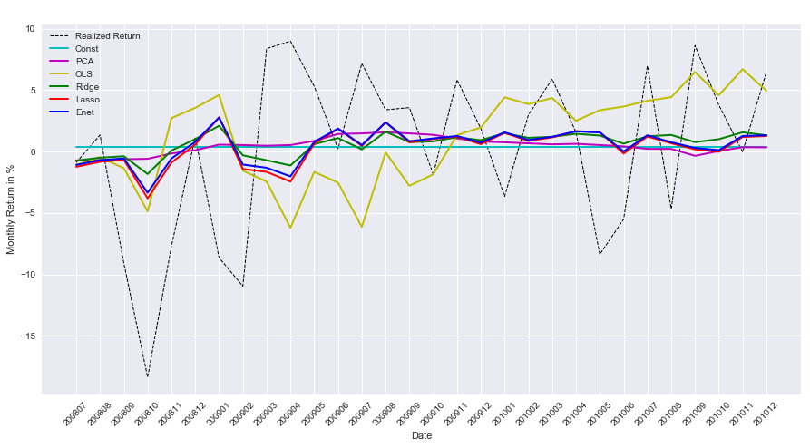
Prediction MSE
Model | Const | PCA | OLS | Ridge | Lasso | Enet
PMSE | 44.540 | 42.191 | 57.024 | 43.017 | 41.794 | 41.918

Slide 15
Caveats
Unstructured project (exploratory analysis)
Not a general framework that fits all types of models
No tests on statistical significance and improvements in prediction accuracy
10-fold cross-validation is not well-suited for time-series

Slide 16
Cross-Validation MSE
Train and Validation Mean Squared Errors
Model | Const | PCA | OLS | Ridge | Lasso | Enet
Avg. Train MSE | 19.396 | 19.131 | 16.659 | 16.729 | 18.340 | 18.325
Avg. Validate MSE | 19.428 | 19.479 | 21.022 | 20.720 | 19.382 | 19.382
Constant model (simple historical average) and a model with principal components as regressors show similar performance in the train and validation samples
OLS performs well in the train sample but has high MSE in the validation sample (overfitting)
Ridge improves slightly this pattern
Lasso and Enet signifcantly improve performance in the validation sample

Slide 17
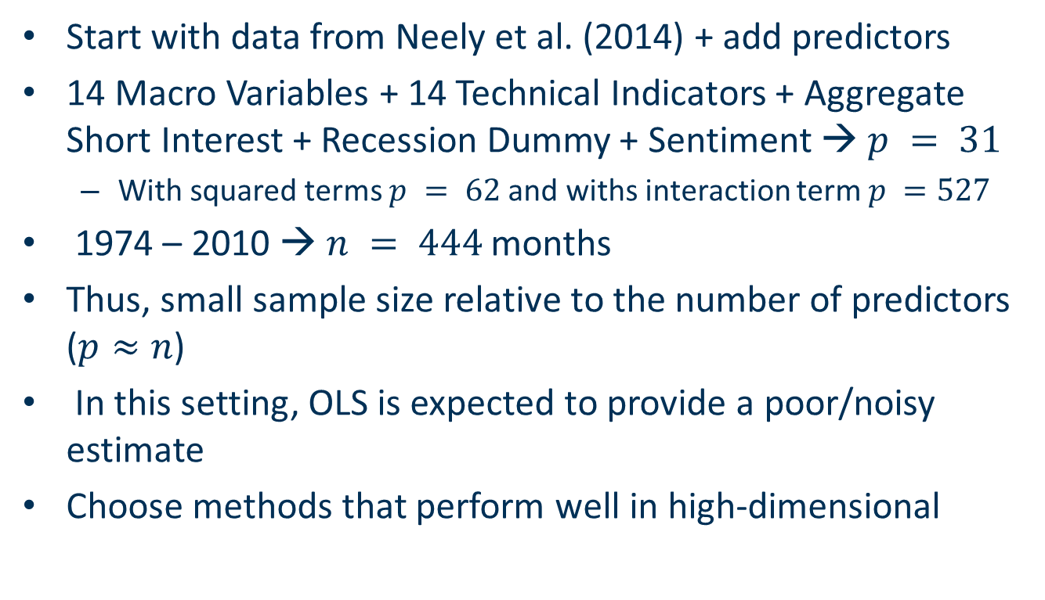
High Dimensional Setting
Start with data from Neely et al. (2014) + add predictors
14 Macro Variables + 14 Technical Indicators + Aggregate Short Interest + Recession Dummy + Sentiment → $p = 31$
With squared terms $p = 62$and withs interaction term $p =527$
1974 – 2010 → $n = 444$months
Thus, small sample size relative to the number of predictors ($p≈n$)
In this setting, OLS is expected to provide a poor/noisy estimate
Choose methods that perform well in high-dimensional

Slide 18
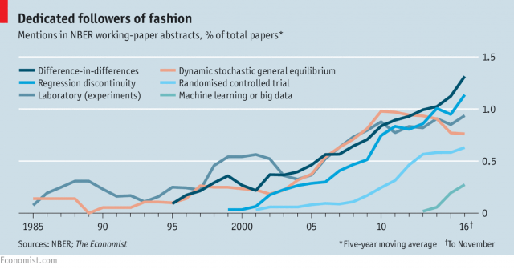
Recent Trend

Slide 19
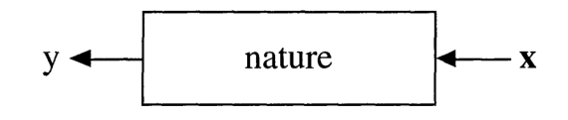
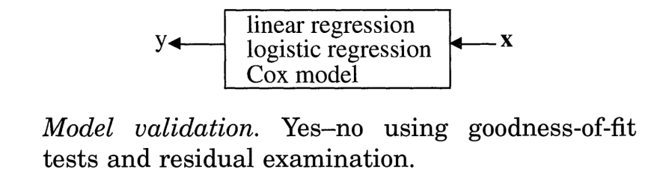
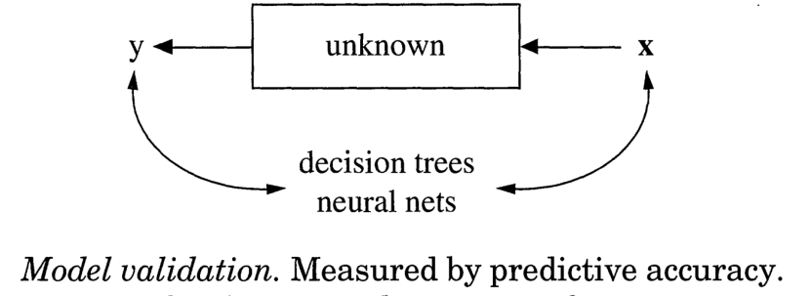

Different Modeling Cultures
Process:
Explanatory Modeling:
Predictive Modeling:
$$y=f\left(x\right)+ε$$

Slide 20
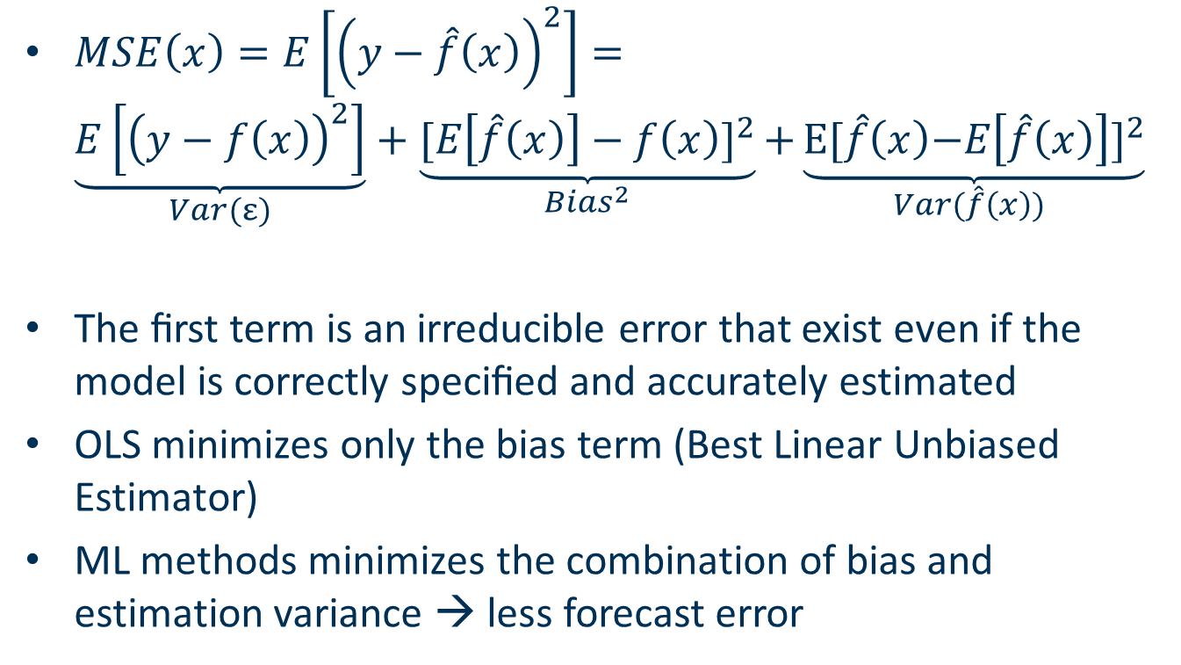
Predictive Modeling Bias-Variance Tradeoff
$MSE\left(x\right)=E\left[{\left(y−\hat{f}\left(x\right)\right)}^{2}\right]=$ $\underset{Var(ε)}{\underbrace{E\left[{\left(y−f\left(x\right)\right)}^{2}\right]}}+\underset{{Bias}^{2}}{\underbrace{{[E\left[\hat{f}\left(x\right)\right]−f\left(x\right)]}^{2}}}\text{+}\underset{Var(\hat{f}\left(x\right)) }{\underbrace{{\text{E}\text{[}\hat{f}\left(x\right)\text{−}E\left[\hat{f}\left(x\right)\right]\text{]}}^{2}}}$
The ﬁrst term is an irreducible error that exist even if the model is correctly speciﬁed and accurately estimated
OLS minimizes only the bias term (Best Linear Unbiased Estimator)
ML methods minimizes the combination of bias and estimation variance → less forecast error

Slide 21
Possible Future Research
More predictors
Weekly/daily data frequency
Advanced ML methods, such as Recurrent Neural Networks and ensemble of methods
International evidence

Slide 22
Predicting Stock Market
Welch, Ivo, and Amit Goyal, 2008, A Comprehensive Look at The Empirical Performance of Equity Premium Prediction, Review of Financial Studies 21, 1455–1508.
None of exisiting predictors are able to outperform the simple historical average benchmark
Rapach, David E., Jack K. Strauss, and Guofu Zhou, 2010, Out-of-sample equity premium prediction: Combination forecasts and links to the real economy, Review of Financial Studies 23, 821–862.
Models combining many individual variables together yield superior predictive performance and outperform the benchmark.
Neely, Christopher J., David E. Rapach, Jun Tu, and Guofu Zhou, 2014, Forecasting the Equity Risk Premium: The Role of Technical Indicators, Management Science 60, 1772–1791.
Technical indicators contain complementary information to macroeconomic variables
Numerous papers with new predictors [Kelly and Jiang (2014), Møller and Rangvid (2015), Huang and Kilic (2016),Rapach, Ringgenberg, and Zhou (2016), Atanasov (2018)]

Slide 23
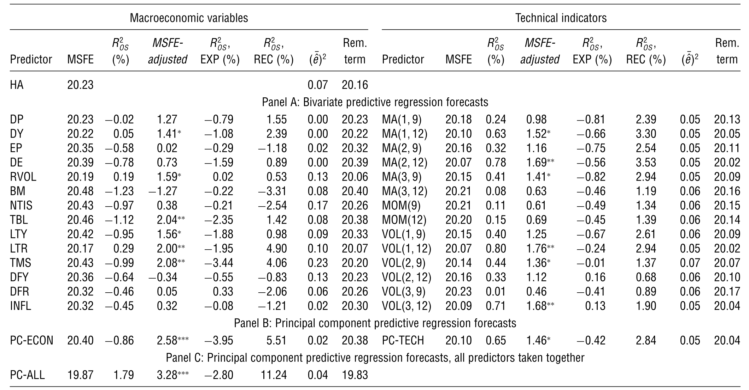
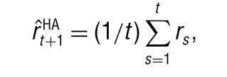


Neely et al. (2014)

Slide 24
Explanatory vs Predictive Modeling
Breiman, Leo, 2001, Statistical Modeling: The Two Cultures, Statistical Science 16, 199–231.
Shmueli, Galit, 2010, To Explain or to Predict?, Statistical Science 25, 289–310.
Kleinberg, Jon, Jens Ludwig, Sendhil Mullainathan, and Ziad Obermeyer, 2015, Prediction Policy Problems, American Economic Review 105, 491–495.
Mullainathan, Sendhil, and Jann Spiess, 2017, Machine Learning: An Applied Econometric Approach, Journal of Economic Perspectives, 31, 87–106.

Slide 25
ML Methods for Explanatory Modeling (Inference)
Belloni, A., Chen, D., Chernozhukov, V., and C. Hansen (2012). „Sparse Models and Methods for Optimal Instruments with Application to Eminent Domain“. Econometrica 80(6), 2269-2429
Belloni, A., Chernozhukov, V., Fernandez-Val, I., and C. Hansen (2017). „Program Evaluation and Causal Inference with High-Dimensional Data“. Econometrica 85(1), 233-298
Belloni, A., Chernozhukov, V., and C. Hansen (2014). „Inference on Treatment Effects after Selection among High-Dimensional Controls“. Review of Economic Studies 81, 608-650
Chernozhukov, V., Chetverikov, D., Demirer, M., Duflo, E., Hansen, C., Newey, W., and J. Robins (2018). „Double/Debiased Machine Learning for Treatment and Structural Parameters“. Econometrics Journal 21, 1-68
Wager, S., and S. Athey (2018). „Estimation and Inference of Heterogeneous Treatment Effects using Random Forests“. Journal of the American Statistical Association, 1-15

Slide 26
ML Methods in Finance
Chinco, A., Clark-Joseph, A. D., and M. Ye.„Sparse Signals in the Cross-Section of Returns“. Journal of Finance (forthcoming)
Freyberger, Joachim, Andreas Neuhierl, and Michael Weber, 2017, Dissecting Characteristics Nonparametrically. (R&R Review of Financial Studies)
Moritz, Benjamin, and Tom Zimmermann, 2016, Tree-Based Conditional Portfolio Sorts: The Relation between Past and Future Stock Returns, Ssrn.(R&R Review of Financial Studies)
Feng, Guanhao, and Stefano Giglio, 2017, Taming the Factor Zoo, SSRN Electronic Journal, 1–69. (Under Revision)
Brogaard, Jonathan, and Abalfazl Zareei, 2018, Machine Learning and the Stock Market, SSRN Electronic Journal, 1–57.
Chinco, Alex, Andreas Neuhierl, and Michael Weber, 2018, Estimating the Anomaly Baserate, , 1–30.
Gu, Shihao, Bryan T. Kelly, and Dacheng Xiu, 2018, Empirical Asset Pricing via Machine Learning, Ssrn.
Kozak, Serhiy, Stefan Nagel, and Shrihari Santosh, 2017, Shrinking the Cross Section, Ssrn, 1–69.
Han, Yufeng, Ai He, David E Rapach, and Guofu Zhou, 2018, What Firm Characteristics Drive US Stock Returns?, Baruch CUNY.

Slide 27
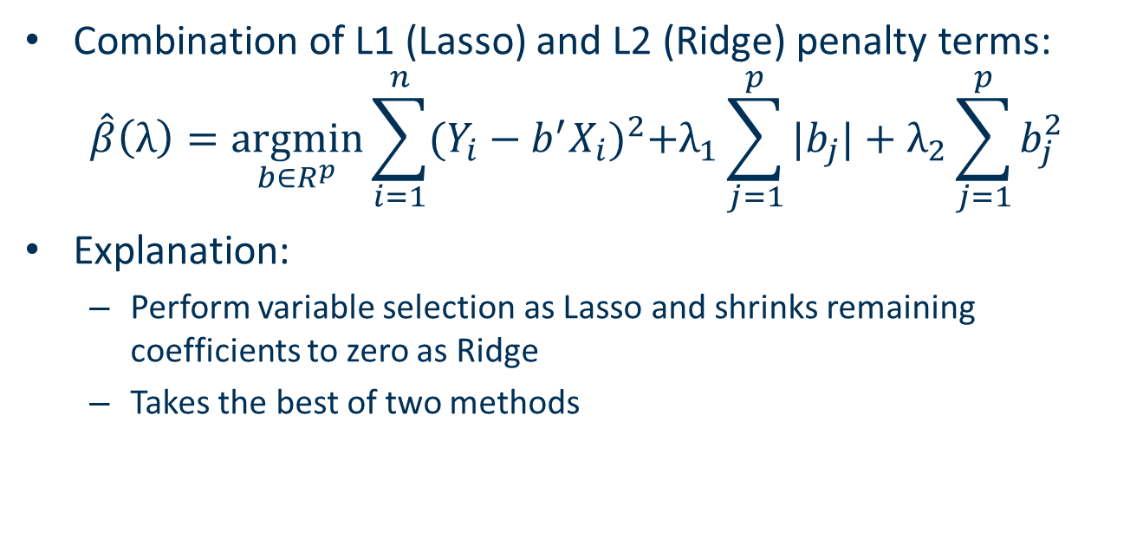
Elastic Net
Combination of L1 (Lasso) and L2 (Ridge) penalty terms:
$$\hat{β}\left(λ\right)=\underset{b∈R^{p}}{argmin}{\sum_{i=1}^{n}{{(Y_{i}−b^{′}X_{i})}^{2}+λ_{1}\sum_{j=1}^{p}{|b_{j}|}+λ_{2}\sum_{j=1}^{p}{b_{j}^{2}}}}$$
Explanation:
Perform variable selection as Lasso and shrinks remaining coefficients to zero as Ridge
Takes the best of two methods

Slide 28
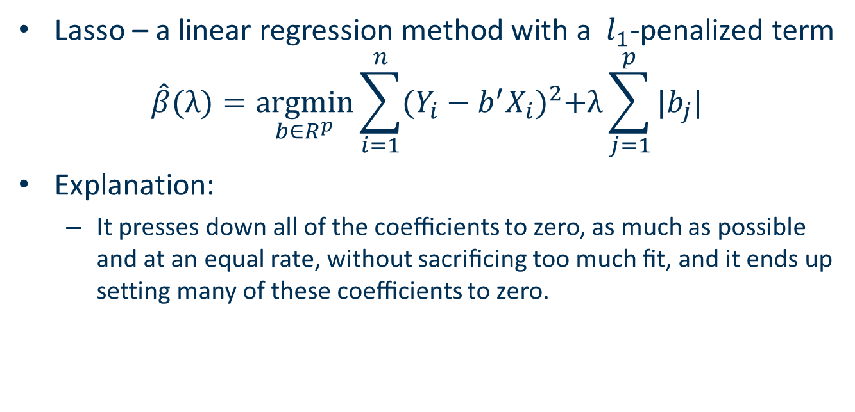
Lasso
Lasso – a linear regression method with a $l_{1}$-penalized term
$$\hat{β}(λ){=\underset{b∈R^{p}}{argmin}\sum_{i=1}^{n}{{(Y_{i}−b^{′}X_{i})}^{2}+λ\sum_{j=1}^{p}{|b_{j}|}}}$$
Explanation:
It presses down all of the coeﬃcients to zero, as much as possible and at an equal rate, without sacriﬁcing too much ﬁt, and it ends up setting many of these coeﬃcients to zero.
Pavel Lesnevski
06.12.2018

Slide 29
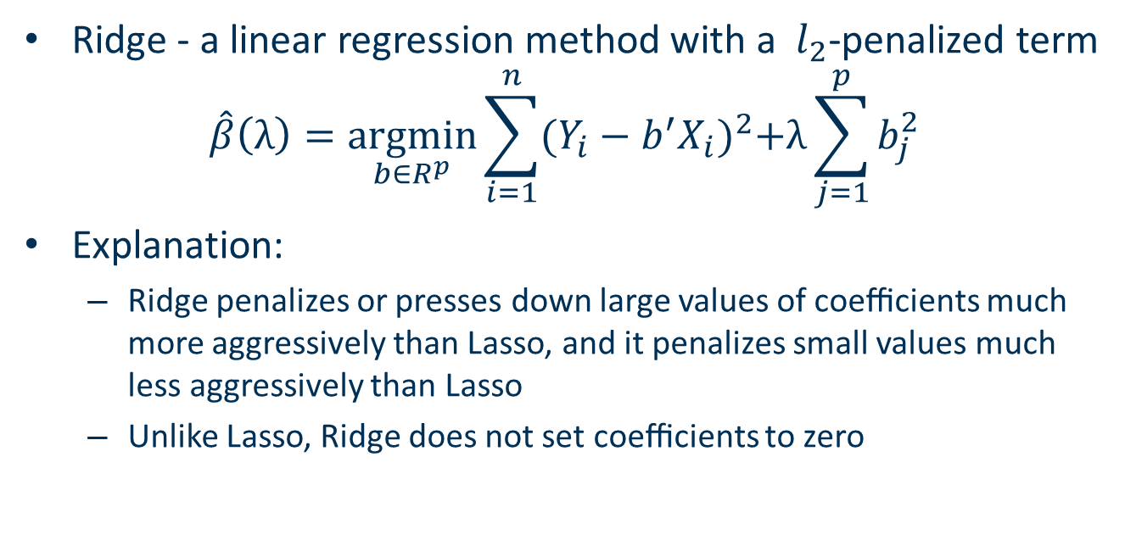
Ridge
Ridge - a linear regression method with a $l_{2}$-penalized term
$$\hat{β}\left(λ\right)=\underset{b∈R^{p}}{argmin}{\sum_{i=1}^{n}{{(Y_{i}−b^{′}X_{i})}^{2}+λ\sum_{j=1}^{p}{b_{j}^{2}}}}$$
Explanation:
Ridge penalizes or presses down large values of coeﬃcients much more aggressively than Lasso, and it penalizes small values much less aggressively than Lasso
Unlike Lasso, Ridge does not set coeﬃcients to zero

Slide 30
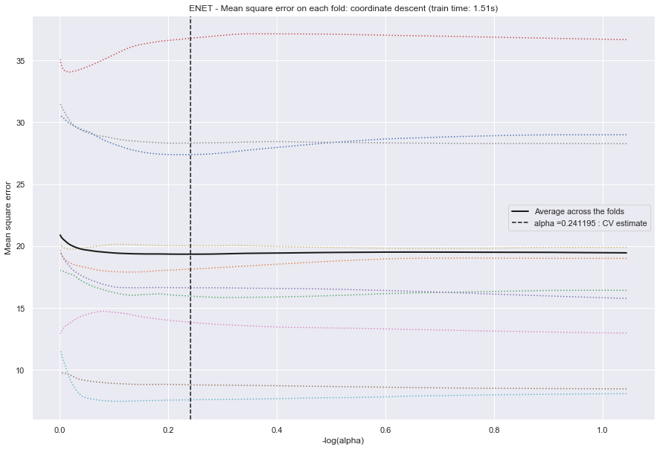
Cross-Validation Result for Enet

Slide 31
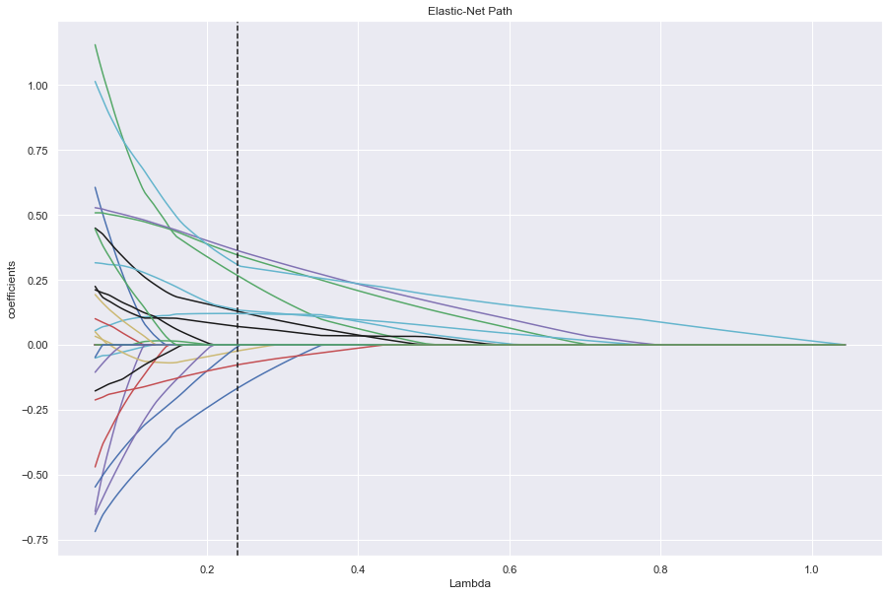
Path for Elastic Net

Slide 32
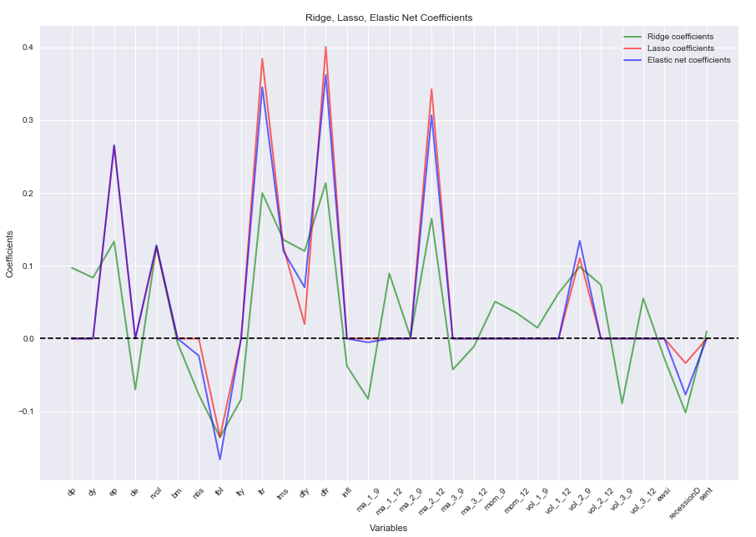
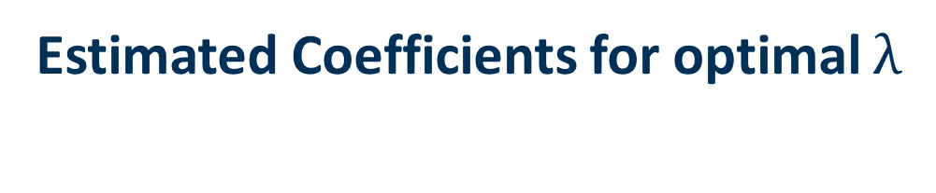
Estimated Coefficients for optimal $λ$

