Slide 1
COMP 20180 Introduction to Operating Systems
1. Basics of low-level ("bare metal") computer programming.
Part 3: Direct Memory Access and Block Storage
UCD School of Computer Science. Scoil na Ríomheolaíochta UCD.

Slide 2
Direct Memory Access (DMA)

Slide 3
What is Direct Memory Access?
In traditional programmed I/O, the CPU handles every byte of data transfer between peripherals and memory.
Direct Memory Access (DMA) allows peripherals to transfer data directly to/from memory without CPU involvement for each byte.
The CPU initiates the transfer by programming the DMA controller, then the hardware handles the actual data movement.
When transfer completes, the DMA controller signals the CPU (typically via interrupt or status flag).

Slide 4
Why Use DMA?
CPU Efficiency
CPU can execute other instructions while data transfers in background
Higher Throughput
Dedicated hardware can transfer data faster than software loops
Lower Latency
No CPU instruction fetch/decode overhead per byte transferred
Essential for high-bandwidth devices: disk controllers, network interfaces, graphics cards

Slide 5
DMA vs Programmed I/O
Programmed I/O (without DMA):
1. CPU reads byte from device register
2. CPU writes byte to memory
3. Repeat for EVERY byte - CPU is 100% busy
DMA-based Transfer:
1. CPU sets up transfer: source, destination, count
2. DMA controller requests the bus
3. Hardware transfers all bytes automatically
4. CPU is FREE to do other work during transfer

Slide 6
Block Storage

Slide 7
History: Why Block Devices Exist
The IBM 350 RAMAC (1956) - First Hard Disk Drive:
50 platters, 24 inches each, stored 3.75 MB, weighed over 1 ton
Physical constraints of magnetic recording:
  Data is stored in concentric tracks on spinning platters
  Read/write head passes over sectors continuously
  Cannot stop mid-sector - must read/write complete sector
Each sector contains: preamble + 512 bytes data + ECC/CRC + gap
The 512-byte sector size has persisted for nearly 70 years!

Slide 8
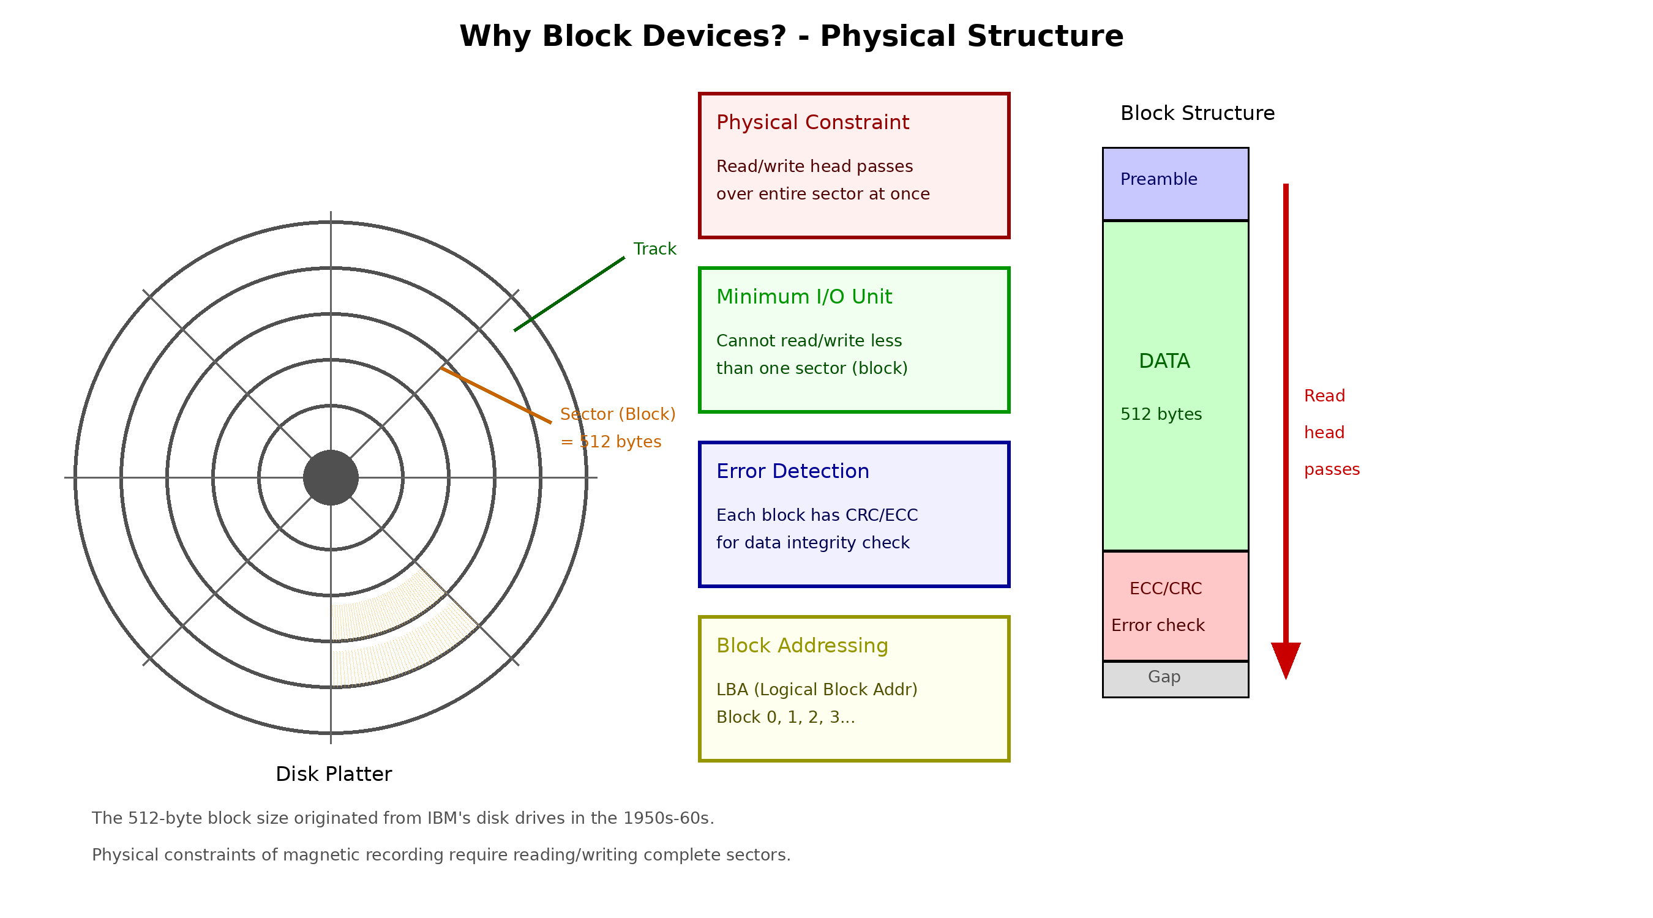
Why Block Devices? Physical Structure

Slide 9
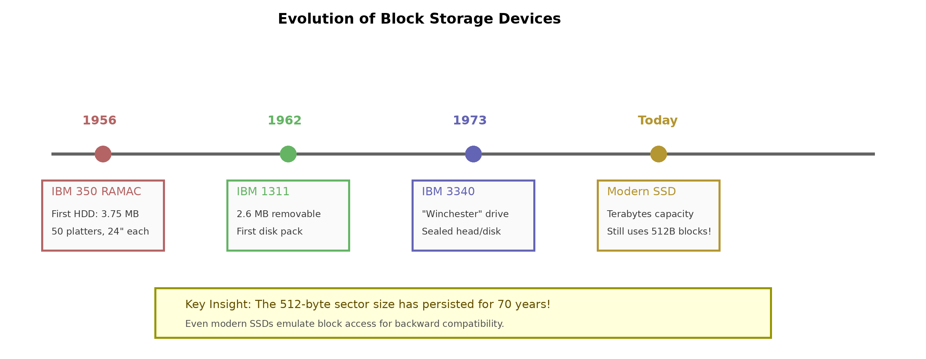
Evolution of Block Storage

Slide 10
Block Storage Basics
Block storage devices organize data into fixed-size chunks called blocks (also known as sectors).
Standard block size is 512 bytes (traditional disk sector size).
Data is read/written in whole blocks - cannot access individual bytes directly.
Block addressing: blocks numbered 0, 1, 2, ... (512 bytes each).
Examples: hard drives, SSDs, USB flash drives, SD cards

Slide 11
BlockStorage Component in Logisim

Slide 12
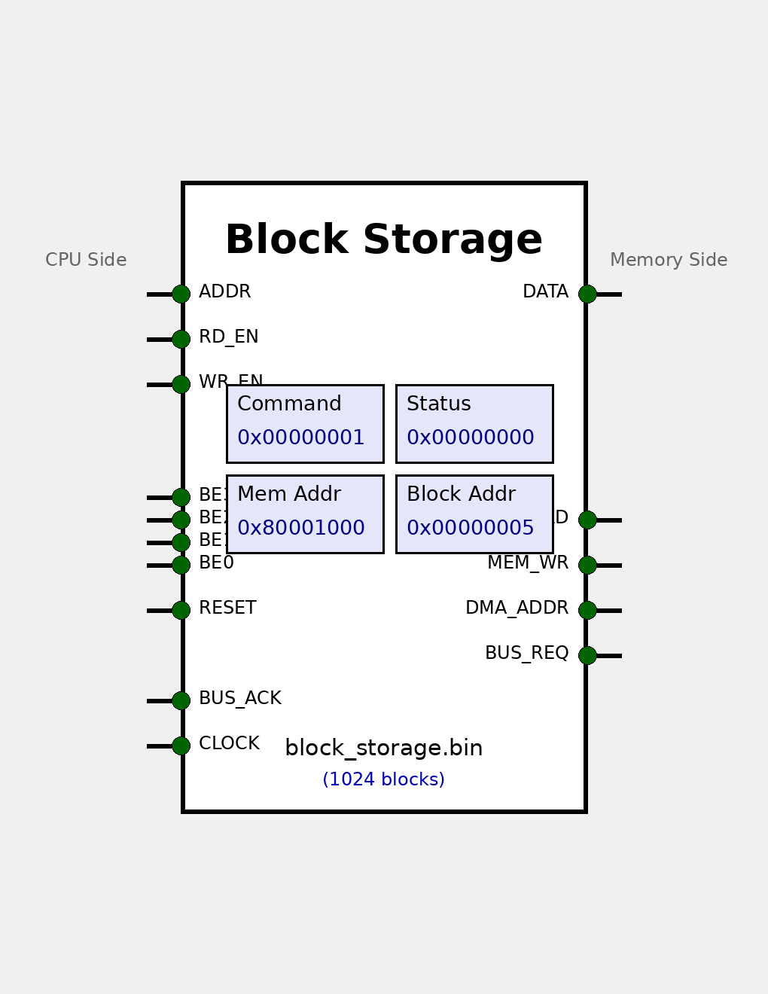
BlockStorage Component

Slide 13
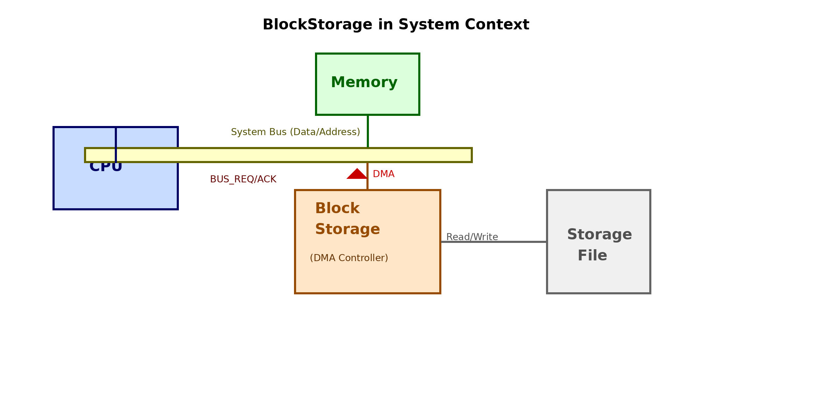
BlockStorage in System Context

Slide 14
BlockStorage Port Interface
CPU Side (Left):
  ADDR (3-bit) - Register address select
  READ_ENABLE, WRITE_ENABLE - Register access control
  CLOCK, RESET - System signals
  BUS_ACK (input) - Bus granted acknowledgement
Memory Side (Right):
  DATA (32-bit bidirectional) - Data bus
  DMA_ADDR (32-bit output) - Memory address during DMA
  MEM_READ, MEM_WRITE - Memory control signals
  BUS_REQUEST (output) - Request bus control for DMA

Slide 15
Register Map
Offset | Name | R/W | Description
0x00 | COMMAND | R/W | 0=NOP, 1=Read, 2=Write
0x04 | MEM_ADDR | R/W | Memory address for DMA
0x08 | BLOCK_ADDR | R/W | Block number on device
0x0C | STATUS | R | Bit 0: BUSY, Bit 1: ERROR
0x10 | RESULT | R | Error code (0 = success)
CPU writes to COMMAND register to initiate transfers. Poll STATUS to check completion.

Slide 16
DMA State Machine
The BlockStorage controller implements a 5-state DMA state machine:
IDLE - Normal operation, CPU controls the bus
BUS_REQUEST_READING - Requesting bus for read DMA
BUS_REQUEST_WRITING - Requesting bus for write DMA
READING - Transferring data: device buffer → memory
WRITING - Transferring data: memory → device buffer

Slide 17
Read Block Operation
To read a 512-byte block from storage to memory:
1. CPU writes destination address to MEM_ADDR
2. CPU writes block number to BLOCK_ADDR
3. CPU writes 1 (CMD_READ_BLOCK) to COMMAND
4. Controller loads block from file into buffer
5. Controller asserts BUS_REQUEST, waits for BUS_ACK
6. Controller writes 128 words (512 bytes) to memory
7. STATUS.BUSY cleared - transfer complete

Slide 18
Write Block Operation
To write a 512-byte block from memory to storage:
1. CPU writes source address to MEM_ADDR
2. CPU writes block number to BLOCK_ADDR
3. CPU writes 2 (CMD_WRITE_BLOCK) to COMMAND
4. Controller asserts BUS_REQUEST, waits for BUS_ACK
5. Controller reads 128 words (512 bytes) from memory
6. Controller writes buffer to file at block address
7. STATUS.BUSY cleared - transfer complete

Slide 19
Bus Arbitration
During DMA, the BlockStorage controller must take control of the bus.
The bus arbitration protocol:
1. Controller asserts BUS_REQUEST signal
2. Bus arbiter sees request, tells CPU to release bus
3. Arbiter asserts BUS_ACK when bus is available
4. Controller takes control of DATA, DMA_ADDR, etc.
5. When done, controller releases BUS_REQUEST
This ensures CPU and DMA controller never drive the bus simultaneously.

Slide 20
Summary
DMA
allows peripherals to transfer data directly to/from memory, freeing the CPU.
Block storage
originated from physical constraints of magnetic disks (1956).
512-byte blocks
remain the standard due to backward compatibility.
The BlockStorage component provides:
  Register-based control (5 registers)
  DMA state machine for transfers
  Bus arbitration via REQUEST/ACK protocol
Understanding DMA and block storage is essential for OS development.

