Slide 1
Example: Simple Unix-like Filesystem
A practical implementation using BlockStorage

Slide 2
Simple FS Overview
A minimal Unix-like filesystem built on top of BlockStorage:
Block-based storage
  512-byte blocks, up to 1024 blocks (512 KB total)
Inode-based file metadata
  32 inodes, each with 26 direct block pointers
Hierarchical directories
  Directories are files containing directory entries
Block bitmap for free space management
  Tracks which blocks are allocated/free

Slide 3
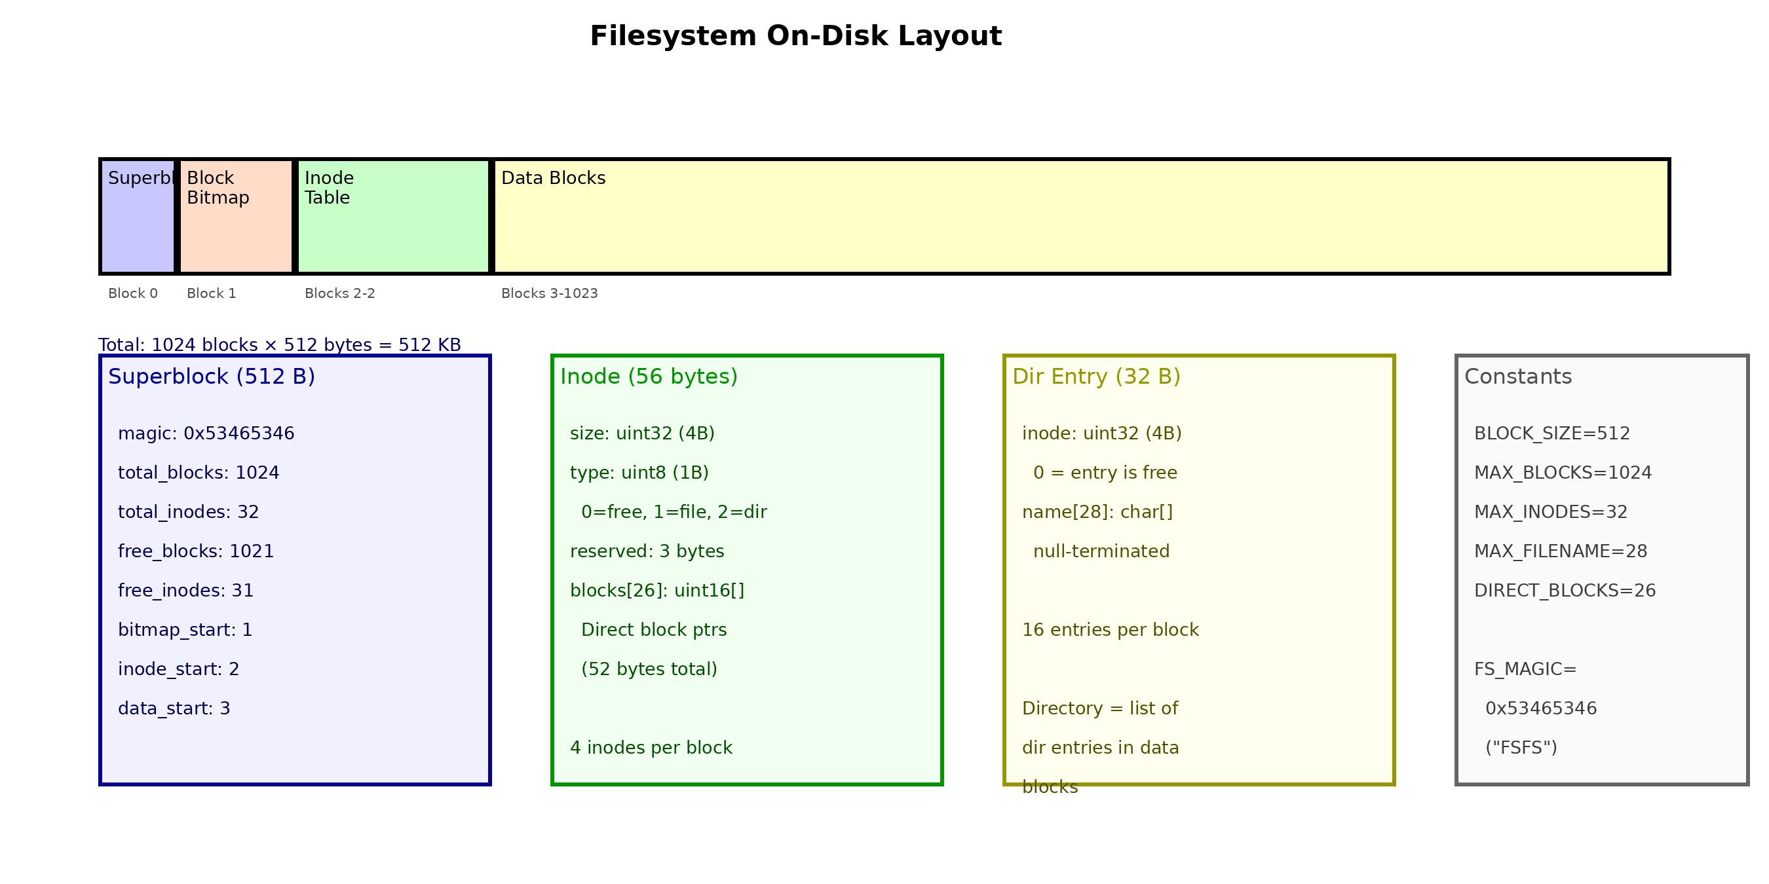
On-Disk Layout

Slide 4
Superblock Structure
The superblock (block 0) contains filesystem metadata:
magic = 0x53465346 ("FSFS") - identifies valid filesystem
total_blocks = 1024 - total blocks on device
total_inodes = 32 - maximum number of files/directories
free_blocks - currently available data blocks
free_inodes - currently available inodes
bitmap_start = 1 - first block of allocation bitmap
inode_start = 2 - first block of inode table
data_start = 3 - first data block for files/directories

Slide 5
Inode Structure
Each inode (56 bytes) stores file/directory metadata:
size (4 bytes) - file size in bytes
type (1 byte) - 0=free, 1=file, 2=directory
blocks[26] (52 bytes) - direct block pointers (uint16)
Maximum file size: 26 blocks × 512 bytes = 13 KB
4 inodes fit in one 512-byte block (56 × 4 = 224 + padding)

Slide 6
Directory Entries
Directories are files containing an array of directory entries:
Each entry (32 bytes):
inode (4 bytes) - inode number (0 = entry is free)
name[28] (28 bytes) - null-terminated filename
16 entries per 512-byte block
To find a file: scan directory entries for matching name
Root directory is always inode 0
No "." or ".." entries in this simple implementation

Slide 7
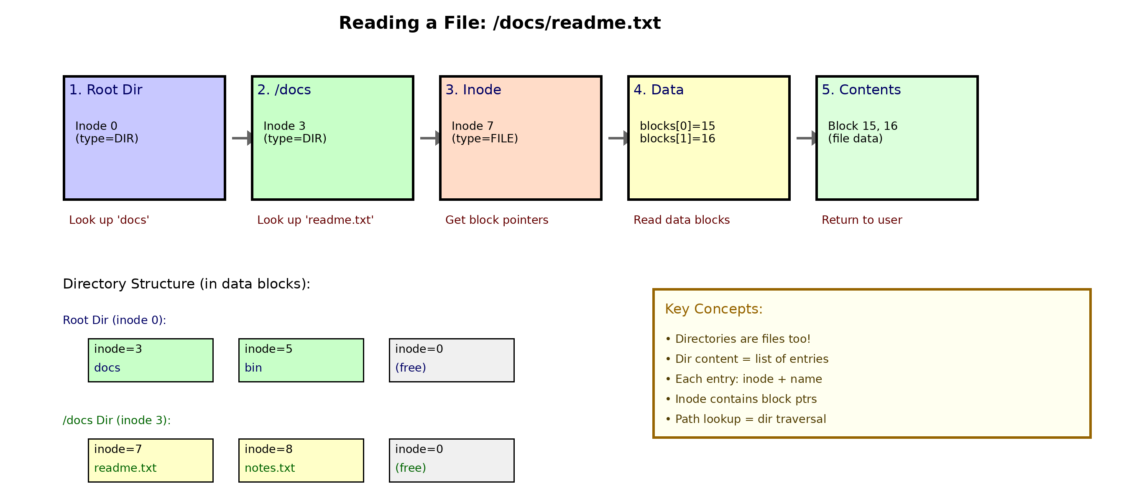
Path Resolution: Reading /docs/readme.txt

Slide 8
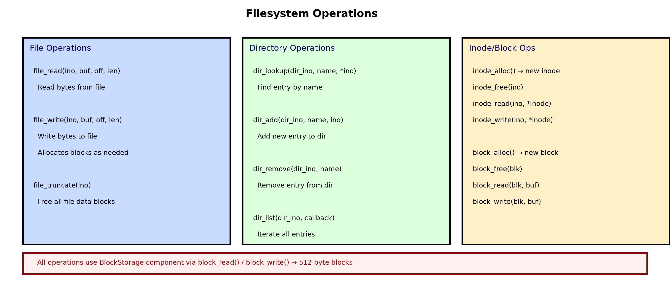
Filesystem Operations

Slide 9
Block Allocation
Free space is tracked using a bitmap (1 bit per block):
block_alloc()
  1. Scan bitmap for first 0 bit
  2. Set bit to 1 (mark as used)
  3. Decrement sb.free_blocks
  4. Return block number
block_free(block_num)
  1. Clear bit to 0 (mark as free)
  2. Increment sb.free_blocks
With 1024 blocks, bitmap fits in 1 block (1024 bits = 128 bytes)

Slide 10
Code: Formatting the Filesystem
int fs_format(uint32_t total_blocks) {
// Calculate layout
uint32_t bitmap_blks = (total_blocks+4095)/4096;
uint32_t inode_blks = (MAX_INODES*56+511)/512;
uint32_t data_start = 1 + bitmap_blks + inode_blks;
// Initialize superblock
sb.magic = 0x53465346; // "FSFS"
sb.total_blocks = total_blocks;
sb.bitmap_start = 1;
sb.inode_start = 1 + bitmap_blks;
sb.data_start = data_start;
// Create root directory (inode 0) ...
}

Slide 11
Integration with BlockStorage
The filesystem uses BlockStorage for all disk I/O:
block_read(block_num, buffer)
  Sets BLOCK_ADDR register, issues READ command
  DMA transfers 512 bytes to memory buffer
block_write(block_num, buffer)
  Sets BLOCK_ADDR register, issues WRITE command
  DMA transfers 512 bytes from memory to storage
The filesystem layer translates file operations into block operations.
Example: Reading byte 1000 of a file requires:
  1. Look up inode, 2. Find block pointer for offset 1000÷512=1
  3. Read that block, 4. Return byte at offset 1000%512=488

Slide 12
Simple FS Summary
Key design decisions:
Fixed-size structures - simple but limited (32 files max)
Direct block pointers only - no indirect blocks (13 KB max file)
Bitmap allocation - O(n) allocation, but simple
Directories as files - unified model, linear search
This implementation demonstrates the core concepts used in real
filesystems like ext2/ext3/ext4, just with smaller limits.

