Slide 1
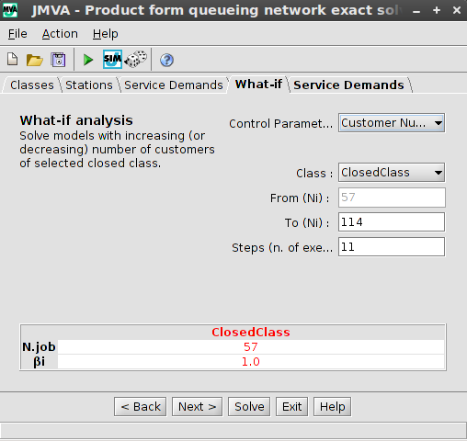
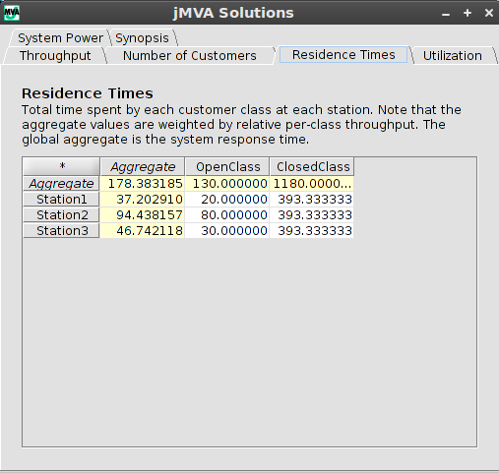
<number>
How to use JMVA
Choose JMVA in JMT main window
Defining a model of queuing network
Select New command from File menu
Define parameters (Classes, Stations, Service demands) using tabs in Wizard interface (What-if Tab is used to perform a what-if analysis)
The model can be loaded from exist file through File menu or save into a .jmva file
Solving model
Using Solve command to solve the model
Performance (Throughput, Queue lengths, Residence Times, Utilizations, Synopsis) will be shown on a separate window
Defining model
Solution

