Slide 1

475 - Advanced Topics in Software Engineering
Coursework #1 - Comprehension
Autumn term - 2011
Antonio Azevedo (ajf211)
Alexandros Panteli (ap4111)
Yu Liu (yl12510)
Zhicong Liu (zl411)
Martin Rouaux (mr2111)

Slide 2
Understanding the codebase
Reading available documentation (Users manual, Chapter 2; System manual).
Importing the codebase into Eclipse, compile it and run some of the included examples.
Run automated documentation tools (Doxygen).
Run automated dependency analysis tools (JDepend, Xdepend, Google CodePro, Structure 101).
Reverse engineer to obtain some UML diagrams (Enterprise Architect).
Explore the codebase, match features on the UI to classes to identify JMVA-specific code.
Validate manual findings and assumptions with output from automated tools and some unit tests.
Write CRC cards for some of the main classes in the JMVA application.
At first, code appeared very disorganized, hard to see any structure.
Notes:
The code appeared initially as an absolute mess…”big ball of mud” in CodePro tools. The packages names’ did not match the name of the application so it was impossible to establish a one-to-one mapping between packages and applications. We had to start by looking at the whole thing.
We only managed to come to useful conclusions when we ran the application and observed the actual flow and classes/objects involved when execution each function.

Slide 3
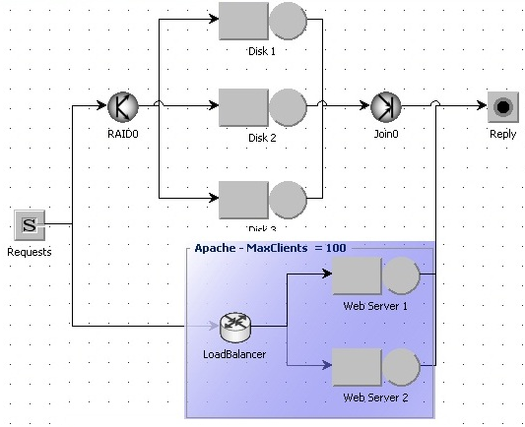
What does JMVA do?
Analysis of queuing networks using Mean Value Algorithm.
The network is defined by classes, stations and service times.
Can perform what-if (sensitivity) analysis by means of a specified control parameter its and range.
The analysis will yield measures of network performance in terms of throughput, utilization, response time, etc. Results are presented in text or graphical form.
Screenshot taken from JMT - JSIMGraph
Notes:
What are service demands -> verbal. Service demand is the product between service time and number of visits.
The queuing network is defined in terms of classes (customer types), stations (service nodes),and service demands (or service times and visits) Service demands define connections: classes ↔ stations

Slide 4
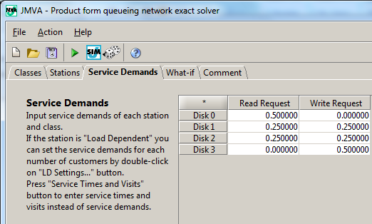
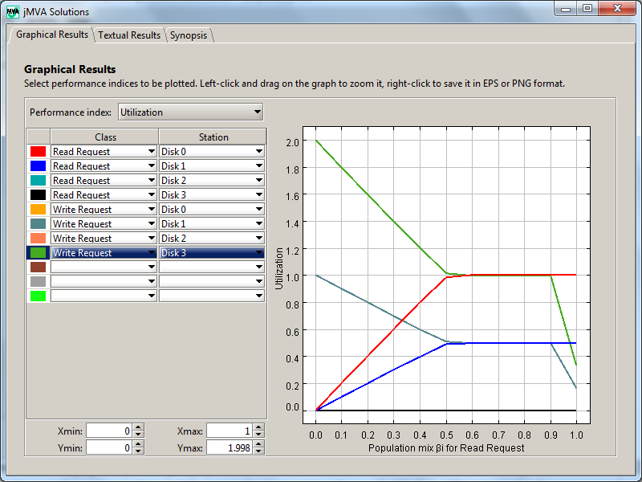
How to use JMVA?
JMT main window → JMVA
The GUI allows the user to create a model of a queuing network.
By entering parameters for classes, stations and service demands.
Model parameters are grouped in 5-6 tabs .
Service times and visits can be randomized from the action menu.
The model can be saved into a .jvma file (XML) or loaded from supported file types through the “File” menu.
After the model is set up, it can be solved via the “Action” menu.
Screenshots taken from JMT - JMVA
Notes:
From the main JMT window, you can click a button that takes you to the JMVA application.
Explain the different options on the screenshot referring to the toolbar. Mention that the same options are available from the Action menu.
Type of classes: open with infinite number of customers and lambda arrival rate, closed is finite number of customers.
Service stations: load dependent (you have to provide an expression that defines service demands in terms of number of customers), load independent (no effect by number of customers) and delay server.
Service Time/Visits – Service Demands: define connections from classes to stations.
What-If Analysis: choose which parameters of the model should be changed and run sensitivity analysis.
Results: you can plot network throughput, delays, utilization, residence times, etc. Results can be presented graphically or in text.

Slide 5
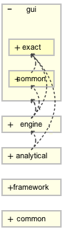
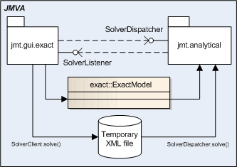
Structure - Dependencies
jmt.gui.exact: most of the UI and the network model.
jmt.gui.common: reusable GUI components.
jmt.engine: simulation engine for the JMT apps.
jmt.analytical: MVA algorithm and solution engine.
jmt.framework.xml: XML utility/helper class.
jmt.framework.gui: base classes for GUI comps.
jmt.common: settings, exceptions, XML, XSLT, etc.
Communication GUI ↔ Solver:
Screenshot taken
from Structure 101
Notes:
Alex: I think the authors were going for a layered approach which is not shown in this figure.
Things to mention in this slide related to structure
How did we find out which packages are used by JMVA? Manual inspection of the code.
There are many dependencies, if you wanted to deploy JMVA as a stand-alone application, you would need all those dependencies. Some of these dependencies make sense and are correct because they usually deal with low-level abstractions (reusable GUI components, XML helper methods, etc). These things are appropriate for a layered structure. However, there are some dependencies that go against this idea…e.g.: jmt.analytical dependens on jmt.gui.exact because of the ExactModel class.
Upward dependencies are wrong!!
jmt.engine depends on jmt.gui.common because of jmt.engine.simDispatcher.Dispatcher_jMVAschema. This class is importing jmt.gui.common.definitions.*.
jmt.analytical depends on jmt.gui.exact. This is because of ExactModel which is defined in the GUI package. It shouldn’t be defined there.
jmt.analytical depends on jmt.engine because of jmt.engine.math.Printer and jmt.engine.math.Erlang. This is bad because the MVA solver has to be deployed with the actual simulation engine which is in fact used by the other applications in the JMT suite.

Slide 6
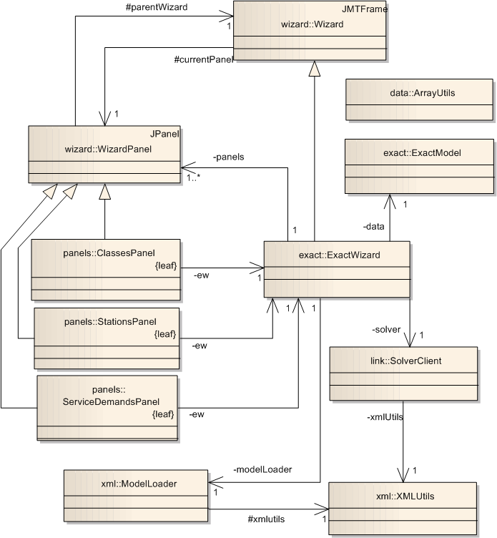
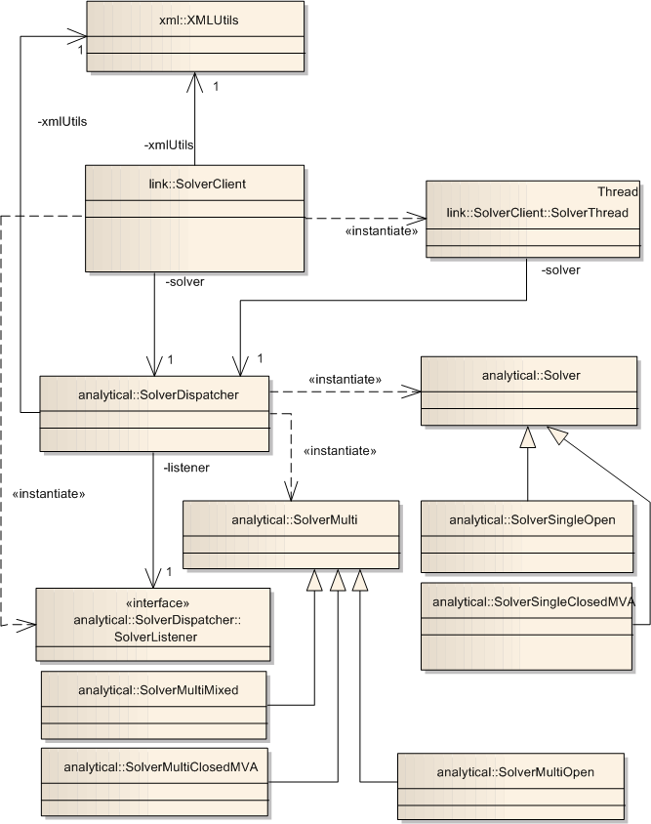
Structure – Main classes
jmt.gui.exact
jmt.analytical
Notes:
Just do a quick review of how the classes interact between

Slide 7
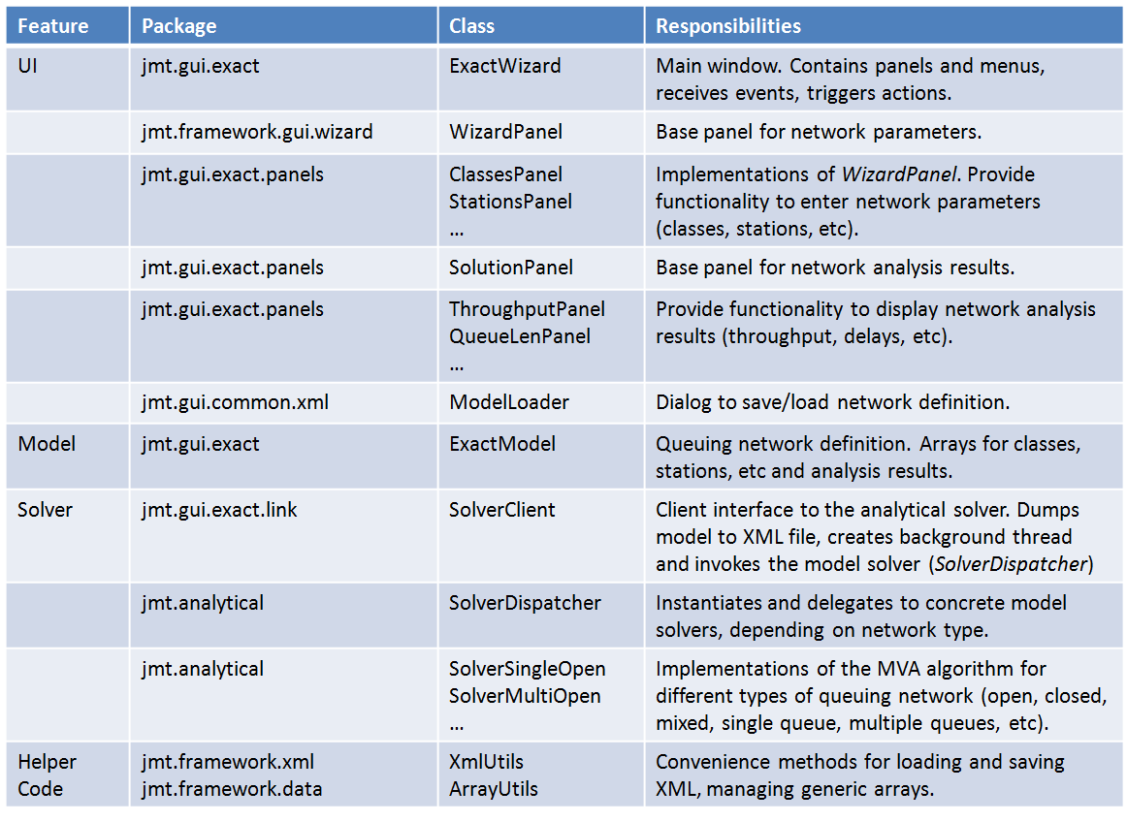
Structure – Responsibilities
Notes:
Just quickly and briefly mention what responsibilities each class has and go over the application features and how they are supported by these classes.

Slide 8
Our opinion – 1/2
The code is not so badly structured after all. There is some structure but seeing it before getting familiarized with the codebase is hard.
There are quite a few reasons…
There are cyclic dependencies from lower layers to higher ones (jmt.analytical → jmt.exact.gui). ExactModel is part of the GUI package when in fact, it has nothing to do with the UI.
Poor encapsulation of the internal state of objects (e.g.: ExactModel)
Getters and setters fail to enforce encapsulation. Public interface leaks internal details to client code (e.g.: ExactModel)
Instead of notifying ExactWizard, panels push data to the model (e.g.: any of the panels deriving from WizardPanel)
Tight coupling between classes. Code is written against implementations rather than interfaces (e.g.: ExactModel)
Extensive use of multidimensional arrays. So many arrays require custom helper methods (resize[1..n], copy[1..n], etc).
Notes:
The internal representation of the model is awkward. Double arrays are used for class parameters, sometime these mean arrival rates (open classes) and other times, population (closed).
Stations: instead of having a list of station objects, the model keeps an array of individual attribute arrays (name, type, etc). Same applies for classes of customers. Service parameters (visits, times) are kept in independent arrays instead of associating it to stations.
Results kept in multidimensional arrays. So many arrays require for the development of custom helper methods (resize, resize2, resize3, copy, copy2, copy3, toString, toString2, toString3).
Some comments are written in Italian, e.g.: ExactModel, line 257.
Getters and setters fail to enforce encapsulation. The interface leaks internal implementation details to client code. There is no setServiceTime(), setServiceTimes() instead. This is valid client code:
int types[] = new int[10];
types[0] = ExactModel.CLASS_OPEN;
types[1] = ExactModel.CLASS_CLOSED;
types[2] = ExactModel.CLASS_CLOSED;
this.data.resize(5, 10);
this.data.setClassTypes(types);
types[2] = 1000;
Another example, this time using a getter to change the internal object’s state without calling a setter. It is possible to set the customer class type to some invalid value:
int[] classTypes = data.getClassTypes();
if((classTypes != null) && (classTypes.length > 1)){
classTypes[0] = 1000;
}
All the “resource” strings for the user interface are hardcoded into ExactWizard’s code. E.g.: “Open saved model”, “JMVA - Product form queueing network exact solver”, etc. Internationalization is almost impossible. Translating the tool’s user interface to some other language is complicated. Help strings are hardcoded in classes derived from WizardPanel.
The internal representation of the model based on arrays is convenient for the solvers, as it makes the MVA algorithm implementation resemble more closely its actual mathematical formulation. Higher-layers, such as the GUI, should deal with higher-level abstractions (e.g.: work with class or station objects rather than arrays for their attributes).
SolverDispatcher, some validations on input data are implemented by model solver. Class does not seem to be cohesive as it does not implement a single well focused behaviour. Maybe having a separate ModelValidator is a good idea. ExactModel does some of the validation as well.
Sometimes naming conventions might be confusing. E.g.: Solve vs. SolveMulti. It might be better to name the first SolveSingle to stress its purpose even further and emphasise that these classes concerns are orthogonal.
In ExactModel there are several methods intended to parse XML documents and initialise an instance of this class. loadDocument() invokes loadClasses(), loadStations(), loadDescription(), etc. All these methods are public and should be private. Furthermore, given the role that this method plays, it would make more sense to make it a static factory method or maybe a file based constructor for ExactModel.
ExactModel does too many things. It makes sense to break it up into smaller classes.
ExactModel is part of the GUI package when in fact, it has nothing to do with the UI.
In general, interfaces are not defined correctly. For instance, in ExactWizard, switchFromSDtoSTV() and switchFromSTVtoSD() are public. Are these two methods really services that should be offered by ExactWizard to other objects? It’s almost as if no one spent anytime considering which methods should be public, protected or private.
Hardly any interfaces except for a few abstract classes in the jmt.analytical package. Code is written against actual implementations rather than interfaces. This facilitates tight coupling between classes.

Slide 9
Our opinion – 2/2
Instead of having a list of network entities, the model keeps an array of individual attribute arrays (name, type, etc) (e.g.: ExactModel)
Some classes are not cohesive, they do not implement a single well focused behaviour (SolverDispatcher, ExactModel do validation)
Some comments are written in Italian, e.g.: ExactModel, line 257.
A lot of GUI strings are hardcoded. Translating will be hard.
Sometimes naming conventions might be confusing. e.g.: Solve vs. SolveMulti. Solve could be named SolveSingle.
Methods are sometimes public and should be private (e.g.: ExactModel.loadClasses(), ExactWizard.switchFromSDtoSTV(), etc)
Interfaces are sometimes not defined in terms of roles played by objects (e.g.: ExactConstants)
Testability was not a priority (e.g.: hardcoded paths to test files in test classes, no unit tests, some end-to-end test for jmt.analytical).
We think the authors developed a command line tool first and then added the GUI. This explains some of the awkward dependencies…
Notes:
It is our assumption that the authors developed a command line tool first and then added the GUI. The result is that the lower layers which were presumably part of the first version of the application are better structured than the higher level ones. We believe that’s the reason for most of the dependencies. For example the analytical package layer is has a specific responsibility and doesn’t have any weird dependencies (exc ExactModel which we believe was an “hack” added later on).

