Slide 1


Software Engineering for Industry: Analysis of JMVA Codebase
Yufei Wang (yw6312)
Paul Gribelyuk (pg1312)
Yawei Li (yl8012)
Jun He (jh1212)
Xiaoxing Yang (xy212)

Slide 2

Exploring JVMA
Initial Steps
We downloaded the project from SVN and imported it into IntelliJ
We fixed a text encoding (UTF-8 vs ISO-8859-1) in the files.
Next, we located the main method in GraphStartScreen and ran it to determine relationship between JMT and JMVA.
This helped us find the entry point into the JMVA application: the ExactWizard class
We observed how the application behaves by tracing the execution of button clicks (JButton and Jpanel actions)
Functionality of JMVA
JMVA produces solution to Mean-Value-Analysis problem from queuing theory
The network model is defined by classes, stations, service time, etc.
What-if analysis can be performed by means of different values of parameters
The analysis of network performance will be represented in terms of throughput, utilization, system response time, etc.
What-if solutions are displayed in graphical or textual form

Slide 3
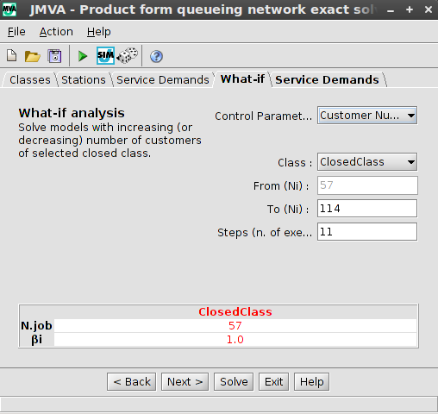
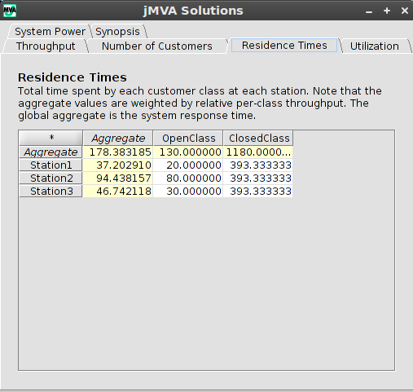
How to use JMVA
Choose JMVA in JMT main window
Defining the model of a queuing network
Select the New command from File menu
Define parameters (Classes, Stations, Service demands) using tabs in Wizard interface (What-if Tab is used to perform a what-if analysis)
The model can be loaded from an existing file through the File menu and saved into a .jmva file
Solving the Model
The Solve command gives Performance (Throughput, Queue lengths, Residence Times, Utilizations, Synopsis) in a separate window

Slide 4
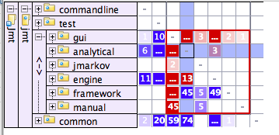
A Strong Cycle
IntelliJ Dependency Matrix functionality shows how much each pair of components depended on each other.
e.g. dependency cycle between analytical and gui.
Expanding the matrix, we see that ExactModel is the primary culprit in this cycle
Because of the coupling effect, these packages are impossible to reuse in other applications
Another strong cycle ... How to get rid of it?
analytical -> gui
gui -> analytical
Figure 1

Slide 5
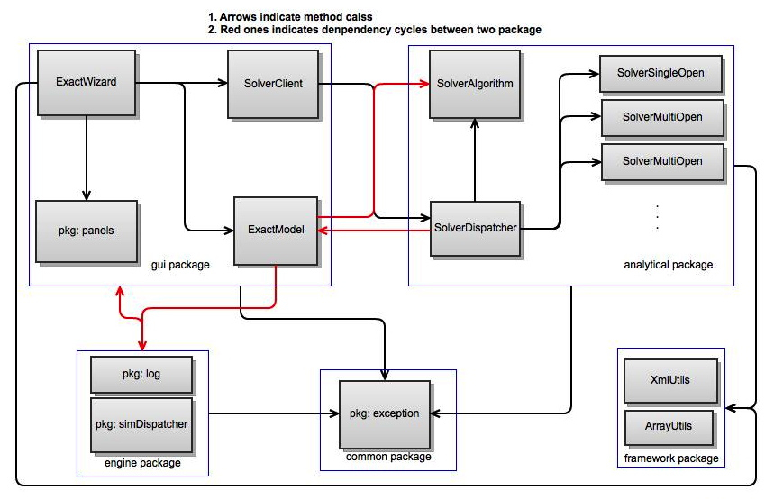
Dependencies among Critical Components

Slide 6
Deciphering the Codebase
Use of STAN Tool:
Used to visualize layers of the code and find where changes will have greatest effect
Allowed us to quickly modify package structure to create more top-down structure by moving the ExactModel to the analytical package (Fig. 2a and 2b)
Ideally, ExactModel should exist in a separate package
The >2800 LOC file should be split into a hierarchical inheritance structure rather than attempting to describe every model in one class
Code metrics showed marked decrease in “entangled-ness” of project (7.49% to 1.45%). Further improvement possible.
Tests
JMVA contains regression tests for different solvers (TestAnalytical), for different model inputs (TestAMVA), threads (PauseThreadTest), and others
These tests tend to measure performance rather than guaranteeing behaviour or state of objects

Slide 7
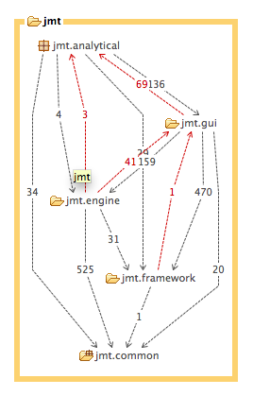
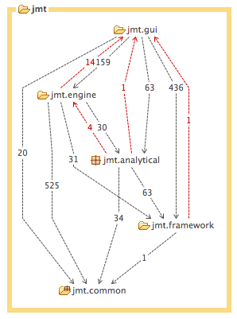
Improved Layout
Figure 2a. Before refactoring
Figure 2b. After refactoring

Slide 8
Deciphering the Codebase
Use of STAN Tool:
Used to visualize layers of the code and find where changes will have greatest effect
Allowed us to quickly modify package structure to create more top-down structure by moving the ExactModel to the analytical package (Fig. 2a and 2b)
Ideally, ExactModel should exist in a separate package
The >2800 LOC file should be split into a hierarchical inheritance structure rather than attempting to describe every model in one class
Code metrics showed marked decrease in “entangled-ness” of project (7.49% to 1.45%). Further improvement possible.
Tests
JMVA contains regression tests for different solvers (TestAnalytical), for different model inputs (TestAMVA), threads (PauseThreadTest), and others
These tests tend to measure performance rather than guaranteeing behaviour or state of objects

Slide 9
Critique
Program architecture
We recommend an interface layer between SolverClient and SolverDispatcher
We recommend moving classes not used by JMVA out of the analytical package
We recommend further refactoring of packages to reinforce a stricter layered structure between GUI components, Model controllers, and Analytics Engines
Cyclical dependencies between different layers make understanding and maintaining project very difficult
Code
Comments are sparse and in Italian make it difficult to understand flow
Names of classes and methods obfuscate their responsibilities and actions (Solver doesn’t solve, solve() method delegates responsibility rather than performing analysis, etc.)

Slide 10
Critique (cont.)
The test package contains tests for main functional classes in analytical and engine packages. Some tests' output is either empty if they succeed or error messages printed to screen otherwise. There is a lack of end-to-end tests and unit tests in other classes.
Components are often linked by direct call or reference (e.g. DirectModel class calls Solver classes in analytical package without any interface). This dependency on concretion sets barriers for doing unit testing with mock objects
Class cohesion is low (e.g. ExactModel, SolverDispatcher)
ExactWizard breaks inheritance model by overriding superclass methods with empty methods (e.g. finish() ); we would prefer to use interface to encapsulate commonality between these classes
Bugs
Application shows inconsistencies between execution and documentation (e.g. naming of tabs in solutions frame)
Notes:
SolverListener interface defined in SolverDispatcher but never used

