Slide 1
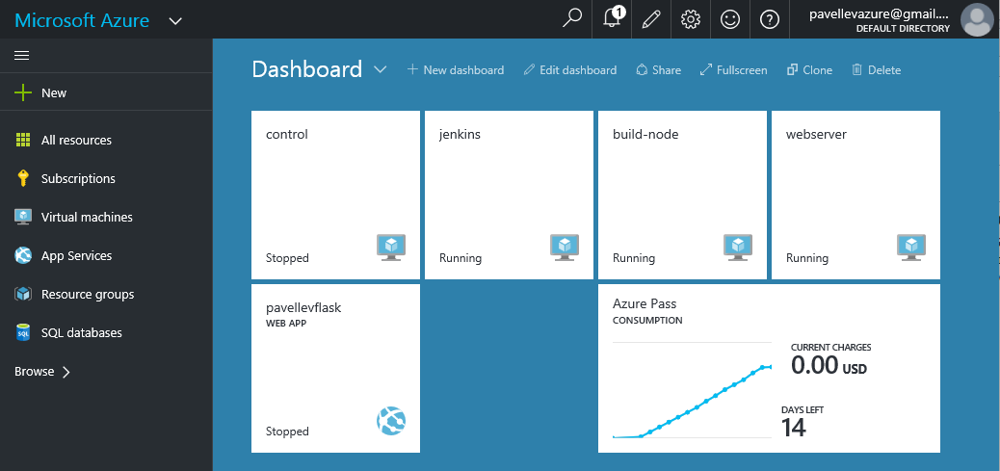

Slide 2
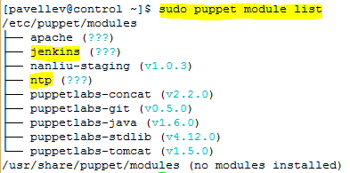
control
/etc
puppet
manifests/site.pp
(attached)
modules
ntp/manifests/init.pp
(attached)
jenkins/manifests/init.pp
(attached)
git
modules installed by ‘puppet module install’
java
forge.puppetlabs.com
tomcat
maven (on build-node) and tomcat (on webserver) was installed manually by ‘yum install’
python was pre-installed

Slide 3
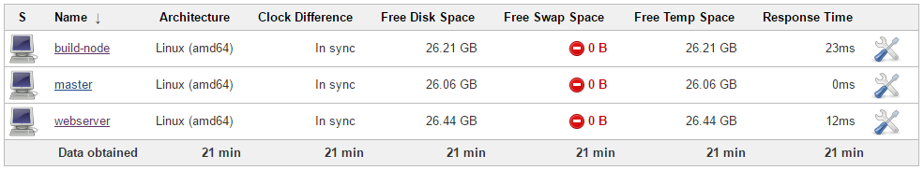
jenkins
installed version (hard-coded in puppet manifest): 1.651-1.1
master/slave mode
Launch method : SSH
JavaPath : /usr/bin/java

Slide 4
jenkins
pipeline
Maven project : WebAppCourseProject
Restrict where this project can be run → Label Expression: build-node
Source Code Management: Git
Build periodically: H/20 * * * *
Build: pom.xml / clean package
Freestyle project : RunScript
Parameterized → string parameter SOURCE, string parameter DESTINATION
Restrict where this project can be run → Label Expression: webserver
Source Code Management: None
Build after other projects are built → Projects to watch: WebAppCourseProject
Build → Execute shell → Command: python ~/get-war-file.py $SOURCE $DESTINATION
requires to enable run sudo
w/o prompt for a password
Freestyle project : RestartTomcat
Restrict where this project can be run → Label Expression: webserver
Source Code Management: None
Build after other projects are built → Projects to watch: RunScript
Build → Execute shell → Command: sudo systemctl restart tomcat

Slide 5
build-node
/home
installed git version 1.8.3.1
pavellev
jenkins
workspace
WebApps/pom.xml
src/main/webapp/index.jsp
target/courseProject.war
slave.jar
maven3-agent.jar
/usr/bin/java
java home
Java version: 1.8.0_91, vendor: Oracle Corporation
/usr/share/maven
maven home
Apache Maven 3.0.5 (Red Hat 3.0.5-16)

Slide 6
webserver
/home
installed Python 2.7.5
pavellev
installed tomcat 7.0.54
get-war-file.py
slave.jar
#!/usr/bin/python
import sys
import os
src_file = sys.argv[1]
dest_path = sys.argv[2]
os.system ( 'sudo scp "%s" "%s"' % (src_file, dest_path) )
/var/lib/tomcat/webapps
courseProject
index.jsp

Slide 7
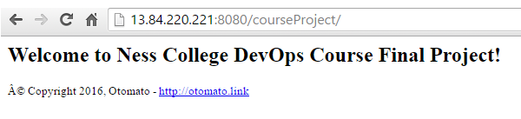
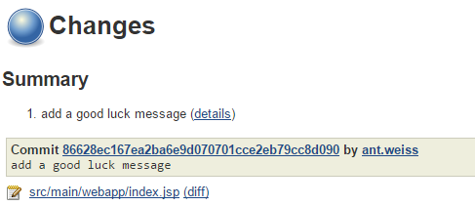
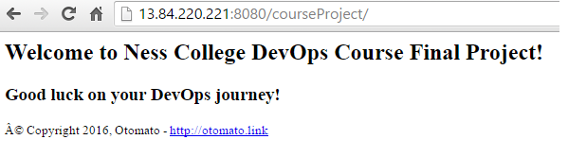
tomcat webapp
initial version
git commit
updated version

