Slide 1
git

Slide 2
Set up
Use all the defaults as a beginner
Recommendation of using git bash as the commands are more universal across linux and mac as opposed to command prompt or power shell.
It will set vim as the default
If you ever get lost google vim commands
Run config
git config --global user.email "you@example.com"
git config --global user.name "Your Name"
You are ready to start using git

Slide 3
Bash cheat sheet
Git cheat sheet (use git prefix)
pwd
Present working directory will show where you are
ls
List content in current directory
cd
Change directory/folder
cd .. -> parent directory/folder
cd directory -> go to directory/folder
mkdir name (let’s call it gitworkshop)
Make a directory/folder
Right click to paste
clone linkFromWebsite
Download copy from remote repo to local machine
add file1 file2
Add a file
status
Show what files have changed
Which ones are added
commit -m “Helpful comment”
Make your snapshot with
push
Upload your changes to your remote repository

Slide 4
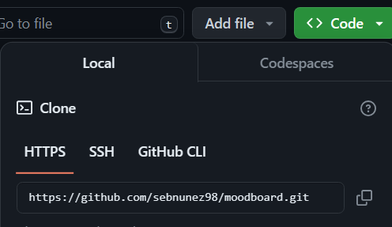
Step 1
Create repo on github
Tick the create a readme.md
Inside git bash go to the folder you want to use
Clone the repo
Grab link from website
Run command
You can now access your repo through file explorer! Start adding files and messing with it as you see fit

Slide 5
Step 2
Search sebnunez98 on github and go to my moodboard repo to use as a template
Add your content to your local-repo to create your own moodboard
You can start with making a moodboard.html file
You can edit the content by adding files to the folder and editing them with your choice editor
You can test your html code by opening it through file explorer in a browser
To get playlist embed find the playlist on spotify on computer and click share then select embed playlist
To get playlist embed find the playlist on apple on computer and click share then select embed playlist

Slide 6
Step 3
Once it’s ready push it to github
Add the ingredients -> commit to them -> cook the recipe and push it to the customers
(Optional) Publish your webpage through git
Settings -> Pages -> Set Main as branch and save (It will take a moment)
(Advanced) Customize your website even further

