Slide 1

Gamma spectrometry
My experiments with SIPM-based gamma ray detection
Pavel Pernička
BUT FEEC

Slide 2
01
Theoretical background

Slide 3
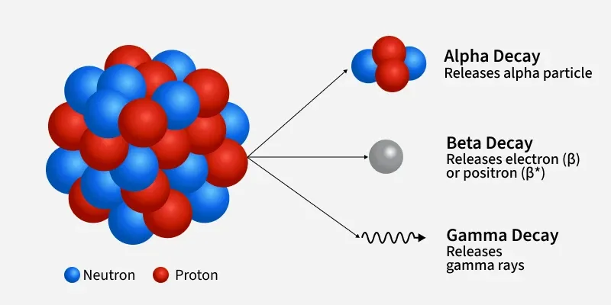
Radioactive decay
Unstable nucleus → spontaneous decay
3 main types, gamma often accompanies alpha and beta
Pavel Pernička / Gamma spectrometry

Slide 4
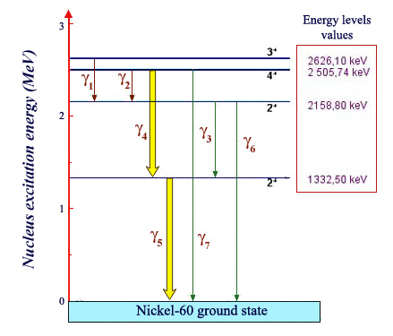
Gamma transition
Transition between nucleus energy states
Allowed transitions – characteristic photon energies (useful)
During de-excitation from previous process
Pavel Pernička / Gamma spectrometry

Slide 5
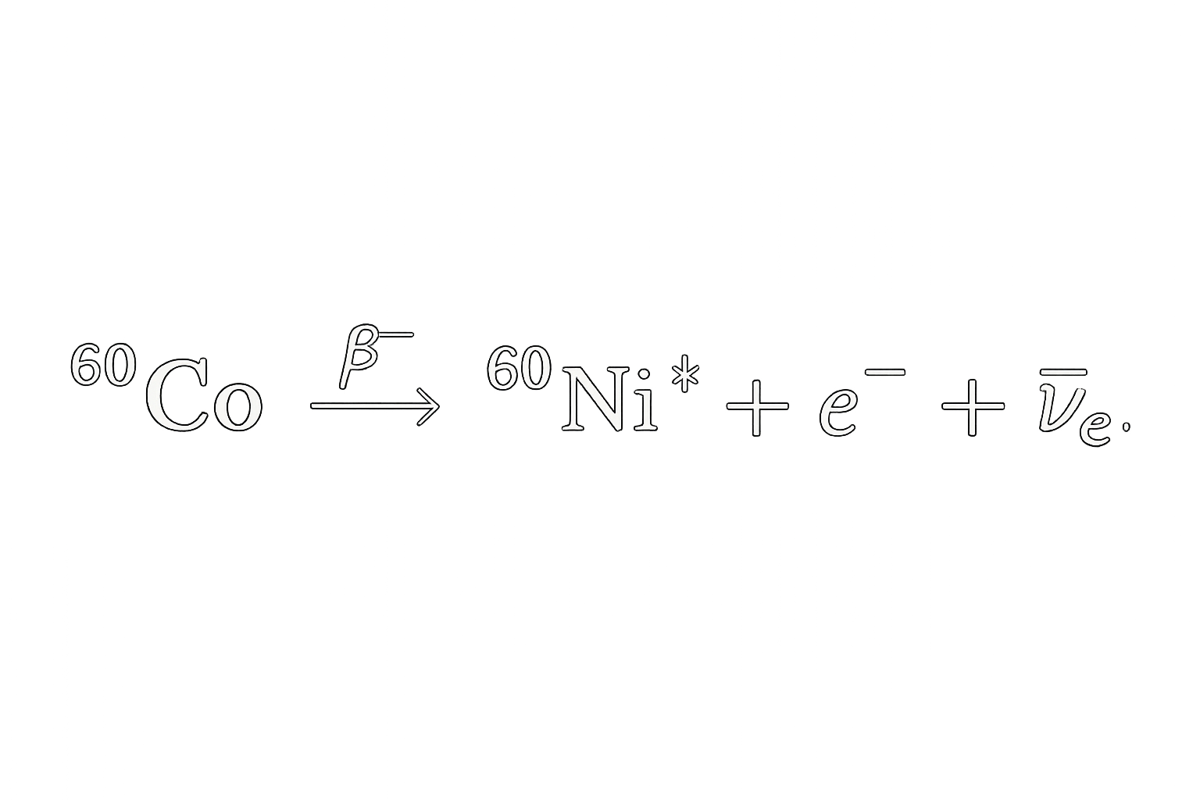
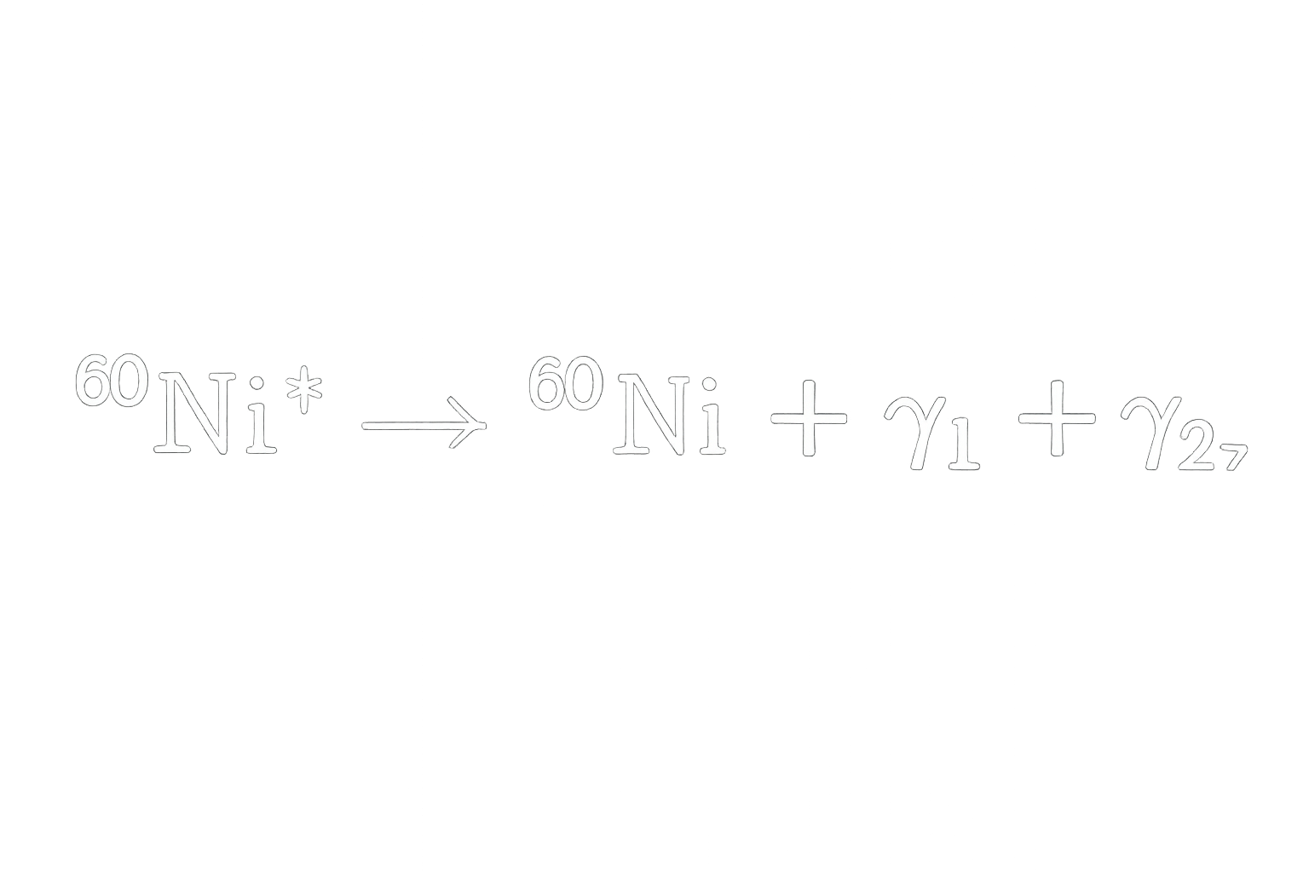
Example: ⁶⁰Co
Decay:
De-excitation:
E1=1173 keV E2=1332 keV
Pavel Pernička / Gamma spectrometry

Slide 6
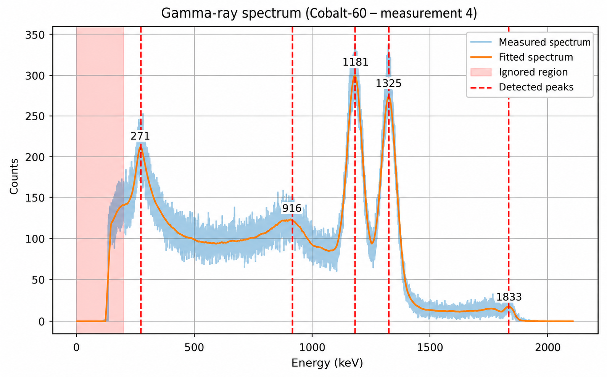
Pavel Pernička / Gamma spectrometry

Slide 7
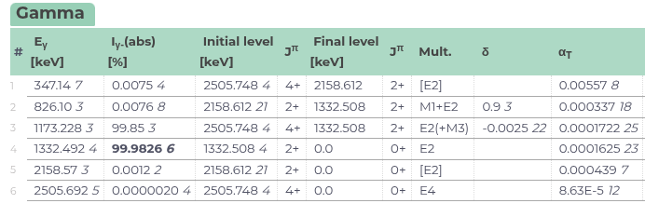
Where can we find gamma-ray energies?
International Atomic Energy Agency Database
Pavel Pernička / Gamma spectrometry

Slide 8
02
How to measure it

Slide 9
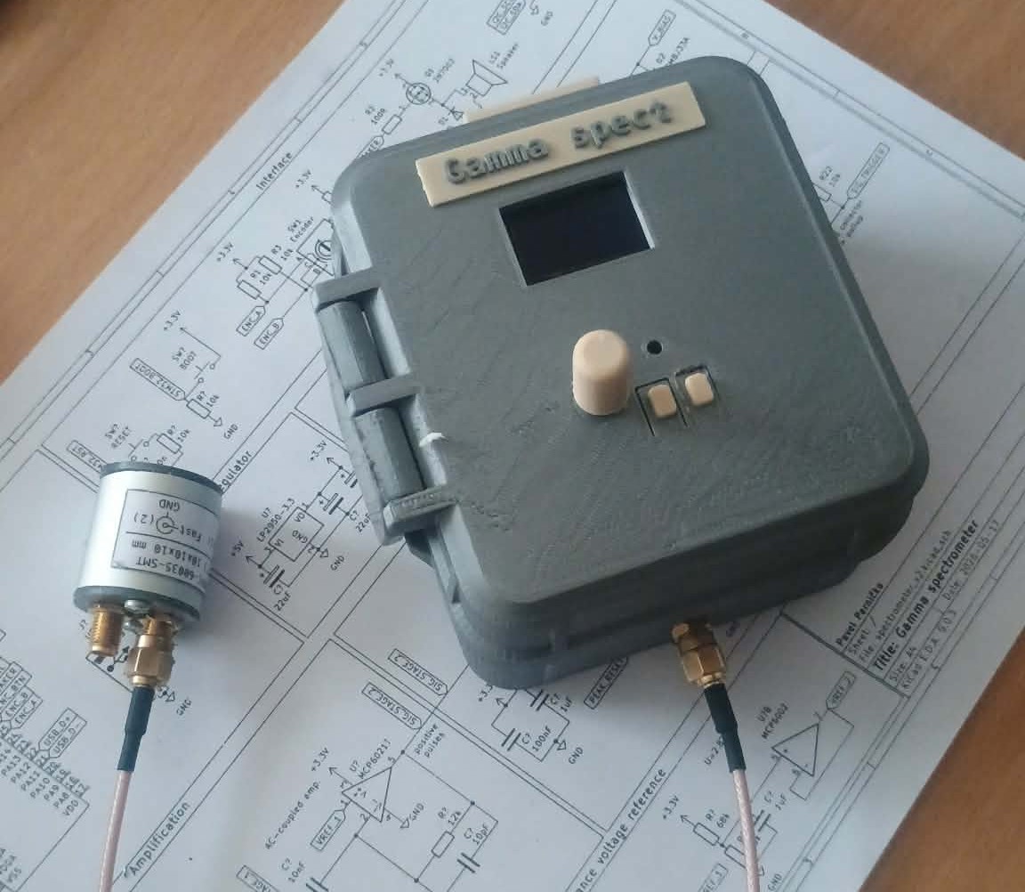
My handheld spectrometer
Analog frontend
Integrated DC-DC step-up converter
Fast event detection (peripherals)
STM32
SIPM-based (modern way)
Pavel Pernička / Gamma spectrometry

Slide 10
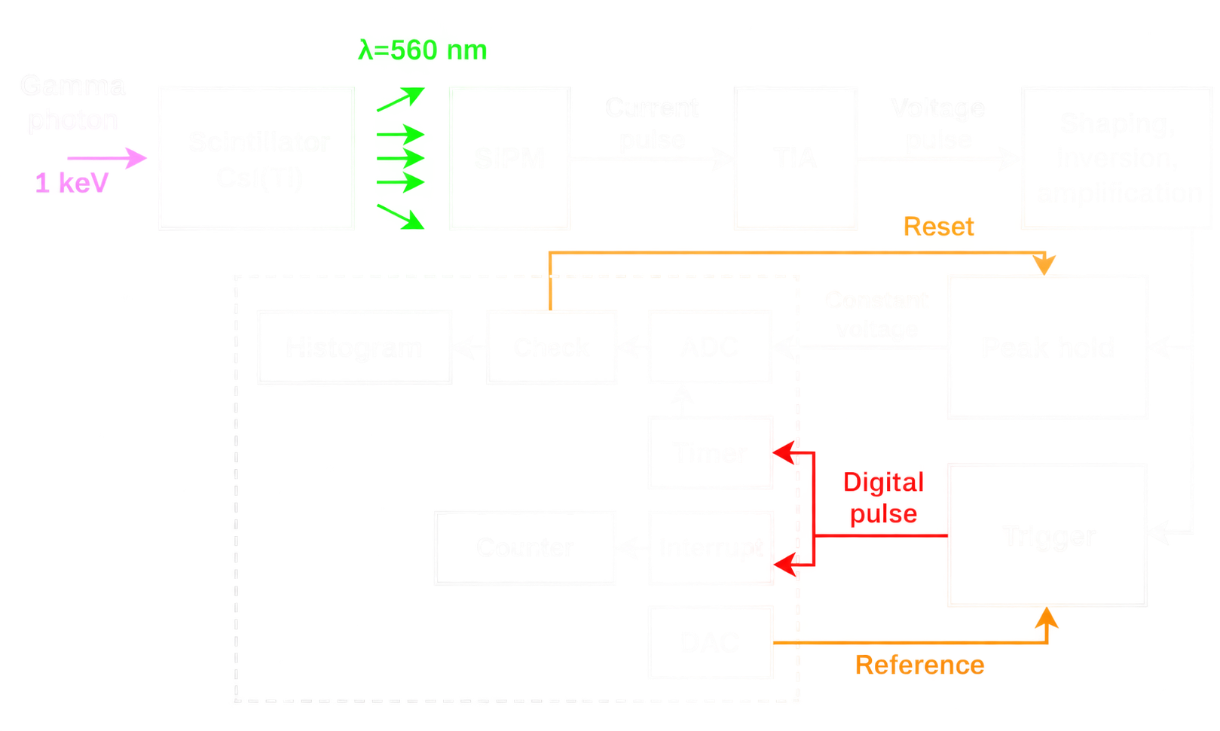
Pavel Pernička / Gamma spectrometry

Slide 11
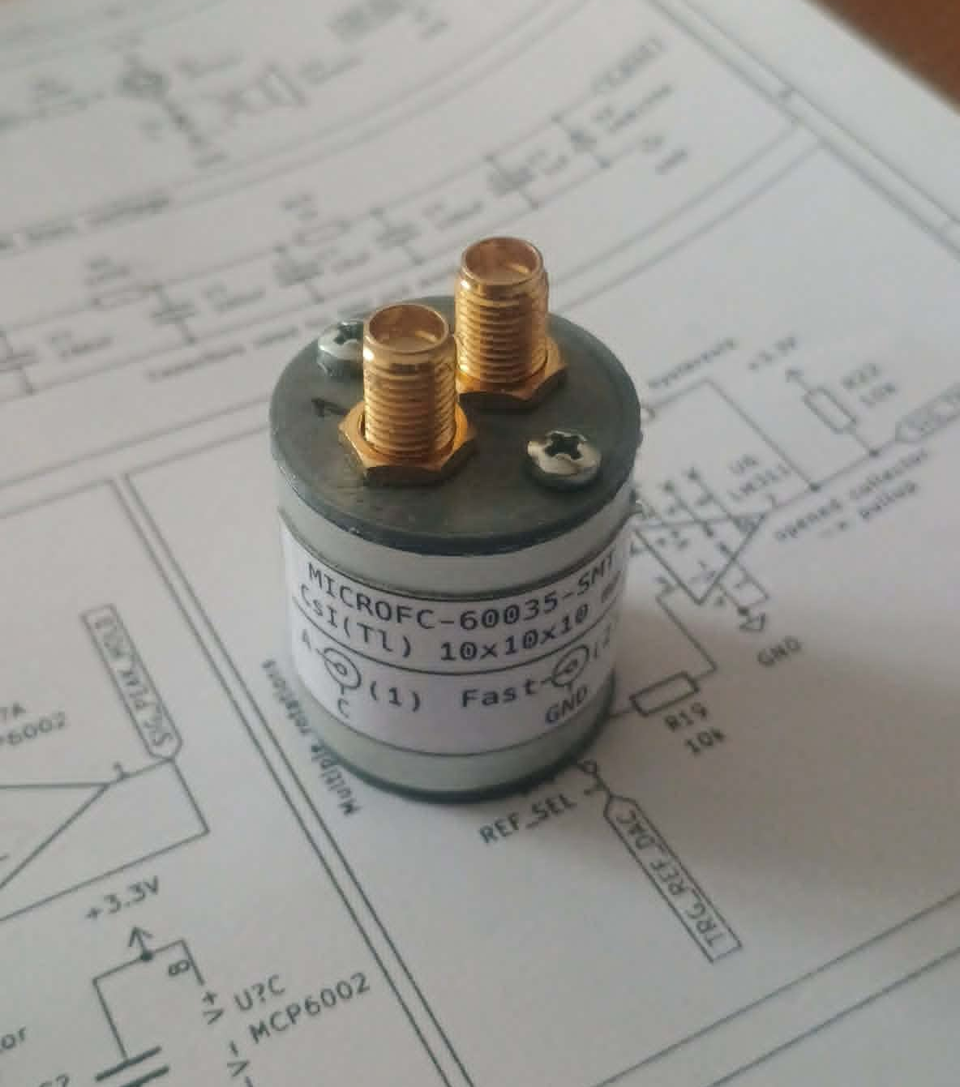
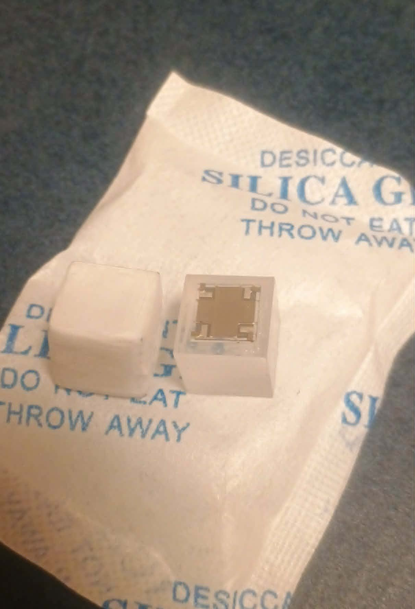
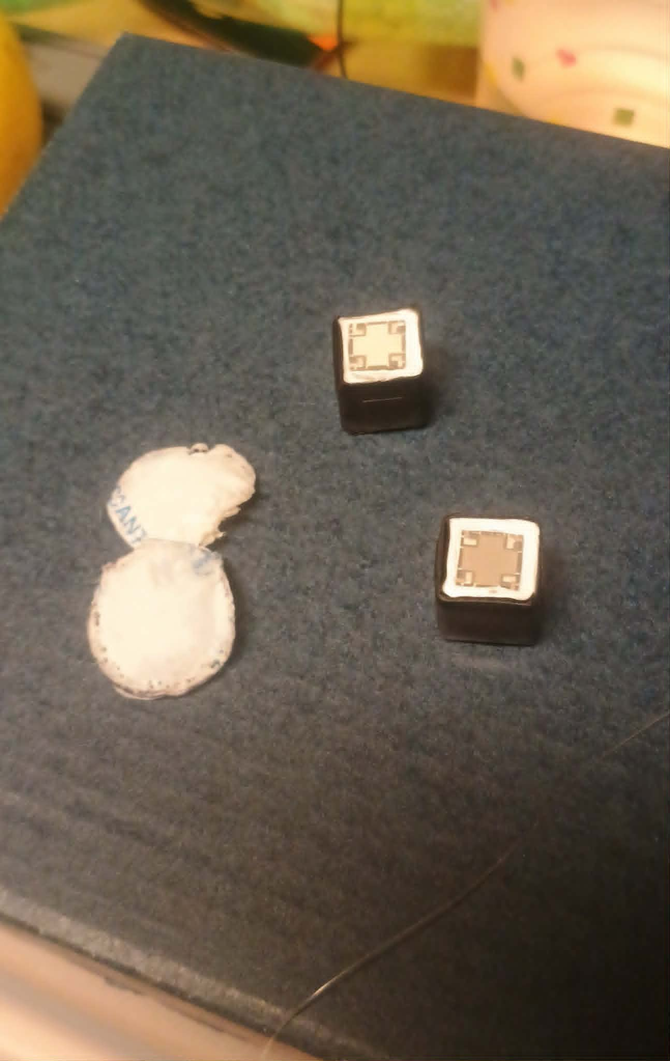
Scintilation crystal
CsI(Tl) – commonly used in detectors
Slower impulse
Ca. 65 photons/keV
Green scectrum (maybe problem?)
Pavel Pernička / Gamma spectrometry

Slide 12

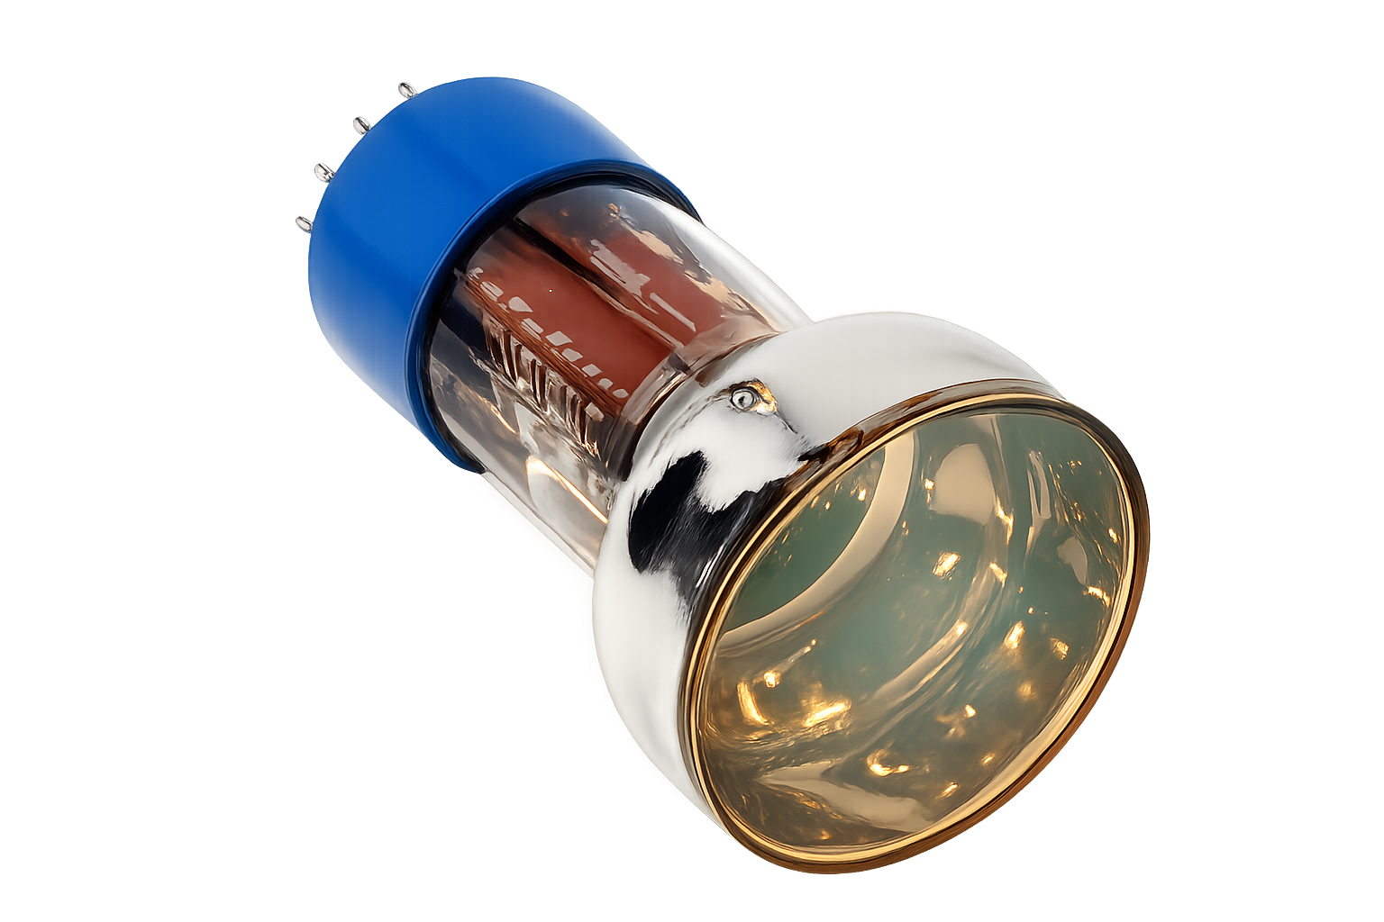
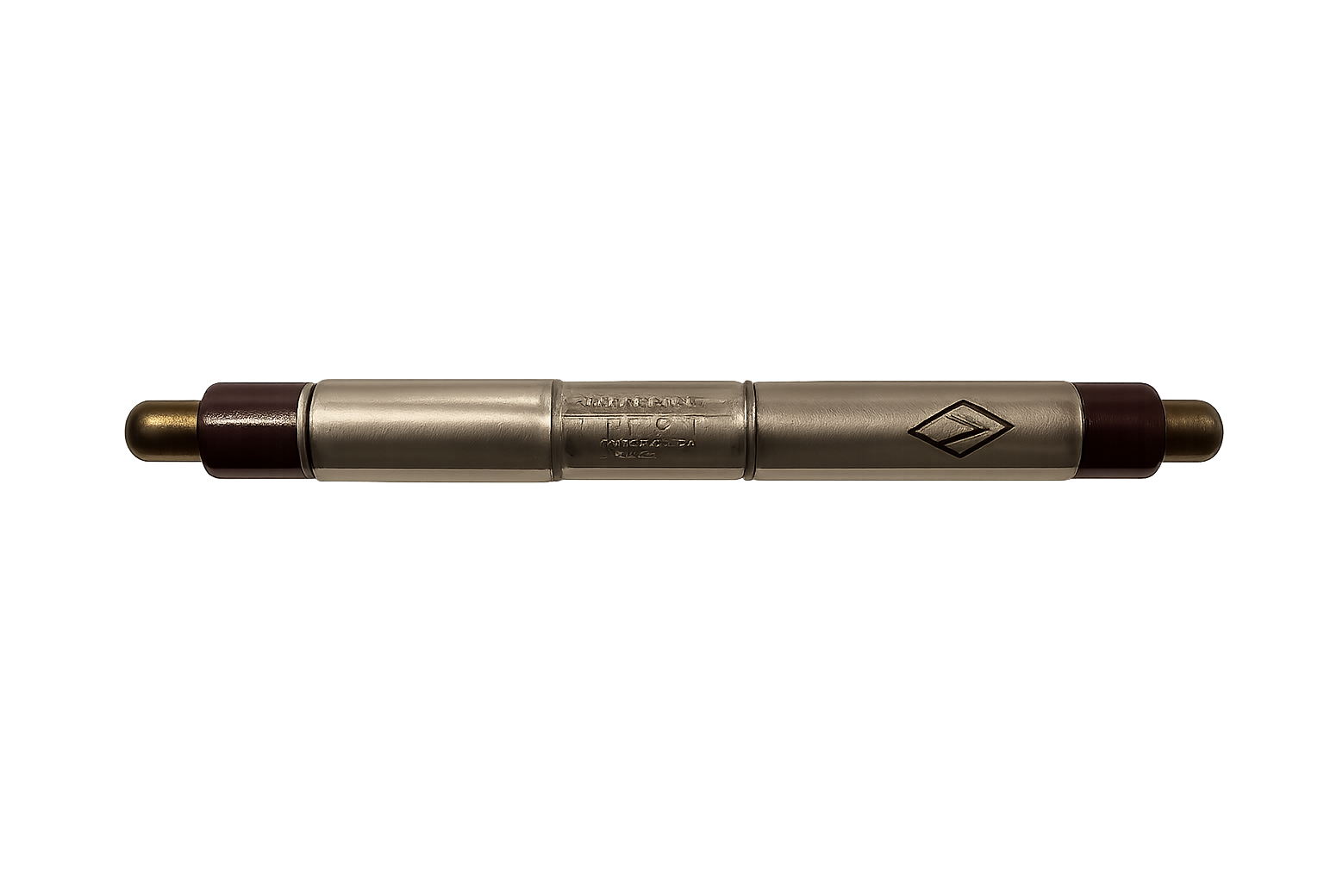
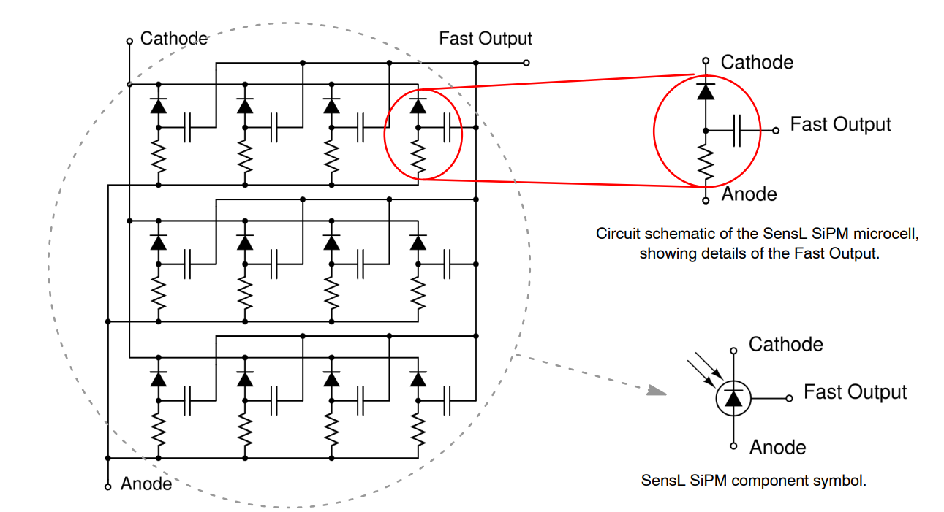
SIPM
SIlicon PhotoMultiplier
Single photon detection
Alternative for PMT (tube)
Price: ~320 CZK
No high voltage,
Almost no saturation (*)
… and analog frontend + MCU
Pavel Pernička / Gamma spectrometry

Slide 13
03
Results

Slide 14
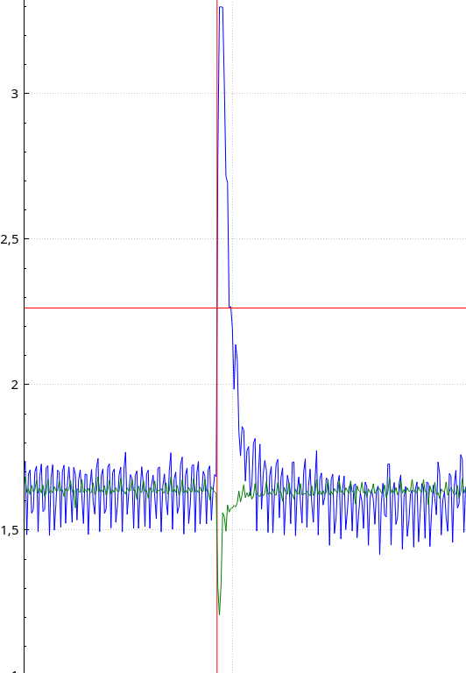
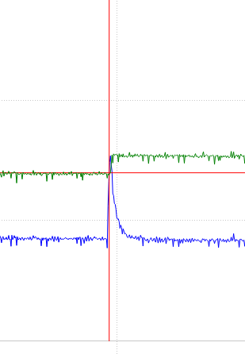
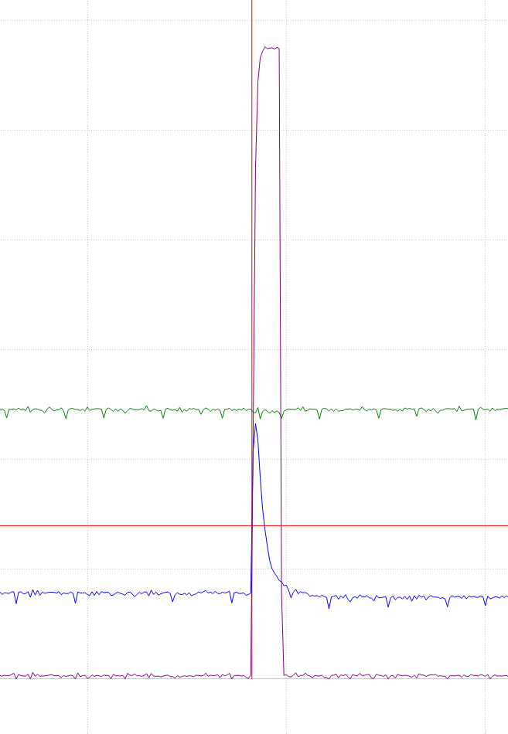
Internal signals
First/second stage amplified signal
Peak holding
Trigger
Pavel Pernička / Gamma spectrometry

Slide 15
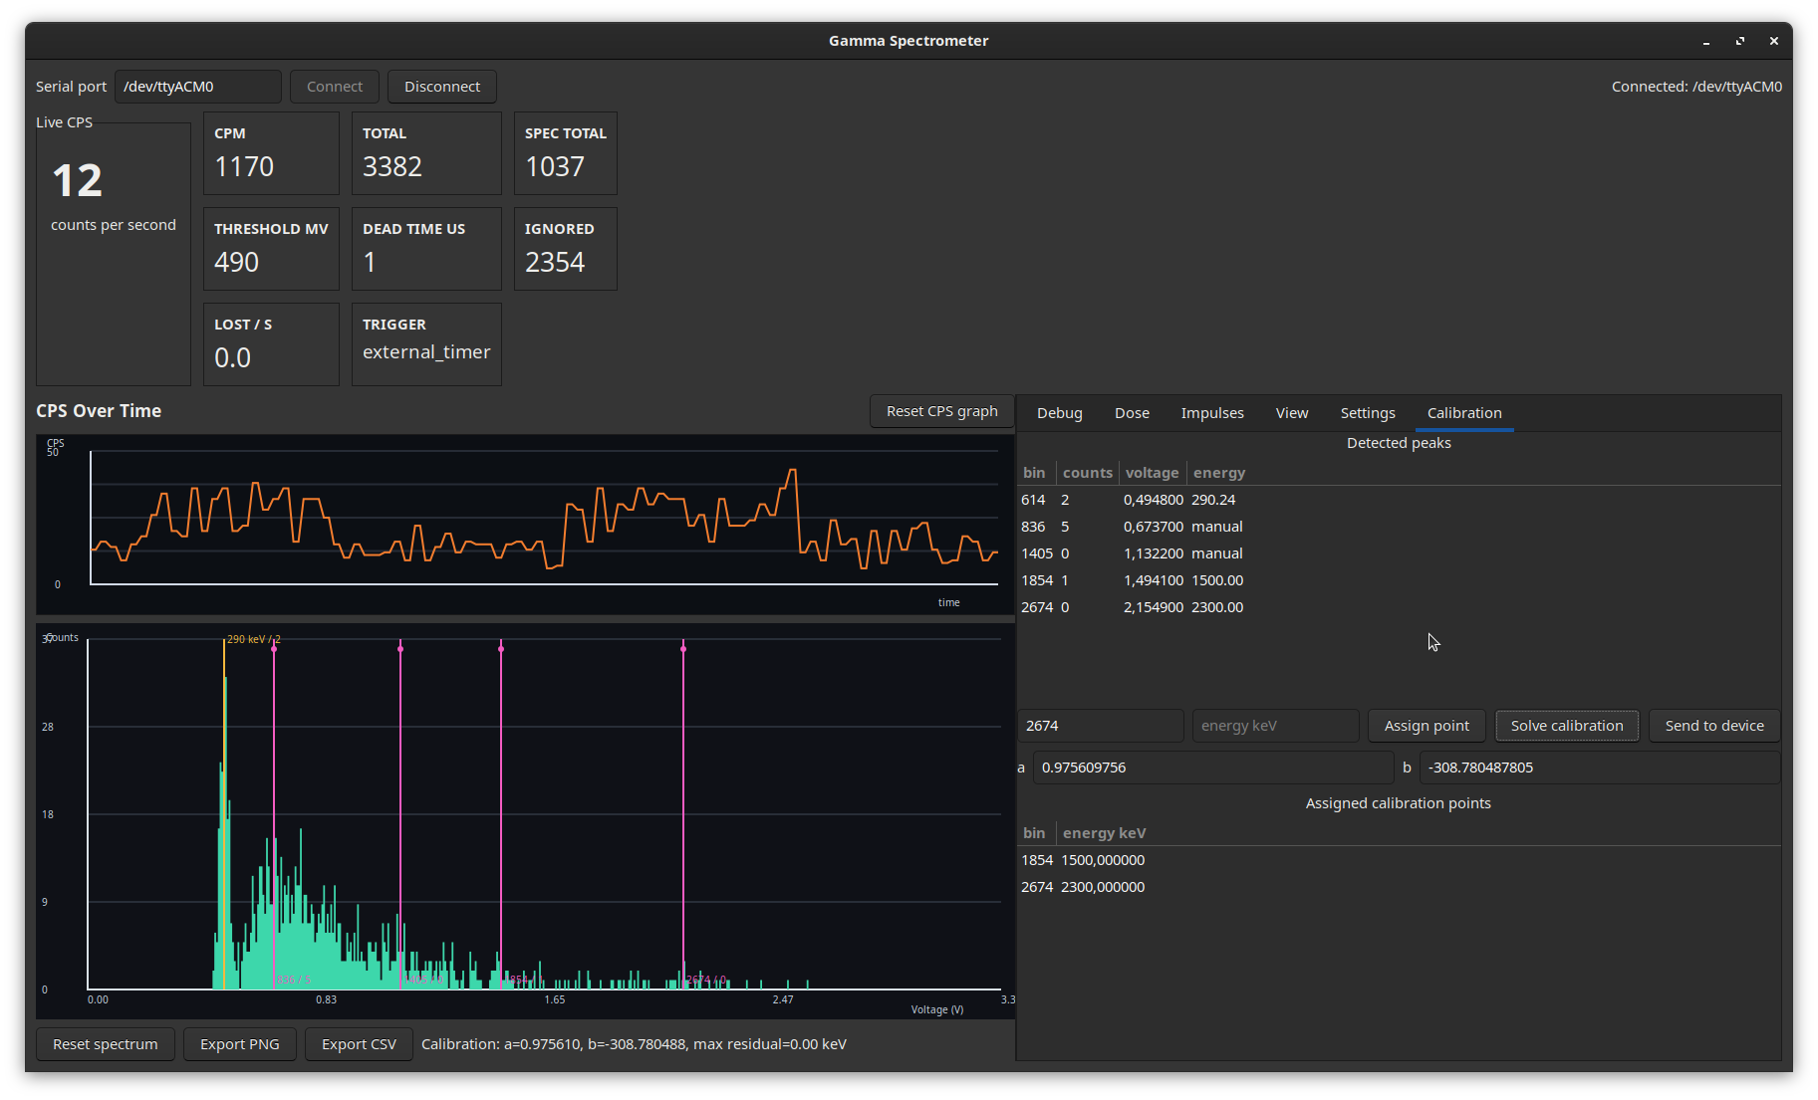
GUI
Pavel Pernička / Gamma spectrometry

Slide 16
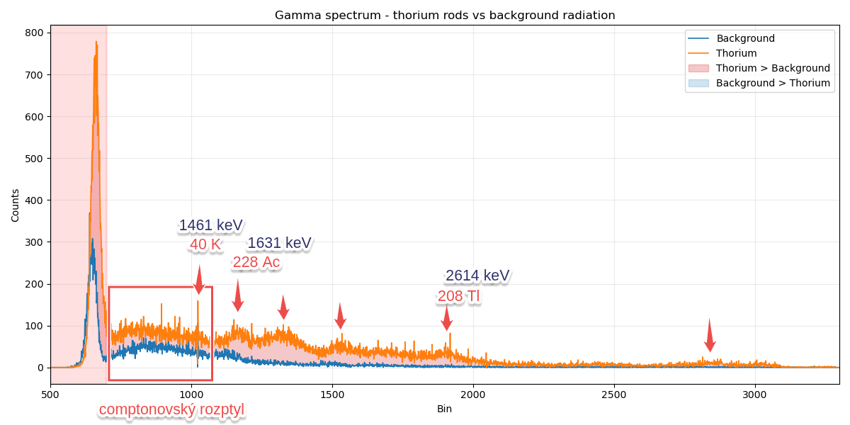
Measured spectrum
Pavel Pernička / Gamma spectrometry

Slide 17
Conclusion
Pros:
Cheap
Precise dose calculation
Identification of strong isotopes
Cons:
Dark noise, analog noise (buck DC-DC)
Wide peaks
Limited range
Pavel Pernička / Gamma spectrometry

Slide 18
Any questions
Thanks for your attention
pavel@pernicka.cz

Slide 19


