Slide 1
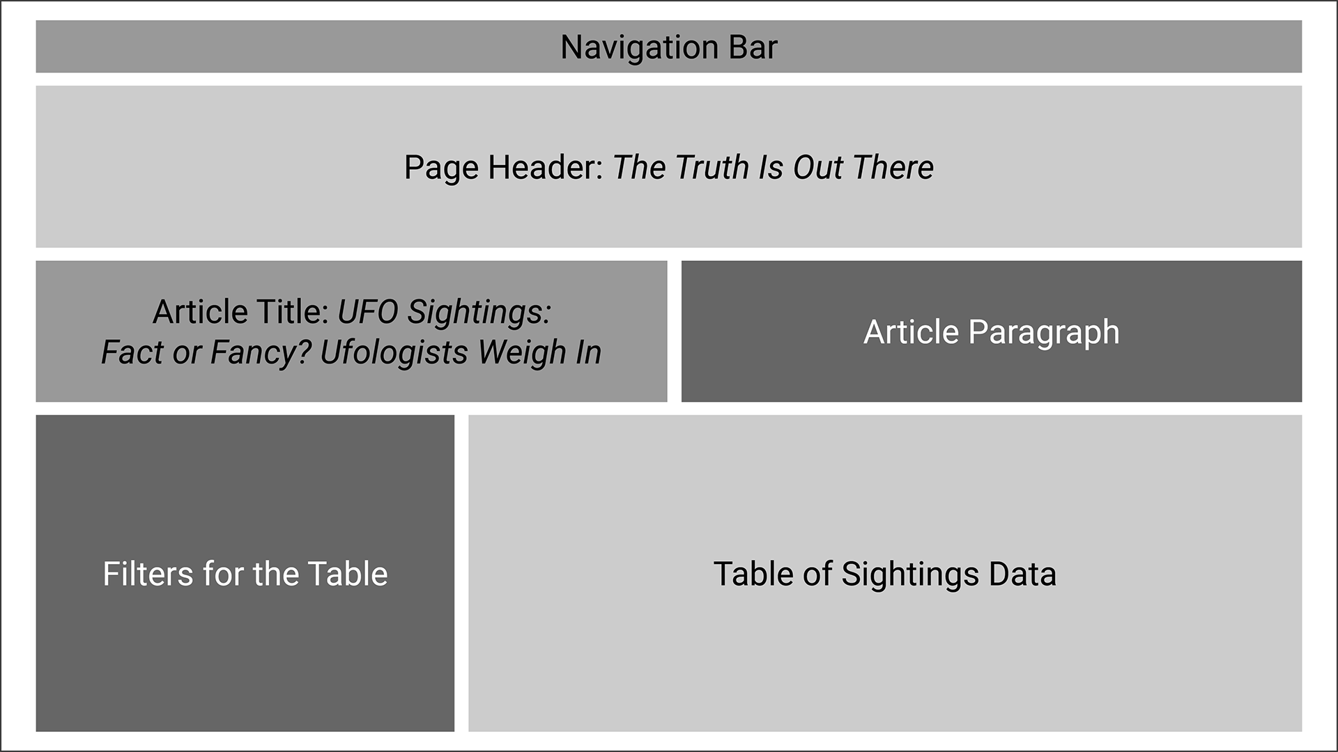
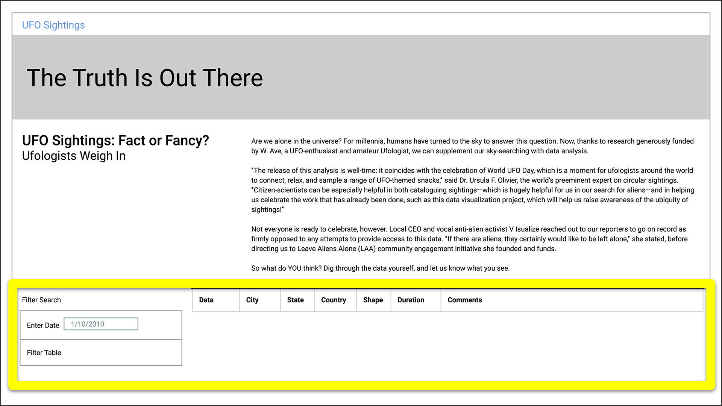
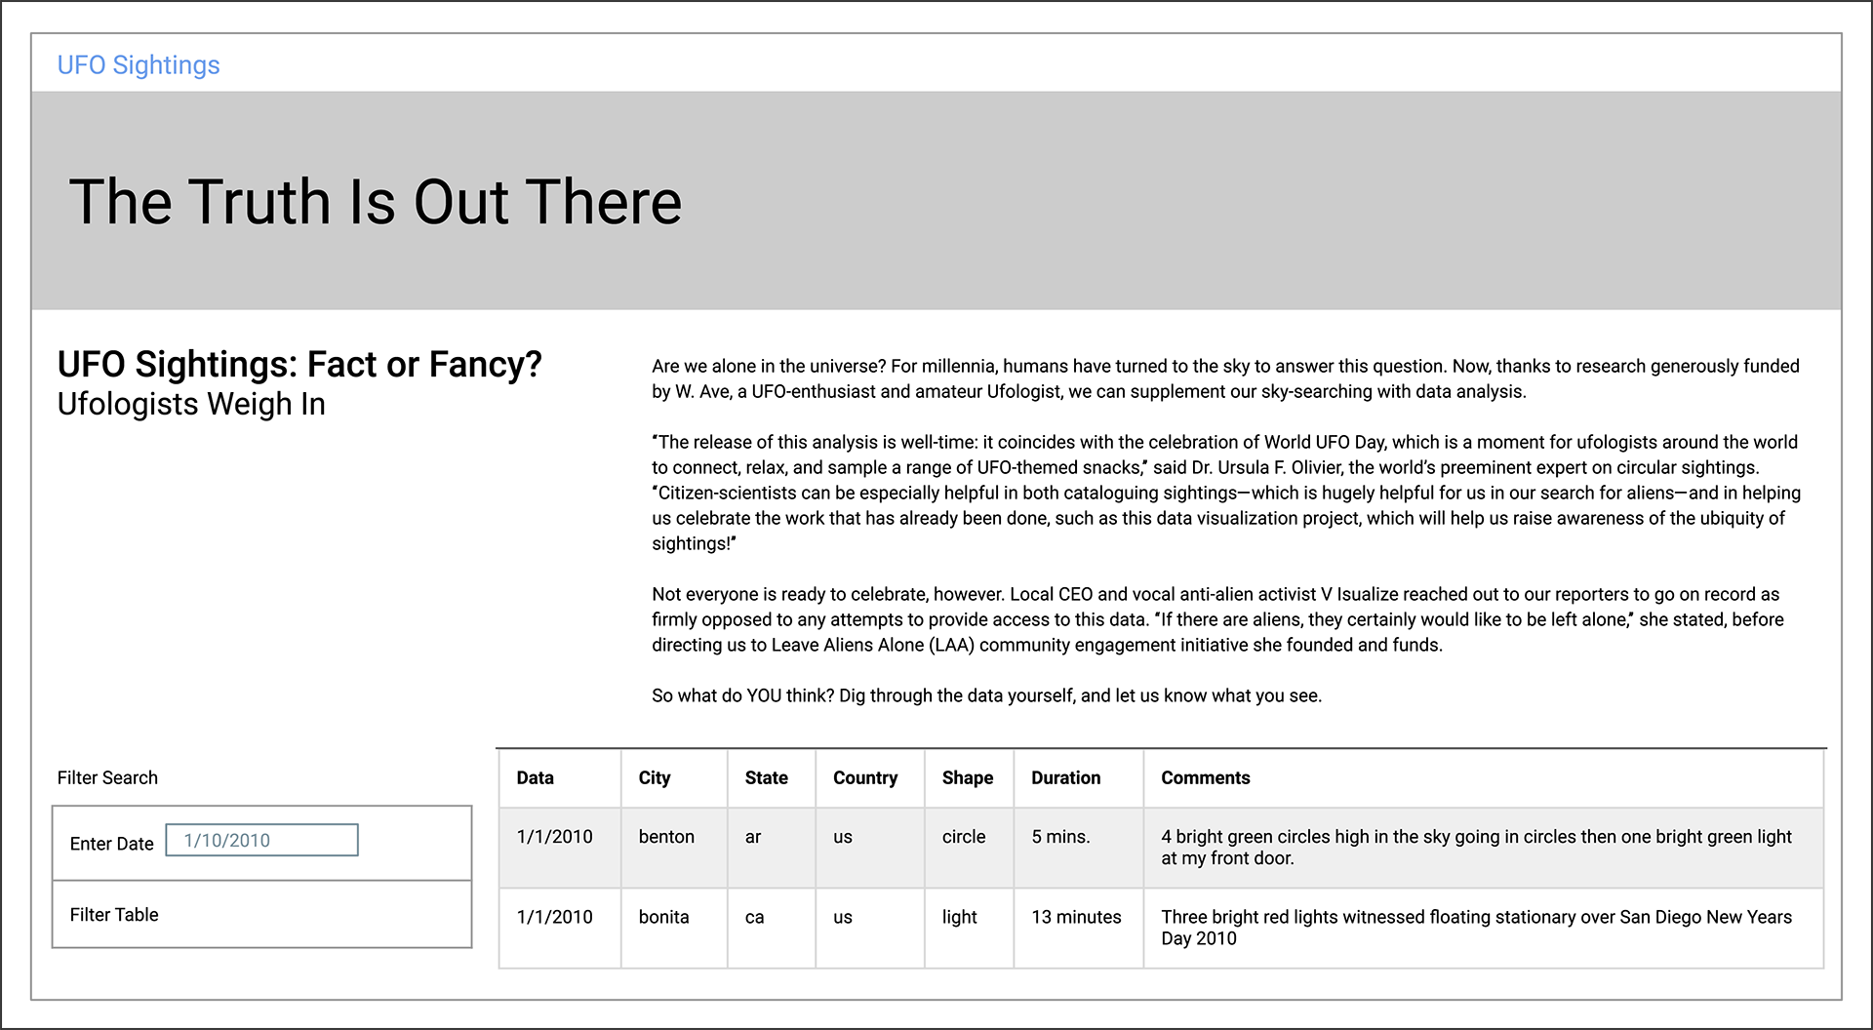
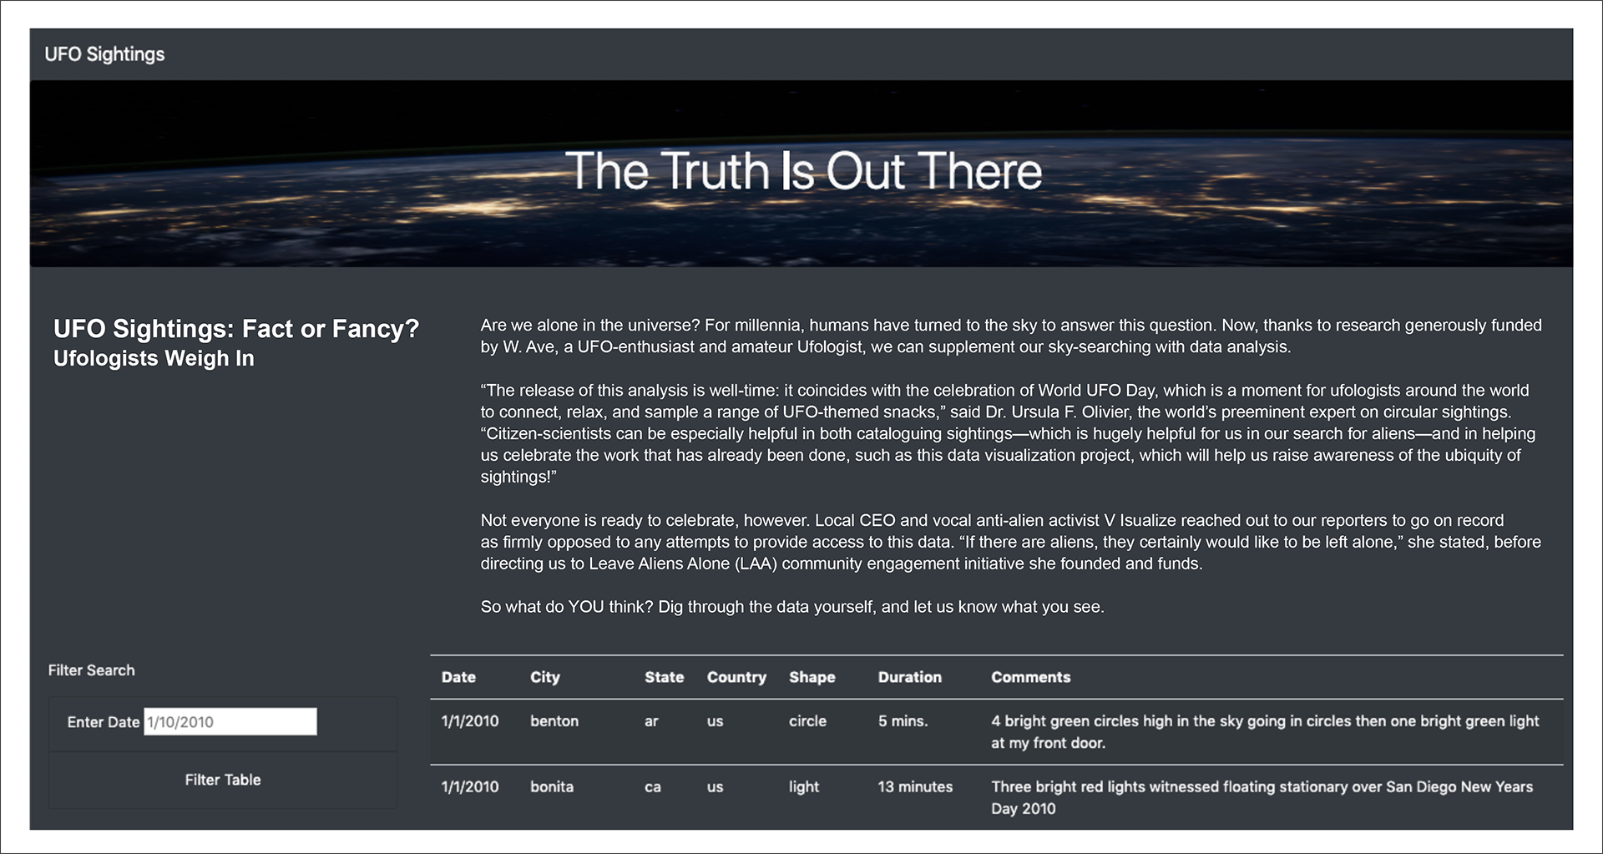
Module 11: Use JS to create a dynamic webpage with one filter using html, bootstrap, css and JS
11.2.2
Organize github repository:
Create and clone repo
Create a storyboard for the webpage and translate the storyboard into html using bootstrap version 4.0 layout and components (11.6.1)
After step 3 add links to d3, data.js and app.js files to make the webpage dynamic (11.6.2)
Create static folder that contains:
css folder
create style.css starter file
js folder
data.js (11.2.2)
ufo_starerCode.js (11.2.2)
images folder
nasa.jpg (11.6.3)
Deploy web app using github pages
static webpage
Storyboard
html & bootstrap css
11.6.1
11.6.1 & 11.6.2
Create table and filter
using JavaScript & data.js
Styling with our css file
11.5.3 & 11.5.4
11.6.3
dynamic webpage
Deploy using github pages

Slide 2
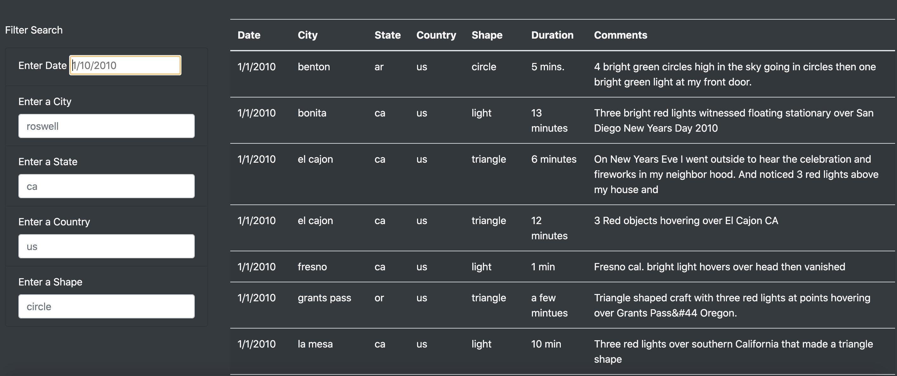
Module 11: Update the webpage to filter on multiple criteria using html, bootstrap, css and js
Webpage using A single filter on date
Webpage using multiple filters
Watch the Video
in SHOW HINT
Use instructions in Module 11 Challenge to make changes to the ufo_starterCode.js (renamed as app.js) using the pseudo code as a guide Note there is a video in the instructions under SHOW HINT with valuable information necessary to complete this assignment.
Button to filter table
Download the ufo_starterCode.js, rename it app.js,
In the index.html file, comment out the list element for the button
Modify the index.html file (keep date) and create four additional filters for city, state, country and shape using html (see the video). This requires a copy & paste of the date filter four additional times. Each of these will need to be modified like the following for the city filter:
Lable for=“city”
Input placeholder=“el cajon”
Change id to id=“city”
Modify the updateFilters() function to update the filters object { } based on user input (video). 4a, 4b, 4c: save the element, value and id of any filter changed by the user.
Create a variable and Use d3.select(this) in step 4a to save the input element within the form that was changed (video)
Create a variable and Use .property("value") in step 4b to save the value of any filter that was changed (video)
Create a variable and Use .attr(“id”) in step 4c to save the id of any filter that was changed (video)
Write an if-else statement that checks if a value was changed in step 5 and adds that filterId and value to the filters object. Otherwise, clear out that filter from the filter object (video)
Call the filterTable() function in step 6
In the app.js file - 1: Create a variable called filters that contains an object { } to keep track of all filters keys and values (video)
Create function called updateFilters() – 3: Use this function to update the filters.
Modify the event listener (video) 2: Attach an event to listen for changes to each filter and calls the updateFilters() function when a “change” occurs
In the filterTable() function write code to filter the table… (we will refence the handleClick function created earlier to assist in creating this function)
In step 8, create a variable for the filtered data
In step 9, loop through the filters object and store the data… using Object.entries vs. Object.values as entries give us both the property and value. Use forEach to iterate over each key, value pair and filter table.
In step 10, rebuild the table using the buildTable() function and passing the filteredData variable as the function’s argument.
Deploy the web app on your GitHub pages.

