Slide 1
Predicting Diabetes Patient Hospital Readmission
Pavel Zimin, PhD
Mentor: Ramkumar Hariharan, PhD

Slide 2
Problem Statement
Hospital readmission is a highly preventable cause for high healthcare costs
The ability to predict hospital readmission will help prioritize patients that will benefit from hospital discharge follow up programs
Business use cases:
The outcome of this analysis will be helpful to the hospital healthcare teams with prioritizing patient support program
This analysis will benefit patients who will receive improved health care, decreased chances of readmission while incurring smaller cost

Slide 3
Data Wrangling Steps
Hospital readmission data were downloaded from UCI Machine Learning Repository (https://archive.ics.uci.edu/ml/datasets/diabetes+130-us+hospitals+for+years+1999-2008)
The dataset contains 101,766 observations of unique hospital encounters with 50 variables: 13 columns of integer type, 37 columns of object type
Medical diagnosis codes with their hierarchical groupings were downloaded from a GitHub repository (https://github.com/sirrice/icd9.git) and merged with the readmission data set
For each variable with missing values a separate column was created with values indicating the missing values
Each categorical variable was encoded with integer values, the code was saved in a dictionary
No outliers were removed

Slide 4
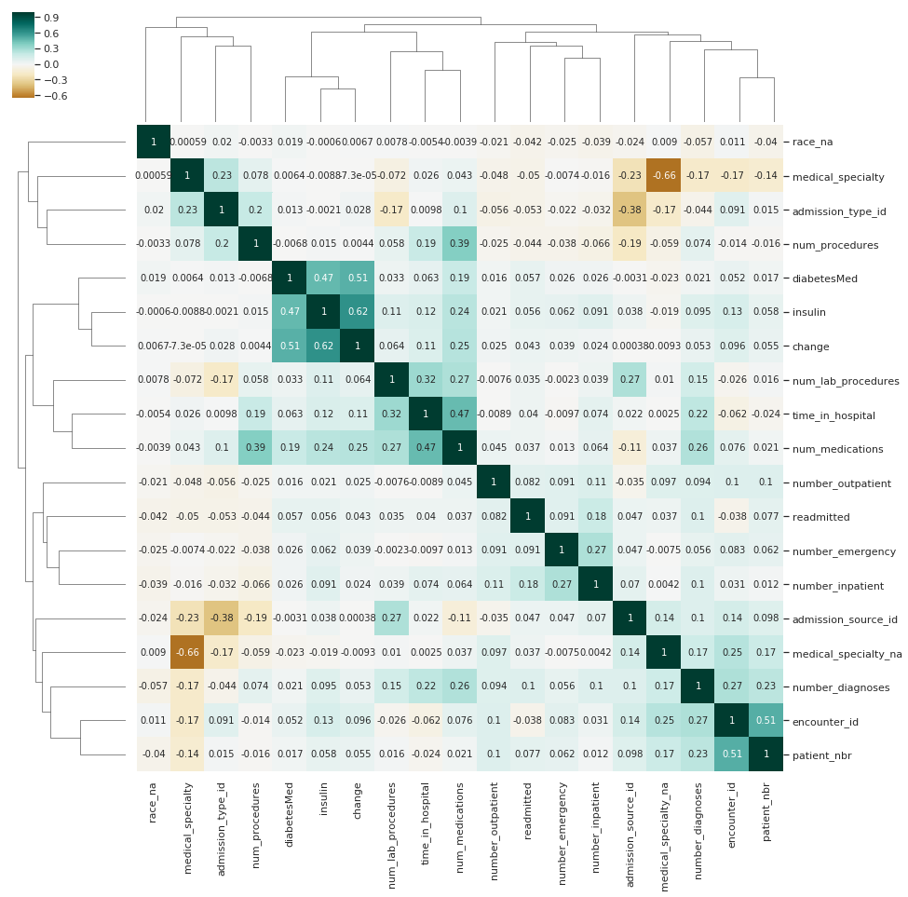
Correlation Clustermap
moderate to low correlation between the readmitted variable and other variables
variables showing largest correlations are:
  number_inpatient (the number of inpatient visits in the year preceding the encounter)
  number_emergency (the number of emergency visits in the year preceding the encounter)
  number_outpatient (the number of outpatient visits in the year preceding the encounter)

Slide 5
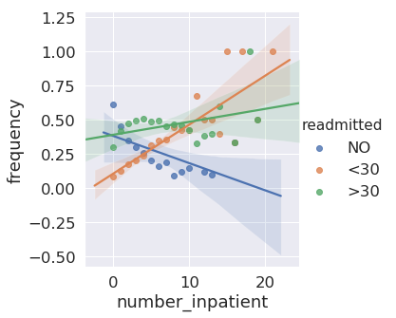
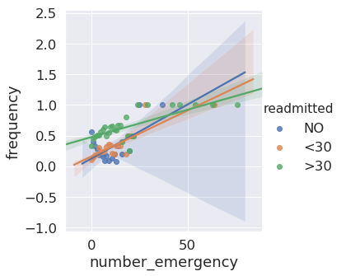
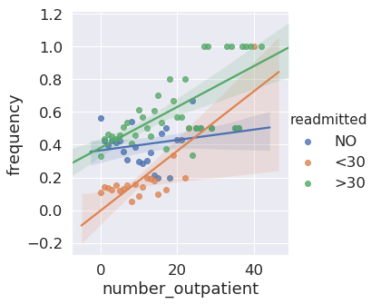
Frequencies of Selected Variables

Slide 6
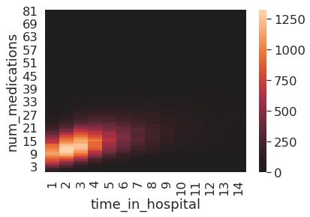
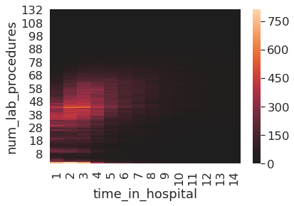
Sanity Check of the Data Set

Slide 7
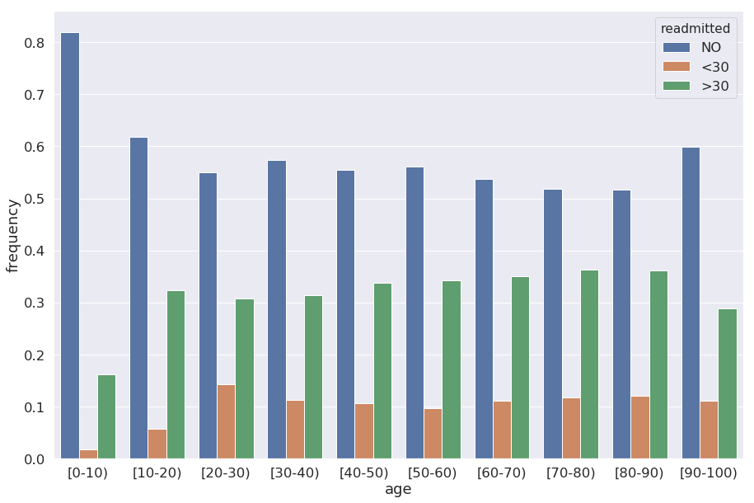
Age Group Frequencies

Slide 8
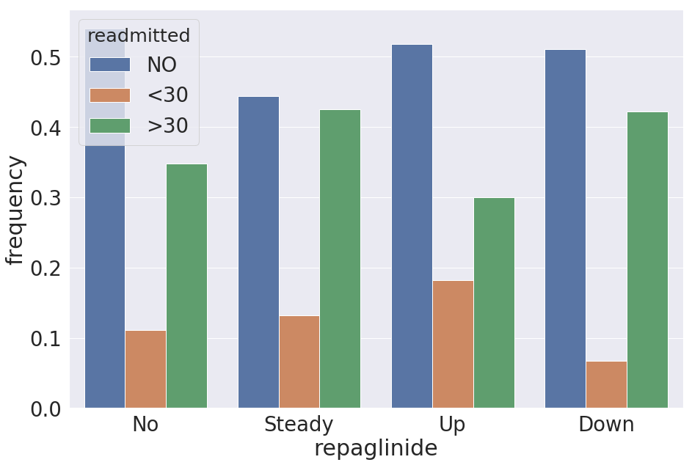
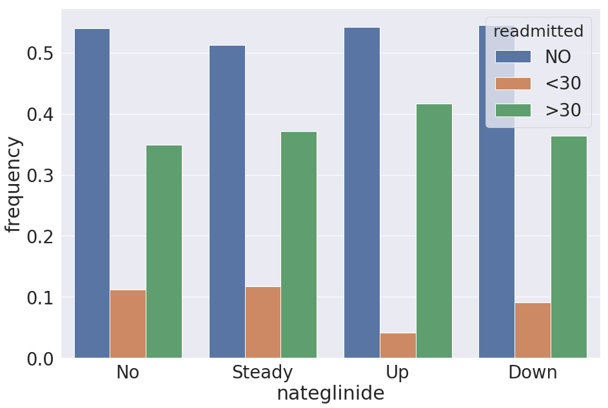
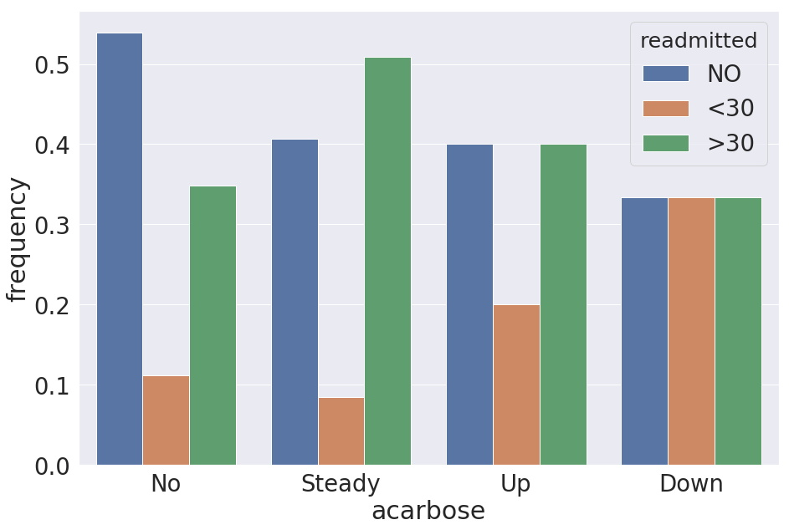
Frequencies of medication dosage changes

Slide 9
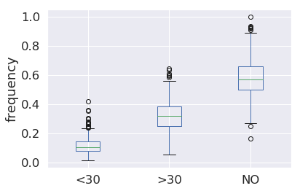
Primary Diagnosis Frequency Distributions
The top primary diagnoses in the group with readmission within 30 days:
  encounter for other and unspecified procedures and aftercare,
  diabetes with renal manifestations,
  peritonitis and retroperitoneal infections.

Slide 10
EDA Conclusions
There is moderate to low correlation between the readmitted variable and other variables.
The variables showing the largest correlations are: number_inpatient, number_emergency, and number_outpatient.
The most dramatic changes in the frequencies of medication changes were for the following medications for treating diabetes: repaglinide, nateglinide, and acarbose.
Distribution of the primary diagnoses shows that for some primary diagnoses the frequency of readmission within 30 days is much higher than the median frequency for that group.
The top primary diagnoses in the group with readmission within 30 days are
    encounter for other and unspecified procedures and aftercare
    diabetes with renal manifestations
    peritonitis and retroperitoneal infections

Slide 11
Machine Learning
Data Splitting
  Data were randomly split into 4 sets: training set (70%), and 3 hold-out sets (10% each). Training set was used for machine learning, hold-out set 1 was used for hyperparameter tuning, hold-out set 2 was used for validating models, hold-out set 3 was used for the final model testing
Dealing with the Imbalanced Data
  Positive class represents 11% of the data
  Random Undersampling, and 2 oversampling methods were tested (SMOTE and ADASYN). Random Unersampling showed the best performance
F1 score was selected for tuning the model

Slide 12
Models fitted
Dummy classifier
Random Forest
Logistic Regression
Logistic Regression with Stochastic Gradient Descent
AdaBoost
Gradient Boosting Classifier
Gradient Boosting Classifier fitted on principal components

Slide 13
Best Hyperparameters
Model | Hyperparameters
Dummy | None
Random Forest | n_estimators=20, max_depth=5, min_samples_split=5, max_features=25
Logistic Regression | penalty='l2', solver='liblinear', C=1
Logistic Regression, stochastic | alpha=0.001, penalty='elasticnet', l1_ratio=0.3
AdaBoost | max_depth=2, min_samples_split=2, n_estimators=10
Gradient Boosting | n_estimators=100, max_depth=2, min_samples_split=2, max_features=20

Slide 14
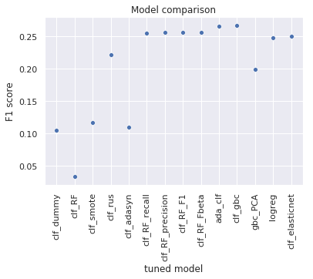
Model Comarison
Gradient Boosting Classifier was selected based on the F1 score

Slide 15
Final Model Evaluation
metric | training data | test data
precision score | 0.64 | 0.17
recall score | 0.57 | 0.57
F1 score | 0.60 | 0.26
Fβ score | 0.63 | 0.17
Mattews correlation coefficient | 0.24 | 0.16
accuracy score | 0.62 | 0.67

Slide 16
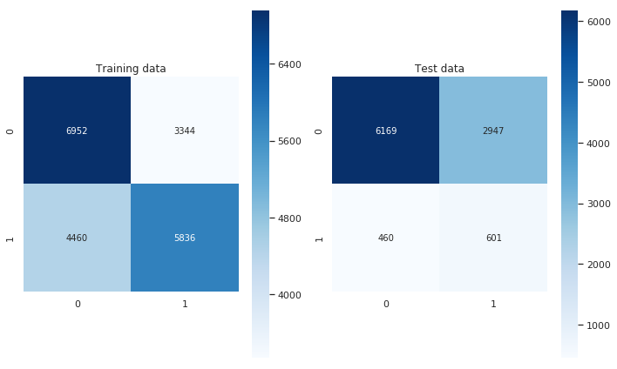
Final Model Evaluation

Slide 17
Limitations
Overfitting. Model performes much better on the training set than on the test set.
Poor precision. Precision of predictions on the test set is ~17%.

Slide 18
Recommendations
Use the model as is. The model allows to narrow down the number of patients that would benefit from the follow-up program aimed at minimazing the chances of readmission. This might result in significant reduction of the 30-day readmission rates.
If all patients identified as positive by the model do not return within 30 days of discharge as a result of follow-up program, the 30-day readmission rate would drop by more than half. This is an upper estimate of the benefit of the current model.
If better precision is required, more data need to be collected. Larger number of features would also be helpful for building the model. This will help with building a model with better precision.

