Slide 1
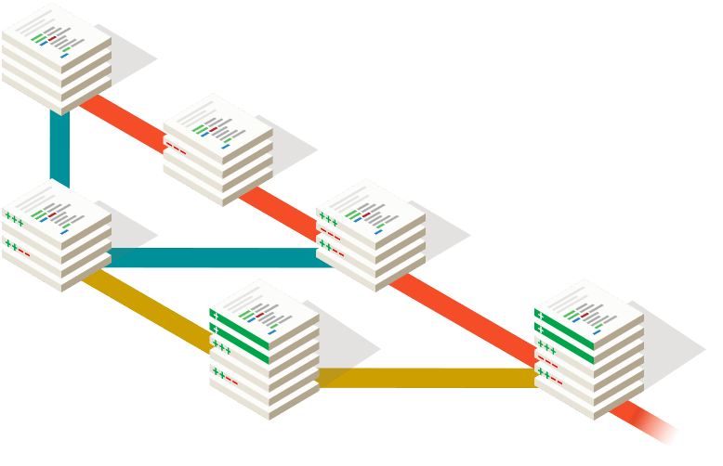
git
the incomplete introduction
René Schwietzke, Xceptance, 2013
v 0.95

Slide 2
Please don't...
Please don't ask for any mapping of SVN to Git commands. Git is different and you cannot simply use the same approach and commands.
Of course you can, but people will hate you forever.

Slide 3

Some (de)motivation first
Most of things are borrowed
Command line only first
Yes, you can mess things up
Don't be scared!
Be scared and respect the tool!
Not every term will be introduced
Google is your friend
Go http://git-scm.com/ and use the book!
Share this deck, it is CC-BY-SA licensed

Slide 4
Why are we so... excited?
Subversion is ok – Git is better
Commit often, very often...
Everything is local
Everything is distributed
Cheap branching
Data assurance
Fast
Everything has a history... P.S That is going to be important later on
The swiss army knife – you just have to know how to use it.

Slide 5
What is that GIT/git/Git thing?
Distributed Version Control System (DVCS)
Open Source
Started by Linus T. to aid kernel development
Used by a lot of projects
Git is not GitHub!
Git is a free and open source distributed version control system designed to handle everything from small to very large projects with speed and efficiency.

Slide 6
Git takes care of...
Content: by protecting each commit with SHA-1
History: by keeping relations
Merges: by using the history
Speed: by using snapshots and not diffs

Slide 7





Distributed vs. Centralized
Centralized
Distributed

Slide 8
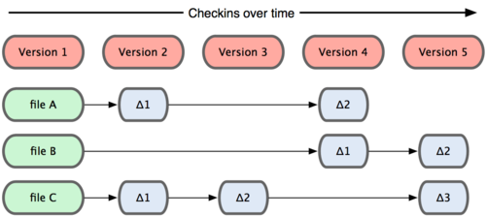
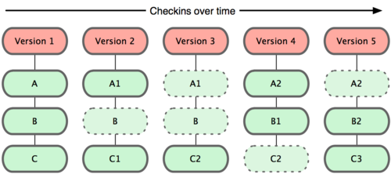
How things are stored
Snapshots and not file differences

Slide 9
Lifetime phases of data
Unmodified – you did nothing
Modified – you changed something
Staged – you prepared for a commit
Committed – you made changes permanent
Pushed – you shared your changes
You have to tell Git that you want a file to be included in the next commit. Git is opt-in!
The thingy were Git keeps your soon to be committed data is called the staging area.

Slide 10
What is a commit?
A commit is a snapshot of files
Keeps references to its parents
Has a unique SHA-1 over the content
Local ~$ git show --pretty=raw 28d88a4
commit 28d88a44d6640a7ab89aa9b0db0597e36b50c831
tree 55335193a182bc9e2850d00700ff482896f95c0f
parent bcbb62be834ca0abd4b81952e612bf64f57bedb2
author Kati Smith <kati@foobar.net> 1379449534 +0200
committer Kati Smith <kati@foobar.net> 1379449534 +0200
Fallback code added
Local ~$ git show --pretty=fuller 0da605d
commit 0da605df6974eaeef472355936b9fc15912a6211
Merge: a6c4011 28d88a4
...

Slide 11
Data assurance and commits
Git does not have a counter
Git has data assurance
  Changes in the past will change anything from that point in time
A commit knows its predecessors
A commit has a unique SHA-1
Any change to a commit changes the SHA-1
Any new SHA-1 is something new despite the same content (see rebase)

Slide 12
What is a branch?
A branch is just a pointer to a commit that is the branch head
A branch contains everything that can be reached by following the parent relations
A branch is like a parallel universe
Each branch has a name
A
B

Slide 13
Get your hands gitty
We play with git

Slide 14
Get your hands gitty
Local repo first
Learn the basics
Clone a remote repo
Some magic around shared code
Local ~$ git –-version
git version 1.8.3.4

Slide 15
git init
Creates a new repository right here
Never ever play with .git subdirectory
Local ~$ mkdir mytest
Local ~$ cd mytest
Local ~mytest$ git init
Initialized empty Git repository in ~mytest/.git/
Local ~mytest$ ls -la
total 0
drwxrwxr-x 3 tfontane tfontane 60 Jul 27 20:56 .
drwxrwxr-x 7 tfontane tfontane 200 Jul 27 20:56 .git

Slide 16
git init
git
HEAD
?
File Sys

Slide 17
git config
Tell something about you
Git identifies you but does not authenticate!
Stash/GitLab/GitHub do the authentication
Local ~$ git config user.name "Rene Schwietzke"
Local ~$ git config user.email "emailme@foobar.com"
Local ~$ git config --global user.name "Rene Schwietzke"
Local ~$ git config --global user.email "emailme@foobar.com"

Slide 18
git status - add a little
Create a file and fill it
Check the status
git status is your friend!
Local ~mytest$ vi foo.txt
Local ~mytest$ git status
# On branch master
#
# Initial commit
#
# Untracked files:
# (use "git add <file>..." to include in what will be committed)
#
# foo.txt
nothing added to commit but untracked files present (use "git add" to track)

Slide 19
Modified
git
HEAD
?
File Sys
foo.txt

Slide 20
git add / git status
Stage the file to make it known to git
Git will snapshot the file
Check the state
Local ~mytest$ git add foo.txt
Local ~mytest$ git status
# On branch master
#
# Initial commit
#
# Changes to be committed:
# (use "git rm --cached <file>..." to unstage)
#
# new file: foo.txt
#
Local ~mytest$ git add . # all recursive
Local ~mytest$ git add * # all in current dir

Slide 21
Staged
master
git
HEAD
?
foo.txt
File Sys
foo.txt

Slide 22
git commit – engrave it in stone
Make your changes permanent
Commits only what you staged
No commit comment – no fun!
Local ~mytest$ git commit -m “Just started”
[master (root-commit) c6a0313] Just started
1 file changed, 2 insertions(+)
create mode 100644 foo.txt
Local ~mytest$ git status
# On branch master
nothing to commit, working directory clean
Local ~mytest$

Slide 23
Committed
master
git
HEAD
c6a0313
File Sys
foo.txt

Slide 24
Play it again Sam!
master
git
HEAD
c6a0313
64177f
File Sys
foo.txt

Slide 25
git branch / git checkout
Cheap and fast
Your playground to try things, finish things, and share things, all that without disturbing others
Use a branch, Luke!
Local ~mytest(master)$ git branch mybranch1; git checkout mybranch1
Local ~mytest(master)$ git checkout -b mybranch1
Switched to a new branch 'mybranch1'
Local ~mytest(mybranch1)$ git status
# On branch mybranch1
nothing to commit, working directory clean
Local ~mytest(mybranch1)$ git branch
master
* mybranch1
Local ~mytest(mybranch1)$ git checkout master
Switched to branch 'master'
Local ~mytest(master)$ git checkout mybranch1
Switched to branch 'mybranch1'

Slide 26
Branch View
master
git
HEAD
c6a0313
64177f
HEAD
mybranch1

Slide 27
Modify / Add / Commit
master
git
HEAD
c6a0313
64177f
7a1198e
HEAD
mybranch1

Slide 28
Back to master and new file
master
git
HEAD
c6a0313
64177f
407084b
7a1198e
HEAD
mybranch1

Slide 29
git rebase on mybranch1
Prepare mybranch1 for merge into master
Resolve conflicts in the branch
Rebasing means rewriting of history
Local ~mytest$ git checkout mybranch1
Local ~mytest$ git rebase master
First, rewinding head to replay your work on top of it...
Applying: Longer sentence
Local ~mytest$ git log --oneline --decorate
703e3f7 (HEAD, mybranch1) Longer sentence
407084b (master) First readme version
641771f Again
c6a0313 Just started

Slide 30
We rebased
master
git
HEAD
c6a0313
64177f
407084b
7a1198e
703e3f7
HEAD
mybranch1

Slide 31
git merge into master
Get your changes into the master
Should run great because you rebased first
Git will remember that the branch was merged
Git will remember the content aka the SHA-1s
Local ~mytest$ git checkout master
Local ~mytest$ git merge mybranch1
Updating 407084b..703e3f7
Fast-forward
foo.txt | 2 +-
1 file changed, 1 insertion(+), 1 deletion(-)
Local ~mytest$ git log --oneline --decorate
703e3f7 (HEAD, mybranch1, master) Longer sentence
407084b First readme version
641771f Again
c6a0313 Just started

Slide 32
We merged via fast-forward
master
git
HEAD
c6a0313
64177f
407084b
703e3f7
HEAD
mybranch1

Slide 33
That was normal but not cool
We fast-forwarded and lost merge info
Fast-forward makes it look like a direct commit
Will retain all single commits and smuggle them into the target branch
Hard to figure out what was going on
Use --no-ff all the time when merging
Fast-forwarding is great for rebasing but not for merging (exceptions apply)

Slide 34
Prepare again
master
git
HEAD
407084b
703e3f7
750ba6b
HEAD
mybranch2

Slide 35
Prevent fast-forwarding
Use --no-ff all the time
Local ~mytest$ git checkout master
Local ~mytest$ git merge --no-ff mybranch2
Merge made by the 'recursive' strategy.
lion.txt | 1 +
1 file changed, 1 insertion(+)
create mode 100644 lion.txt
Local ~mytest$ git log --oneline --decorate --graph
* f223150 (HEAD, master) Merge branch 'mybranch2'
|\
| * 750ba6b (mybranch2) The new file
|/
* 703e3f7 (mybranch1) Longer sentence
* 407084b First readme version
* 641771f Again
* c6a0313 Just started

Slide 36
Perfect merge via --no-ff
master
git
HEAD
407084b
703e3f7
f223150
750ba6b
HEAD
mybranch2

Slide 37
Remove merged branches
Always clean up never not continue
Merging means finishing up!
More reasons: see reverting a merge
Local ~mytest$ git branch -d mybranch1
Deleted branch mybranch1 (was 703e3f7).
Local ~mytest$ git branch -d mybranch2
Deleted branch mybranch2 (was 750ba6b).
Local ~mytest$ git log –-oneline –-decorate –-graph
* f223150 (HEAD, master) Merge branch 'mybranch2'
|\
| * 750ba6b The new file
|/
* 703e3f7 Longer sentence
* 407084b First readme version
* 641771f Again
* c6a0313 Just started

Slide 38
Clean up after merges
master
git
HEAD
407084b
703e3f7
f223150
750ba6b

Slide 39
The small helpers
Other commands you might need

Slide 40
git rm – remove stuff
git rm removes and stages
Register already deleted files with git rm
Local ~mytest$ git rm lion.txt
rm 'lion.txt'
Local ~mytest$ git status
# On branch remove1
# Changes to be committed:
# (use "git reset HEAD <file>..." to unstage)
#
# deleted: lion.txt
#
Local ~mytest$ rm readme.txt
Local ~mytest$ git rm readme.txt

Slide 41
git mv – rename stuff
git mv renames/relocates and stages
Recommended but not required
git tracks content not files so it guesses external moves based on content similarity
Local ~mytest$ git mv readme.txt README
Local ~mytest$ git status
# On branch remove1
# Changes to be committed:
# (use "git reset HEAD <file>..." to unstage)
#
# renamed: readme.text -> README
#
Local ~mytest$ git commit -m “Adjusted to GitHub style”
[remove1 72f240a] Adjusted to Github style
1 file changed, 0 insertions(+), 0 deletions(-)
rename readme.text => README (100%)

Slide 42
git diff – what changed?
To see changes locally: now vs. HEAD
Local ~mytest$ change a file, e.g. README
Local ~mytest$ git diff
diff --git a/README b/README
index a3a48b3..81db0bb 100644
--- a/README
+++ b/README
@@ -1 +1 @@
-My readme and it is more
+My readme and it is more.
Local ~mytest$ git diff --word-diff
diff --git a/README b/README
index a3a48b3..81db0bb 100644
--- a/README
+++ b/README
@@ -1 +1 @@
My readme and it is [-more-]{+more.+}
Local ~mytest$ git diff README
...

Slide 43
git diff – what changed?
To see changes of commits
Local ~mytest$ git log <you know the rest>
* 079aaab (HEAD, origin/master, master) master 3
* 7ba35ee master 2
* cad3fee master 1
Local ~mytest$ git show 079aaab
What changed with 079aaab
Local ~mytest$ git diff 7ba35ee
What changed since 7ba35ee aka the change introduced by 079aaab
Local ~mytest$ git diff 703e3f7 README
Same as before, but limited to a specific file
Local ~mytest$ git log --since=2.weeks readme.txt
List all commits that touched readme.txt in the last two weeks.
Local ~mytest$ git log --since=2.weeks -G Rene
Where 'Rene' was in the changes including removals in the last two weeks.
You can go nuts here. Google it when you need it. It is powerful and allows basically everything possible to find and identify changes and problems.

Slide 44
git mergetool – conflict solver
Solve conflicts during rebasing and merging
Uses the configured tool of your choice
Local ~mytest$ git rebase origin/qa
First, rewinding head to replay your work on top of it...
Applying: Conflict
Using index info to reconstruct a base tree...
M qa/start.txt
Falling back to patching base and 3-way merge...
Auto-merging qa/start.txt
CONFLICT (content): Merge conflict in qa/start.txt
Failed to merge in the changes.
Patch failed at 0001 Conflict
The copy of the patch that failed is found in:
/tmp/learn_git/.git/rebase-apply/patch
When you have resolved this problem, run "git rebase --continue".
If you prefer to skip this patch, run "git rebase --skip" instead.
To check out the original branch and stop rebasing, run "git rebase –abort".
Local ~mytest$ git mergetool
Local ~mytest$ git rebase --continue

Slide 45
git cherry-pick – simply the best
Rescue commits
Preserves all data but the SHA-1 because of the new predecessor
Good for downstream hotfix merges
Use to preserve pieces of a dead branch
Local ~mytest (master)$ git checkout -b kirsche
Local ~mytest (kirsche)$ git cherry-pick 56fe781
[tets b8c3f20] New readme file
1 file changed, 1 insertion(+)

Slide 46
Dealing with Oops!
The reason for version control

Slide 47
Forgot something? --amend
Changes the last commit (when not pushed!)
Removes old commit, creates new commit
Local ~mytest$ change two files
Local ~mytest$ git commit -m “Updated two files”
Local ~mytest$ git log --stat
* 5cb60ce (HEAD, master) Updated two files
| foobar.txt | 1 +
| 1 file changed, 1 insertion(+)
* 0da605d Merge branch 'oauth.fix'
Local ~mytest$ git add file2.txt
Local ~mytest$ git commit --amend -m “Really updated two files”
Local ~mytest$ git log --stat
* c3ae1b1 (HEAD, master) Really updated two files
| foobar.txt | 1 +
| readme.txt | 1 +
| 2 files changed, 2 insertions(+)
* 0da605d Merge branch 'oauth.fix'

Slide 48
Staged too much?
Remove from the staging area
Not very intuitive... sadly enough
Local ~mytest$ git add test.txt
Local ~mytest$ git status
# On branch master
# Changes to be committed:
# (use "git reset HEAD <file>..." to unstage)
#
# new file: test.txt
#
Local ~mytest$ git reset HEAD test.txt
Local ~mytest$ git status
# On branch master
# Untracked files:
# (use "git add <file>..." to include in what will be committed)
#
# test.txt
nothing added to commit but untracked files present (use "git add" to track)

Slide 49
Get rid off the last commit
Kills the last commit without a trace
Of course, only when not shared yet
Local ~mytest$ git log
* 4db3017 (HEAD, master) Too much, oops
* a0a842d Fine 2
* 99ca82a Fine 1
Local ~mytest$ git reset HEAD~1
Unstaged changes after reset:
M readme.txt
Local ~mytest$ git log
* a0a842d (HEAD, master) Fine 2
* 99ca82a Fine 1

Slide 50
git revert – undo things I
Reverting means committing reversed content
Step 1: Identify hash aka revision
Local ~mytest$ git log --oneline --graph --decorate
* 01d9051 (HEAD, master) Cleaner now
|\
| * 72f240a Adjusted to Github style
| * 5a9e51a Redundant file removed
|/
* f223150 Merge branch 'mybranch2'
|\
| * 750ba6b The new file
|/
* 703e3f7 Longer sentence
* 407084b First readme version
* 641771f Again
* c6a0313 Just started

Slide 51
git revert – undo things II
Step 2: Undo the work with a “negative” commit
Revert a revert the same way
Local ~mytest$ git revert 5a9e51a
[master 7b6e6cf] Revert "Redundant file removed"
1 file changed, 1 insertion(+)
create mode 100644 lion.txt
Local ~mytest$ git log <you know the rest> --stat
* 7b6e6cf (HEAD, master) Revert "Redundant file removed"
| lion.txt | 1 +
| 1 file changed, 1 insertion(+)
* 01d9051 Cleaner now
|\
| * 72f240a Adjusted to Github style
| | README | 1 +
| | readme.text | 1 -
| | 2 files changed, 1 insertion(+), 1 deletion(-)
| * 5a9e51a Redundant file removed
|/
| lion.txt | 1 -
| 1 file changed, 1 deletion(-)
...

Slide 52
git revert – revert a merge
Merges are reverted like any other commit
But when you continue to work on it and merge later, it does not work as expected
Git does not track the content, but the commits
When commits are already in the tree, the next merge with them again makes no difference aka they are still reverted
Revert the revert in these cases first

Slide 53
git revert – revert a merge
Local ~mytest (master)$ git log
* 5169844 (HEAD, master) Foo is new
* 35a597f Merge branch 'test1'
|\
| * 52212e1 A change in readme
|/
* bbd0c7b (origin/master) Readme 2
# identify predecessor to use
Local ~mytest (master)$ git show 35a597f
Merge: bbd0c7b 52212e1
Author: Peter Meier <r.schwietzke@xceptance2.net>
...
# revert 35a597f
Local ~mytest (master)$ git revert -m 1 35a597f
# create branch to continue
Local ~mytest (master)$ git checkout -b fix-it
# revert the revert in the branch to see original code
Local ~mytest (fix-it)$ git revert 42635ec
# fix all the bad stuff and merge
Local ~mytest (fix-it)$ edit, add, commit...
Local ~mytest (fix-it)$ git checkout master
Local ~mytest (master)$ git merge --no-ff fix-it
# clean up
Local ~mytest (master)$ git branch -d fix-it

Slide 54
git revert – revert a merge
42635ec – revert in main branch
b8796e0 – revert of the revert to continue later
70e18de – second merge attempt including fix
Local ~mytest (master)$ git log
* 70e18de (HEAD, master) Merge branch 'fix-it', previously test1
|\
| * d980ef0 Fixed the bad stuff
| * b8796e0 Revert of "Revert "Merge branch 'test1'""
|/
* 42635ec Revert "Merge branch 'test1'"
* 5169844 Foo is new
* 35a597f Merge branch 'test1'
|\
| * 52212e1 A change in readme
|/
* bbd0c7b (origin/master) Readme 2

Slide 55
git reset/checkout – trash it
Kill or revert all your uncommitted changes
# git rid off all changes
Local ~mytest$ change a file, e.g. README
Local ~mytest$ git reset --hard
HEAD is now at 25f967d ! The was the message.
# remove from staging area
Local ~mytest$ change a file
Local ~mytest$ git reset README
Unstaged changes after reset:
M README
# get README back to last commited state
Local ~mytest$ git checkout README
Local ~mytest$ git status
# On branch master
nothing to commit, working directory clean

Slide 56
It is called branching, not treeing
Do not build trees from your branches

Slide 57
Branches – important to know
Remember, every commit has at least one parent
So your branch is based on something
If you merge your branch to a place you have not started from, you get everything merged that is not yet in... not just what you have touched
Git makes sure that nothing is lost
A branch is just a pointer!

Slide 58
Branches – the unexpected
?
A
B
C
D
E
F
1
2
W
X
Y
Z
CD12

Slide 59
Branches – cherry-pick from red
1
2
1'
2'
Local (red)$ git checkout -b get-red-in
Switched to new branch 'get-red-in'
Local (get-red-in)$ git cherry-pick 1 2
Local (get-red-in)$ git checkout green
Switched to branch 'green'
Local (green)$ git merge --no-ff get-red-in -m “Cherry picked the red”
...
Local (green)$ git branch -d get-red-in

Slide 60
A small workflow
Just you and git. Local and simple.

Slide 61
Small and quick local workflow
Practice the workflow in your local world
Local (abranch)$ git checkout master
Switched to branch 'master'
Local (master)$ git checkout -b new-branch
Local (new-branch)$ edit and commit often
Local (new-branch)$ git rebase master
Local (new-branch)$ git checkout master
Local (master)$ git merge --no-ff new-branch -m “Cleaner now”
Removing lion.txt
Merge made by the 'recursive' strategy.
readme.text => README | 0
lion.txt | 1 -
2 files changed, 1 deletion(-)
rename readme.text => README (100%)
delete mode 100644 lion.txt
Local (master)$ git branch -d new-branch

Slide 62
Let's go remote now
Play with others in the same sandbox

Slide 63
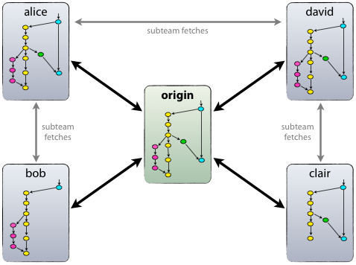
Let's go remote
Every repository is a complete repo
Except for unsynced changes with “friends”
No obligation to use a remote
More than one remote possible
No obligation to upload (push) everything
Only what you want to share
Only what you have to protect

Slide 64
git clone – get a remote repo
Get a remote repo downloaded
Git automatically sets up tracking
Local ~mytest$ git clone ssh://git@git0.foobar.net:7999/train/learn_git.git
Cloning into 'learn_git'...
remote: Counting objects: 192, done.
remote: Compressing objects: 100% (160/160), done.
remote: Total 192 (delta 78), reused 0 (delta 0)
Receiving objects: 100% (192/192), 20.35 KiB | 0 bytes/s, done.
Resolving deltas: 100% (78/78), done.
Checking connectivity... done
Local ~mytest$ cd learn_git
Local ~mytest$ git status
* master
Local ~mytest$ git remote --verbose
origin ssh://git@git0.foobar.net:7999/train/learn_git.git (fetch)
origin ssh://git@git0.foobar.net:7999/train/learn_git.git (push)

Slide 65
git fetch – get work from others
Fetches data from remote
Does not touch your work
Local ~mytest$ git fetch origin
remote: Counting objects: 7, done.
remote: Compressing objects: 100% (4/4), done.
remote: Total 4 (delta 2), reused 0 (delta 0)
Unpacking objects: 100% (4/4), done.
From ssh://git0.svc1.foobar.net:7999/train/learn_git
aa2e115..d85515d qa -> origin/qa
Local ~mytest$ git diff aa2e115..d85515d
diff --git a/qa/start.txt b/qa/start.txt
index 006f308..067ab29 100644
--- a/qa/start.txt
+++ b/qa/start.txt
@@ -1,3 +1,5 @@
This is beginning of a text.
It might continue.
Or it might now.
+I am remote.

Slide 66
git merge/rebase – pull it in
Works like a local rebase or merge
Picks the way that fits best
Merge to make operation visible
Rebase to just get you updated to latest
Local ~mytest$ git fetch origin
Local ~mytest$ git merge origin/qa
Merge made by the 'recursive' strategy.
qa/start.txt | 2 +-
1 file changed, 1 insertion(+), 1 deletion(-)
Local ~mytest$ git rebase origin/qa
First, rewinding head to replay your work on top of it...

Slide 67
git pull – fetch and merge
Pull is fetch and merge in one command
There is no --no-ff option, git picks the best way
So prefer --rebase when content is unpushed
Local ~mytest$ git pull origin mybranch
From ssh://git0.foobar.net:7999/train/learn_git
* branch mybranch -> FETCH_HEAD
Updating 0d1c02a..974c00d
Fast-forward
qa/start.txt | 2 ++
1 file changed, 2 insertions(+)
Local ~mytest$ git pull --rebase origin mybranch

Slide 68
git push – deliver your work
Deliver your work to a remote destination
Nothing changes (commit hashes)
DO NOT CROSS PUSH
Local ~mytest$ branch, edit, commit
Local ~mytest$ git push origin qa
Counting objects: 5, done.
Delta compression using up to 4 threads.
Compressing objects: 100% (3/3), done.
Writing objects: 100% (4/4), 377 bytes | 0 bytes/s, done.
Total 4 (delta 1), reused 0 (delta 0)
To ssh://git@git0.foobar.net:7999/train/learn_git.git
* [new branch] qa -> qa
Local ~mytest$ git log
* 0743e1d (HEAD, origin/qa, qa) QA directory
* d0400d5 (origin/master, origin/HEAD, master) Merge pull request #12...
...

Slide 69
git push – too slow and you fail
Someone was faster
You have to get the remote changes first
Prefer rebase over merge, avoids ugly commit
Local ~mytest$ branch, edit, commit
Local ~mytest$ git push origin master
To ssh://git@gitlab.foobar.de/test/training.git
! [rejected] master -> master (fetch first)
error: failed to push some refs to 'ssh://git@gitlab.foobar.de/test/training.git'
hint: Updates were rejected because the remote contains work that you do not have locally. This is usually caused by another repository pushing to the same ref. You may want to first integrate the remote changes (e.g., 'git pull ...') before pushing again.
See the 'Note about fast-forwards' in 'git push --help' for details.
Local ~mytest$ git log
* 3fc556d (HEAD, master) New text
* ba74a5a (origin/master) Merge branch 'michael'
|\
| * bd8bf6e Micha branch
* | 57cdc9a Code addded
|/

Slide 70
git pull --rebase
You have not shared the commit, so rebase for clean history with the remote content.
See, no non-sense merge!
Local ~mytest$ git log
* 3fc556d (HEAD, master) New text
* ba74a5a (origin/master) Merge branch 'michael'
...
Local ~mytest$ git pull --rebase origin master
...
First, rewinding head to replay your work on top of it...
Applying: New text
Local ~mytest$ git log
* 85f62f6 (HEAD, master) New text
* c2e9a1a (origin/master) One more thing added
* ba74a5a Merge branch 'michael'
|\
| * bd8bf6e Micha branch
...

Slide 71
git pull – the ugly merge
By default you get a merge when you have local changes
Local ~mytest$ git log
* 2272ff5 (HEAD, master) No stuff anymore
* f5d6db1 (origin/master) Entry 10
* fd4fdd7 Entry 9
Local ~mytest$ git pull origin master
...
From ssh://gitlab.foobar.de/asdf/traning
* branch master -> FETCH_HEAD
f5d6db1..d39a17e master -> origin/master
Merge made by the 'recursive' strategy.
asdf.txt | 0
1 file changed, 0 insertions(+), 0 deletions(-)
create mode 100644 asdf.tct
Local ~mytest$ git log
* d1247b3 (HEAD, master) Merge branch 'master' of ssh://gitlab.foobar.de...
|\
| * d39a17e (origin/master) New file
* | 2272ff5 No stuff anymore
|/
* f5d6db1 Entry 10

Slide 72
A small shared workflow
Just you, git, and other dudes or dudettes.

Slide 73
Let me flow alone
# get the master latest changes
Local ~(master)$ git pull --rebase origin master
# create a new branch with a meaningful name and switch
Local ~(master)$ git checkout -b jaropener-4210
# do some development
Local ~(jaropener-4210)$ git add File.java; git commit -m “base class”
Local ~(jaropener-4210)$ git add .; git commit -m “tests added”
# switch to master
Local ~(jaropener-4210)$ git checkout master
# get the latest master changes, no local changes assumed
Local ~(master)$ git pull --rebase origin master
# switch to branch
Local ~(master)$ git checkout jaropener-4210
# rebase branch against master, assuming you have not pushed your branch!
Local ~(jaropener-4210)$ git rebase master
# switch to master
Local ~(jaropener-4210)$ git checkout master
# merge the branch in without fast-forward to get a single commit
Local ~(master)$ git merge --no-ff jaropener-4210
# delete the branch now, you merged it!
Local ~(master)$ git branch -d jaropener-4210
# refresh your master, no further local changes
Local ~(master)$ git pull --rebase origin master
# push your work and be happy
Local ~(master)$ git push origin master

Slide 74
Merge vs. Rebase
The common misunderstanding

Slide 75
But SVN...
SVN does not have a rebase
Server counts up and each commit gets a number
What is merged ends in mergeinfo properties
Git uses a cryptographic hash to protect content
Includes the parents in that aka new parent, new hash
It is non-linear but linear... confused?
Git forms a chain of content

Slide 76
Rebase vs. Merge
Rebase
  Makes your work latest
  Set's your work aside, updates branch, puts your work on top of it, so your work wins mostly
  Removes all your commits and creates them new
  Bad when already shared
Merge
  Fits your work into the timeline
  Uses the timeline to figure out who is right
  Creates a commit with the merge content

Slide 77
Local rebase and merge visualized
aa
1245aab
bb
cc
master
aa
1245aab
bb
dd
ee
mybranch
HEAD
git rebase master
aa
1245aab
bb
cc
master
aa
1245aab
bb
cc
dddd
eeee
mybranch
HEAD
HEAD
git merge --no-ff mybranch
aa
1245aab
bb
cc
ff
master
dddd
eeee

Slide 78
Rebase from remote visualized
HEAD
a54341b
1245aab
a54341b
c3dffd1
19ab4dd
master
a54341b
1245aab
a54341b
c3dffd1
561abcd
origin/master
HEAD
git pull --rebase origin master
a54341b
1245aab
a54341b
c3dffd1
561abcd
61b48aa
master
a54341b
1245aab
a54341b
c3dffd1
561abcd
origin/master
HEAD
git push origin master
a54341b
1245aab
a54341b
c3dffd1
561abcd
61b48aa
master
a54341b
1245aab
a54341b
c3dffd1
561abcd
61b48aa
origin/master

Slide 79
Remote merge visualized
HEAD
a54341b
1245aab
a54341b
c3dffd1
19ab4dd
master
a54341b
1245aab
a54341b
c3dffd1
561abcd
origin/master
561abcd
HEAD
git pull origin master
a54341b
1245aab
a54341b
c3dffd1
19ab4dd
981715a
master
a54341b
1245aab
a54341b
c3dffd1
561abcd
origin/master
561abcd
HEAD
git push origin master
a54341b
1245aab
a54341b
c3dffd1
19ab4dd
981715a
master
a54341b
1245aab
a54341b
c3dffd1
19ab4dd
981715a
origin/master
561abcd

Slide 80
When to rebase
When you cannot push because someone was faster: git pull --rebase
When you have not shared anything and want to have a clean branch and solve the possible merge conflicts before merging
When you do not care about your base

Slide 81
When rebase becomes evil
When you shared commits already
When you branch off of the to-be-rebased branch aka you shared you commit with yourself already
When you already merged in from other branches
Do not forget, squashing means rewriting too
Rebasing means rewriting of commits!

Slide 82
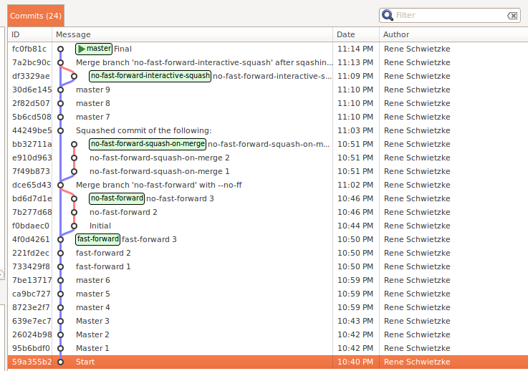
Merge/no-ff/squash?

Slide 83
Misc
Does not fit anywhere else

Slide 84
Some other stuff
Force branch delete: git branch -D name
Remote delete: git push origin :name
Stash things away: git stash save
Get things back: git stash apply
Remove stash: git stash drop
Clean up after merge: git clean -f -d

Slide 85
Golden git advantages to use
Always branch
Commit often
Not sure about a merge? New branch and try
Rebase your branch before merge, if not shared
Do not run anything advanced, there is barely any reason for doing that
Keep it simple!

Slide 86
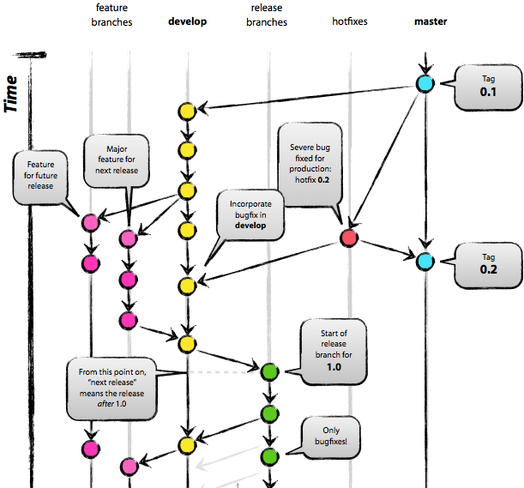
The git future

Slide 87
Tools
In case you don't like the command line

Slide 88
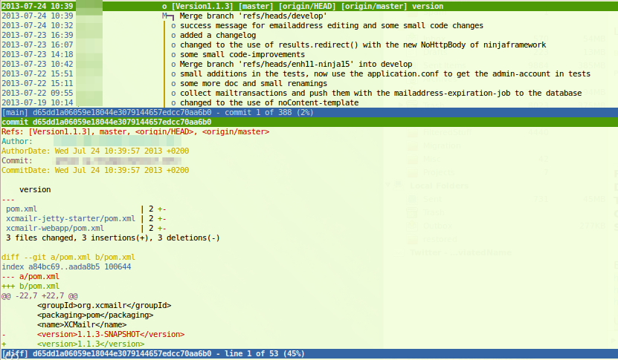
Tools - tig

Slide 89
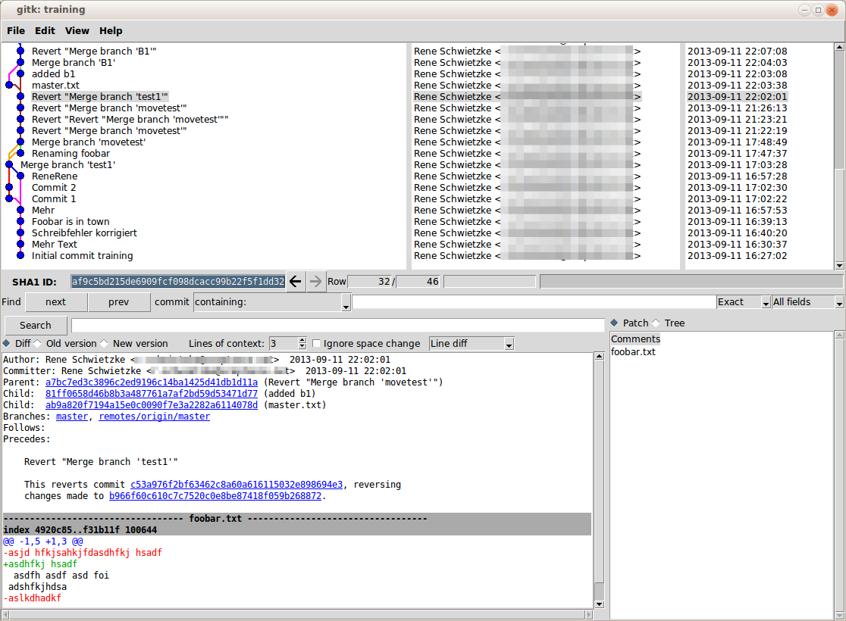
Tools - gitk

Slide 90
A list of tools
GitEye
SmartGit
TortoiseGit
EGit for Eclipse

Slide 91
git blame
Q & A
Your moment to ask questions, to show off, to blame us for wasted life time, blame git, or blame Linus.

Slide 92
git resources
Atlassian's Git Pages
  https://www.atlassian.com/git
The official web page
  http://git-scm.com/
Stuff about Git
  http://gitready.com/

Slide 93
Sources used
http://git-scm.com/
http://gitready.com/
https://www.atlassian.com/git
Subversion DB: http://commons.wikimedia.org/wiki/File:Database-vcs-subversion.svg (CC-BY-SA)
Creative Commons icons: http://creativecommons.org/about/downloads (CC-BY)

Slide 94
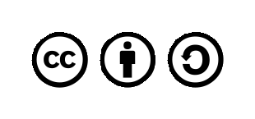
License
Use these slides freely
Share them freely
Modify them freely but share them again
Creative Commons Attribution-ShareAlike 3.0 Unported License
http://creativecommons.org/licenses/by-sa/3.0/deed.en_US

Slide 95
One more last thing... Stash
Stash is a system for git authentication and permission handling
Easy system for setting up reviews
Issuing and handling merge requests
Forking etc.
Connects Jira and code

Slide 96
One more last thing... GitLab
GitLab is a system for git authentication and permission handling
Easy system for setting up reviews
Issuing and handling merge requests
Forking etc.

