Slide 1
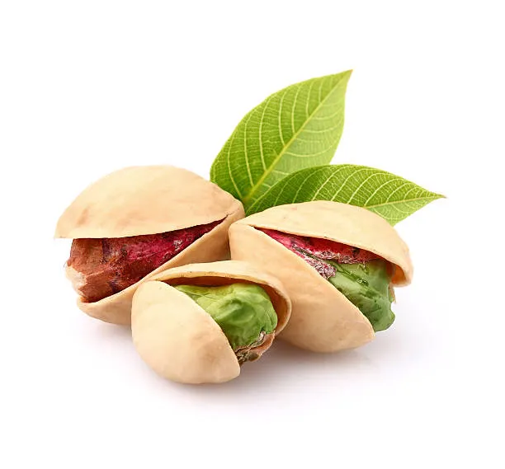
PISTA
Preventive Investigation System for Transaction Auditing
Pista(chio) provides a hard shell for your nuts
to ensure they stays green inside
Mattia Careddu mattia.careddu@conio.com
Antonio Luca antonio.luca@conio.com
Simone Barbanti simone.barbanti@conio.com
Matteo Gagliardi matteo.gagliardi@conio.com
Marco Crotta marco.crotta@conio.com

Slide 2
The objective
Provide a system that:
Detect unusual usage patterns while they happen
Allows smart contracts to react to new threads
Stop novel attacks before they spread too far
Fine tune the response with complex logic like
  bull/bear market
  cross chain events
  broad market status
With flexible logic that changes over time

Slide 3
The problem
Encoding complex & evolving detection logic directly in Solidity is prohibitively expensive and complex.
Even if you could, it would hardly adapt as smart contracts are too rigid
You might need to protect assets of smart contracts you don't control
Reaction might require on-chain and off-chain actions
...by the time you update the contract, the attack has already moved on.

Slide 4
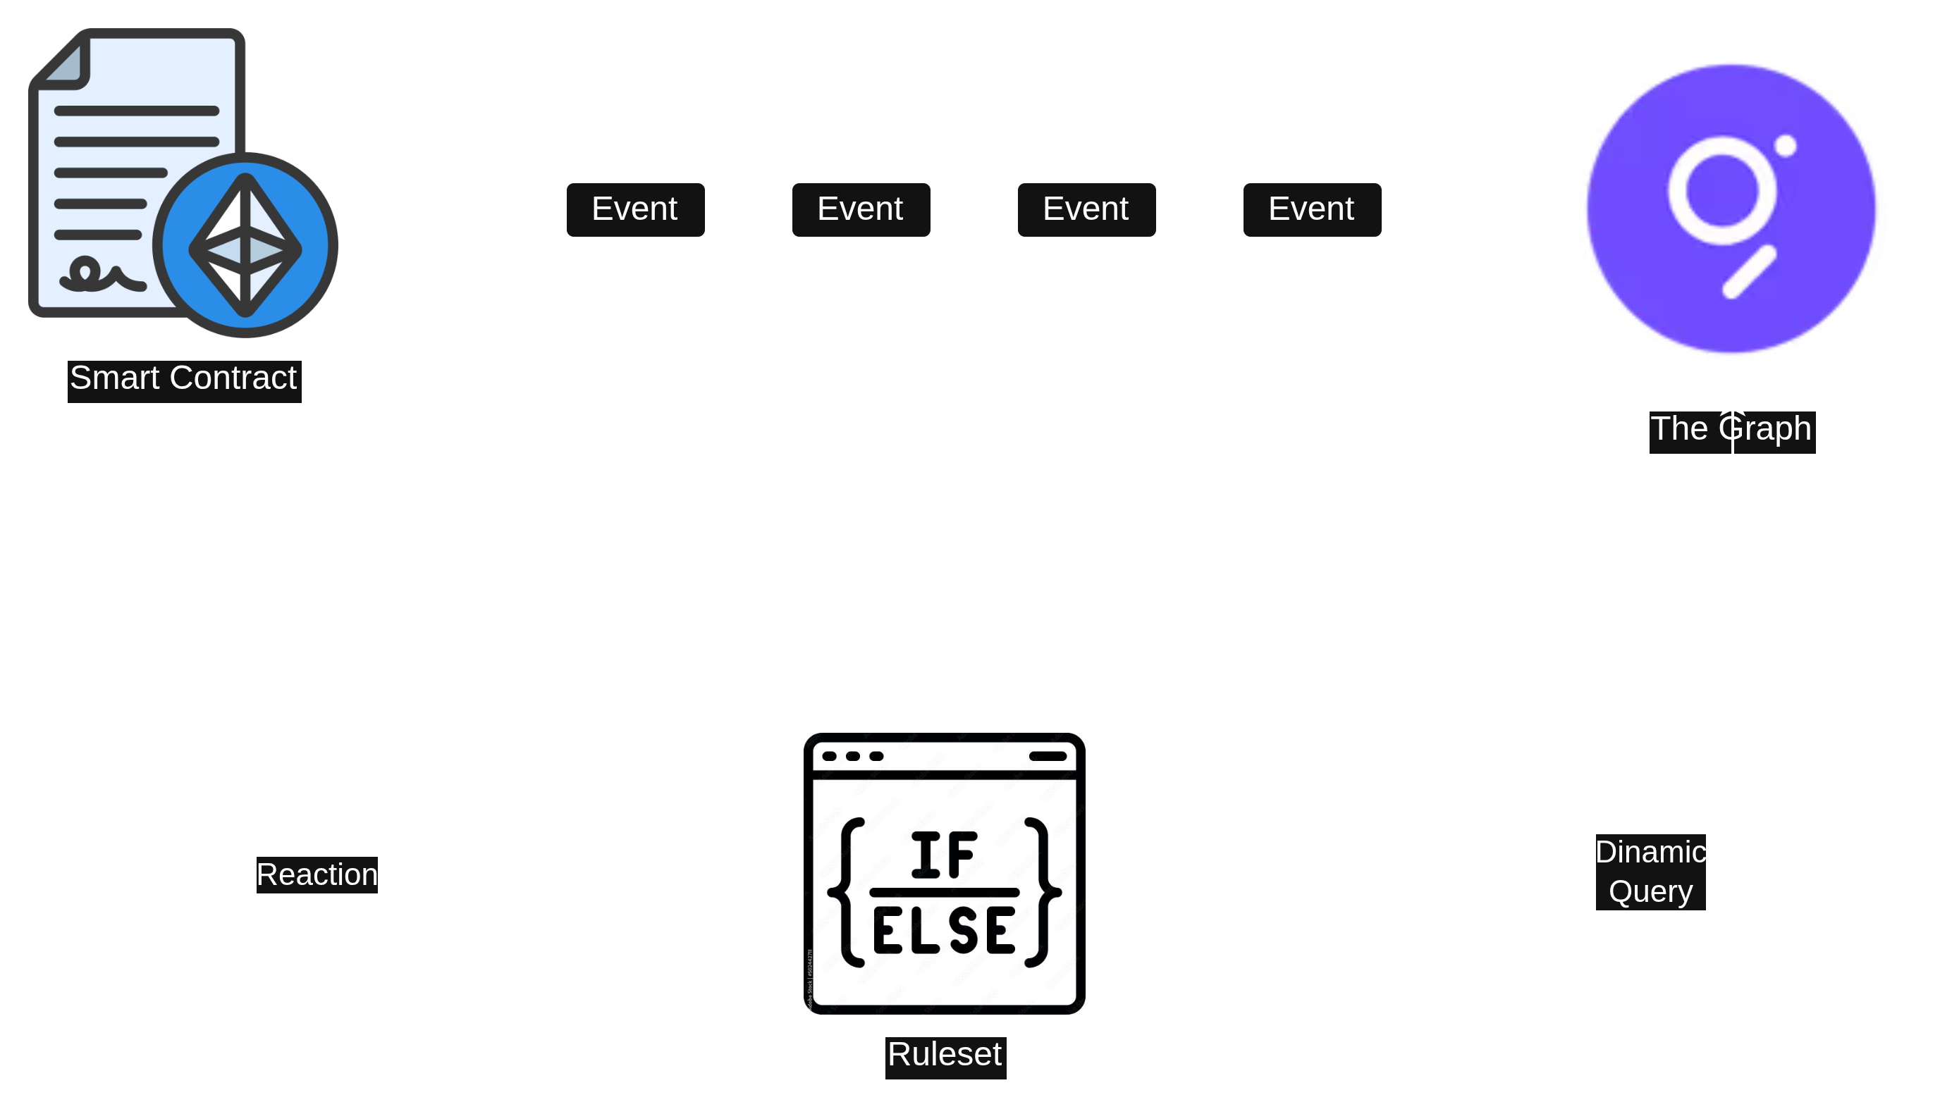
How it works: simple version

Slide 5
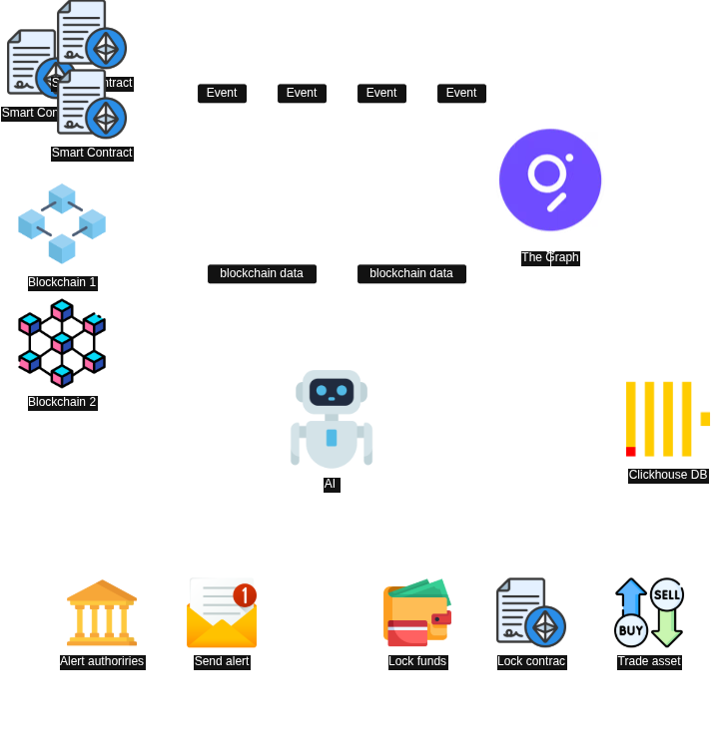
How it might/will work

Slide 6
Examples
Monitor all transactions on a smart contract
Monitor cross-chain assets (USDC/USDT...)
Monitor all stablecoins backed by USD/EUR
Consider broad chain data (eth price, gasprice...)

Slide 7

Why The Graph
What we used
Broad data availability
High throughput
Flexibility over time
Fast indexing & retrieving
Substreams Development (substreams-dev)

Slide 8
Use cases and applications
Detect AML events
Detect new hacks (classic and distributed)
Enforce compliance with regulations (MICAr)
Asset protection

