Slide 1

Smart Warranty Management System —
VaultX
Team: Pavithran , Jupalli Dharan, Santhosh, Sathya, VishnuPrasad
Purpose
Deliver an enterprise- platform to manage warranties, claims, and analytics end-to-end.
Audience
Product managers, technical leads, and stakeholders evaluating a warranty SaaS solution.

Slide 2

Project Overview
VaultX is a digital warranty management platform enabling role-based operations (Customer, Seller, Service Center), end-to-end claim tracking, real-time analytics, and an AI assistant for self-service support.
Key Capabilities
Claim lifecycle with progress tracking
Analytics dashboard for trends and KPIs
AI chatbot for rapid support and triage

Slide 3

Module 1 — Login & Authentication
Owner: Vishnu Prasad
User Registration & Secure Login
Strong password rules, encrypted storage, and session controls.
Role-Based Authentication
Distinct access levels for Customer, Seller, and Service Center roles.
OTP & Google Sign-In
Phone/email OTP and Google OAuth for streamlined onboarding.
Session Management
Timeouts, secure logout, and refresh token policies to reduce risk.

Slide 4


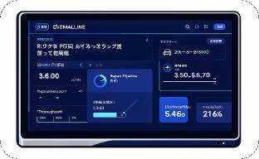
Module 2 — Service Center Dashboard
Owner: Sathya
Claim Review
Approve or reject claims with audit trail and standardized reasons.
Status & Progress
Update statuses (Pending → Repair → Completed); progress auto-calculated.
Pipeline Monitoring
Live repair queue, SLA alerts, and daily/monthly completion stats.

Slide 5

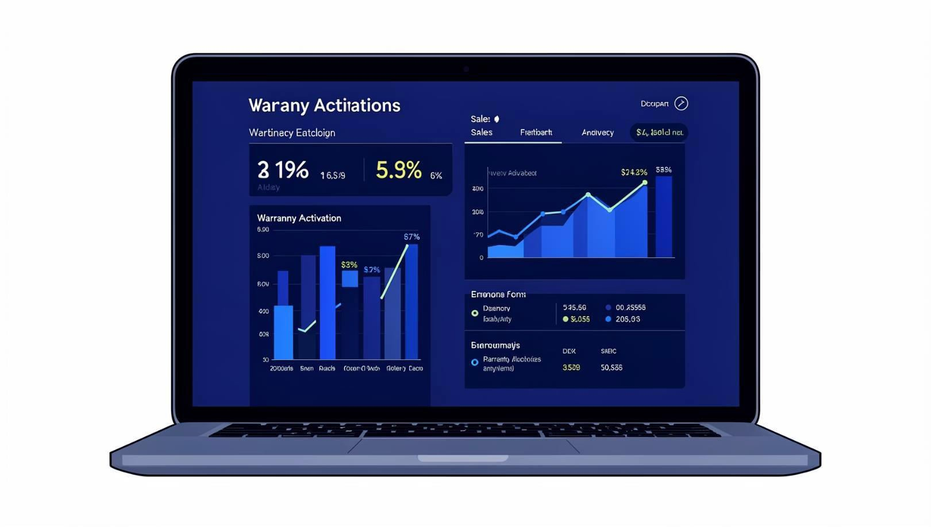
Module 3 — Seller Dashboard
Owner: Santhosh
Customer & Product Registration
Fast onboarding at POS or via portal; capture serials and purchase proof.
Warranty Activation
Automated activation rules, validation, and expiration scheduling.
Sales & Product Analytics
Real-time charts for activations, returns, and seller performance.

Slide 6
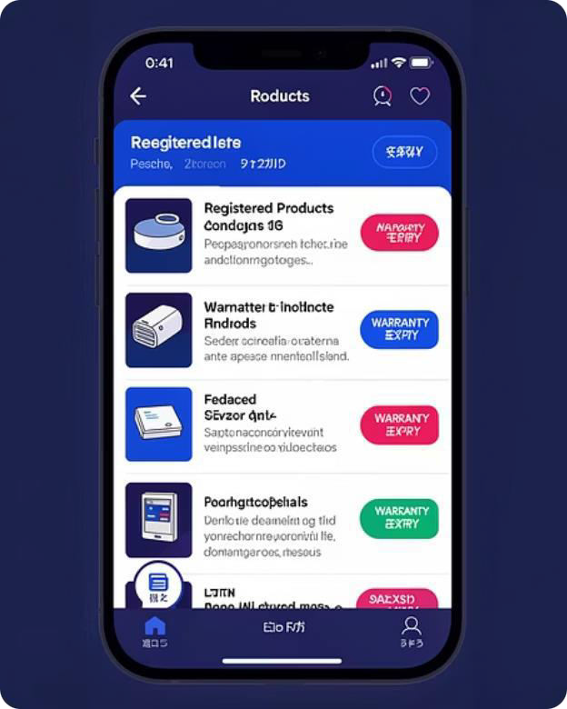
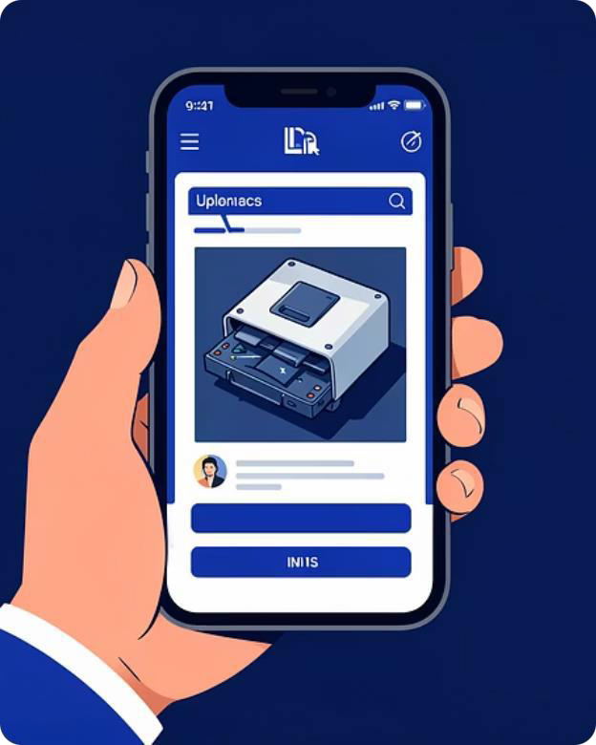
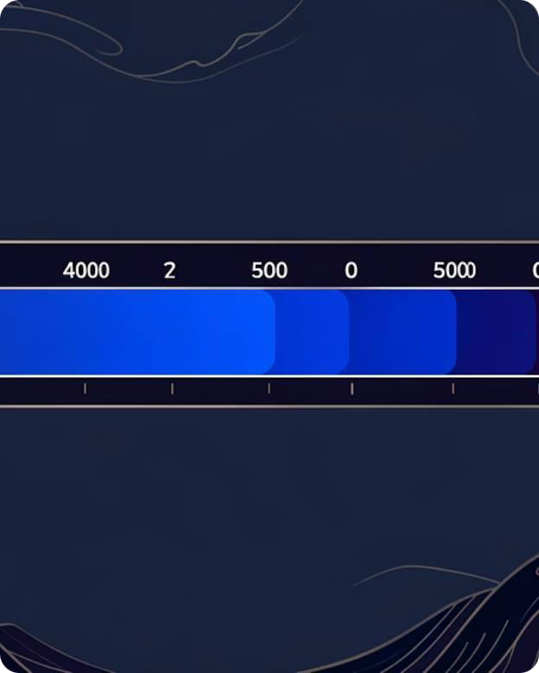
Module 4 — Customer Dashboard
Owner: Jupalli Dharan
Product Registry & Validity
View registered devices and remaining warranty at a glance.
Claims with Attachments
Submit claims with photos/docs; file auto-tagging and validation checks.
Track Repair Progress
Real-time progress updates (0%– 100%) and historical claim timeline.

Slide 7

Module 5 — Backend & Chatbot
Owner: Pavithran V
Tech Stack
Django REST APIs, MySQL persistence, Chart.js for visualizations.
Business Logic
Auto status-progress mapping, role checks, and transaction-safe updates.
VaultX AI Chatbot
Context-aware assistance for claim status, guided claim filing, and FAQs.

Slide 8
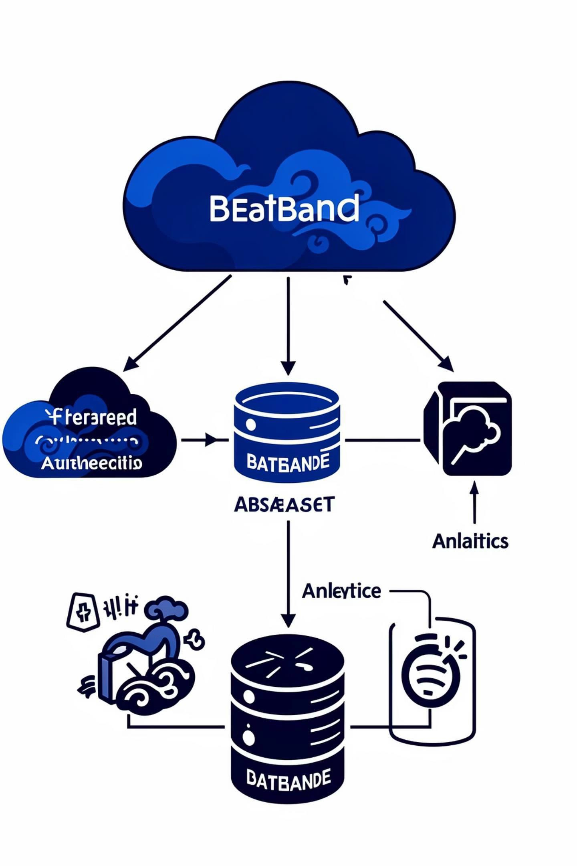
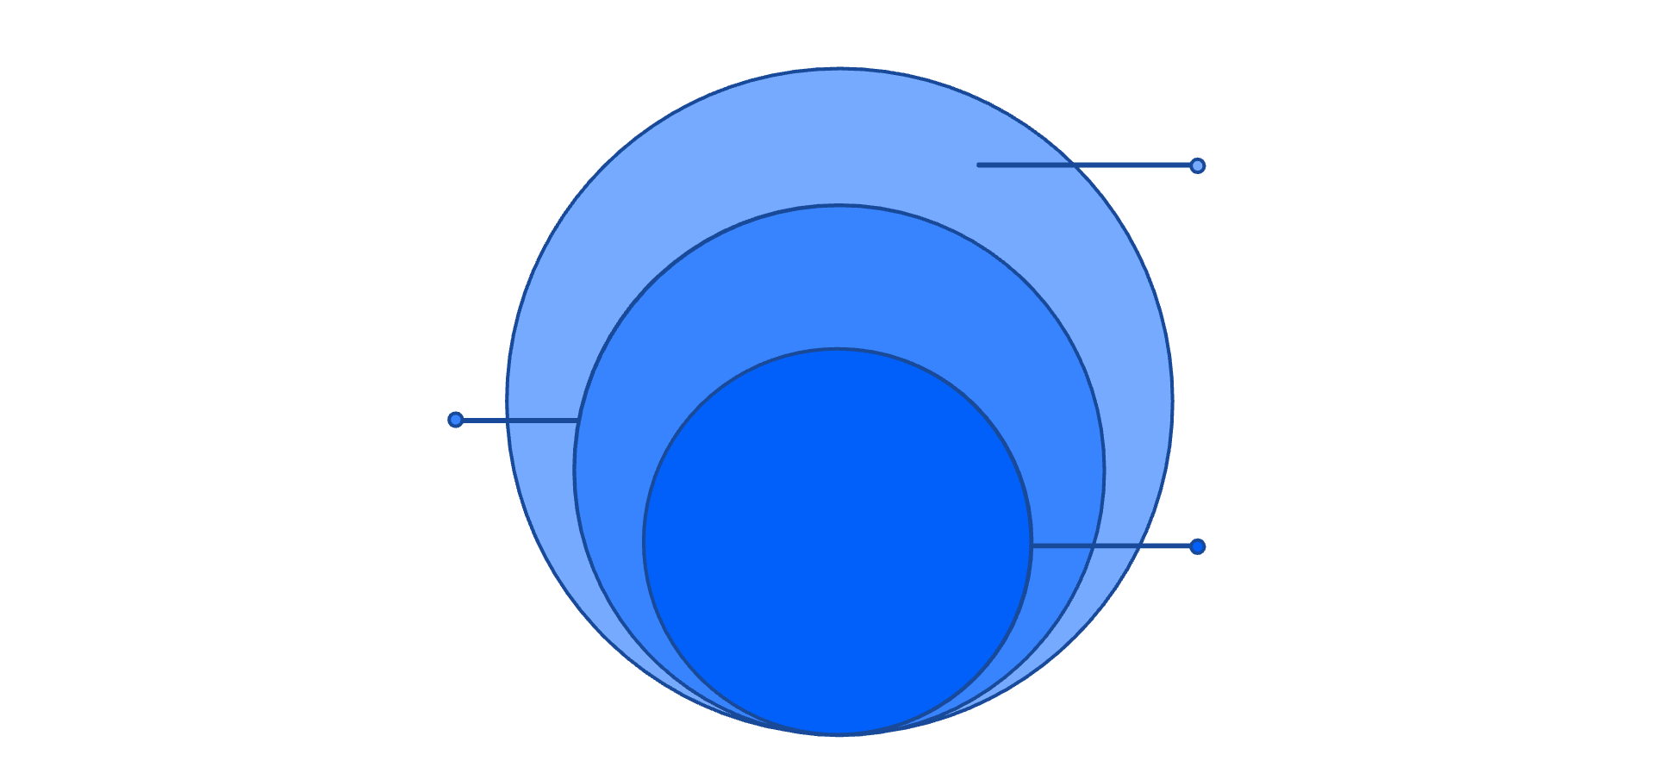
System Architecture
Clear separation of concerns ensures scalability, security, and maintainability across the stack.
Frontend
HTML/CSS/JS presents UI and shows Chart.js analytics
Backend API
Django REST handles auth, business logic, and
APIs
Database
MySQL storing users, sessions, and analytics
Frontend: HTML/CSS/JS • Backend: Django • Database: MySQL
Auth: OTP & Google OAuth • Analytics: Chart.js

Slide 9
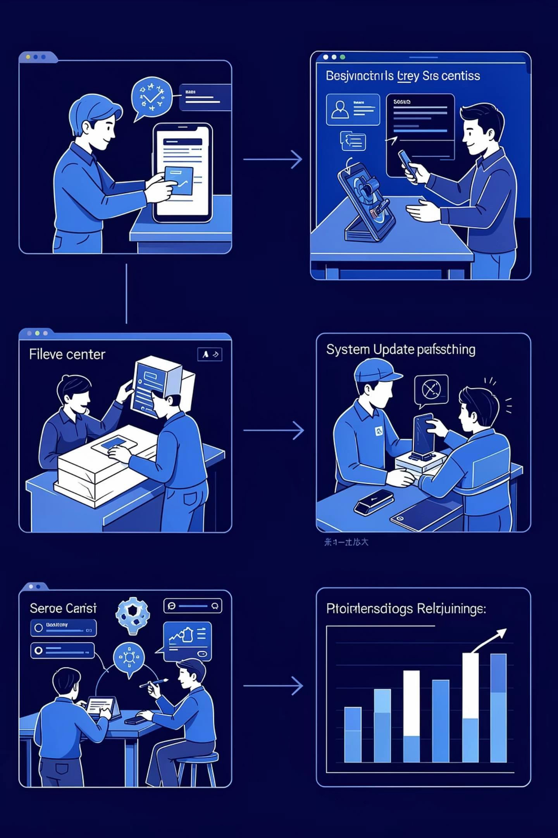

System Workflow
From purchase to resolution — VaultX automates each handoff, preserving data and providing visibility at every step.
Seller Registers
Customer Claims
Service Processes
System Updates
Automated notifications, SLA checks, and dashboard refreshes keep stakeholders informed and reduce manual follow-up.

Slide 10


Conclusion & Next Steps
Benefits
Enterprise-ready system that increases transparency, reduces paperwork, and accelerates claim resolution — improving customer satisfaction.
Immediate Next Steps
Pilot deployment with select sellers and service centers
Measure SLA adherence and NPS impact
Iterate chatbot intents based on pilot data
Theme accents use #609DFF, #041938, #013180. For a demo or architecture deep dive, request the API spec and database ER diagram.

