Slide 1

SC3253 (Machine Learning) Project: DoorDash ETA Prediction
Group 3:
Reynold jONG
PAVITRA MODI
DENYS PASHCHENKO

Slide 2
Problem Statement and Objective
Problem Statement
As mentioned in the DoorDash Dataset description, it is a crucial task for DoorDash to predict the correct Estimated Time of Arrival (ETA) of the Order for customers [1].
The prediction of ETA is crucial to enhance the experience of customers when using DoorDash [1].
Objective
To solve this problem, we aim to use the tools and techniques learnt in this course to predict to the best of our effort the Estimated Time of Arrival of DoorDash Orders.

Slide 3
Data Preprocessing
Dataset Selection [12]
DoorDash ETA Prediction dataset from Kaggle
Data Cleaning [12]
Dependent Variable calculation
Filled missing values
Dropped missing values
Dropped unreasonable data
Removed outliers
Out of interquartile range
Extreme values
Feature Scaling [12]

Slide 4
Data Preprocessing
Feature Engineering
Combination of features
Correlated features
One-hot encoding
Categorical features
Bins
Uneven distribution
Clustering
K-means
Reduce categorical features

Slide 5
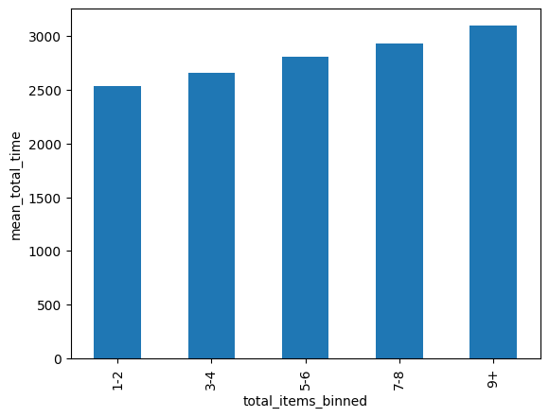
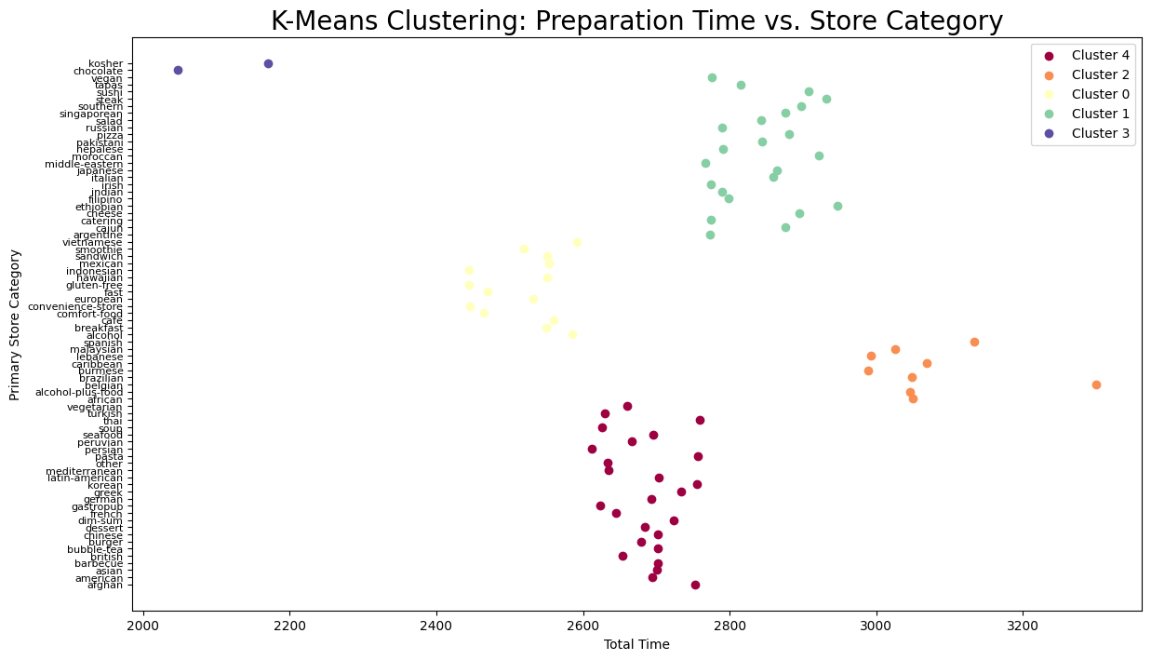
Data Preprocessing

Slide 6
Model Design
Linear Models
Linear Regression [12], Lasso Regression [3], and Ridge Regression [4].
Non-Linear Models
RandomForestRegressor [2], XGBoostRegressor [5], HistGradientBoostRegressor [7], GradientBoostingRegressor [8], AdaBoostRegressor [9] and Support Vector Regressor (SVR) [6]
Neural Network Model
One input and output layer, two hidden layers with fine-tuned hyperparameters

Slide 7
Model Evaluation Metrics
Mean Squared Error (in terms of loss in Neural Network)
Root Mean Squared Error
Mean Absolute Error

Slide 8
Model Evaluation
Linear Models
Did not perform well on predicting the delivery ETA on this dataset.
The best performing Lasso Regression [3] model of the three was chosen to formulate the model equation in the next slide
Results are shown in the table after the next slide
Conclusion is non-linear models are preferrable

Slide 9
Coefficients for Model Formulation
[0.003653011420601956, 0.001866154049894035, 0.1478753685057152, 0.0490623141365967, 0.004752181513870551, 0.024466915843793808, 0.33448827192901315, 0.10106820578804454, 0.26109260061137096, 0.016284628396457244, -0.014039430824844821, -0.08148398628960292, -0.13908553148300243, -0.05960491809596083, -0.1452745520524844, 0.09853981427034658, -0.21764173056964056, 0.3014933302411122, 0.16157358741491215, 0.24944590324255997, -0.22630091730810645, 0.16112322239855004, -0.1856979362015046, 0.09488495008463457, -0.09345522242424245, 0.02047415571285431, 0.059992887804594885, -0.1343935233878221, 0.08576416195424483, 0.0019418199233979566, 0.121779879074481, -0.052124143828089754, -0.1444405412882857, 0.595643987599396, 0.3379627962785311, -0.07433700384271107, -0.1174594675027641, 0.30766224518449936, 0.006303797807856211, 0.04307479339153727, -0.0017784687687277094, 0.038781106716558794, -0.016585268659483263, -0.08823957719347787, -0.0829625694796958, 0.0, -0.1586680927103278, -0.08184546931941966, 0.04046387744513118, -0.09396913922716796, 0.1556211971589354, -0.30727845860265757, -0.18351134693594812, 0.3131607306514623, -0.13667719081259944, -0.2035758408679297, -0.04215464722297647, -0.34745713409130186, 0.028105772799718442, -0.11918269270807032, 0.050751441918518825, -0.11670790059985132, 0.12134399780353197, 0.028357556791276214, 0.04744407254631359, -0.07324740764830785, -0.14853373346872953, -0.13542516462447038, 0.33562810194318277, 0.17779342014537147, -0.04677064764829697, -0.10372441940757235, 0.051151025357197746, 0.05629300630196202, 0.19865704189886085, 0.03014685894953744, 0.14867437688731233, -0.025033930584788366, -0.23144105672130025, -0.18017330530369843, 0.15764202917489895, 0.1864496764163184, 0.20598101744391709, 0.015507285149036744, -0.1049353407013884, -0.42777432377701485, -0.06547313137111609, -0.07073166760761757, 0.17964931536864728, 0.02948203243712013, 0.01597596568883823, 0.09114619517090485, 0.223489660137472, -0.04363949886913647, -0.10832499987619429, -0.064830059972382, -0.07578621166474181, -0.0991039106861251]

Slide 10
Table – Linear Models
Model | Mean Squared Error | Mean Absolute Error | Root Mean Squared Error
Linear Regression [12] | 3.16 * 10^17 | 2950231.855 | 562512458.347
Lasso Regression [3] | 0.86 | 0.75 | 0.92
Ridge Regression | 0.77 | 0.70 | 0.88

Slide 11
Model Evaluation
Non-Linear Models
Perform very well on this dataset.
Results of each of the models are shown in the next slide
To make the results more robust, we performed cross validations [12] on all models.
XGBoostRegressor [5] is the best performer
RandomizedSearch was used for hyperparameters tuning
Achieved lowest mean-squared error of 0.642

Slide 12
Table – Non-Linear Models
Model | Mean Squared Error | Mean Absolute Error | Root Mean Squared Error
XGBoostRegressor [5] | 0.642 | 0.632 | 0.801
RandomForestRegressor [2] | 0.70 | 0.67 | 0.84
HistGradientBoostingRegressor [7] | 0.67 | 0.65 | 0.81
GradientBoostingRegressor [8] | 0.715 | 0.677 | 0.845
SVR [6] | 0.732 | 0.701 | 0.856
AdaBoostRegressor [9] | 0.89 | 0.79 | 0.94

Slide 13
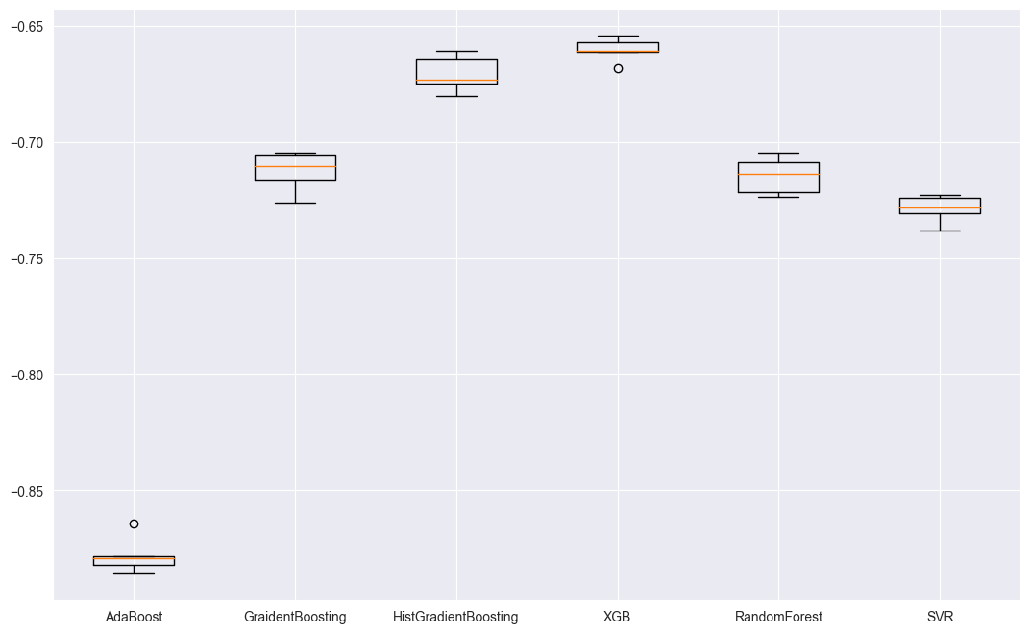
Cross Validations

Slide 14
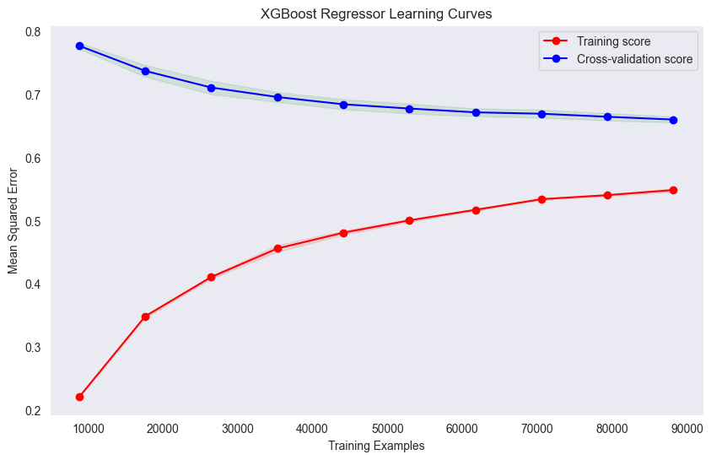
Learning Curves

Slide 15
Neural Network Build
Build Details (GridSearchCV hyperparameters tuning)
Input layer (64 neurons, ReLU activation)
First hidden layer (32 neurons, ReLU activation)
Second hidden layer (16 neurons, ReLU activation)
Output layer (1 neuron, Linear activation)
Optimizer = Adam, learning rate = 0.01
Loss = Mean Squared Error

Slide 16
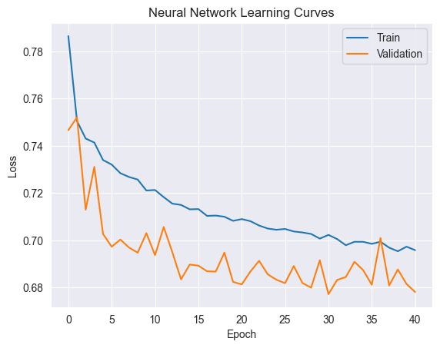
Before Regularization

Slide 17
Neural Network Build
Regularization
Dropout layers for hidden layers
0.2 dropout rate
Batch normalization
Lower learning rate to 0.005

Slide 18
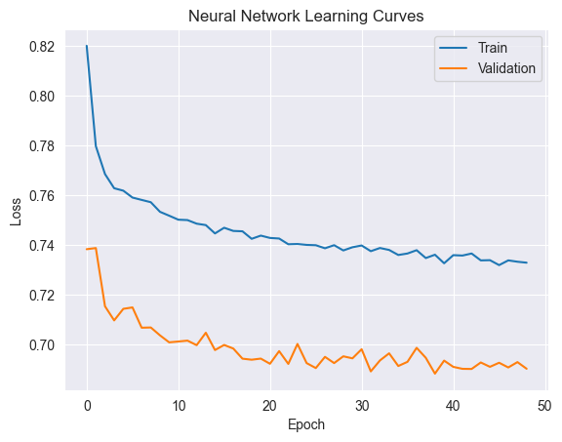
After regularization

Slide 19
Model Evaluation
Neural Network
Mean Squared Error = 0.698
Performance is slightly worse than XGBoostRegressor
Increasing the neurons and layers could improve accuracy but causes overfitting issue
Could be too complex to predict the delivery ETA

Slide 20
Best Model
Mean Squared Error as the major performance metric to select the best model
Based on all the models trained and hyperparameter tuned, we found the model with the least MSE was XGBoostRegressor [5]
Next step: Further analysis and development of XGBoostRegressor for predict Estimated Time of Arrival of Deliveries for DoorDash [1].

Slide 21
Reflection
Conclusion
Advanced algorithms perform better than neural network
All techniques were leveraged but they have minimal impacts to further lower the MSE
Future improvements
Get more training data for model training
Further future engineering
Further hyperparameters tuning

Slide 22
References
[1] D. Suryaa, “Doordash Eta Prediction,” Kaggle, https://www.kaggle.com/datasets/dharun4772/doordash-eta-prediction (accessed Aug. 1, 2024).
[2] L. Breiman. "Random forests." Machine learning 45 (2001): 5-32.
[3] R.Tibshirani. "Regression shrinkage and selection via the lasso." Journal of the Royal Statistical Society Series B: Statistical Methodology 58.1 (1996): 267-288.
[4] A. E. Hoerl and R. W. Kennard. "Ridge regression: Biased estimation for nonorthogonal problems." Technometrics 12.1 (1970): 55-67.
[5] T. Chen and C. Guestrin. "Xgboost: A scalable tree boosting system." Proceedings of the 22nd acm sigkdd international conference on knowledge discovery and data mining. 2016.

Slide 23
References
[6] Smith, J. (2019). Introduction to Support Vector Regression
[7] Pedregosa, Fabian, et al. "Scikit-learn: Machine learning in Python." the Journal of machine Learning research 12 (2011): 2825-2830.
[8] Friedman, Jerome H. "Greedy function approximation: a gradient boosting machine." Annals of statistics (2001): 1189-1232.
[9] Freund, Yoav, and Robert E. Schapire. "A decision-theoretic generalization of on-line learning and an application to boosting." Journal of computer and system sciences 55.1 (1997): 119-139.
[10] LeCun, Yann, Yoshua Bengio, and Geoffrey Hinton. "Deep learning." nature 521.7553 (2015): 436-444.
[11] Chollet, François. "Keras: The python deep learning library." Astrophysics source code library (2018): ascl-1806.
[12] A. Géron. “Hands-On Machine Learning with Scikit-Learn, Keras, and TensorFlow, 2nd Edition”.

