Slide 1


Slide 2

Excel
Json File Load to excel:
Date – Get Data – From File – From JSON – Select the file – import – power Query Editor open – Transform - To table – Popup box open – select or enter Delimiter – none option select - How to handle extra columns (Truncate extra columns) – ok – column created - click arrow – Load all the columns – ok – column expanded – close & Load.
Cleaning Process:
Unname and key removed in this data set.
Create New column:
Trip Count – S.no
Location – based on latitude and longitude value
Travel Mode – Based on passenger count (Uber Go - 0 to 3, Uber XUV – 4, Uber Premium – 5 & 6)
Year – Based on Pickup_datetime.
Month - Based on Pickup_datetime.
Day - Based on Pickup_datetime.
Week - Based on Pickup_datetime.

Slide 3
Excel
Hour - Based on Pickup_datetime.
Minutes - Based on Pickup_datetime
Second - Based on Pickup_datetime.
Time – Based on Hour, second, minutes.
Date – Based on Year, month, Day
Weekday – Based on Date
Distance_in_km – Based on Latitude and Longitude
Time of Day – Based on pickup_datetime
DateTime – Based on Time, Date

Slide 4
Load data from excel to SQL & SQL to Power BI
Load Data Excel to SQL
I use Pgadmin(SQL)
Create New Server –
Host : localhost
Name : MBT12
User name : postgres
Password : *****
Port : 5432
Database : uber_csv
Create new table and import all the data from excel to sql server.
Load the data SQL to Power BI
Open Blank report – get data – PostgreSQL database – Connect – popupbox open –
Server name – localhost:5432
Database – uber_csv – import - ok
Navigator open – select database name – load.
Finally, I make the visualization.

Slide 5
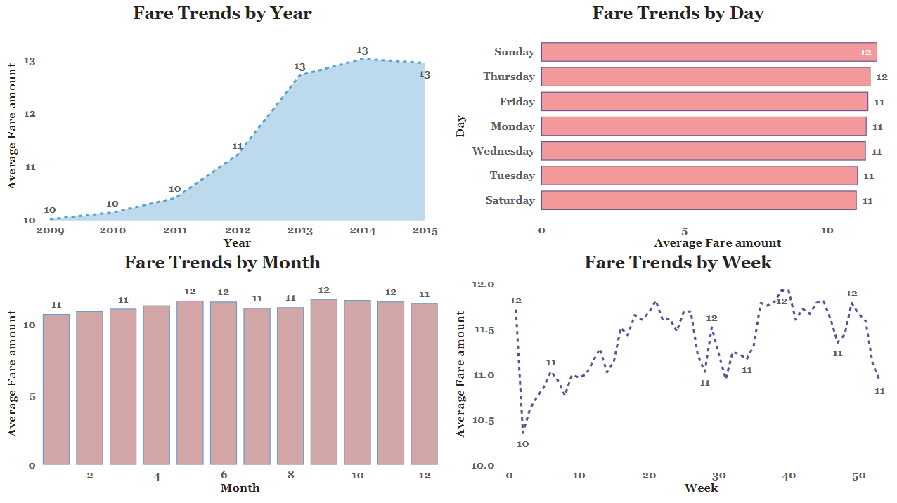
Fare Trends (Year, Month, Week, Day)

Slide 6
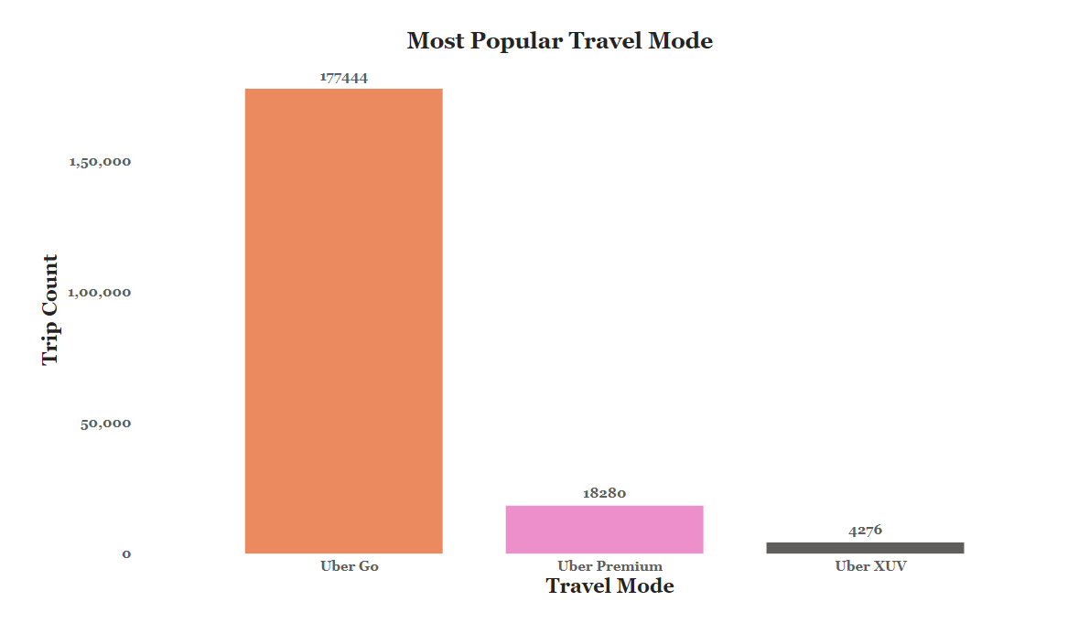
Most Popular Travel Mode

Slide 7
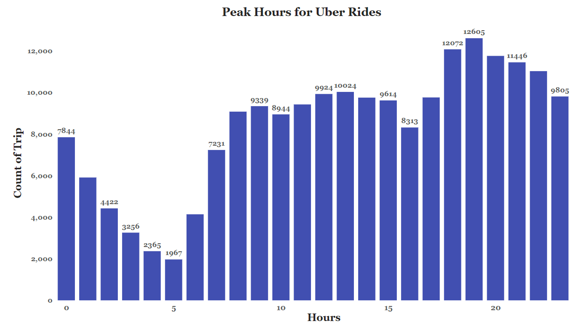
Peak Hours for Uber Rides

Slide 8
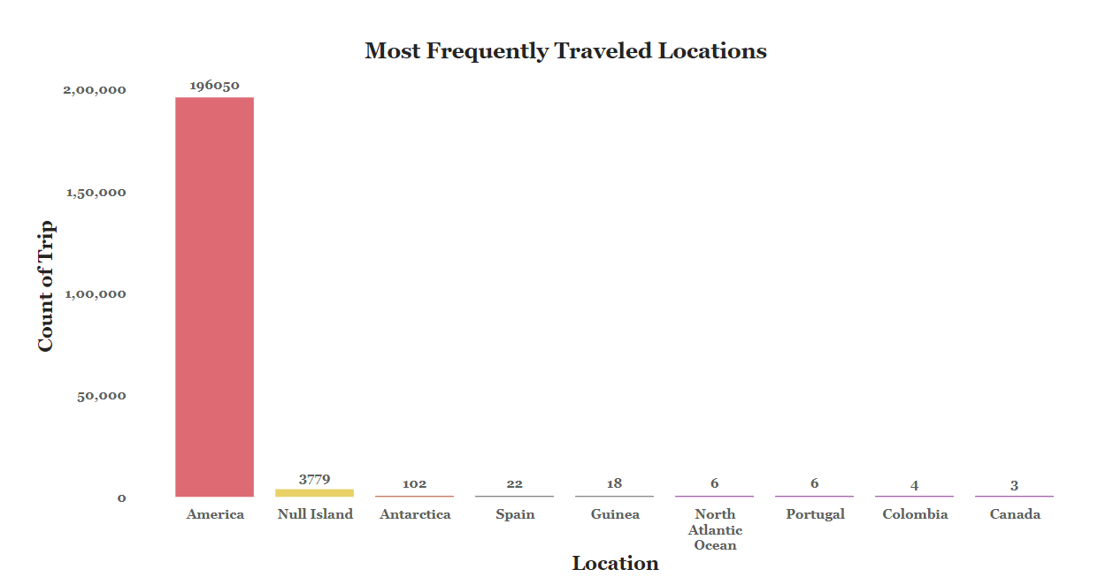
Most Frequently Traveled Locations

Slide 9
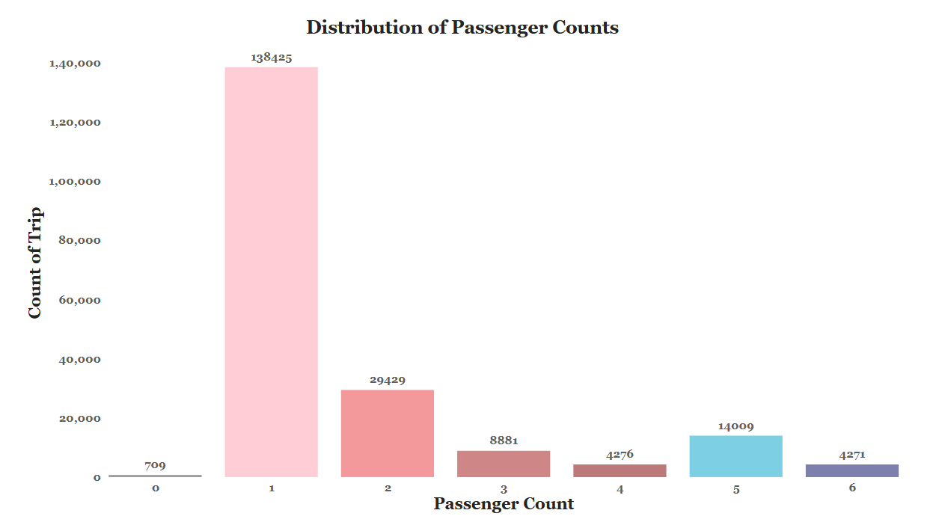
Distribution of Passenger Counts

Slide 10
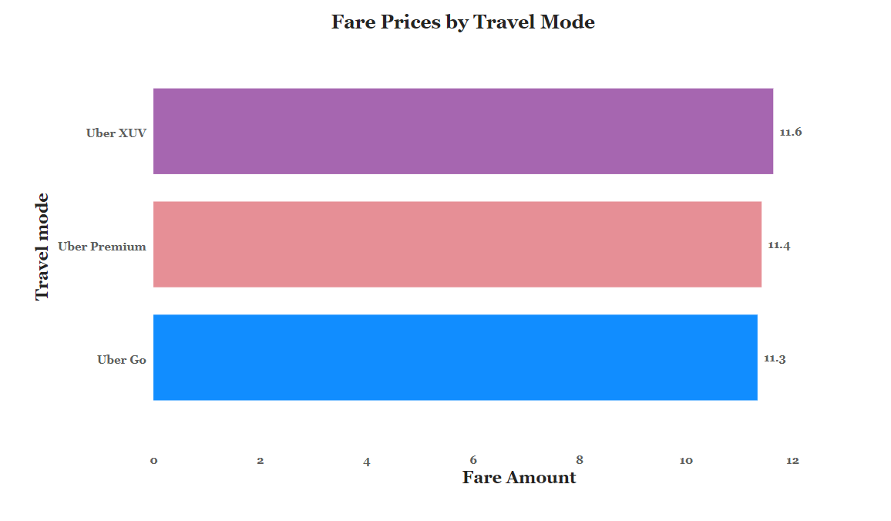
Fare Prices by Travel Mode

Slide 11
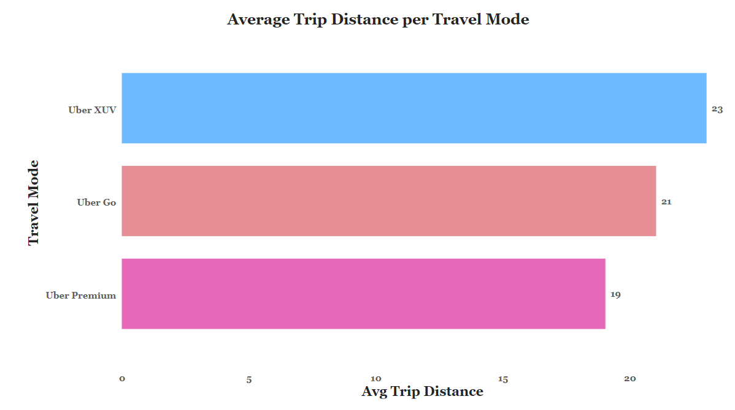
Average Trip Distance per Travel Mode

Slide 12
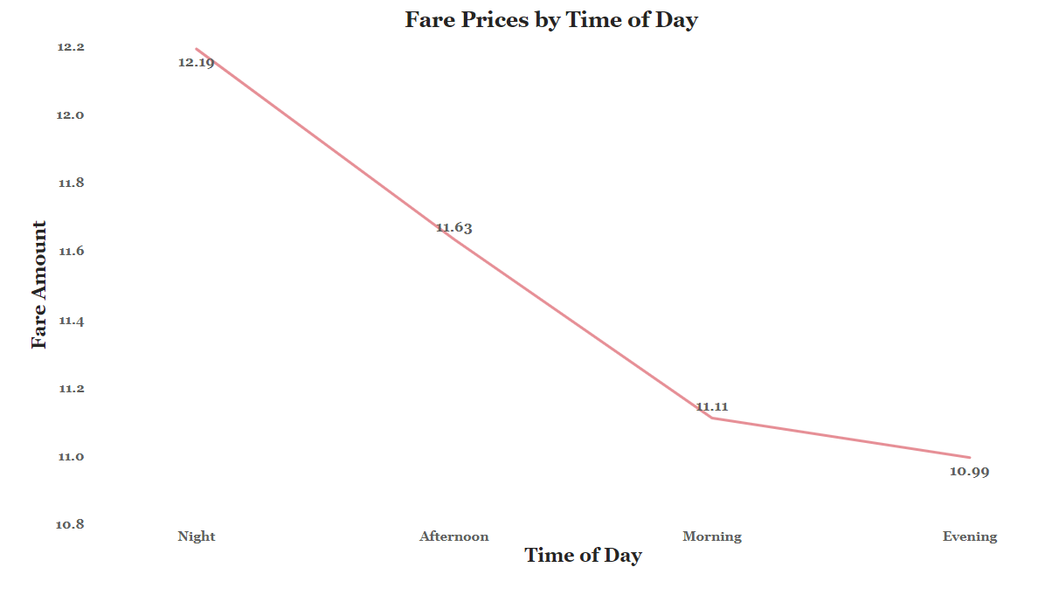
Fare Prices by Time of Day

Slide 13
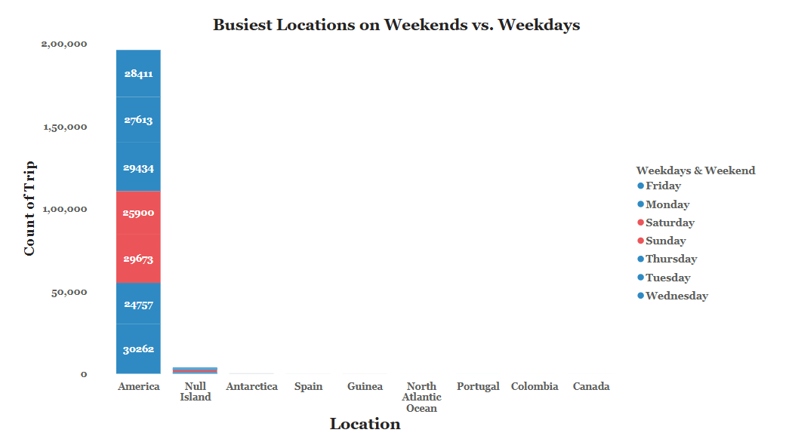
Busiest Locations on Weekends vs. Weekdays

Slide 14
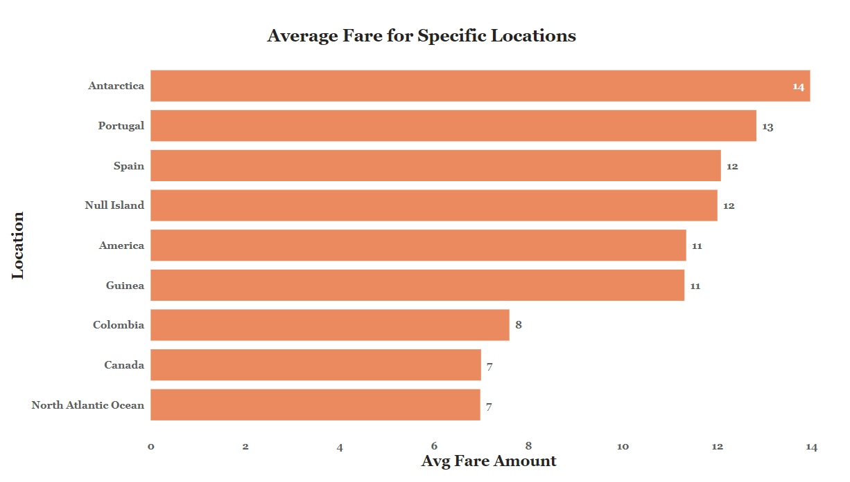
Average Fare for Specific Locations

Slide 15


