Slide 1
Heart Disease Prediction - EDA
Team 11: Janani, Monisha, Praveenkumar, Varsha, Viswanath

Slide 2
About the Dataset
- 506 samples, 7 features
- Features: Age, Gender, BP, Cholesterol, Heart Rate, QuantumPatternFeature
- Target: Heart Disease (Yes/No)

Slide 3
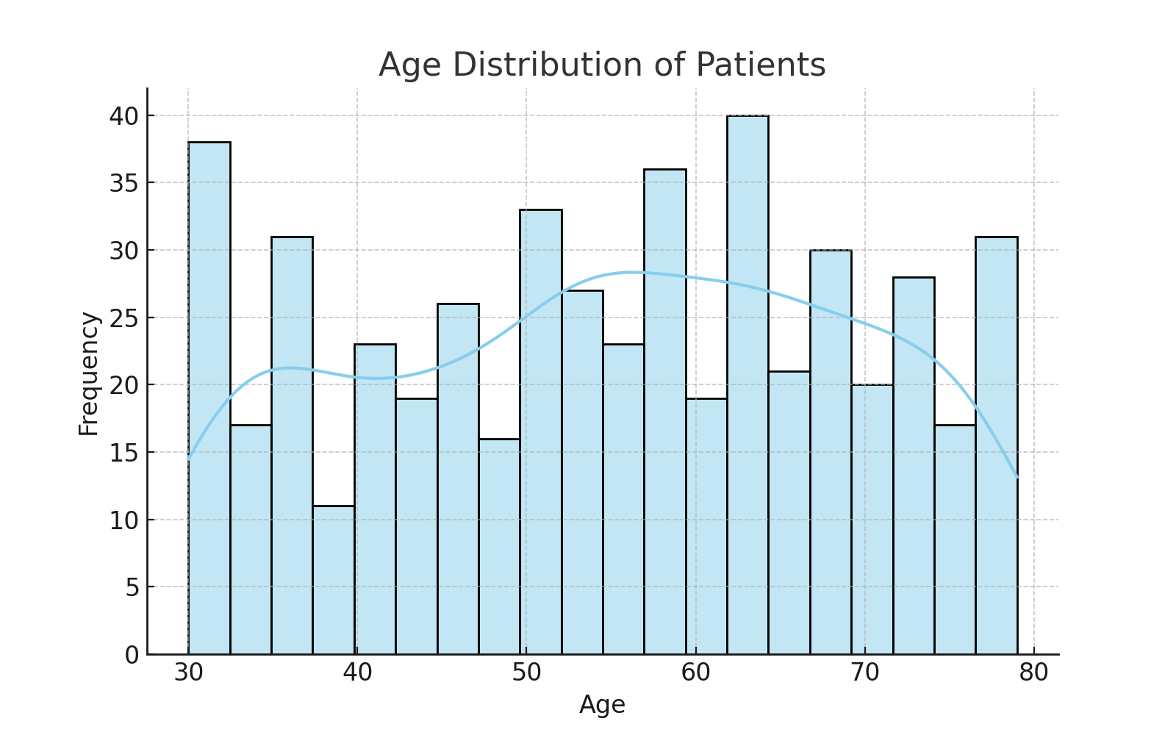
Age Distribution
Most patients are aged between 40 to 60 years — heart disease risk increases with age.

Slide 4
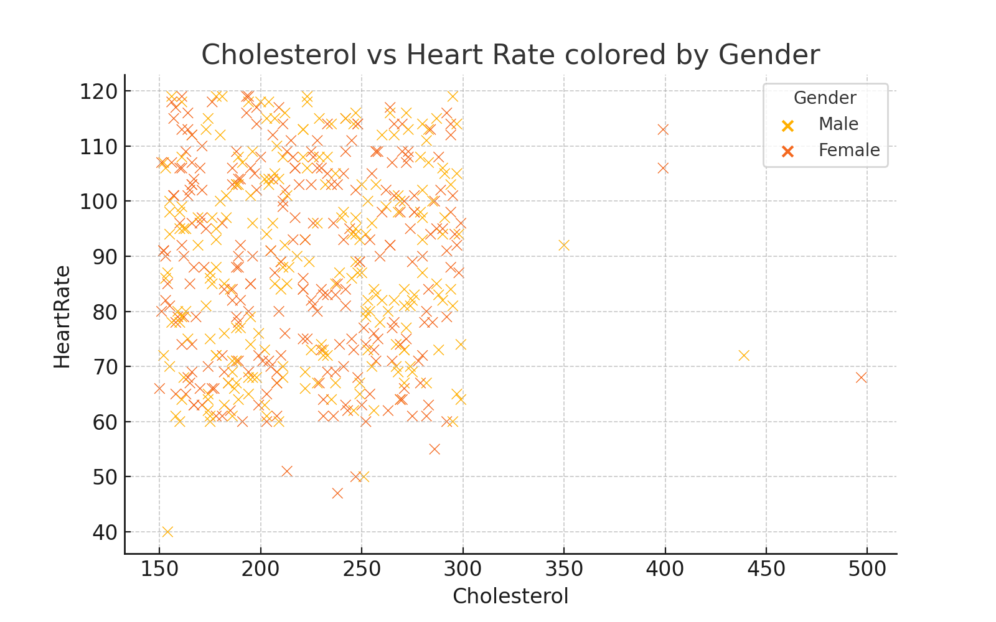
Cholesterol vs Heart Rate
No strong direct relationship visible, but outliers may suggest critical conditions.

Slide 5
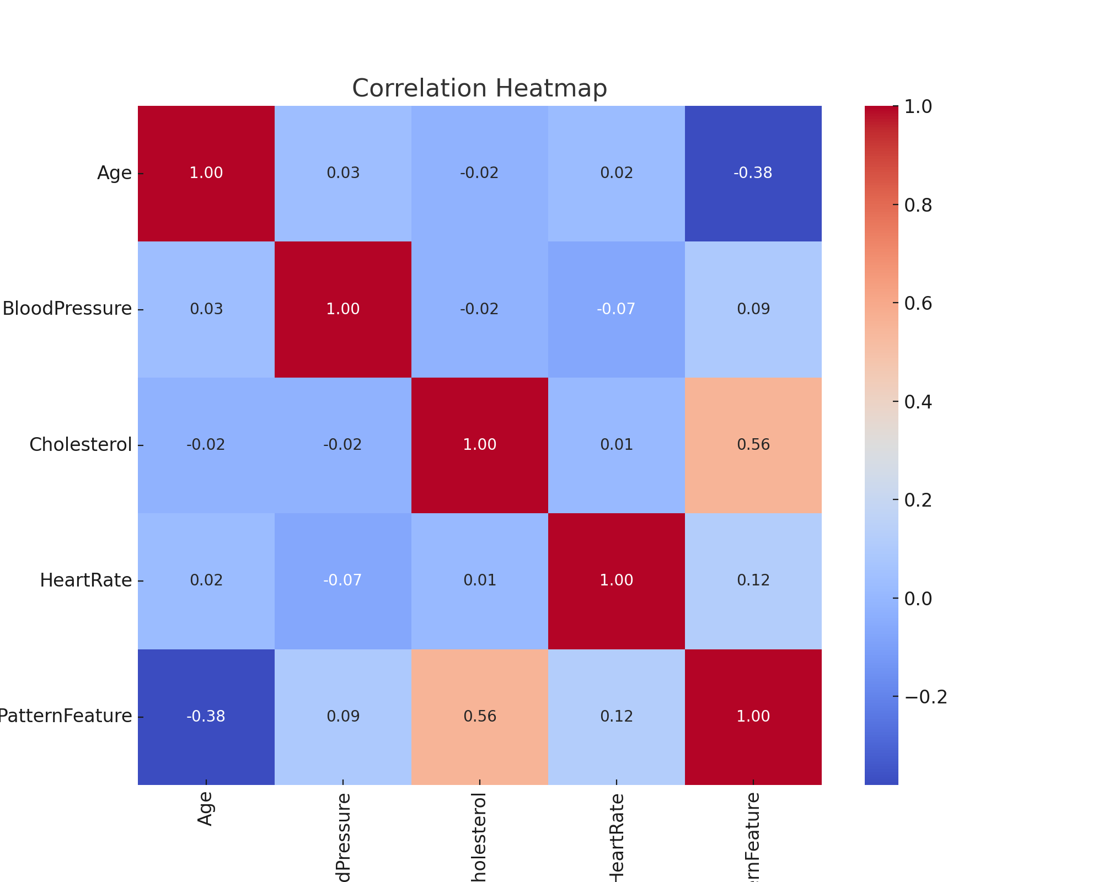
Feature Correlation
Cholesterol and Age are moderately correlated with Heart Disease. QuantumPatternFeature shows interesting patterns.

Slide 6
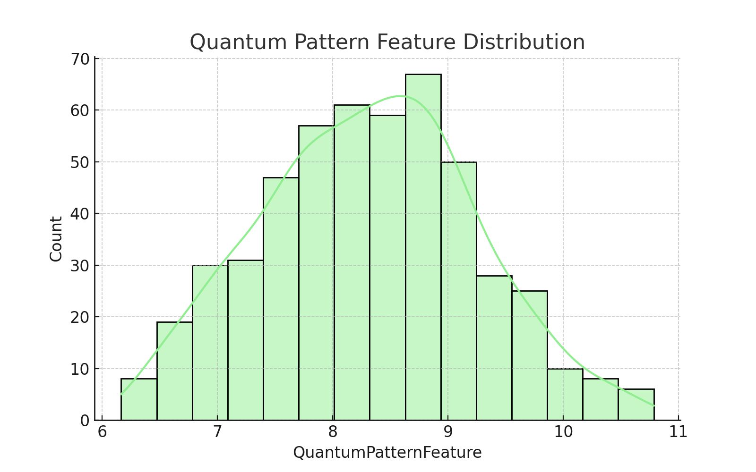
QuantumPatternFeature Analysis
Quantum Pattern Feature follows a skewed distribution — potential for non-linear modeling.

Slide 7
Conclusion & Next Steps
- Dataset cleaned and ready
- Key variables: Age, Cholesterol, QuantumPatternFeature
- Next: Apply ML models (Logistic Regression, Random Forest, etc.)

