Slide 1
Text Box to accept accession numbers
Phylogenic tree : Branch tips can accept two descriptors as either size or color .
Interactivity Examples :
https://observablehq.com/@d3/tree-of-life
Filter Tool : This controls all following plots (tree, pyramid chart, time, geography)
Tree Feature Setting:
Color : Descriptor
Color : Themes or even custom
Shape : Descriptor
Shape : Themes (Might need to limit to ~10)
Tree Shape : Rectangle, unrooted, radial, etc.
Save Image / Download Tree file

Slide 2
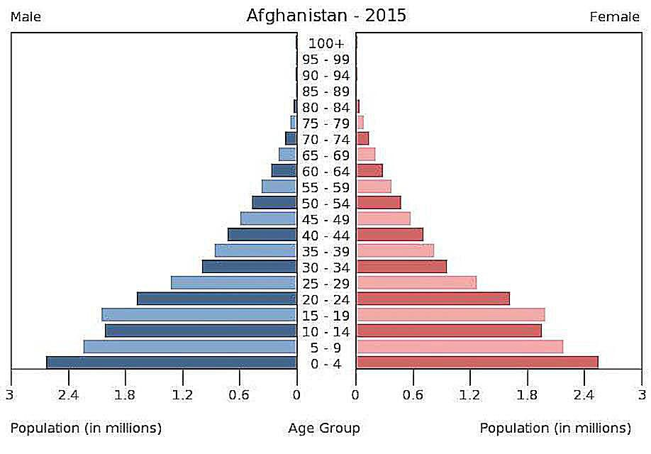
Text Box to accept accession numbers
Pyramid Setting : X and Y can either be categorical or numerical, counting will need to be done
Filter Tool : This controls all following plots (tree, pyramid chart, time, geography)
Graph Setting:
Type : Pyramid, Scatter
X : Descriptor
Y : Descriptor
Color : Pyramid or Scatter
Shape : Scatter
Save Image / Download csv file

Slide 3
Text Box to accept accession numbers
Time Setting : Categorical variable over time (I think difficult, or useless, with lineage information.
Interactive example :
https://observablehq.com/@d3/revenue-by-music-format-1973-2018
Missing ability to “highlight” a specific group.
Filter Tool : This controls all following plots (tree, pyramid chart, geography)
Time Setting:
Type : Pyramid, Scatter
X : Descriptor
Y : Descriptor
Color : Pyramid or Scatter
Shape : Scatter
Save Image / Download csv file

