Slide 1




PYTHON
REINFORCEMENT PROJECT
NYC RESTAURANT INSPECTION RESULTS
Presented by : M.Pavithra
Course : DADS (A Cohort)
Date : 25-09-2025

Slide 2
Introduction
The NYC dataset contains detailed information about food establishments, their inspections, and geographic attributes. It includes variables such as inspection SCORE, GRADE, establishment identifiers (CAMIS, BIN, BBL), and location details (ZIPCODE, Latitude, Longitude, Street, Community Board, Council District, Census Tract, NTA). This dataset enables analysis of food safety compliance across different neighborhoods, identification of geographic patterns, and exploration of governance-related impacts on inspection outcomes.
Project Overview
Analyze food inspection scores and grades.
Study the impact of violation based on Scores.
Find geographic and trend patterns.
Clean data for accurate analysis.
Provide insights to support better decisions.

Slide 3
Problem Statement
Food safety is a critical public health concern in New York City, where thousands of establishments are inspected regularly.The project aims to analyze NYC restaurant inspection data to identify key factors affecting health inspection scores. By finding trends, outliers, and common issues, it seeks to understand why some restaurants perform poorly. The ultimate goal is to provide insights that help improve food safety and maintain high hygiene standards across restaurants.
Objective
To study NYC food inspection scores and grades.
To clean and transform data to enhance quality and accuracy for analysis.
To apply statistical hypothesis testing to validate observed patterns and relationships.
To identify score patterns through EDA.
To provide insights for better food safety decisions.

Slide 4
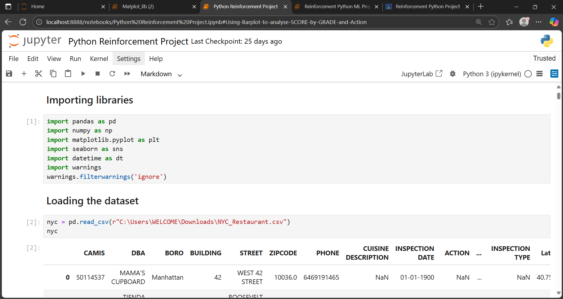

Importing & Loading
Importing Libraries
Imported Libraries to analyze and visualize the trends.
pandas for Handles and analyzes data in tables (DataFrames).
numpy for math operations on arrays and matrices.
matplotlib.pyplot for creating basic plots and charts.
seaborn to make attractive statistical plots easily.
datetime for work with dates and times.
warnings to hide unnecessary warning messages.
Loading Dataset
Loaded csv dataset using the command pd.read_csv.

Slide 5
Data Understanding
The dataset used is The DOHMH New York City Restaurant Inspection Results .
Data Understanding involves exploring the NYC food inspection dataset to get familiar with its structure, variables, and contents.
Checked :
unique() for unique values
shape for shape of the dataset
columns for column names
info() for quick overview of a DataFrame.
head() for first five rows
tail() for last five rows
Dataset Overview :
Rows : 290022 and Columns : 27
Key Variables :
1. Inspection Outcome Variables : SCORE ,GRADE.
2. Location Variables : Community Board ,Council District ,Latitude & Longitude ,ZIPCODE ,Street, Census Tract, BIN, BBL, NTA.
3. Establishment Identifiers & Contact : CAMIS,PHONE .

Slide 6
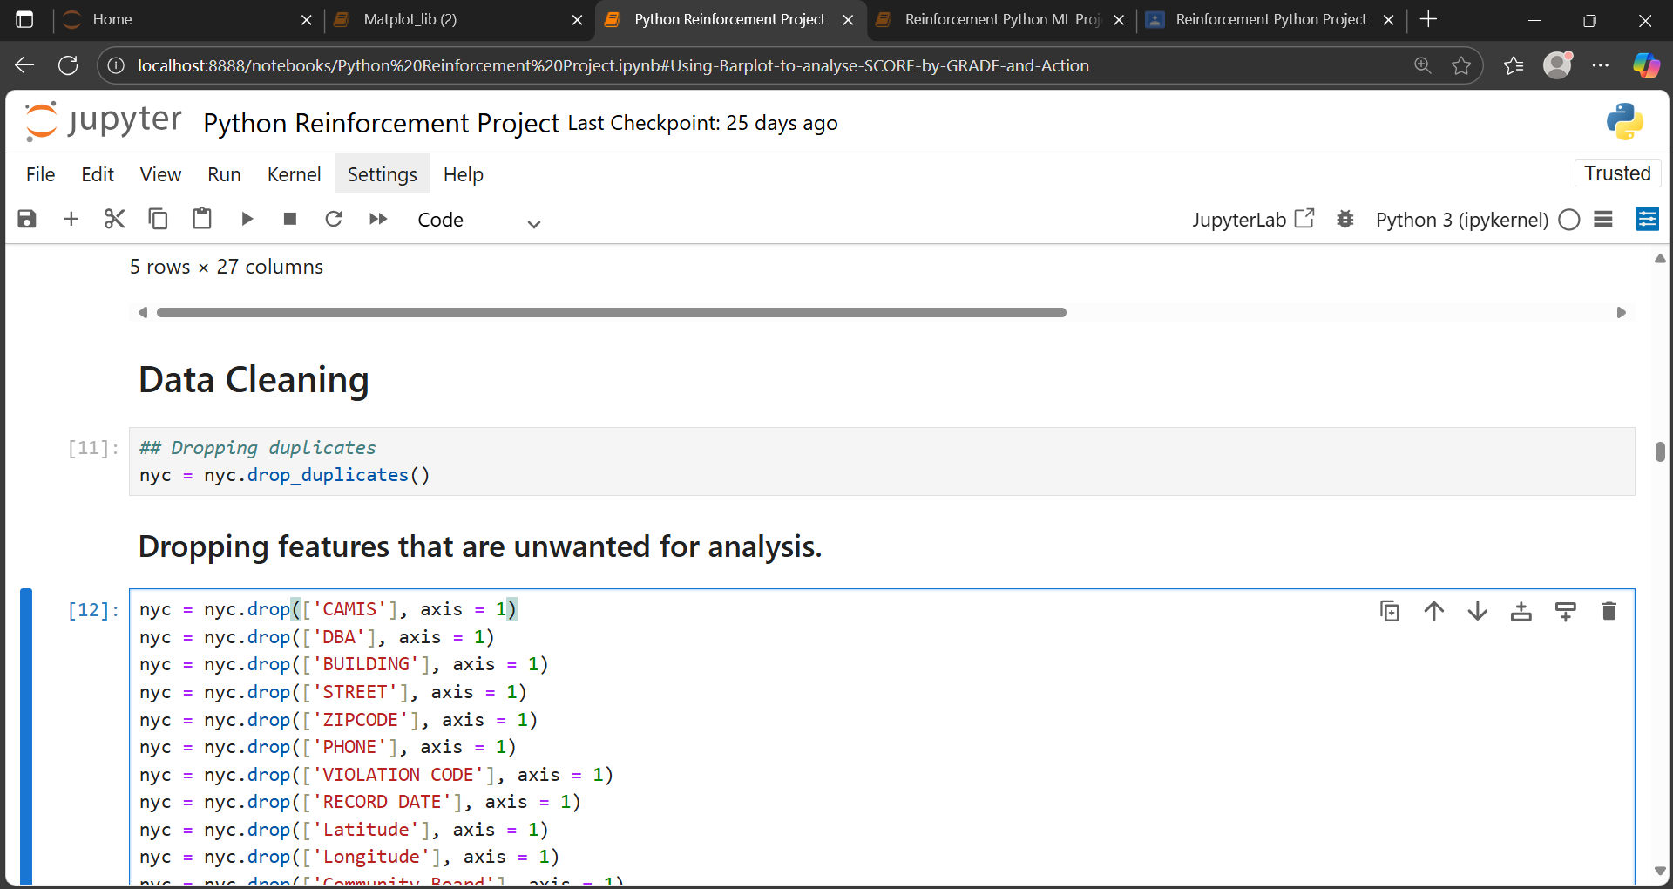
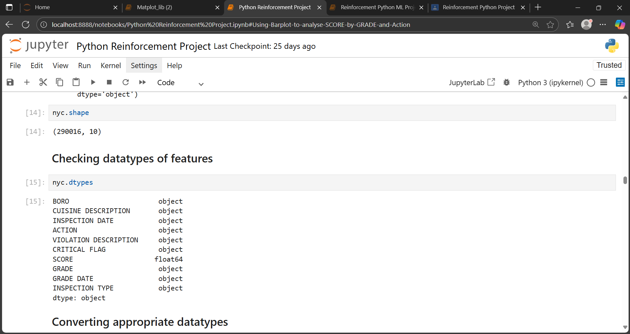
Data Cleaning
Dropped duplicates with the command.
Dropped features that have more null values.
Dropped unwanted features for better analysis.
Checked Data types by using the command.
Corrected data types for analysis.
Before cleaning After cleaning
Rows : 290022 Rows : 290016
Columns : 27 Columns : 10

Slide 7
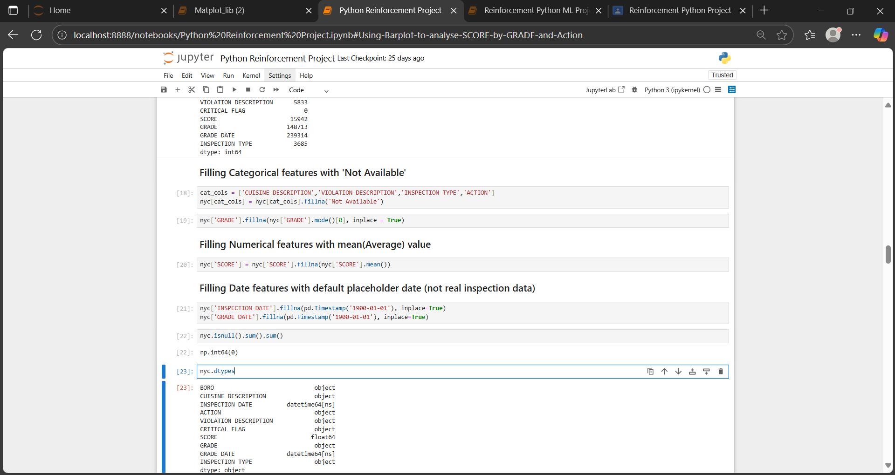

Handling Missing Values
Identified missing values :
Categorical features with “Not Available“.
For GRADE, mode is used to find the most frequent inspection score or grade.
Filled null values for numerical features with their Average(mean).
Filled Date features with default placeholder date (not real inspection data) means the actual date was missing or never recorded.

Slide 8
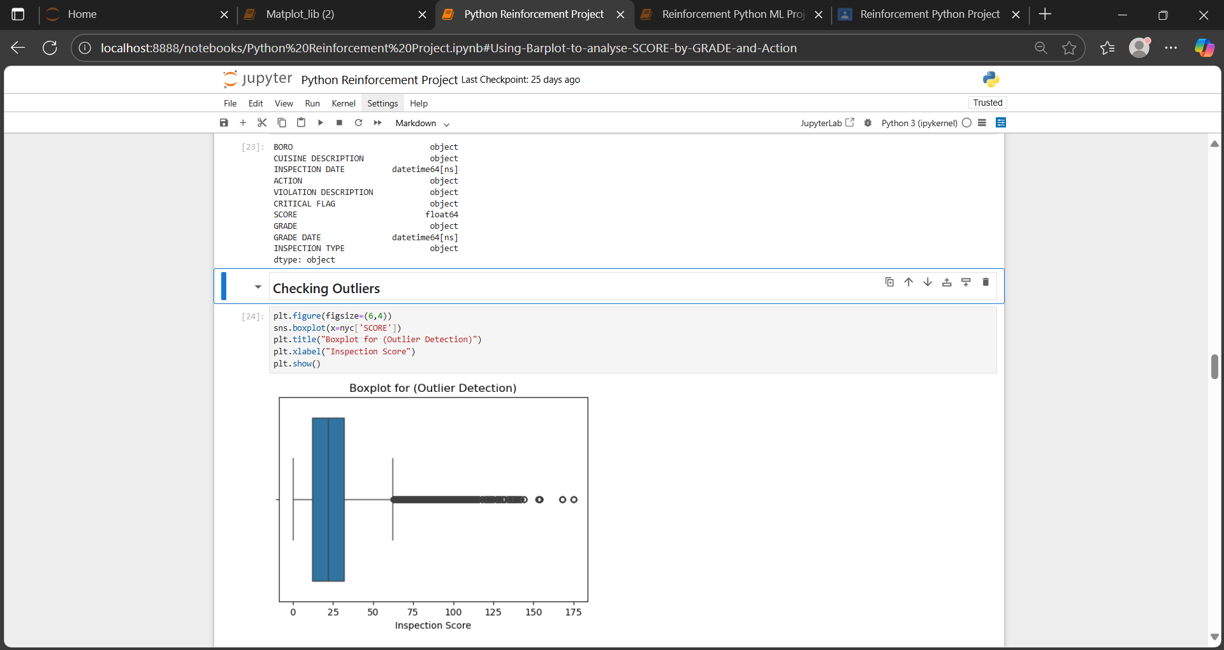
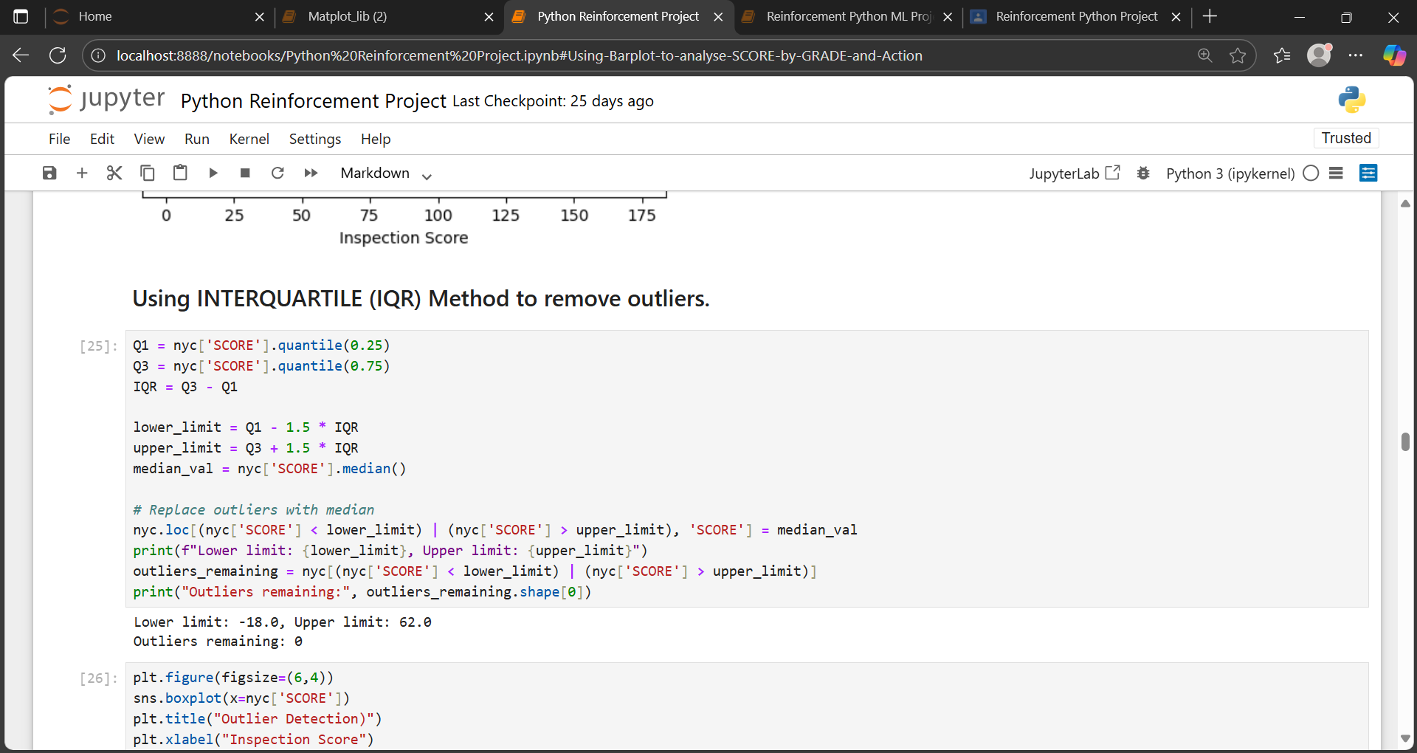
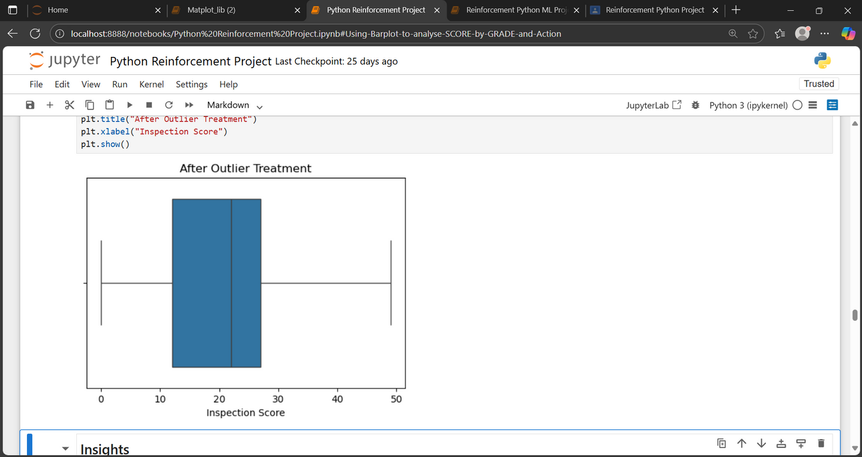
Outlier Handling
Identified outliers using Boxplot method in the numerical column.
Handled Outliers with Interquartile (IQR) Method.
Repeated IQR Method so that the outliers will be removed.

Slide 9
Handling Invalid Values
Invalid values occur when data is incorrect, inconsistent, or unrealistic. Such values can affect accuracy of the analysis.
Methods Used :
Removing features
Replacing with appropriate values
Standardizing categories

Slide 10
Statistical Analysis
Performed Statistical analysis to understand relationships between variables in the dataset.
Methods Used :
1.Independent Sample t-test :
Comparing SCORE between GRADE A and GRADE B Restaurants :
Null Hypothesis Ho : No Significant difference between GRADE A and GRADE B SCORES.
Alternate Hypothesis Ha : Significant difference between GRADE A and GRADE B SCORES.
2.Chi Square Test :
Taking two Features ACTION and GRADE to check they are independent or not :
Null Hypothesis Ho : ACTION and GRADE are independent.
Alternate Hypothesis Ha : ACTION and GRADE are dependent.

Slide 11
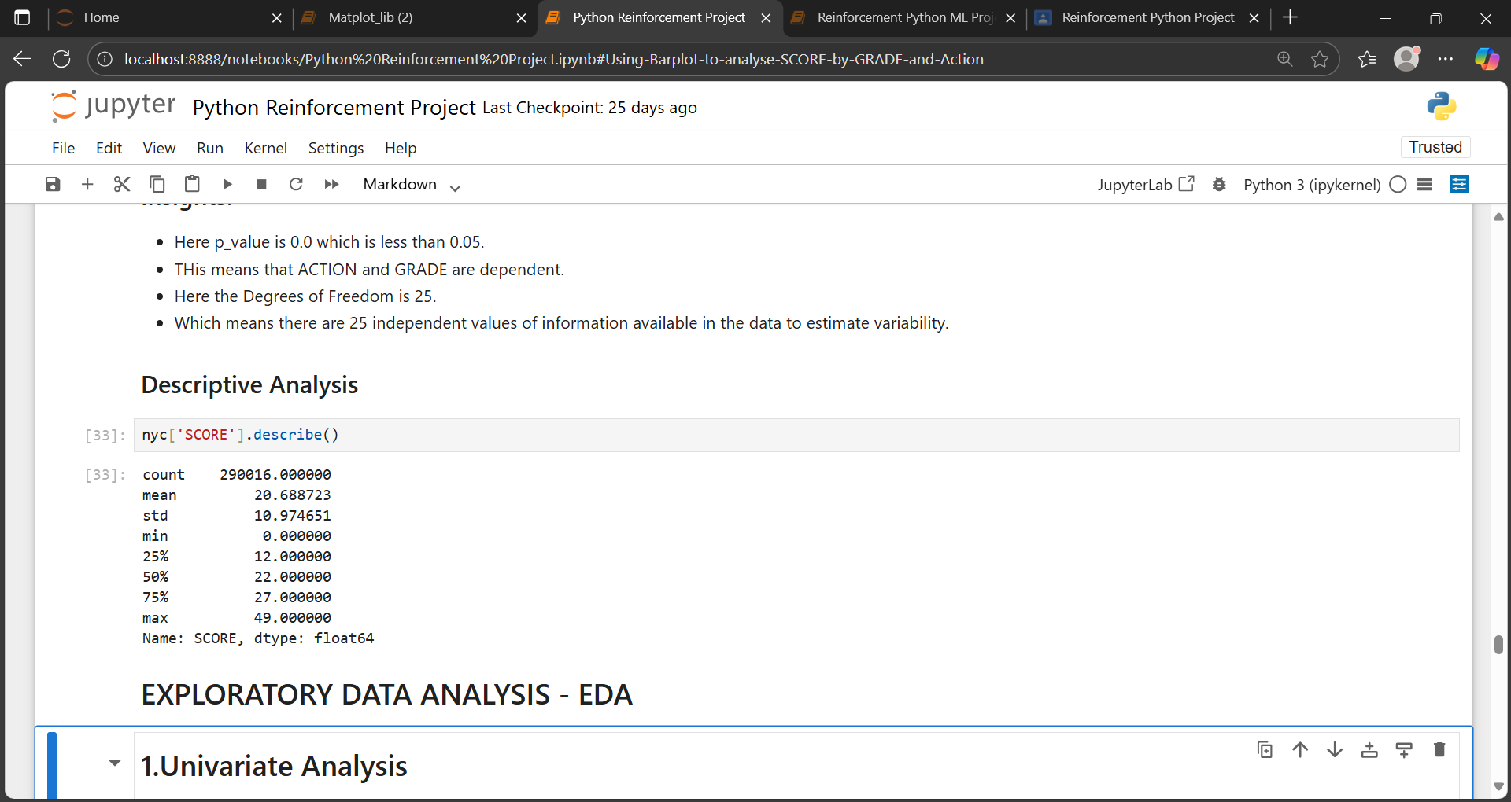
Descriptive Analysis
Descriptive statistics summarize and describe the main features of a dataset.
They include metrics like mean, median, standard deviation, minimum, maximum, and quartiles, which give information of the distribution and spread of values.

Slide 12
Data Visualization
Importance of Data Visualization
Data visualization helps present complex data in a clear and visual way using charts, graphs, and maps.
It makes information easier to understand, highlights trends and patterns, and supports quick and effective decision-making.
It turns data into meaningful insights that anyone can understand easily.
Types of Visualizations used :
Histplot
Countplot
Violinplot
Lineplot
Barplot
Correlation Heatmap

Slide 13
Univariate Analysis
Univariate analysis studies one variable at a time to understand its distribution and key statistics like mean, median, and range.
It provides a simple yet powerful way to understand each variable’s characteristics before deeper analysis.
Type of Visualizations used :
Histplot for SCORE Distribution to show how restaurant inspection scores vary, highlighting both average performers and outliers.
Countplot for Analzing Geographical trends by counting how many inspections occurred in each borough (BORO).

Slide 14
Bivariate Analysis
Bivariate analysis is the study of two variables to understand the relationship between them.
It helps determine how one variable influences or relates to another
Types of Visualizations used :
The violin plot of SCORE by GRADE shows patterns in inspection scores, highlights high and low performing restaurants, and reveals trends across grades.
The line plot of SCORE & INSPECTION DATE shows time-Based Trend by how the average score changes over time.

Slide 15
Multivariate Analysis
Multivariate analysis examines three or more variables simultaneously to understand complex relationships among them.
It helps identify patterns, interactions, and key factors influencing outcomes
Types of Visualizations used :
Barplot to analyze patterns in inspection scores across grades , identifying areas for improvement and trends in restaurant performance (SCORE by GRADE & ACTION).
Correlation Heatmap to analyze the violations based on the inspection SCORE.

Slide 16
Overall Insights
Most NYC restaurants maintain good hygiene, achieving grade A.
A few restaurants consistently score low, indicating poor compliance.
Inspection scores vary by borough, with Manhattan and Brooklyn having the most inspections.
Scores have generally improved over the years, showing better food safety awareness.
Restaurants with critical violations have higher scores and need more attention.
Tracking scores and grades over time helps see improvement and focus on risky restaurant.
Data highlights areas and restaurants needing targeted improvement for public health safety.
Recommendations
Strengthen hygiene and sanitation practices in low-scoring restaurants.
Increase inspection frequency for high-risk areas.
Provide health and safety training for restaurant staff.
Implement a reward system for consistently top-performing restaurants.
Use data insights to predict and prevent future violations.

Slide 17
Conclusion
The project provided valuable insights through data analysis and visualization.
By performing statistical analysis revealed key patterns in restaurant performance, helping identify areas needing improvement in food safety and hygiene.
By performing EDA, univariate, bivariate, and multivariate analyses, key patterns, trends, and relationships were identified within the dataset.
These findings support better decision-making and highlight areas for improvement or further exploration.
Overall, the analysis provides insights to enhance restaurant quality and public health safety

Slide 18
THANK YOU

