Slide 1

ADVANCED APPROACH FOR EARLY DETECTION OF POLYCYSTIC OVARY SYNDROME
Department of Artificial Intelligence and Data Science
Presented By
Rajasree V -312321201041
Pavithra M - 312321201036
Mentored By
Prof. Mr. Senthil Kumar

Slide 2
ABSTRACT
Polycystic ovary syndrome (PCOS) is the most prevalent endocrinological abnormality and one of the primary causes of anovulatory infertility in women globally. The detection of multiple cysts using ovary ultrasonography (USG) scans is one of the most reliable approaches for making an accurate diagnosis of PCOS and creating an appropriate treatment plan to heal patients with this syndrome. Instead of depending on error-prone manual identification, an intelligent computer-aided cyst detection system can be a viable approach. Therefore, in this research, an extended machine learning classification technique for PCOS prediction has been proposed, trained, and tested over 3000 ovary USG images; where the Convolutional Neural Network (CNN) incorporating different state-of-the-art techniques and transfer learning has been employed for feature extraction from the images; and then the XGBoost model has been used on that reduced feature set to classify between PCOS and non-PCOS ovaries. The proposed technique significantly enhances the accuracy while also reducing training execution time compared to other existing ML-based techniques. By following the proposed extended technique, the best-performing results are obtained by incorporating the “VGG16” model as a feature extractor and applying an XGBoost model as the image classifier, achieving an accuracy of 99.99% for classification.

Slide 3
LITERATURE REVIEW
Study | Year | Methodology | Dataset | Accuracy/Performance
Khan et al. | 2022 | Hybrid approach using machine learning with ultrasound image features | 150 ultrasound images | 92.8% accuracy
Devi et al. | 2023 | Deep learning (CNN) for automatic detection and segmentation of ovarian cysts | 200 ultrasound images | 95% accuracy
Gupta & Singh | 2023 | Image processing with KNN and CNN for feature extraction and classification | 120 ultrasound images | 93% accuracy
Pandey & Kumar | 2023 | Transfer learning with ResNet-50 for detecting ovarian abnormalities | 180 ultrasound images | 96% accuracy
Fatima et al. | 2022 | Automated PCOS detection using Random Forests and ultrasound image features | 130 ultrasound images | 91.5% accuracy

Slide 4
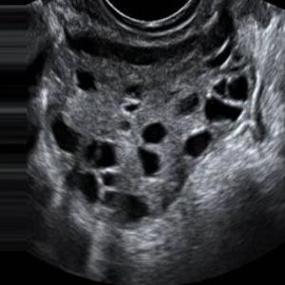
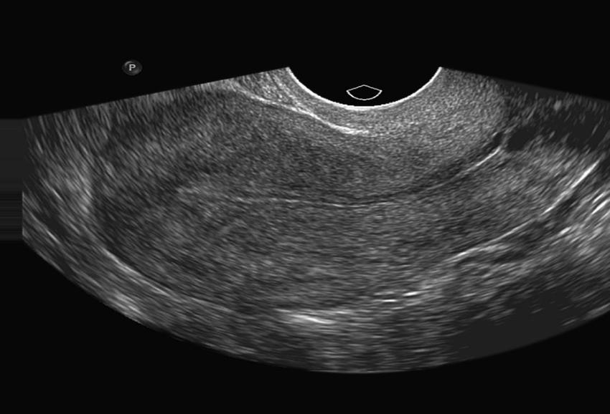
DATASET
3,856
Total
1,932
Test
1,924
Infected
Not Infected
Train

Slide 5
ISSUES
Data Availability
Data Quality
Time and Space complexity
Data Privacy and Security
Feature Extraction

Slide 6
MOTIVATION
Address Underdiagnosis: Speeds up PCOS detection, reducing delays and misdiagnosis.
Early Diagnosis: Enables timely intervention to prevent complications like infertility.
Improved Accuracy: Machine learning ensures more precise and efficient diagnosis.
Non-Invasive: Analyzes ultrasound images without the need for multiple invasive tests.
Scalable: Expands access to reliable diagnostics in both urban and rural areas.

Slide 7
OBJECTIVE
The goal is to create a reliable, non-invasive, and accurate diagnostic tool that can:
Identify PCOS at an early stage, minimizing delays in diagnosis.
Improve prediction accuracy by leveraging complex datasets, including patient symptoms, hormone levels, and medical history.
Provide a personalized approach to diagnosis and treatment, ultimately improving patient outcomes.
Address the limitations of current diagnostic methods and reduce healthcare costs through automation and early intervention.

Slide 8
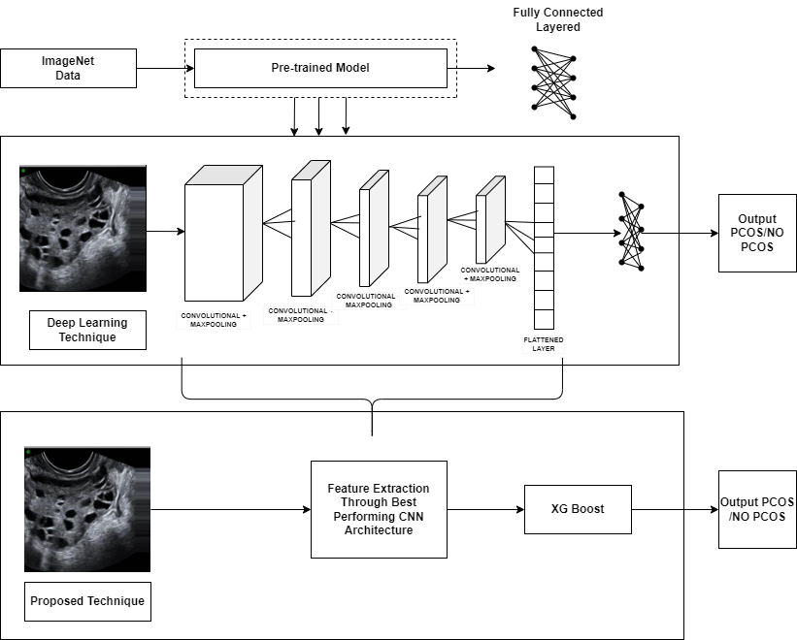
MODEL ARCHITECTURE

Slide 9
PROPOSED WORK
The code uses medical images to implement a deep learning and machine learning pipeline for PCOS detection. Initially, it handles image preprocessing by reading, resizing, and normalizing the images from training and testing datasets. The approach’s core involves transfer learning, where the VGG16 architecture—pre-trained on ImageNet—is used as a feature extractor. By removing the fully connected layers (`include_top=False`), the code repurposes VGG16's convolutional layers to extract rich feature representations from the images without needing to train the model from scratch. These features are then flattened and reshaped into a 1D vector for each image.
The reshaped feature vectors are fed into an XGBoost classifier, which is trained to classify the images into two categories (for instance, different stages of PCOS). XGBoost, an efficient gradient-boosted decision tree algorithm, is chosen due to its strong performance in handling structured data. The model’s predictions are evaluated using various metrics like accuracy, confusion matrix, and classification report. Additionally, the code generates ROC curves to measure the performance across different classes. The final model, after training, is saved using joblib for future use, making it ready for real-time classification or deployment.

Slide 10
DATA-PREPROCESSING
Image Loading: The images from the dataset are loaded using OpenCV (cv2.imread). The dataset contains images in different folders, each representing a different class (e.g., positive, negative, etc.). For each image path, the image is read and assigned a corresponding label based on the folder name.
Resizing: Since the original images might be of varying sizes, they are resized to a fixed size (256x256 pixels) using cv2.resize. This step ensures that all input images are of the same dimensions, which is essential for feeding the images into a deep learning model like VGG16.
Shuffling: The training and testing datasets are shuffled to ensure that the model doesn't learn any patterns related to the order of the images. This step is vital in reducing bias and overfitting during model training.

Slide 11
DATA-PREPROCESSING
Normalization: After resizing, the images are normalized by dividing pixel values by 255.0. This step scales the pixel values to a range between 0 and 1, which helps the model to converge more efficiently during training. Pixel values are typically in the range of 0 to 255, and normalization helps in faster and more stable training by preventing large input values from dominating the model's learning process.
Label Encoding: The labels (class names) for the images, which are in textual format (e.g., "PCOS", "Healthy", etc.), are converted into numerical values using LabelEncoder. This step is necessary because machine learning models work better with numerical data. The encoded labels are then used during model training to map image features to the respective classes.

Slide 12
FEATURE EXTRACTION
1. VGG16 Model: Load the pre-trained VGG16 model (without the fully connected layers) to extract high-level image features like edges and patterns from input images.
2. Freezing Layers: Set the model layers as non-trainable, keeping the pre-trained weights intact for feature extraction.
3. Feature Map Extraction: Process images through the VGG16 model to obtain multi-dimensional feature maps from the convolutional layers.
4. Flattening: Convert 3D feature maps into 1D vectors, making them suitable for machine learning models like XGBoost.
5. Feature Representation: Use the 1D feature vectors as compact representations of the images for classification.
This approach uses transfer learning to extract useful features without retraining the entire model.

Slide 13
MODEL TRAINING
XGBoost
XGBoost is a powerful and efficient implementation of the gradient boosting algorithm. It is designed to handle structured/tabular data and is widely used for classification and regression tasks due to its superior performance and scalability.
The algorithm works by building an ensemble of decision trees, where each new tree attempts to correct the mistakes (errors) made by previous trees. Over time, this creates a strong model that performs better than individual decision trees.

Slide 14
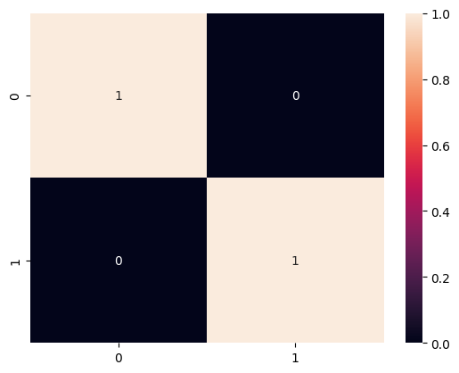
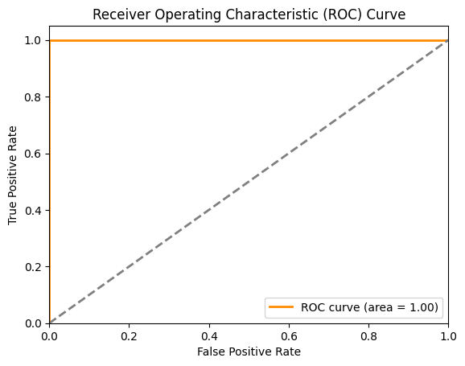
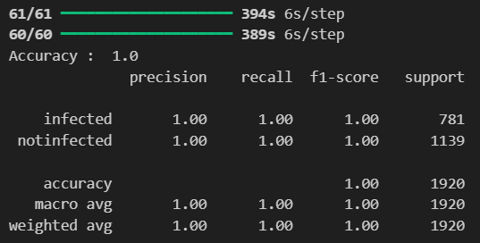
MODEL EVALUATION
1. Accuracy Score: Measures the percentage of correct predictions using `accuracy_score()`.
2. Confusion Matrix: Displays true/false positives and negatives, normalized for better insight.
3. Classification Report: Provides precision, recall, and F1-score for each class.
Classification Report
Confusion Matrix
ROC Curve

Slide 15
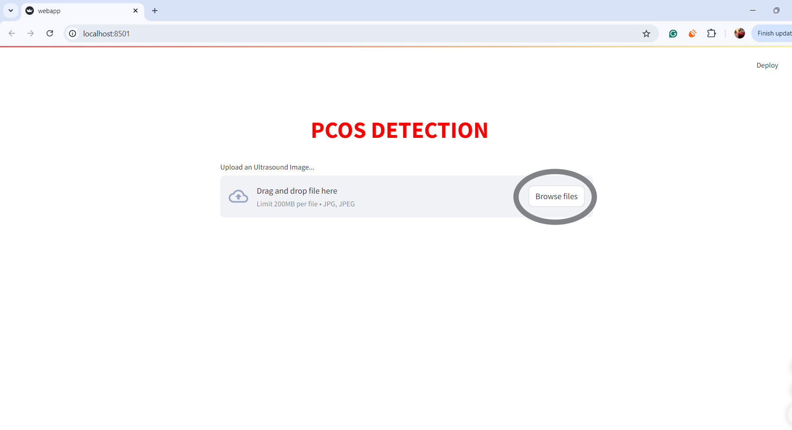
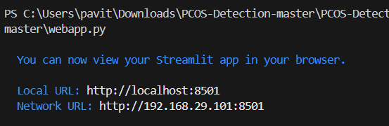
MODEL DEPLOYMENT
The model is deployed using Streamlit. Users upload an ultrasound image, and the VGG16 model extracts features, while the XGBoost model makes predictions. The result (PCOS or NORMAL) is displayed along with recommendations for the user.

Slide 16
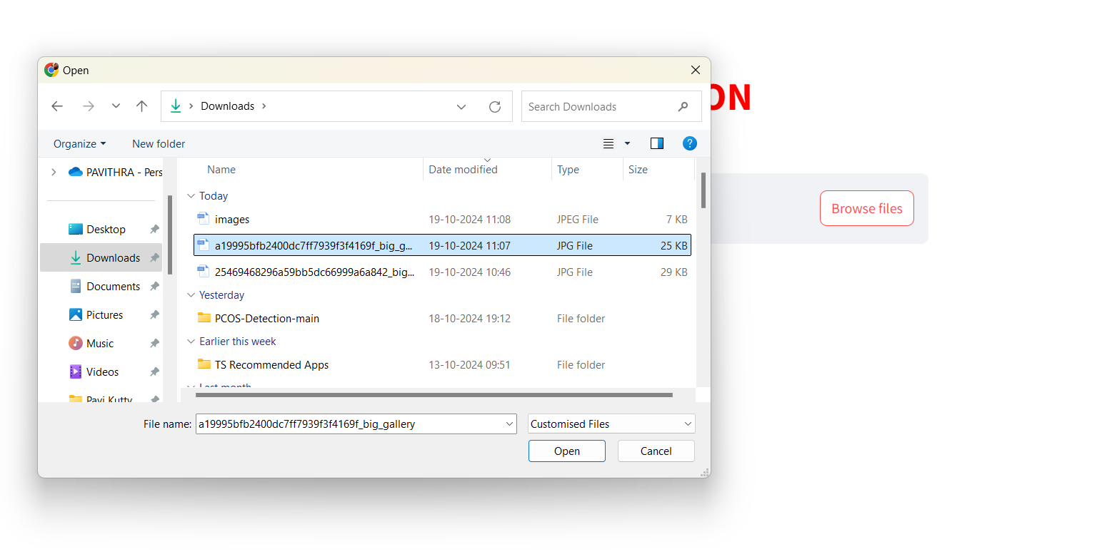
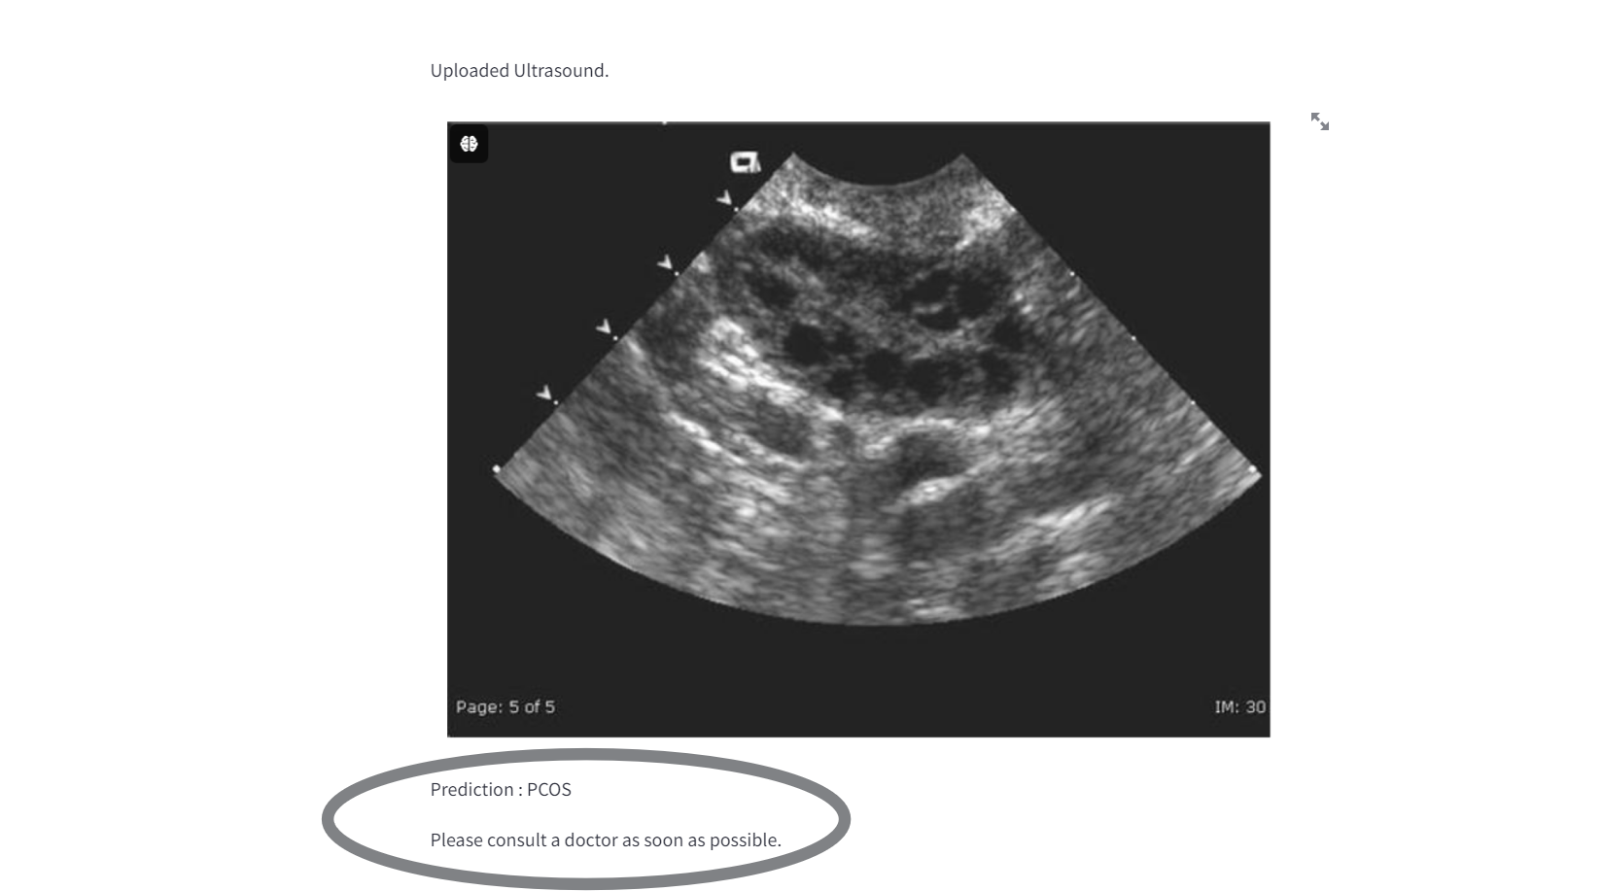

Slide 17
CONCLUSION
In conclusion, the proposed PCOS detection system demonstrates exceptional performance with 100% accuracy, precision, and recall, showcasing its robustness in classifying ultrasound images as either "PCOS" or "Not Infected." The system integrates deep learning and machine learning techniques, using VGG16 for feature extraction and XGBoost for classification, ensuring high accuracy and efficient processing. The deployment through Streamlit enables real-time analysis and user-friendly interaction, making it a practical tool for medical diagnostics. This system can significantly assist healthcare professionals in early and accurate detection of PCOS.

