Slide 1
Employee Data Analysis using Excel
STUDENT NAME: Pavithra.U
REGISTER NO: 312209435
DEPARTMENT: B.com commerce
COLLEGE: Anna Adarsh College for Women

Slide 2
PROJECT TITLE
Employee Performance Analysis using Excel

Slide 3


AGENDA
Problem Statement
Project Overview
End Users
Our Solution and Proposition
Dataset Description
Modelling Approach
Results and Discussion
Conclusion
3/21/2024 Annual Review

Slide 4

PROBLEM STATEMENT
By implementing this Employee Performance Analysis tool in Excel, the organization will be able to conduct more objective, data-driven performance evaluations. This will lead to better-informed decisions regarding employee development, rewards, and resource allocation, ultimately fostering a more productive and motivated workforce.
Notes:
By implementing this Employee Performance Analysis tool in Excel, the organization will be able to conduct more objective, data-driven performance evaluations. This will lead to better-informed decisions regarding employee development, rewards, and resource allocation, ultimately fostering a more productive and motivated workforce.

Slide 5

PROJECT OVERVIEW
To develop a standardized template for collecting employee performance data across various parameters.
To automate the calculation of performance metrics and scores using Excel formulas.
To provide data visualization through charts, graphs, and dashboards to support analysis and reporting.
To ensure the tool is user-friendly, scalable, and customizable to meet the varying needs of different departments or roles within the organization.
.

Slide 6

WHO ARE THE END USERS?
Human Resource professionals
Executives and senior leadership
Employee
Manager’s and team leaders
Performance analysts and business intelligent teams
Leaning and development
Project manager
Notes:
Human Resource professionals
Executives and senior leadership
Employee
Manager’s and team leaders
Performance analysts and business intelligent teams
Leaning and development
Project manager

Slide 7

OUR SOLUTION AND ITS VALUE PROPOSITION
Centralization Data management
Dynamic dashboard and report
Performance analysis
Trend analysis
Cost effective and flexible
Implementation and high adoption
Secure and stable framework

Slide 8
Dataset Description
Employee ID
Name
Gender
Department
Salary
FTE
Employee type
Start date
Work location
Notes:
Employee ID
Name
Gender
Department
Salary
FTE
Employee type
Start date
Work location

Slide 9

THE "WOW" IN OUR SOLUTION
Analytics and Insights
Reporters and notifications
Employee engagement
Comprehensive support and Training
Customizable views
Predictive analysis
3/21/2024 Annual Review
9

Slide 10
MODELLING
Conditional formatting
Pivot table
Data encryption
Slicers and timeliness
Bar chart
10

Slide 11
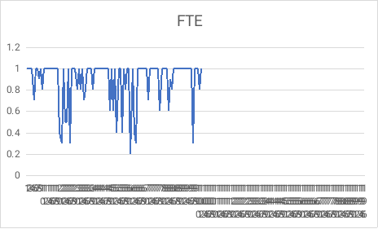
RESULTS
11

Slide 12
conclusion
In conclusion, the Excel-based Employee Performance Analysis tool represents a significant step forward in the organization’s ability to manage and enhance employee performance. By adopting this tool, the organization is well-positioned to foster a culture of continuous improvement, drive employee engagement, and ultimately achieve better business outcomes.

