Slide 1
Digital Portfolio
STUDENT NAME:
REGISTER NO AND NMID:
DEPARTMENT:
COLLEGE: COLLEGE/ UNIVERSITY
S.pavithra
30324u09068/astvu30330324u09068
BCA
Arcot Sri Mahaalakshmi women's college
1
Notes:
1

Slide 2
PROJECT TITLE
Inactive digital portfolio using frontend development
2

Slide 3


AGENDA
Problem Statement
Project Overview
End Users
Tools and Technologies
Portfolio design and Layout
Features and Functionality
Results and Screenshots
Conclusion
Github Link
3
3/21/2024 Annual Review

Slide 4

PROBLEM STATEMENT
Students struggle to present their skills and projects effectively.Traditional resumes are static and not engaging.Need for an interactive platform to showcase personal details.
4

Slide 5
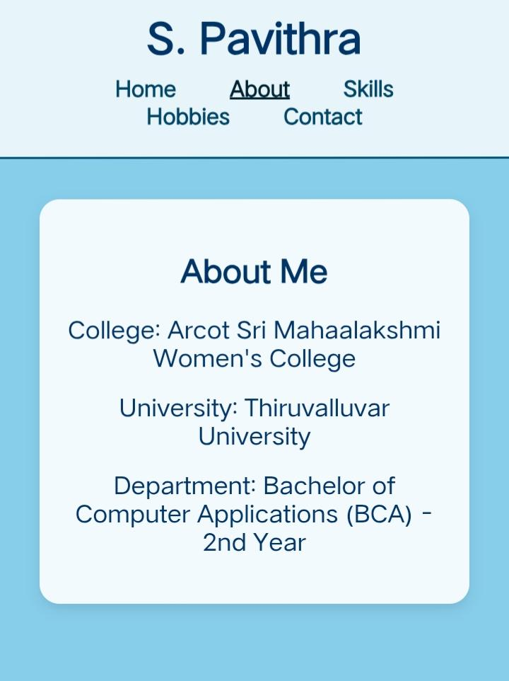
About me
I am studying in Aroct Sri Mahaalakshmi women's college under Thiruvalluvar university BCA department 2nd year
Notes:
5

Slide 6

PROJECT OVERVIEW
Developed a personal portfolio website.Built using HTML, CSS, and JavaScript.Highlights name, department, skills, hobbies, and achievements.Provides a creative and professional online presence.
6

Slide 7
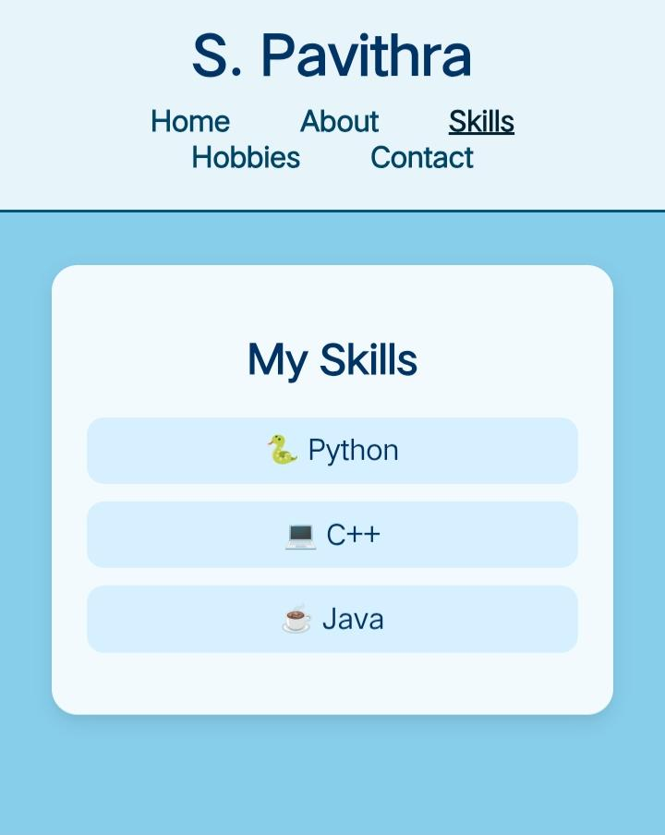
My Skills
I learn python,c++ and java

Slide 8

WHO ARE THE END USERS?
Students – to display academic and project work.Fresh graduates – to apply for jobs/internships.Professionals – to showcase career achievements.Recruiters/Employers – to easily view candidate profiles
8

Slide 9
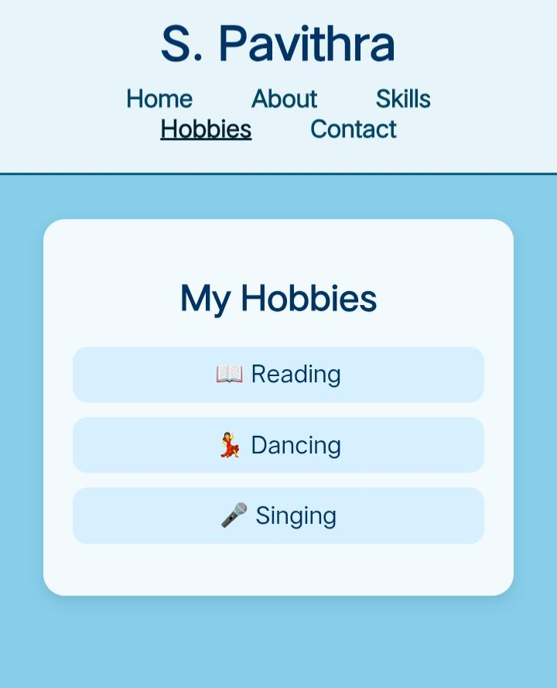
HobbIes
My hobby is reading , singing and dancing

Slide 10

TOOLS AND TECHNIQUES
HTML5 – structure of the website.CSS3 – design, styling, and layout.JavaScript – interactive functionality.GitHub – hosting and version control.
10

Slide 11
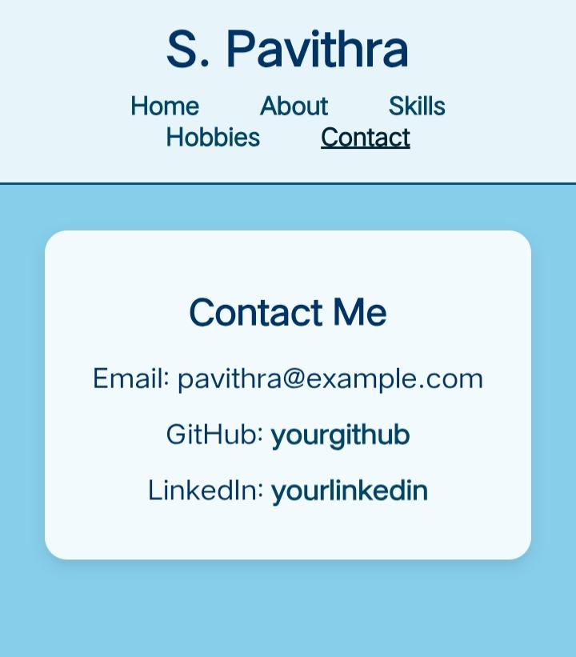
Contact
Email: Pavithra@gmail.comGitHub: PavithragithubLinkedIn:pavithralinkedin

Slide 12
POTFOLIO DESIGN AND LAYOUT
Sky-blue background for clean look.Separate sections: Name, Department, Skills, Hobbies, Games, Achievements.Simple navigation menu.User-friendly and responsive design.
12

Slide 13
FEATURES AND FUNCTIONALITY
Fully responsive across devices.Smooth navigation between sections.Attractive design with clear fonts and colors.Option to showcase hobbies, skills, and district-level achievements.

Slide 14
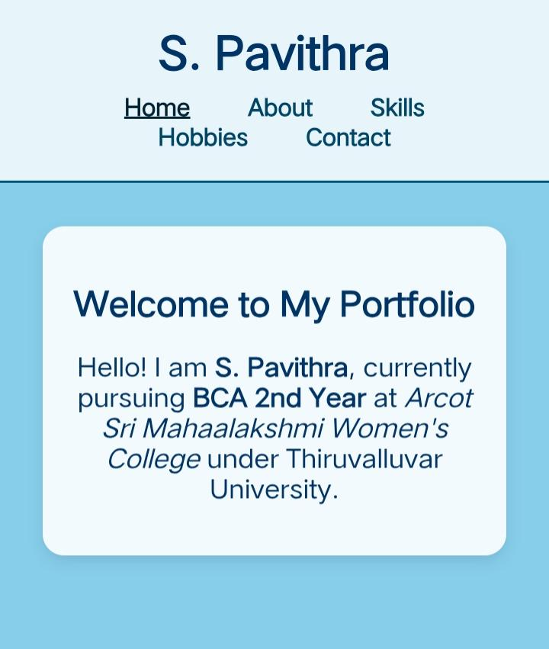

RESULTS AND SCREENSHOTS
Successfully hosted on GitHub Pages.Working portfolio with all sections.Screenshots of homepage, skills, hobbies, and achievements.
3/21/2024 Annual Review
14

Slide 15
CONCLUSION
Provides an effective platform to showcase personal details.Makes resumes more interactive and professional.Helps in career opportunities and online visibility.
15

Slide 16
Git hub link
https://github.com/pavithra22122006/pavithra.git

