Slide 1
Esp32-Web Server

Slide 2
Introduction
In this project we’ll create a standalone web server with an ESP32 module that controls outputs (two LEDs) using the Arduino IDE programming environment. The web server is mobile responsive and can be accessed with any device that as a browser on the local network.

Slide 3
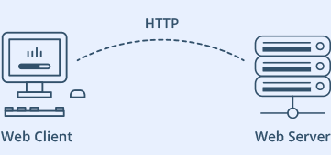
What is a Web server and how it works?

Slide 4
Working of a web server
The main job of a web server is to display website content through storing, processing and delivering webpages to users. Besides HTTP, web servers also support Simple Mail Transfer Protocol and File Transfer Protocol, used for email, file transfer and storage.
We can connect to a web server running on our IoT device by entering the IP address into the browser url. The connection will be made in this case via the switch built into the home router. The switch knows what port the IoT device is connected to and transmits and receives data via this port.

Slide 5
esp32 module
ESP32 is a series of low-cost, low-power system on a chip microcontrollers with integrated Wi-Fi and dual-mode Bluetooth.
ESP32 provided not only connect to an existing Wi-Fi network or act as a Web Server, but it can also set up a network of its own, allowing other devices to connect directly to it and access web pages. Because ESP32 can operate in three different modes: Station mode, Soft Access Point mode, and both at the same time.
Smart industrial devices, including programmable logic controllers(PLC’s).
It is a smart device which includes security surveillance,
smart lock and wearable health monitors, etc.
.

Slide 6
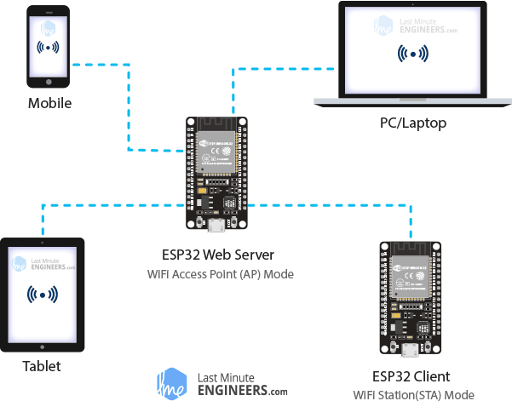
ESP32 Operating Modes

Slide 7
Concept Behind Controlling Things From ESP32 Web Server
So, you might be thinking, “How am I going to control things from a web server that merely processes and delivers web pages?” Well, then you need to understand what’s going on behind the scene.

Slide 8
components
ESP32 Module
2 LED
2x330 Ohm resistors
Breadboard
Jumper wires

Slide 9
wiring
Start by placing the ESP32 on to your breadboard, ensuring each side of the board is on a separate side of the breadboard. Next, connect two LEDs to digital GPIO 15 and 5 through a 330Ω current limiting resistor.

Slide 10
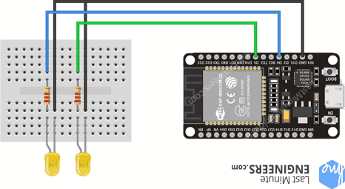
Schematic diagram

Slide 11
Code
explaination

Slide 12
simulation
To access the web server, open your browser, paste the ESP32 IP address, and you’ll see the following page.
If you take a look at the Serial Monitor, you can see what’s happening on the background. The ESP receives an HTTP request from a new client

Slide 13
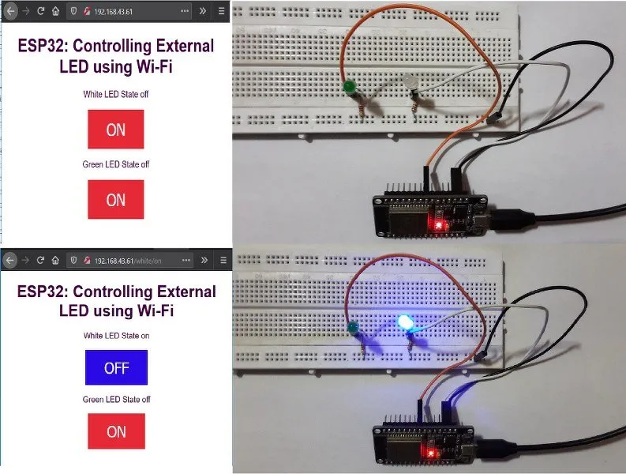
Demo of out put

Slide 14
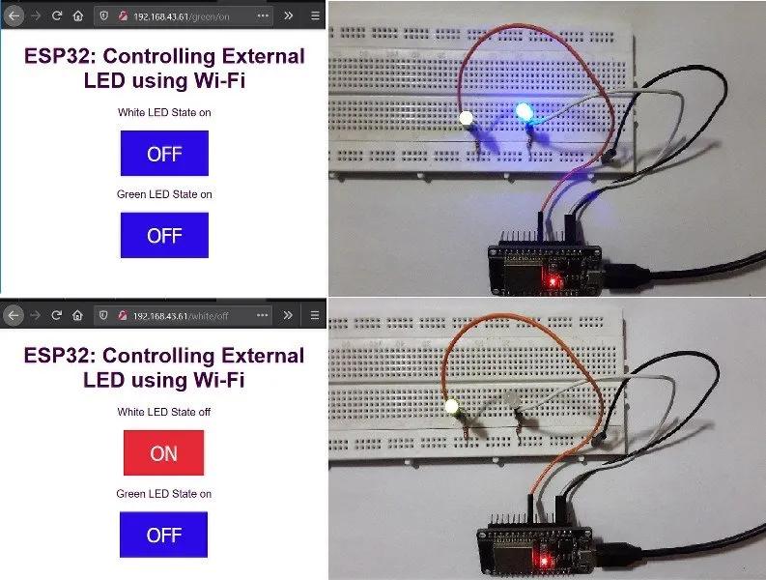

Slide 15
outcome
The web server-built controls two LEDs connected to the ESP32 GPIO 5 and GPIO 15;
For example, when you click the button to turn GPIO 5 ON, ESP32 receives a request on the URL.
When the ESP32 receives that request, it turns the LED attached to GPIO 5 ON and updates its state on the web page. The button for GPIO 15 works in a similar way.
You can access the ESP32 web server by typing the ESP32 IP address on a browser in the local network;
By clicking the buttons on your web server you can instantly change the state of each LED.

Slide 16
THANK YOU
BY:
I.PAVITHRA(19BEC017)
P.MOHAN BABU(19BEC031)
P.SRIRAM(19BEC033)
CH.VINAY Venkat sai(19BCS032)

