Slide 2
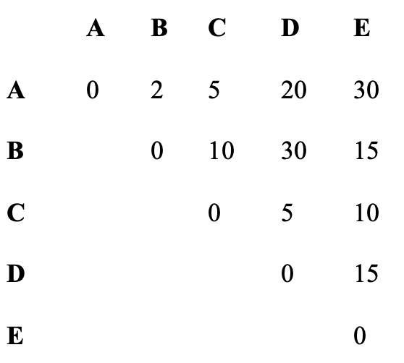
A space research organization is analyzing the distances between 5 celestial objects (labeled as A, B, C, D, and E) in a galaxy. The distances (in light-years) between these objects are represented in the following distance matrix
The organization wants to group these celestial objects into clusters based on their proximity to each other. The distance between two clusters is defined as the shortest distance between any single pair of objects from the two clusters.

Slide 3
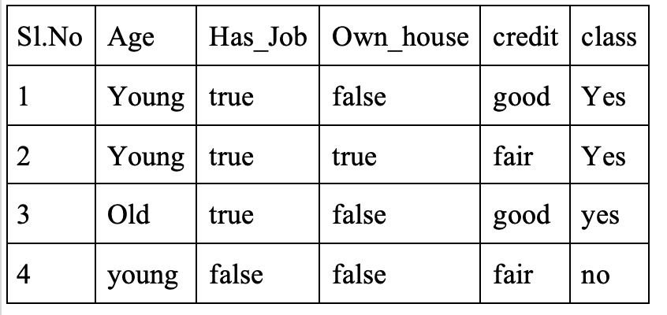
For the given dataset, compute the version space containing all hypotheses from H that are consistent with an observed sequence of training examples.

Slide 4
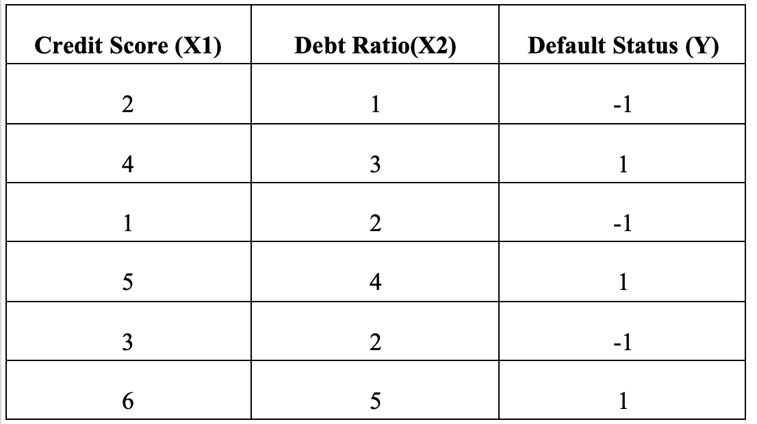
You are developing a credit risk prediction model for a financial institution to help assess whether loan applicants are likely to default on their loans. The data available for this task includes applicants' credit scores (X) and their default status (Y), where -1 indicates a high risk of default, and 1 indicates a low risk of default. The bank has provided a small sample of historical data for training the model to predict credit risk for future applicants.
Evaluate the predicted credit risk status (Y) for a new applicant with a credit score, debt ratio of X = {2.5, 3.5}.

