Slide 1
Automatic Speech Recognition (ASR) using Kaldi
GROUP 10

Slide 2
Introduction - ASR
Automatic Speech Recognition (ASR) is the process of transcribing spoken language into text. Kaldi is a popular open-source toolkit for speech recognition, offering powerful tools and algorithms for ASR applications. It also contains recipes for training your own acoustic models on commonly used speech corpora

Slide 3
Download and install all required library for Kaldi
Create separate folder for project in Kaldi/egs folder
Project directory –run.sh, cmd.sh,path.sh
Download Data for Model Training and Testing
Data preparation involves creation of required directories and files
Under Project Directory kaldi/egs/myproject/
Data Preparation
Sub Directory
exp
data
local
conf
steps
utils
Feature Extraction
(MFCC features)
Sub Directory
Train
lang
local
Mfcc.conf
Language Model and Acoustic Model Training
Sub Directory
lang
Decoding and
Evaluation
Text
Wav.scp
Utt2spk
spk2utt
Lexicon.txt
Nonsilence_phones.txt
Silence_phones.txt
Deployment

Slide 4


Steps for Processing Telugu Language in ASR
Data Preparation:
Collect and organize audio data.
Prepare transcripts for the audio data.
Installation of all required libraries for Kaldi
Prepare the required directories for Acoustic and language model
Feature Extraction:
Extract acoustic features from the audio data.
Common feature extraction techniques include Mel-Frequency Cepstral Coefficients (MFCCs), filter banks, and pitch features.
Prepare the required files like : text,wav.scp,utt2spk,spk2utt for acoustic model
Prepare the required files like : lexicon.txt,nonsilence_phones.txt,optional_silence.txt,silence_phones.txt for language model
sampling frequency=16000 used in mfcc.conf file
making use of make_mfcc.sh in steps to compute the MFCC features from the audio data.

Slide 5
Acoustic model : it learns to recognize the patterns and shape of sounds in speech
Files:
text – utt_id WORD1 WORD2 WORD3 WORD4 …
Wav.scp - file_id path/file
Utt2spk - utt_id spkr
Spk2utt - spkr utt_id1 utt_id2 utt_id3
Lexicon.txt – WORD phonemic pronunciation
Nonsilence_phones.txt -- list of all the phones that are not silence
Silence_phones.txt – silence and out of vocabulary

Slide 6
Steps for Processing Telugu Language in ASR
Acoustic Model Training:
Train an acoustic model using the audio data and their corresponding transcripts.
Kaldi supports training of various acoustic models, including Gaussian Mixture Models (GMMs), Hidden Markov Models (HMMs), and Deep Neural Networks (DNNs).
> Train Monophone Model and align the audio with the acoustic model
> Train Triphone Model and align the audio with the acoustic model
Language Model Preparation:
Prepare a language model based on the text data.
Language models capture the probability of word sequences occurring in a language.
Decoding:
Apply the trained acoustic model and language model to decode the audio data.
Evaluation:
Evaluate the performance of the ASR system using metrics such as Word Error Rate (WER) and accuracy.
Use evaluation results to refine and optimize the ASR system.
Deployment:
Deploy the trained ASR system for real-world applications.
Integrate the ASR system with other software components or systems as needed.

Slide 7
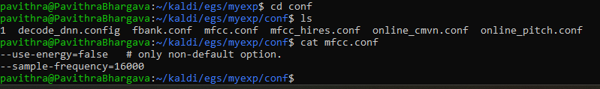
Data specification
We are using Telugu dataset which is having - 50hrs of corpus data, we are using 45hrs of training and 5hrs of testing ,
Sampling frequency is 16khz

Slide 8

ASR MODEL
During decoding, the trained acoustic and language models are used to transcribe unseen audio data. This involves aligning the acoustic features with linguistic units (e.g., phonemes) and selecting the most likely word sequence given the acoustic and language model scores.
Text Output: Finally, the text output is generated from the decoded word sequences. This text output represents the recognized speech in the form of textual transcriptions.
Build ASR model which takes wav file as input and gives the text output.
Compare the ASR output with the text from the text file.
Calculate the Word Error Rate (WER) based on the comparison.
The WER (Word Error Rate) formula calculates the error rate between two sequences of words: the reference (ground truth) sequence and the hypothesis (recognized) sequence.
The formula for WER is:
N: Total number of words in the reference transcript.
S: Number of substitutions (words in the reference transcript that were replaced by incorrect words in the hypothesis transcript).
D: Number of deletions (words in the reference transcript that were missing in the hypothesis transcript).
I: Number of insertions (words in the hypothesis transcript that were not present in the reference transcript).

Slide 9

Evaluation Metric: Word Error Rate (WER)
What is WER?
Word Error Rate (WER) measures the accuracy of the ASR system by comparing the transcribed text with the ground truth. It calculates the percentage of words that were incorrectly recognized or substituted.
Significance of WER 33% is achieved by our model
A WER of 33% indicates a high level of accuracy in transcribing Telugu speech. It signifies that only 33% of the words were incorrectly recognized or substituted, showcasing the effectiveness of the ASR system.

Slide 10



Steps in Achieving WER to 25 %

Slide 11
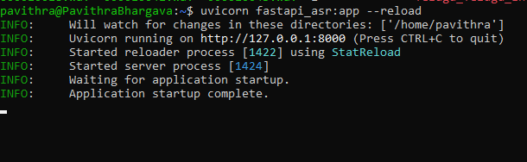
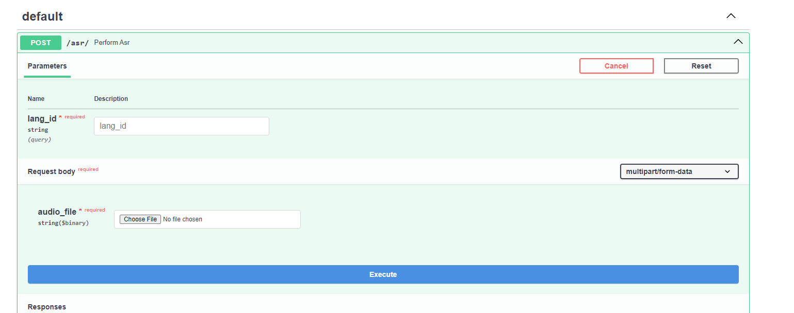
FastAPI

Slide 12
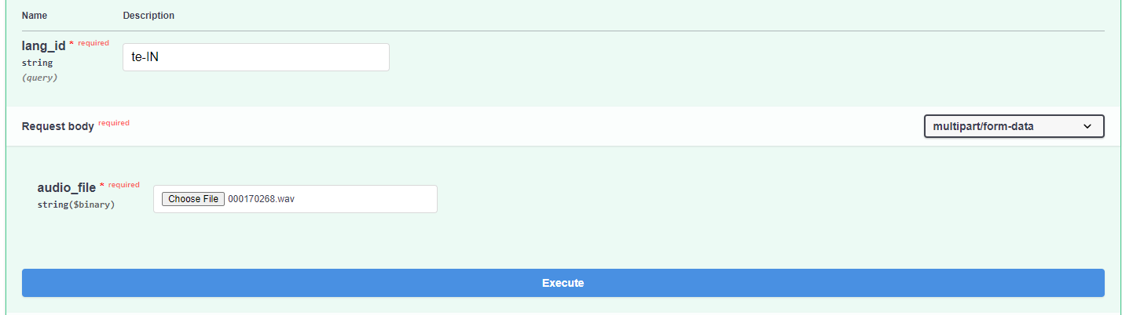

Slide 13
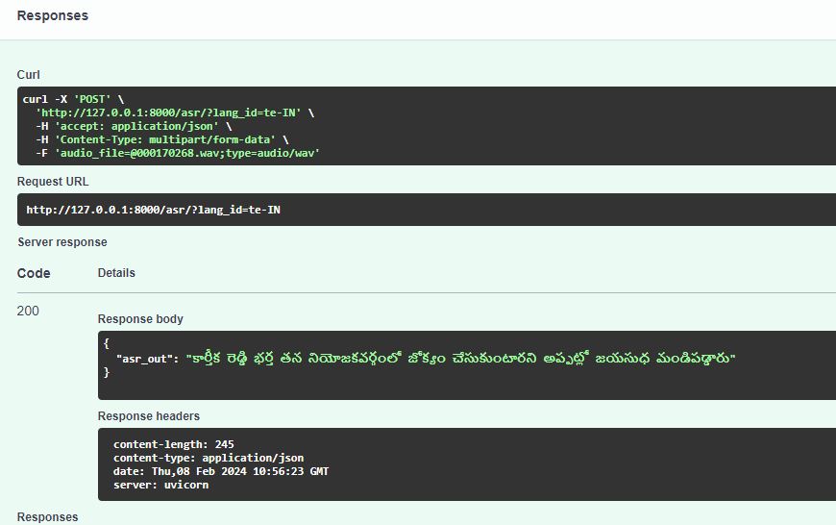
Fast Api Response:

Slide 14
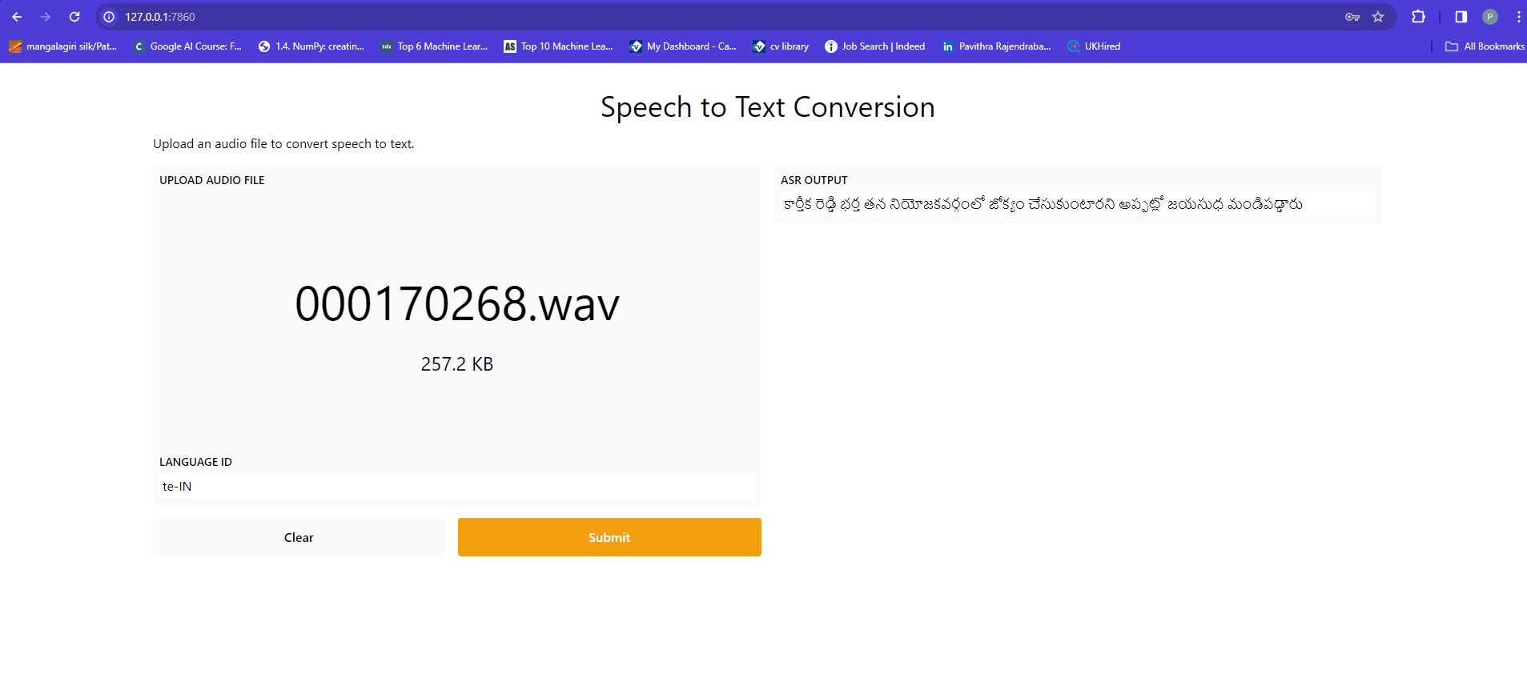
FRONTEND: Using Gradio

Slide 15
Challenges faced
During installation of Kaldi faced issues in requirement of installation of various libraries.
struck at Align monophones in executing command: steps/align_si.sh --boost-silence 1.25 --nj 16 --cmd "$train_cmd" \data/train data/lang exp/mono_10k exp/mono_ali || exit 1; which was exiting for no of parallel process was 16 and later decreased to 4 based on system requirements.
.wav file was not read properly since there was wave.py file saved in the same folder where the project python file which reads the audio file runs, so faced multiple issues which later got resolved on removing wave.py file from that folder.

Slide 16
References
1) ExKaldi-RT: A Real-Time Automatic Speech Recognition Extension Toolkit of Kaldi -3 Apr 2021- https://paperswithcode.com/paper/exkaldi-rt-a-real-time-automatic-speech
2) PyKaldi2: Yet another speech toolkit based on Kaldi and PyTorch - 12 Jul 2019 - https://paperswithcode.com/paper/pykaldi2-yet-another-speech-toolkit-based-on
3)https://maelfabien.github.io/machinelearning/speech_reco/#
4) https://huggingface.co/tasks/automatic-speech-recognition
5) https://www.gladia.io/blog/an-introduction-to-asr-speaker-recognition-identification-verification-and-diarization

Slide 17
Thank You

