Slide 1
IDEA DETAILS
Organization Name: Education department Gujarat
Problem Statement: IoT Based Portable Smart Bottles For Health Care
Team Name: Inovatsia
Team leader name: Rithika B
College code: 1-3516209872

Slide 2
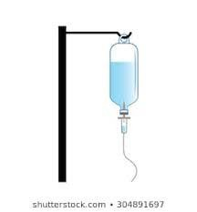
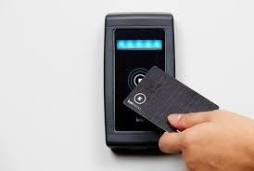
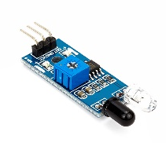
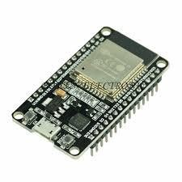
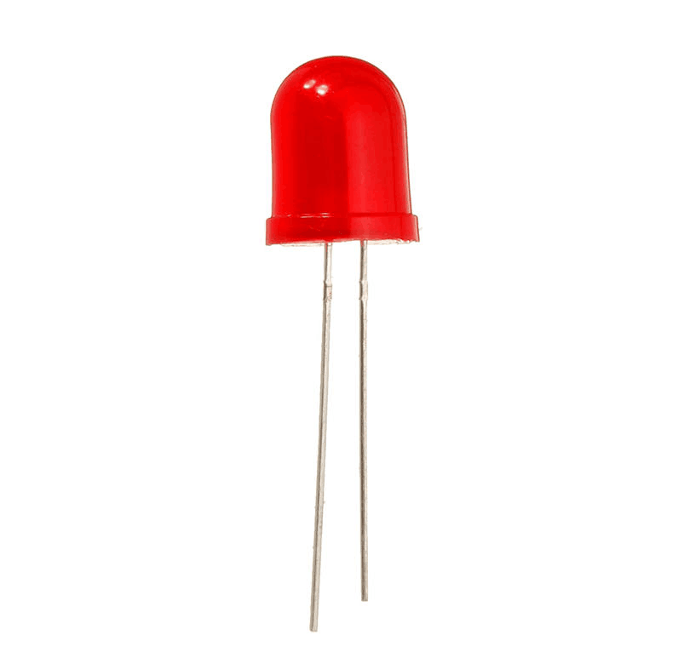

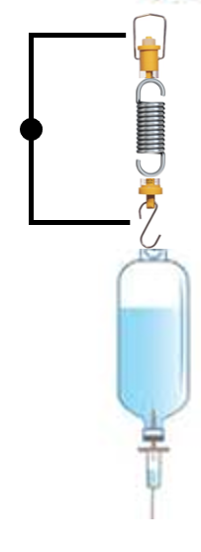
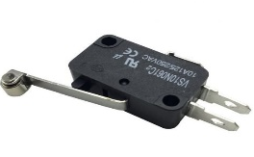


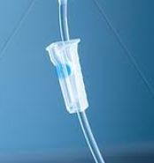
SMART INDIA HACKATHON 2020
IoT based portable measuring device is used to monitor the quantity of the electrolyte and restricts the flow when the electrolyte bottle is empty. This measuring of electrolyte can be done in two ways:
Sensor Based Model (Variant 1) – The Quantity of electrolyte will be tracked by laser and LDR sensors through the refraction principle. It results in almost 95% ACCURACY
Mechanical Based Model (Variant 2) –The Quantity of Electrolyte will be tracked by interaction of metal terminals connected to the Spring. It is COST EFFICIENT than variant 1.
The signal received from either one of the variant is sent to the servo motor that blocks the flow of the electrolyte with the controller and sends an alert where it generates a text message. Incase of any fault, a notification will be send to the concerned authority for checking.
VARIANT- 1 SENSOR BASED METHOD
TECHNOLOGY STACK
EITHER ONE OF THE VARIANTS CAN BE USED FOR MEASURING THE ELECTROLYTE
IR SENSOR
RFID SCANNER
ESP8266 Node MCU
BUZZER
LED
VARIANT- 2 MECHANICAL
BASED METHOD
SPRING MECHANISM
LIMIT SWITCH
ALERT MESSAGE
FLOW CONTROLLER
SERVO
MOTOR

Slide 3
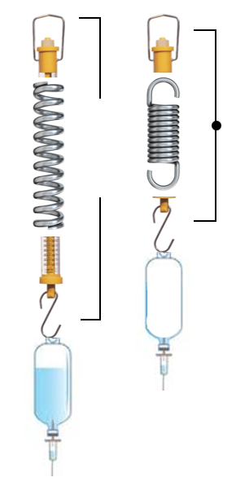
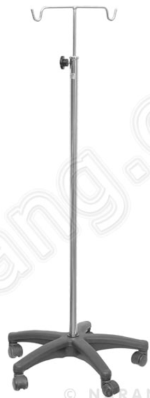




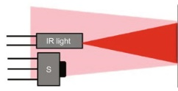
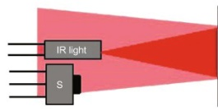


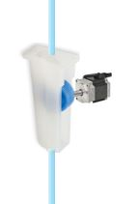
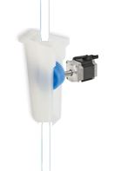
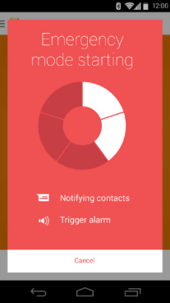
Mechanical Based Model (Variant 2)
Sensor Based Model (Variant 1)
Cost: 400/-
Cost: 750/-
HALF LEVEL - 50%
EMPTY 10%
A
B
B
Saline bottle may be of 100ml, 250ml,500ml, 1000ml
In A, Electrolyte present – Low Infrared beam reflected – signal sensed by IR.
In B, Electrolyte absent – High Infrared beam reflected – signal sensed by IR is changed.
A
Flow Control
In A, Bottle filled – spring elongated – Limit switch stays still.
In B, Bottle empty – spring compressed – Limit switch Strikes.
After detecting the presence of Electrolyte by either one of the method, Flow controller will be used to stop the outlet of the saline bottle
In A: Electrolyte flows – Servo motor is still - Valve is open
In B: Flow stops – Servo motor runs – Valve closes – alert message.
DEPENDENCY
Internet facility is essential at hospitals for notification to authorities via app, even without which the electrolyte back flow will be stopped by servomotor.
A

