Slide 1




oject Name: Saline Care
am Members: RahulRaja R
Naveen Kumar K R Rithika B SHUBHAKARINI S PAVITHRA DEVI V

Slide 2

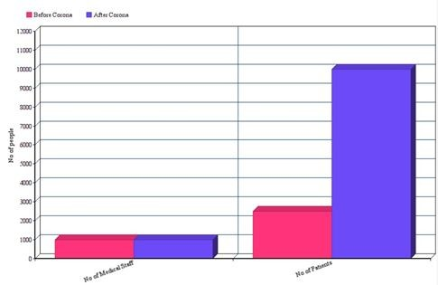
Problem Statement
IoT based smart saline bottles for healthcare
When the saline (electrolyte) in the (IV Bottle)bottle is emptied, backﬂow of blood occurs into the intravenous line causing certain unpleasant feelings to the patient. The pandemic COVID-19 cases are increasing on a daily basis which becomes harder for the limited number of healthcare workers to treat the patients. To not worry about the regular check on the saline drip, this technique can be taken to the hospitals at this much needed time so that it becomes easier for the workers to monitor and provide the needy with the correct schedule. The following chart shows the difference between the number of Medical Staff and patients before and after the outbreak of Corona:

Slide 3
Proposed Solution
IoT based portable measuring device is used to monitor the quantity of the saline and restricts the ﬂow when the saline bottle is empty. One of the Two variants can be used to measure the level of saline in the bottle:
Sensor-based (ii) Mechanical base
Sensor -Based Model (Variant 1) – The Quantity of saline (electrolyte) will be tracked by the help of sensors (IR/LDR) through the refraction principle.
Mechanical Based Model (Variant 2) –The Quantity of saline (electrolyte) will be tracked with the limit switch that is hit by the saline bottle once it is empty. It is COST EFFICIENT than variant 1.
The signal received from either one of the variant is sent to the servo motor that blocks the ﬂow of the electrolyte with the controller and sends an alert to an application.The App is handled by the Hospital authorities (Nurse/Doctor). The App shows the saline bottles in room wise followed by the bed numbers.
For Variant 1, the app shows 3 level indications. i.e., 100%-51%; 50%-3% and less than 3%. For each indication, it gives a pop up notiﬁcation to the concerned authorities.
For the Variant 2, the app shows 2 level indications. i.e., 100%-3% and less than 3%. As earlier, the authorities will be notiﬁed with a pop up message.

Slide 4
Unique Selling Point
The existing models only measures the amount of saline but the IOT based smart saline bottles ensure that the ﬂow of the liquid is arrested in time and backﬂow doesn’t occur even if the healthcare workers couldn’t make it in time.
This model reduces the risk of infections and contaminations since the RFID present in the device allows only the authorities with the tag to open the set up and do further changes in the saline.

Slide 5
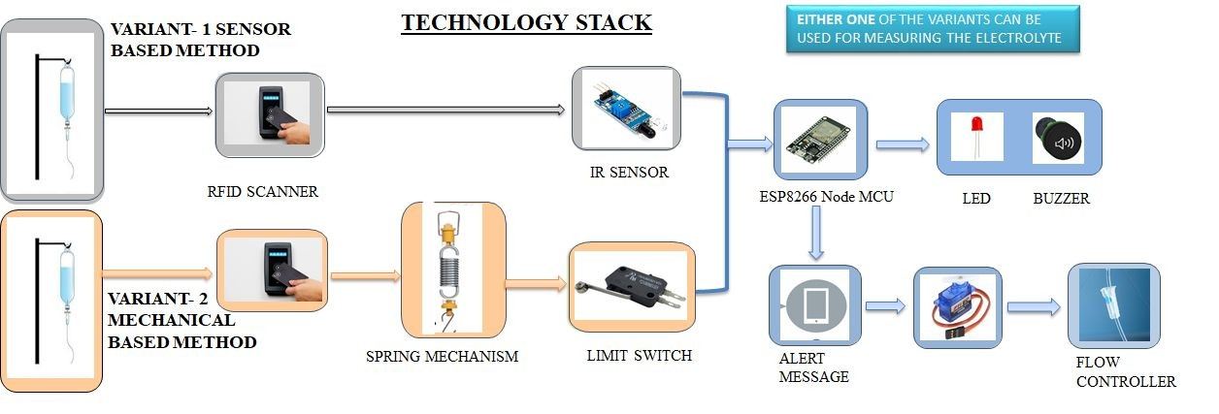
Proposed TechStack
The Overall control of all the Stands in a hospital can be monitored using a website

Slide 6
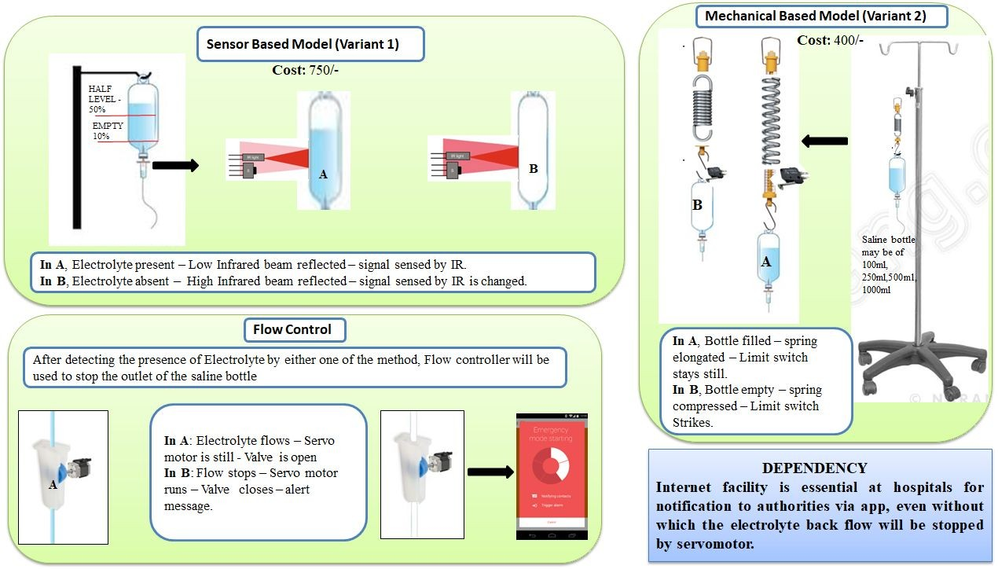

Slide 7
How our idea makes India Atmanirbhar
When the saline (electrolyte) in the bottle is emptied, backﬂow of blood occurs into the intravenous line causing certain unpleasant feelings to the patient.So the health care workers need to regularly check the saline drip manually which cost a huge time and man work being wasted
By using our idea health workers can monitor the saline bottle remotely and if they failed up to show up when the Saline bottle is going to empty our device automatically restricts ﬂow which save time and man work

Slide 8
THANK YOU!

