Slide 1
TWITTER FAKE BOT DETECTION MODEL
Group 2
RUTU AJANI
Disha neve
Tanuj Sawant

Slide 2
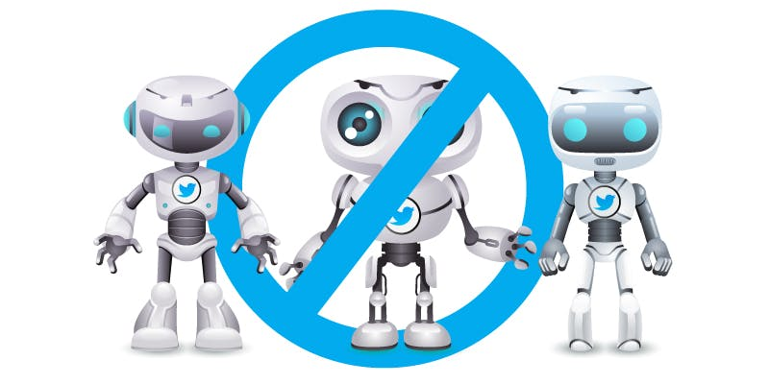
TWITTER BOT

Slide 3
contents
Introduction
Problem Statement
Exploratory Data Analysis
Twitter Bot Creation
Data Cleaning, Transformation and Labeling.
Modeling and Model Comparison.
Insights
Future Scope
Business Implications

Slide 4
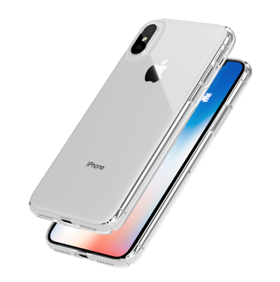
Introduction
iPhone… for better or for worse?

Slide 5
Problem statement
21st Century marks the Era of Digital Marketing with emphasis on social media platforms like Facebook, Twitter, Snapchat, etc.
Social media, being vulnerable and having a wide range of audience acts like a platform for negative marketing.

Slide 6
Exploratory data analysis

Slide 7
Twitter bot creation
Understanding and replicating the behavior of a real world twitter bot.
We used NLTK library to create corpus of words.
Used Markov Chain sentence generator algorithm to form tweet content.
Tweeted using the created bot at regular intervals.

Slide 8
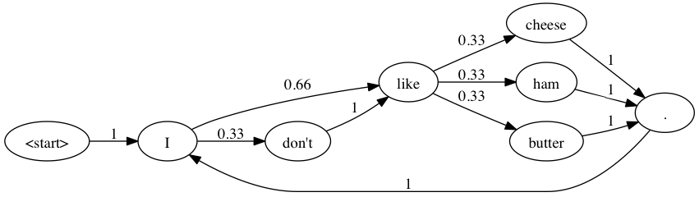
Markov chain Logic(Sentence generator)

Slide 9
Data Cleaning, Transformation and Labeling.
Data Cleaning: Removed stop words, special characters, HTML decoding and url links.
The main challenge was labeling which was performed manually for training data referring the below papers.

Slide 10
Bot and no bot labeling
Bot
No Bot
Usually less number of followers.
More number of friends.
Geo location disabled.
Higher status count.
Usually more or equal number of followers.
Less number of friends.
Geo location enabled.
Lower status count.

Slide 11
Baseline accuracy

Slide 12
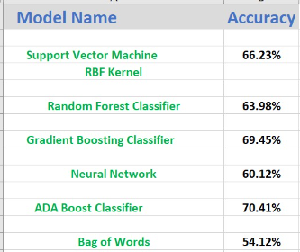
Model comparison

Slide 13
Insights
How to differentiate between a Bot and No Bot on the basis of various parameters.
If twitter premium was available more number of tweets could be extracted and the algorithm would have been more accurate.
If we had used a sophisticated API bot from API.AI the process would have been escalated and more simple.

Slide 14
Future scope
By finding the right permutations and combinations for the bag of words algorithm we can replicate the behavior of a human tweeting.
Given more time frame, we could have mined diverse Twitter data over a period of time to generate good training set and use semantic analysis.

Slide 15
Business Implications
It can be used for Brand monitoring and flagging the fake Tweets.
It is used to analyze the effect of negative marketing on Sales and Brand value.

Slide 16
Thank You!

