Slide 1
AI CUSTOMER SUPPORT · RAIL
DeBian
DeBian Assistant
AI
Claim compensation
Your Deutsche Bahn Assistant for Agent Analytics, Booking, delay support, compensation claims and human in the loop (HITL)
Bot
Status for ICE 999: delayed.
Delay: approximately 140 minutes.
You may be eligible for compensation.
Presentation
Stack
Cloud
7 min + 2 demo
Agent + RAG
GCP-ready
Security
IBAN masked: ******************3000
Pavithra Rani · AI Engineer
DeBian AI Rail Assistant | Pavithra Rani

Slide 2
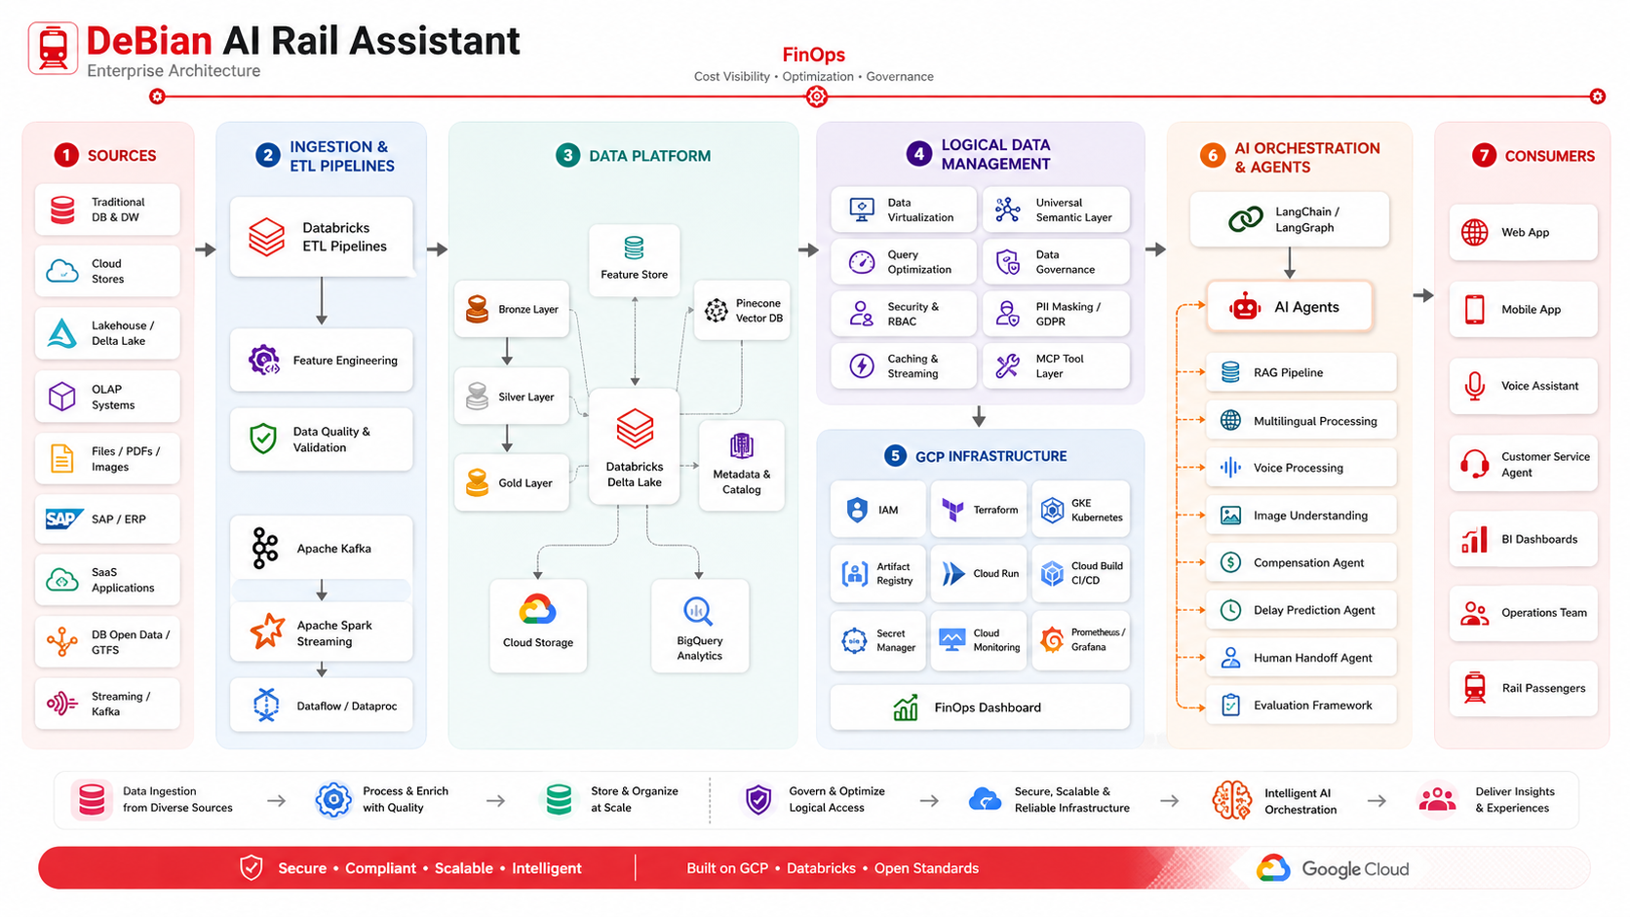

Slide 3
Hook + Project Overview
02
A customer-support assistant that converts disruption into a guided, secure workflow
Problem
Solution
Why it matters
Demo case
Rail passengers need quick answers during delays. Support teams receive repetitive compensation and route questions. Sensitive data must be handled carefully.
DeBian guides users through delay checks, compensation claims, alternative travel and human escalation, occupancy status using an agentic workflow.
Reduces support friction, structures claims, protects PII and creates analytics/evaluation traces for continuous improvement.
ICE 572
95 min delay
€80 ticket
25% = €20
What is implemented in the MVP
Production-ready design direction
FastAPI backend endpoints: chat, delay, claim, human assistance
LangChain orchestration and MCP-like tools
Guided frontend flow for compensation claims
RAG with Pinecone vector database and metadata filters
PII masking: account/IBAN never displayed fully
Databricks-style Bronze/Silver/Gold data layer
Mock delay lookup for stable demo scenarios
GKE/Terraform deployment architecture and observability
Hook
Architecture
Data/RAG
Agent/Tools
Eval/Security
Demo
DeBian AI Rail Assistant | Pavithra Rani

Slide 4
End-to-End User Journey
03
The assistant does not just answer — it guides the passenger to the next safe action
1. Input
2. Intent
3. Tool call
4. Secure answer
5. Learning loop
Text · voice · image. Document processing
multilingual
Delay? claim? route?
human handoff?
Delay lookup · claim
route · handoff
PII masked
LLM/fallback text
Analytics + eval logs
quality improvement
Example demo path
Business outcome
Passenger selects “Claim compensation”
The conversation becomes a structured claim object that can be routed to backend systems, analytics and human support if needed.
DeBian asks for train, station, planned/actual time, delay, ticket price
Claim is submitted and account number is masked
Hook
Architecture
Data/RAG
Agent/Tools
Eval/Security
Demo
Talk track: Walk through one complete user journey and point out where AI, tools and governance fit.
DeBian AI Rail Assistant | Pavithra Rani

Slide 5
Architecture of the Solution
04
Agentic customer support with RAG, tools, evaluation and GCP-ready deployment
Experience Layer
AI Orchestration
Business Tools
Data Layer
Platform
Web/Mobile UI
Text input
Voice placeholder
Image placeholder
Multilingual UX
Intent classifier
LLM response layer
RAG retrieval
MCP-like tool registry
Streaming endpoint
Delay lookup
Compensation rules
Route alternatives
Human handoff
PII masking
Cloud Storage
Databricks ETL
BigQuery analytics
Pinecone vector DB
Feature Store
Docker
GKE
Terraform
Secret Manager
Monitoring
Design principle: separate the conversation layer from tools and data so each part can be evaluated, secured and scaled independently.
Hook
Architecture
Data/RAG
Agent/Tools
Eval/Security
Demo
Talk track: Explain this as three layers: experience, intelligence, data/platform.
DeBian AI Rail Assistant | Pavithra Rani

Slide 6
Dataset + Data Layer
05
From raw rail/support data to features and retrievable knowledge
Bronze
Silver
Gold
Raw DB open data
GTFS / delay logs
Uploaded images
Support documents
Cleaned schedules
Station data
Delay events
Passenger-rights docs
Eligibility table
Route recommendations
Support analytics
Delay features
Feature Store columns
RAG document types
Metadata filters
train_number, route_id, station_id
Passenger-rights policy
language = de / en
planned_departure_time, weekday
Compensation rules
document_type
historical_delay_minutes
Station FAQs
region = Germany
weather_signal, congestion score
Ticket refund instructions
valid_from / valid_to
cancellation_flag
Internal SOPs
confidence_score
Hook
Architecture
Data/RAG
Agent/Tools
Eval/Security
Demo
Talk track: Show that the data layer is designed like a production lakehouse, even if the demo uses mock/local data.
DeBian AI Rail Assistant | Pavithra Rani

Slide 7
RAG + Vector Retrieval
06
Grounding support answers in policy and support documents
1. Query optimization
2. Retrieval
3. Grounded generation
Detect language, expand synonyms and infer metadata filters such as language, document_type and region.
Search vector DB for passenger-rights, refund, station FAQ and SOP chunks. Local fallback keeps demo stable.
LLM receives user input + sanitized tool output + retrieved context, then returns a customer-friendly answer.
Vector DB record example
Why RAG matters
id: passenger_rights_en
language: en
document_type: passenger_rights
region: germany
valid_from / valid_to
confidence_score: 0.95
• Reduces hallucination risk
• Keeps policy answers maintainable
• Supports multilingual documents
• Separates data updates from application code
Hook
Architecture
Data/RAG
Agent/Tools
Eval/Security
Demo
Talk track: Describe query optimization, chunking and metadata before talking about the LLM.
DeBian AI Rail Assistant | Pavithra Rani

Slide 8
Q&A Agent Design
07
A deterministic workflow first, LLM response layer second
Message
Intent
RAG
Tool
LLM / Fallback
PII Mask
Intent categories
Tool registry
Prompt safety
delay_lookup
compensation_guidance
compensation_claim
route_alternatives
human_handoff
image / voice placeholder
The agent routes the request to a specific tool instead of relying on free-form generation for business actions.
System prompt instructs: no raw JSON, use source-of-truth tool result, ask one next question, mask sensitive data.
Key decision: deterministic tools calculate delay and compensation; the LLM only formats and explains the result.
Hook
Architecture
Data/RAG
Agent/Tools
Eval/Security
Demo
Talk track: Emphasize that tools produce truth and the LLM improves language, not business logic.
DeBian AI Rail Assistant | Pavithra Rani

Slide 9
Tools and Business Capabilities
08
Each tool maps to a real customer-support action
Delay Tool
Compensation Tool
Route Tool
Mock delay lookup now; DB Timetables API-ready mode with station + planned time.
Production: DB API / real-time feed
Applies compensation rules, calculates percentage and amount, submits claim object.
Production: Claims backend / CRM
Suggests alternative travel options based on origin/destination.
Production: Route planner / GTFS
Human Handoff
PII Masking
Streaming
Queues a request for callback or service-agent support.
Production: Call center / CRM
Masks account/IBAN and sanitizes logs, prompts and responses.
Production: Cloud DLP / governance
Server-sent events endpoint prepared for token-style response.
Production: Cloud Run / GKE service
Hook
Architecture
Data/RAG
Agent/Tools
Eval/Security
Demo
Talk track: Connect every tool to a user need and a production integration point.
DeBian AI Rail Assistant | Pavithra Rani

Slide 10
Security + Governance
09
Customer-support AI must protect personal data by design
PII protection
Secrets
Access control
Governance
IBAN/account numbers are normalized and masked. Only the last four digits are shown.
.env locally, Secret Manager/Kubernetes Secrets in production. No keys committed.
IAM, Kubernetes RBAC and service accounts isolate runtime permissions.
Unity Catalog / audit logs / retention controls.
Secure response lifecycle
Demo proof point
User input sanitized
Input IBAN: DE89370400440532013000
Displayed output: ******************3000
The full account number is not returned to the UI.
Tool output sanitized
LLM receives masked context
Logs store masked payloads
Evaluation checks PII leakage
Hook
Architecture
Data/RAG
Agent/Tools
Eval/Security
Demo
Talk track: Focus on why a passenger support bot needs enterprise-grade governance.
DeBian AI Rail Assistant | Pavithra Rani

Slide 11
Evaluation + Observability
10
Quality is measured as a product capability, not as an afterthought
PII leakage
Grounding
Tool accuracy
User value
Blocked
RAG context
Intent → tool
Guided flow
Evaluation checks
Observability plan
• Intent classification is compared with expected flow
• PII leakage detector scans responses
• RAG context presence is tracked as a groundedness signal
• Logs are created for analytics and quality improvement
• Cloud Logging for backend events
• BigQuery for support analytics
• Grafana for service metrics
• Cost dashboards for LLM and vector DB usage
Hook
Architecture
Data/RAG
Agent/Tools
Eval/Security
Demo
Talk track: Explain how evaluation logs make this more than a demo chatbot.
DeBian AI Rail Assistant | Pavithra Rani

Slide 12
Deployment and Productionization
11
GCP-ready design with containerized services and Terraform-managed infrastructure
Container
GKE services
Terraform
Monitoring
Dockerized backend with a clear runtime entry point.
API, agent, RAG, tools, human handoff and evaluation services.
VPC, subnets, GKE, Artifact Registry, BigQuery, Cloud Storage, Secrets.
Cloud Monitoring, Logging, OpenTelemetry, cost dashboards.
Developer
GitHub
Artifact Registry
GKE
Users
Deployment path: local MVP → container → GCP infrastructure → managed secrets, logging and scaling.
Hook
Architecture
Data/RAG
Agent/Tools
Eval/Security
Demo
Talk track: Present deployment as production architecture, not necessarily something the demo depends on.
DeBian AI Rail Assistant | Pavithra Rani

Slide 13
Live Demo Plan
12
2-minute script with backup screenshots/test payloads
Demo script
Demo input
Expected output
1. Start backend: python -m app.main
2. Start frontend: python frontend\streamlit_app.py
3. Check Backend
4. Check delay → ICE 999
5. Claim compensation → ICE 572
6. Confirm IBAN masking
Train: ICE 572
Station: Frankfurt(Main)Hbf
Planned: 2026-05-20T10:00:00
Actual: 2026-05-20T11:35:00
Delay: 95
Ticket: €80
Refund: bank_account
Claim submitted.
Estimated compensation:
25% = €20.
Account confirmation:
******************3000
Sensitive data masked.
Hook
Architecture
Data/RAG
Agent/Tools
Eval/Security
Demo
Talk track: Keep the demo short: show one delay lookup and one compensation claim.
DeBian AI Rail Assistant | Pavithra Rani

Slide 14
Conclusion
13
DeBian demonstrates an enterprise-ready pattern for customer-facing AI
Customer value
Engineering value
Business value
Passengers receive structured, multilingual guidance during stressful rail disruption moments.
The architecture separates UI, agent, tools, data, evaluation and governance for scalable iteration.
Support operations can reduce repetitive tasks while collecting analytics for quality improvement.
Next improvements: connect live DB APIs, enrich RAG documents, deploy to GKE, and add real voice/image processing.
Thank you · Questions?
Hook
Architecture
Data/RAG
Agent/Tools
Eval/Security
Demo
Talk track: End with value, not only technology.
DeBian AI Rail Assistant | Pavithra Rani

