Slide 1
CREDIT CARD FRAUD DETECTION
A Machine Learning-Based Approach for Secure Transactions
Presented By: Pavithra Bhat
Date: 02-05-2025

Slide 2
INTRODUCTION
With the rise of digital payments, credit card fraud has become a major concern for financial institutions and users. Detecting fraudulent transactions in real time is crucial to prevent financial loss. This project uses machine learning techniques to analyze transaction patterns and accurately identify fraudulent activity, ensuring secure and reliable payment systems.

Slide 3
LITERATURE REVIEW
1. Alsharif Hasan Mohamad Aburbeian & Huthaifa I. Ashqar - SMOTE + Random Forest
Objective: Combine SMOTE with Random Forest to improve fraud detection accuracy in imbalanced datasets.
Method:
SMOTE: Applied to balance the dataset by oversampling fraudulent transactions.
Random Forest: Ensemble method using multiple decision trees for improved classification.
Key Findings:
Achieved 98% accuracy with robust detection even in heavily imbalanced data.
Random Forest demonstrated strong performance and generalization on fraud detection tasks.

Slide 4
LITERATURE REVIEW
2. N. Kumar et al. (2023) - SMOTE + XGBoost
Objective: Address class imbalance in credit card fraud detection using SMOTE and XGBoost.
Method:
SMOTE: Balances dataset by generating synthetic fraud samples.
XGBoost: Gradient boosting algorithm used to classify transactions.
Key Findings:
Significant improvement in precision and recall for fraud detection.
XGBoost enhanced the detection of fraudulent transactions in highly imbalanced datasets, outperforming traditional methods.

Slide 5
DATASET OVERVIEW
SOURCE
Kaggle's Credit Card Fraud Detection dataset.
Total transactions: 284,807
Highly imbalanced: Only 492 fraud cases (0.17%).
V1 to V28: Anonymized numerical features from PCA transformation.
Time: Seconds elapsed between the transaction and the first transaction.
Amount: Transaction amount.
Class: 0 for legitimate, 1 for fraudulent.
FEATURES

Slide 6

SYSTEM REQUIREMENTS
Software Requirements
Anaconda
Python
Hardware Requirements
OS – Windows 7, 8, 10, 11 (32 and 64 bit)
RAM – 4GB

Slide 7
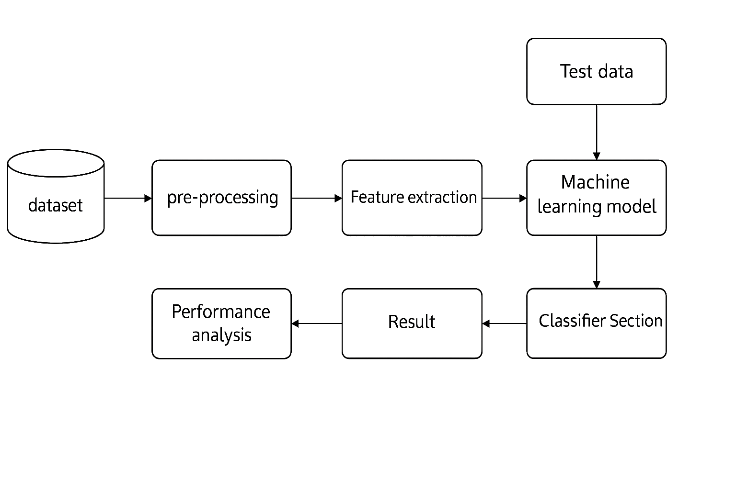
SYSTEM DESIGN

Slide 8
MODELS USED
XGBOOST CLASSIFIER
RANDOM FOREST CLASSIFIER
It is a powerful boosting algorithm that builds trees sequentially, where each new tree tries to correct the errors of the previous ones. It is highly efficient and scalable, offering excellent performance on structured or tabular data. XGBoost is effective for datasets with class imbalance and is widely used in competitive machine learning tasks.
It is an ensemble learning algorithm that builds multiple decision trees during training and combines their outputs to improve accuracy. It uses majority voting to make predictions and is known for being robust, handling imbalanced data well, and reducing the risk of overfitting by averaging results across trees.

Slide 9
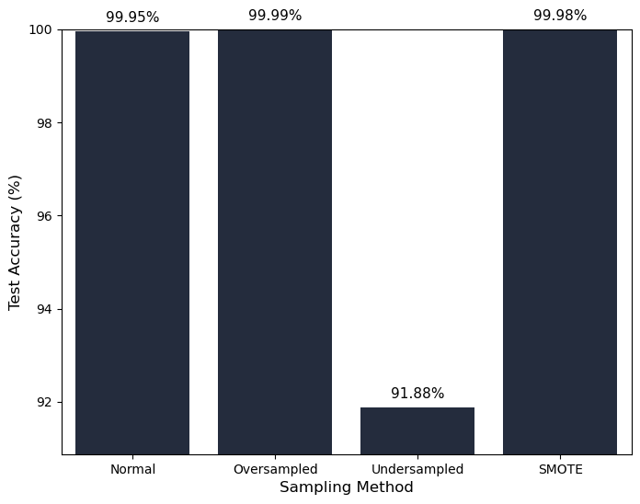
RESULTS & ANALYSIS
XGBoost Accuracy with Resampling Techniques
Applied on: Normal (original) data, Oversampled data, Undersampled data, SMOTE data Best Accuracy: Achieved on oversampled data Testing Accuracy: Close to 99–100%, indicating strong performance.

Slide 10
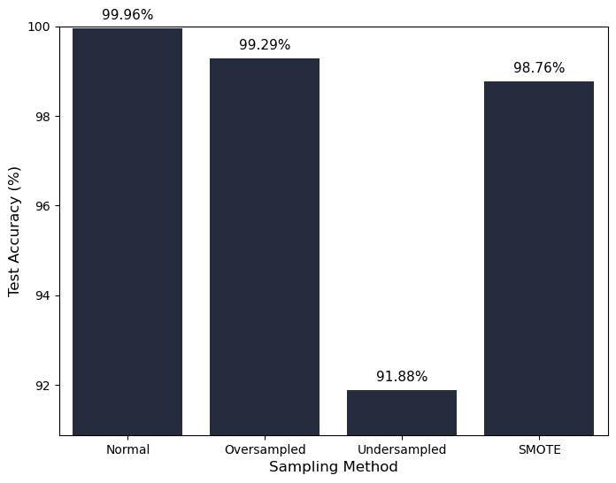
RESULTS & ANALYSIS
Random Forest Accuracy with Resampling Techniques
Applied on: Normal (original) data, Oversampled data, Undersampled data, SMOTE data Best Accuracy: Achieved on normal data Consistency: Slightly less consistent than XGBoost across datasets.

Slide 11
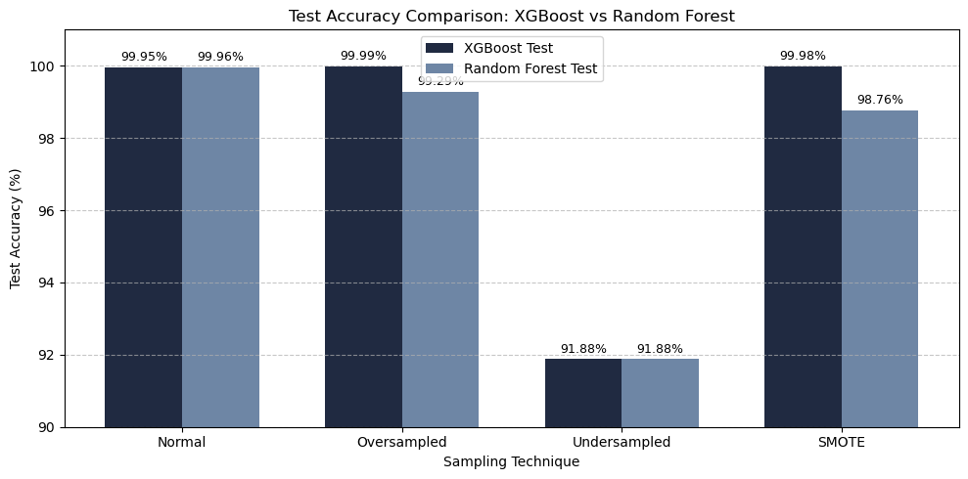
RESULTS & ANALYSIS
Conclusion: Oversampling with XGBoost gave the best fraud detection results.

Slide 12

FUTURE GOALS
Integrate the model with real-time payment systems for live fraud detection.
Deploy the system with alert notifications via SMS or email.
Mobile or web-based dashboard integration.
Support multiple type of transactions beyond credit cards.

Slide 13
REFERENCES
Kaggle. Credit Card Fraud Detection Dataset. https://www.kaggle.com/mlgulb/creditcardfraud
Streamlit Documentation. Streamlit: Turn data scripts into shareable web apps. https://docs.streamlit.io
AlsharifHasan Mohamad Aburbeian, Huthaifa I. Ashqar. Credit Card Fraud Detection Using Enhanced Random Forest Classifier for Imbalanced Data, ResearchGate, 2023. https://www.researchgate.net
N. Kumar et al. (2023) – “Effective Credit Card Fraud Detection Using SMOTE and XGBoost Algorithm”

Slide 14
THANKS!

