Slide 1
IT TICKET ANALYSIS
BY PAVITHRA VENUGOPAL

Slide 2
ABOUT PROJECT
This project focuses on analyzing IT support ticket data to assess agent performance, resolution times, and employee satisfaction. By examining key metrics such as ticket volume, handling time, and satisfaction scores, we identify areas for improvement in staffing, training programs, and system upgrades
The ultimate goal is to develop a comprehensive dashboard that provides actionable insights, helping guide strategic investments to enhance the efficiency and quality of IT services.

Slide 3
DATA SUMMARY
Ticket Data
Each data encomapasses key attributes such as Ticket ID,Date,EmployeeId,AgenT ID,Request Category,Issue type,Severity,Priority,Resolution Time(in days),and Satisfaction Rate.This data offers
a detailed snapshot of IT Support requests,highlighting their urgency,how efficiently they were handled and the level of satisfaction rate
IT Agent Data
This Dataset provides detailed agent profiles,including AgentID,
Full Name,email and Date of Birth(year,month,day).By linking this data with ticket information.can conduct the in-depth performances analyses.

Slide 4
METHODOLOGY
We leveraged advanced Google sheet tools such as pivot tables, VLOOKUP, charts, and IF formulas to conduct a thorough analysis of key performance metrics. Pivot tables were instrumental in summarizing complex data, providing insights into ticket categories, agent efficiency, and resolution times. Visualizations, including dynamic bar and line charts, were crafted to illustrate agent productivity and performance trends.
All these elements were seamlessly integrated into a comprehensive and interactive dashboard, offering data-driven insights to inform strategic decision-making and optimize IT support operations.

Slide 5
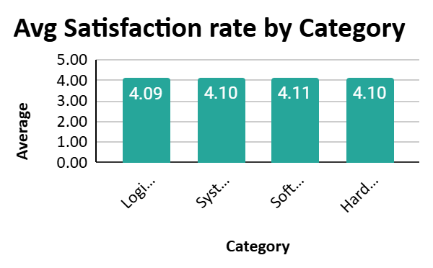
SATISFACTION RATE BY CATEGORY
The Hardware and System categories exhibit similar satisfaction rates, both covering around 4.10.
Login Access tickets have the lowest satisfaction rate, falling below 4.095. This suggests potential challenges or inefficiencies in resolving login- related issues, such as delays or recurring problems.

Slide 6
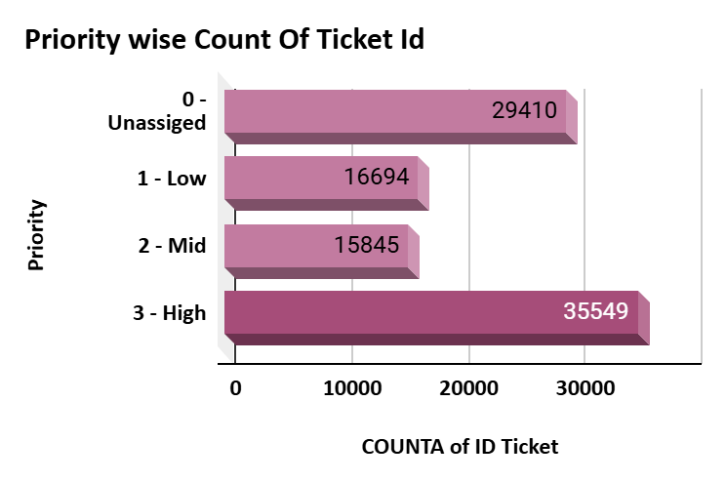
TICKET COUNT BASED ON PRIORITY
The High-Priority category has the highest ticket count, indicating that a significant portion of the workload involves urgent issues requiring immediate attention.
The Unassigned category has the second- highest count. This could point to inefficiencies in ticket routing or delays in assigning tickets to the appropriate agents
The Mid- and Low-Priority categories have noticeably fewer tickets compared to High and Unassigned categories.
Your title here
Presentations are communication tools that can be used as demonstrations, lectures, speeches, reports, and more.

Slide 7
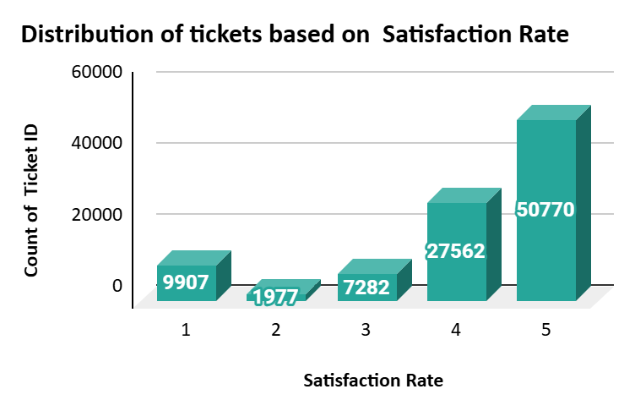
DISTRIBUTION OF TICKETS BASED ON SATISFACTION RATE
The majority of tickets (50,770) received a satisfaction rating of 5, indicating a large proportion of users are highly satisfied with the support they received.
27,562 tickets have a satisfaction rating of 4, showing that a significant number of users are generally satisfied, though there might be room for minor improvements.

Slide 8
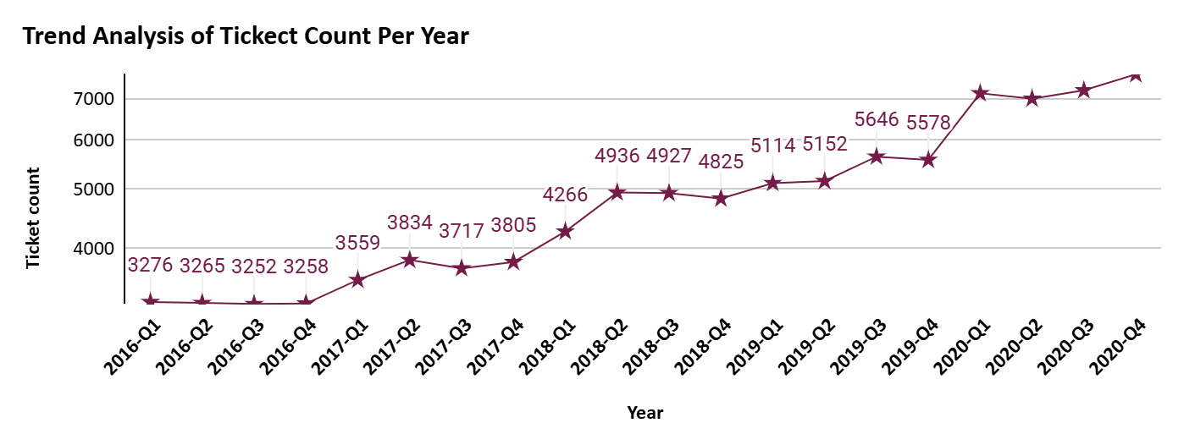
TREND ANALYSIS OF TICKET COUNT PER YEAR
There is a steady increase in ticket counts over the years, indicating a growing demand for IT support services.
The most notable rise occurs between 2019 and 2020, suggesting changes in operational needs or external factors
Peaks are consistently observed in Q4, hinting at seasonal factors, such as year-end activities, system upgrades
From 2016 to 2018, the growth is relatively moderate, reflecting a manageable workload before the surge in 2019.

Slide 9
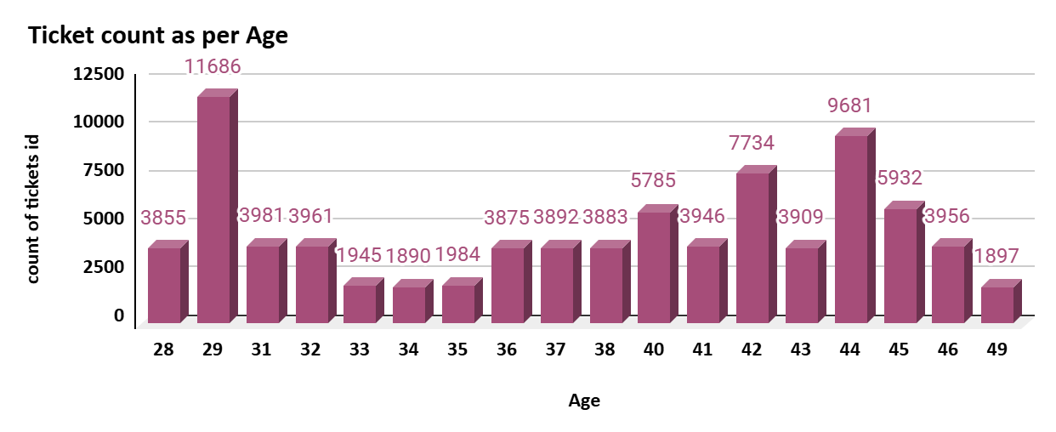
COUNT OF TICKETS AS PER AGE
The ticket count appears to be highest for agents in their early 40s (around 42-43 years old).
There is a significant drop in ticket count for agents in their late 40s and early 50s.
The ticket count gradually increases from age 34 onwards until it peaks around 42-43.

Slide 10
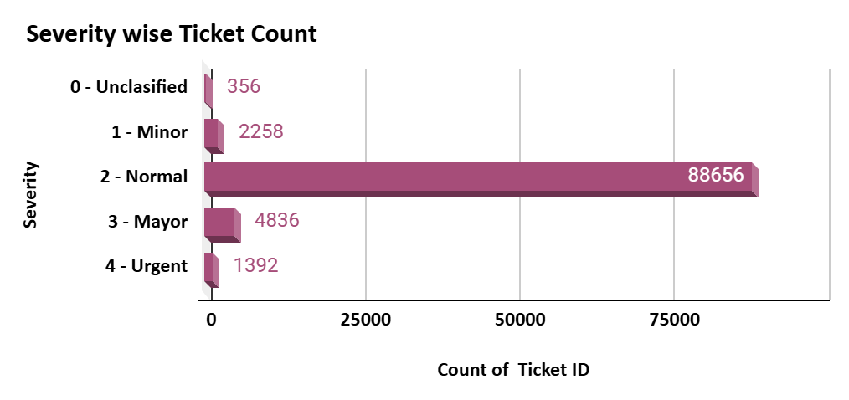
DISTRIBUTION OF TICKETS BASED ON SEVERITY
The majority of tickets fall under this category with a count of 88,656.
The second-highest category, with 4,836 tickets.
Only 1,392 tickets are classified as urgent, implying that critical, time-sensitive issues are relatively rare.

Slide 11
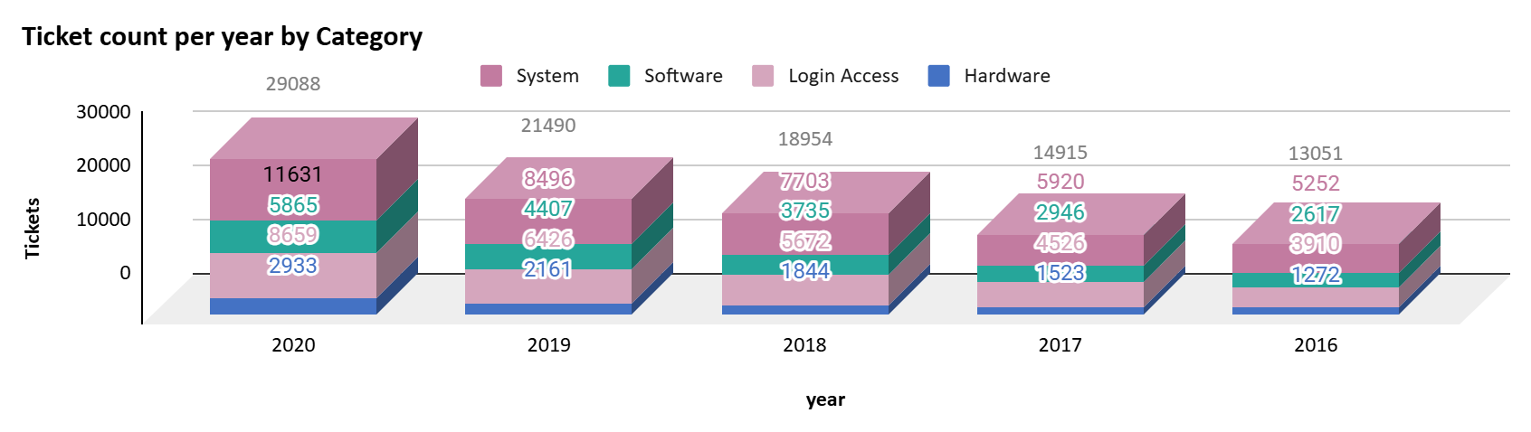
DISTRIBUTION OF TICKETS BY REQUEST CATEGORY
The largest share of tickets each year, growing significantly from 3,910 in 2016 to 11,631 in 2020.
Steady increase from 2,617 in 2016 to 8,659 in 2020.

Slide 12
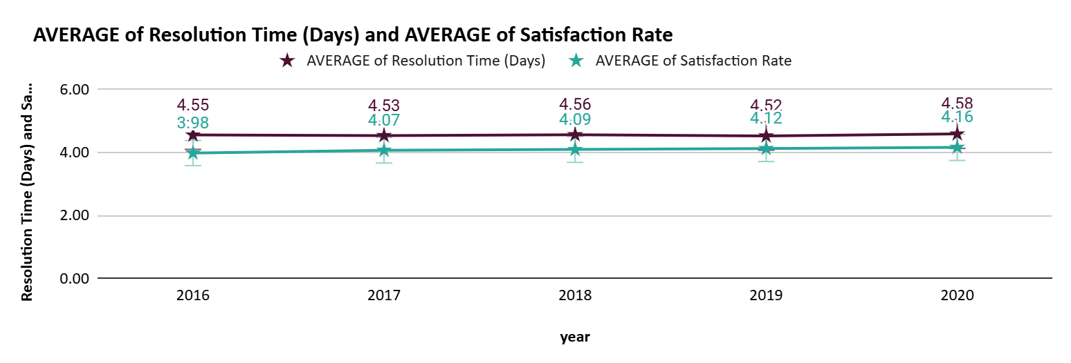
Avg Satisfaction Rate And Resolution Time Yearly
The average satisfaction rate has been consistently high, hovering around 4.5.
The resolution time has been steadily decreasing over the years, indicating improvements in efficiency and service delivery.
The satisfaction rate remained high (4.58) and the resolution time reached its lowest point (4.12).

Slide 13
ANALYTIC RECOMMENDATIONS
Upgrade Ticket Management Software: Invest in advanced software to enhance efficiency.
Upgrade Hardware Infrastructure: Improve IT support efficiency with faster ticket processing and resolution times, boosting both employee and customer satisfaction.
Investment in Training: Provide targeted training for agents with resolution times and satisfaction scores hovering around the average, helping them elevate performance and drive higher customer satisfaction.
My comprehensive analysis of this data paves the way to improve the efficiency of the support team, reduce resolution time of tickets and also enhance employee satisfaction.

Slide 14
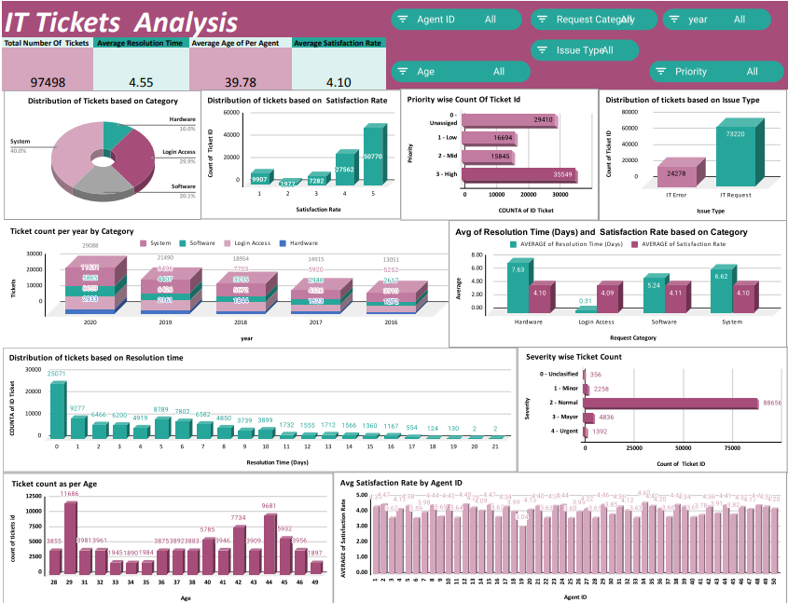
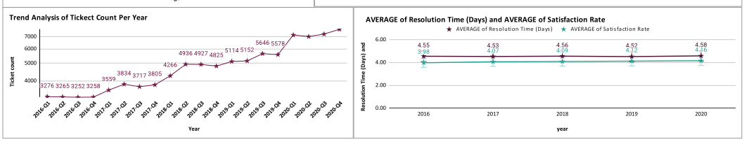

Slide 15


THANK YOU
pavithrahari1395@gamil.com

