Slide 1
♔
MACHINE LEARNING · COMPUTER VISION
Chess Piece
Classification
HOG + SVM · 12 Classes · 2,400 Images
Pavithra K M · Angel George · Yadhu Krishnan V B

Slide 2
Project Overview
12 Piece Classes
White
♔
♕
♖
OBJECTIVE
Classify chess pieces into 12 classes (white/black × 6 piece types) from top-down board images using classical computer vision and machine learning.
King
Queen
Rook
♗
♘
♙
12
2,400
3
Bishop
Knight
Pawn
Classes
(6 types × 2 colors)
Total Images
after augmentation
Models
Trained & Compared
Black
♚
♛
♜
King
Queen
Rook
Dataset Source:
Kaggle — s4lman chess-pieces-dataset-85×85
♝
♞
♟
Bishop
Knight
Pawn

Slide 3
Our Team
♙
Pavithra K M
♗
Angel George
♖
Yadhu Krishnan V B
Data Preparation &
Preprocessing
Feature Engineering &
Dimensionality Reduction
Modeling, Evaluation
& Analysis
Class audit & dataset selection
Color-based splitting (6→12 classes)
Grayscale conversion + resize 64×64
CLAHE illumination normalization
Augmentation to balance classes
HOG features (winSize 64×64, 9 bins)
Statistical: mean, std, Sobel edges
Shape: contour area, aspect ratio
Hu moments (7 descriptors)
PCA (95% variance) + SelectKBest
SVM (RBF kernel, probability=True)
Random Forest (200 estimators)
Logistic Regression (max_iter=1000)
Confusion matrix & F1-score analysis
Streamlit app deployment

Slide 4
Preprocessing Pipeline
Pavithra K M
01
Class Audit & Dataset Selection
Input
WHY THIS
PIPELINE?
Kaggle s4lman chess-pieces-dataset-85×85 · Original 6 classes
02
Color-Based Splitting (6 → 12 Classes)
Handles lighting variability via CLAHE
cv2
Brightness detection splits White King/Queen/Rook/Bishop/Knight/Pawn from Black variants
03
Class balance prevents bias in SVM training
Grayscale Conversion + Resize to 64×64
cv2.resize
Standardize image dimensions for consistent HOG window size
64×64 matches HOG window perfectly
04
CLAHE Illumination Normalization
cv2.CLAHE
clipLimit=2.0 · tileGridSize=8×8 · Adaptive histogram equalization
Color-split gives 12 discriminable classes
05
Augmentation to Balance Classes
200/class
Target: 200 images per class · 2,400 total after augmentation

Slide 5
Feature Engineering
Angel George
HOG Features
Shape Features
winSize = 64×64
blockSize = 16×16
9 orientation bins
Gradient-based local shape
Primary discriminative feature
7 Hu moments
Rotation-invariant
Contour area
Aspect ratio
From largest contour
Statistical Features
Color Features
Mean intensity
Standard deviation
Sobel edge strength
Global texture summary
Lighting-aware
Brightness-based label
White/black detection
One-hot encoded
Helps split 6→12
Categorical encoding
Combined Feature Matrix: HOG + Statistical + Shape features merged into a single high-dimensional vector per image

Slide 6
Dimensionality Reduction
Angel George
Raw
Features
Standard
Scaler
PCA
Select
KBest
Reduced
Features
▶
▶
▶
▶
HOG + Stats
+ Shape
Zero mean
Unit variance
95% variance
svd_solver='full'
k = 500
ANOVA F-score
SVM-ready
vector
StandardScaler
PCA — 95% Variance
SelectKBest (k=500)
Normalizes each feature to zero mean and unit variance. Essential before PCA and SVM to prevent features with large ranges from dominating.
Principal Component Analysis reduces the high-dimensional HOG feature space. Using svd_solver='full' ensures numerical precision for the covariance matrix decomposition.
Selects the top 500 most statistically significant features using ANOVA F-score. This removes redundant or low-discriminative features post-PCA.
sklearn.preprocessing
sklearn.decomposition
sklearn.feature_selection

Slide 7
Models Trained
Yadhu Krishnan V B
★ BEST MODEL
HIGHEST F1-SCORE
Selection
Criteria
Support Vector Machine
Kernel: RBF · Strategy: One-vs-One · probability=True
Weighted F1-Score
Primary metric — balances precision and recall across all 12 classes
Multi-class SVM with RBF kernel handles non-linear decision boundaries inherent in HOG feature space. probability=True enables confidence score output for top-3 predictions.
Per-class Accuracy
Ensures no single piece class dominates or underperforms
Random Forest
Ensemble of decision trees voting on HOG features. Robust but slower inference.
Confusion Matrix
200 estimators
Visual check for systematic piece confusion (e.g. Bishop vs Knight)
Train vs Test Gap
Logistic Regression
Linear baseline. Efficient but struggles with complex HOG boundaries.
Overfitting/underfitting detection via accuracy differential
max_iter=1000

Slide 8
Results & Analysis
Yadhu Krishnan V B
SVM Best Performer
Highest weighted F1-score. RBF kernel handles non-linear HOG feature boundaries better than linear models.
Random Forest Overfits
100% train accuracy vs ~78% test — classic overfitting. HOG features are high-dimensional relative to dataset size.
Lighting Affects Stability
HOG gradient features sensitive to illumination variation. CLAHE normalization significantly improves consistency.
Top-3 Confidence Scores
Model outputs probability estimates for top-3 candidates, surfacing ambiguous cases in the Streamlit app.

Slide 9
Tech Stack & Deployment
Python
OpenCV
Scikit-learn
HOG
Core language
Image processing & HOG
SVM, PCA, metrics
Feature extraction
Streamlit
Matplotlib
Seaborn
Pickle
App deployment
Visualization
Confusion matrix plots
Model serialization
LIVE
OPEN APP ↗
Deployed on Streamlit
App link: chess-classifier.streamlit.app
Upload a chess piece image → Top-3 predictions with confidence scores → Lighting analysis insights

Slide 10
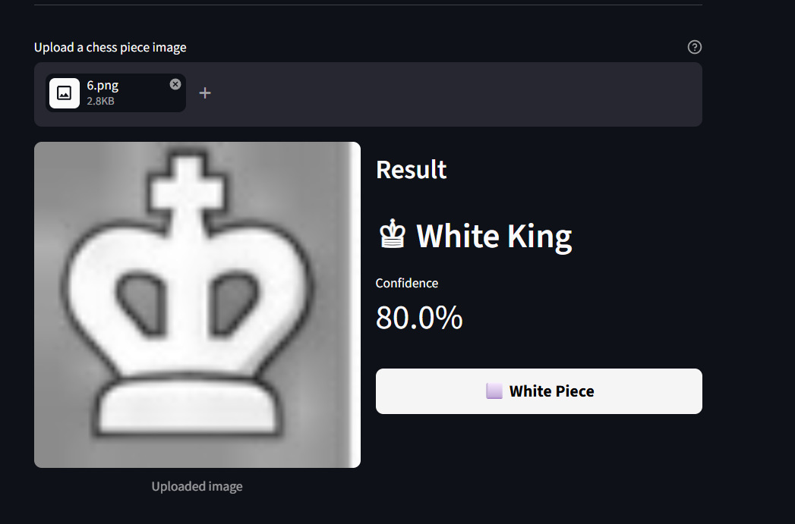
Prediction

Slide 11
THANK YOU
Chess Piece Classification
using HOG + SVM
♔ ♕ ♖ ♗ ♘ ♙
12
2,400
HOG
SVM
Classes
Images
Features
Best Model
Pavithra K M · Angel George · Yadhu Krishnan V B
chess-classifier.streamlit.app

