Slide 1


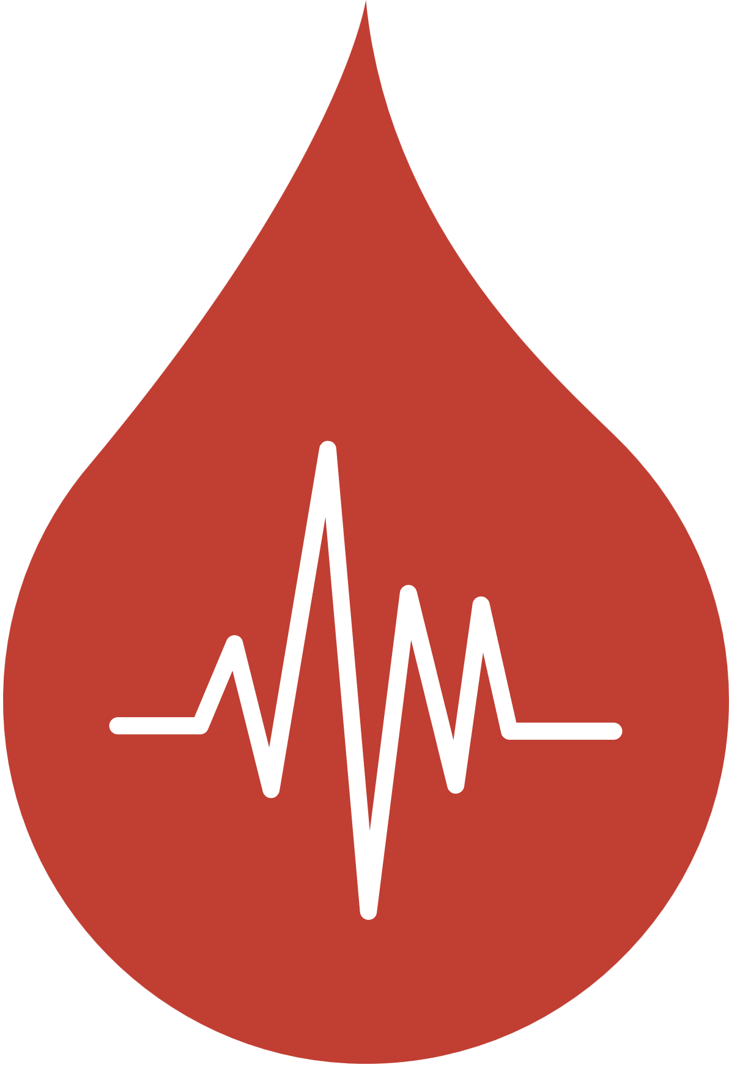



(Blood Bank)
Health Care Management System
DS5110: Introduction to Data Management and Processing
Naga Pavithra Lagisetty
Vinisha Sunkara
Roshitha Tiruveedhula

Slide 2




Agenda
Objectives
Results
Project Scope
Discussion
Literature Survey
Conclusion
Methodology
References

Slide 3

Objectives
Blood donation is a crucial component of healthcare, enabling emergency treatment options and life-saving interventions. However, organizing blood donations and guaranteeing timely access to suitable blood supplies is a considerable difficulty. This project presents a donor and blood bank management system intended to address these issues. Using a centralized database, real-time inventory tracking, and geospatial technology, the system allows for efficient donor registration and quick access to nearby donors during emergencies. The goal is to improve resource allocation, decrease waste, and ensure blood availability when it is most required, while also strengthening the blood donation infrastructure using a data-driven approach.

Slide 4
Project Scope
The Donor and Blood Bank Management System is intended to address important issues of blood donation and supply chain management. It offers a comprehensive platform for registering donors, maintaining blood inventories, and managing blood requests. A major component, "Find Nearby Donors," uses geolocation to connect donors with recipients during an emergency, ensuring a quick response.
The system optimizes resource allocation by combining advanced data management techniques, real-time inventory updates, and predictive analytics. Blood banks and healthcare providers benefit from increased operational efficiency since it reduces delays and improves accessibility. Finally, the project intends to provide a dependable and data-driven solution to bridge the gap between blood donors and recipients, reducing waste and guaranteeing that life-saving blood supplies are always available.

Slide 5


Literature Survey
Sharma et al. (2019) highlighted the benefits of real-time inventory monitoring utilizing dashboards, resulting in less waste and better decision-making in blood banks.
Gupta et al. (2021): Created machine learning models for demand forecasting, improving supply-demand alignment, and reducing shortages.
Zhang et al. (2022) utilized predictive analytics to forecast donor availability and blood shortages. The study incorporated machine learning models with interactive graphs, allowing for effective visualization and enhanced preparedness for high-demand periods.

Slide 6

Methodology
Data Collection and Integration
Data Sources: Gather data from various sources such as donor registrations, blood bank records, and blood requests.
Data Integration: Combine data from these sources into a unified database format to ensure consistency across the system
Data Cleaning
Deduplication: Identify and remove duplicate records to ensure each donor, blood bank, and request is unique
Missing Values: Handle missing data by ensuring that every field is properly filled.

Slide 7
Methodology
Data Standardization and Normalization
Standardization: Ensure that all data follows a consistent format (e.g., date formats, phone numbers)
Outlier Detection and Handling
Identify outliers in numerical fields (e.g., age of donors) using statistical methods and decide whether to correct or remove them based on domain knowledge.
Data Storage and Management
Use SQLite3 to manage the database schema efficiently, ensuring relationships between tables like Donor, BloodBank, and BloodRequests are well-defined.

Slide 8
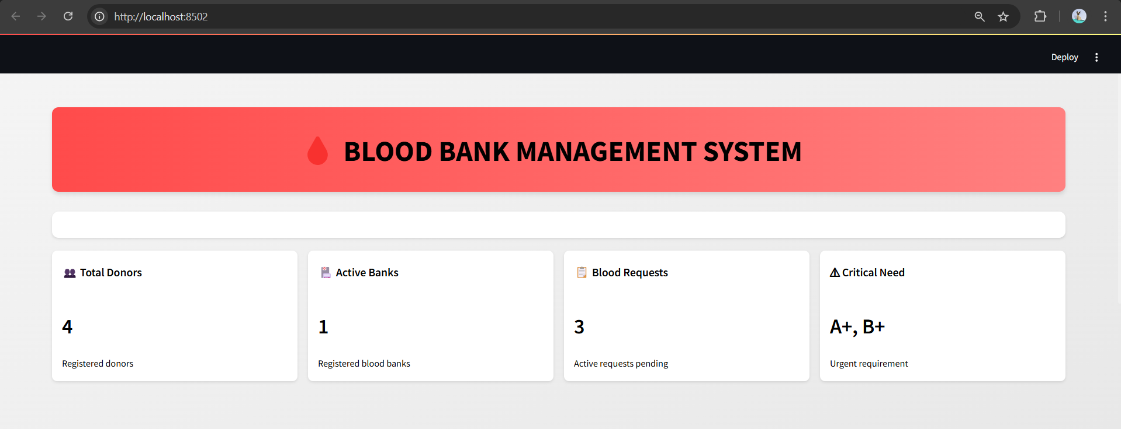
Results

Slide 9
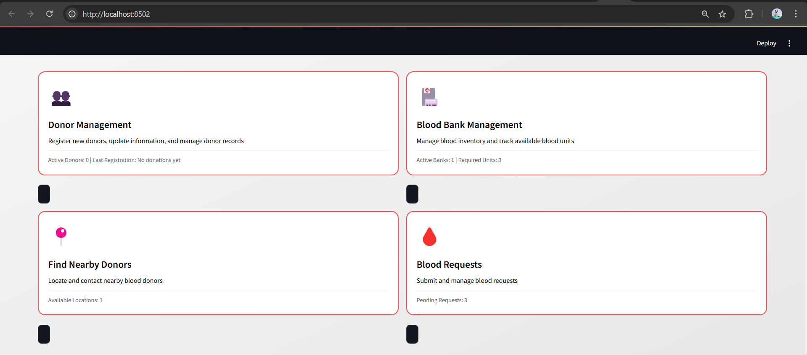
Results

Slide 10
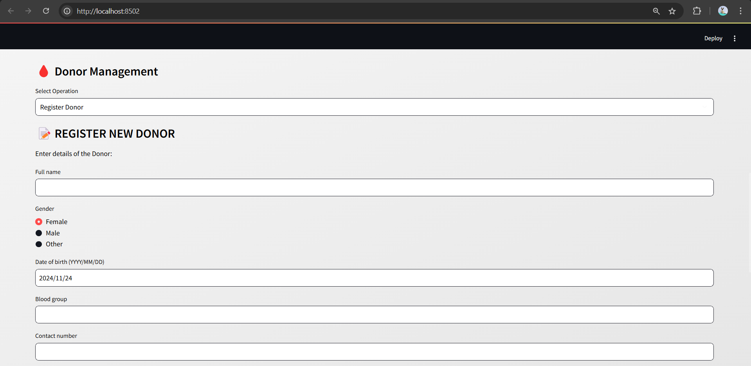
Results

Slide 11
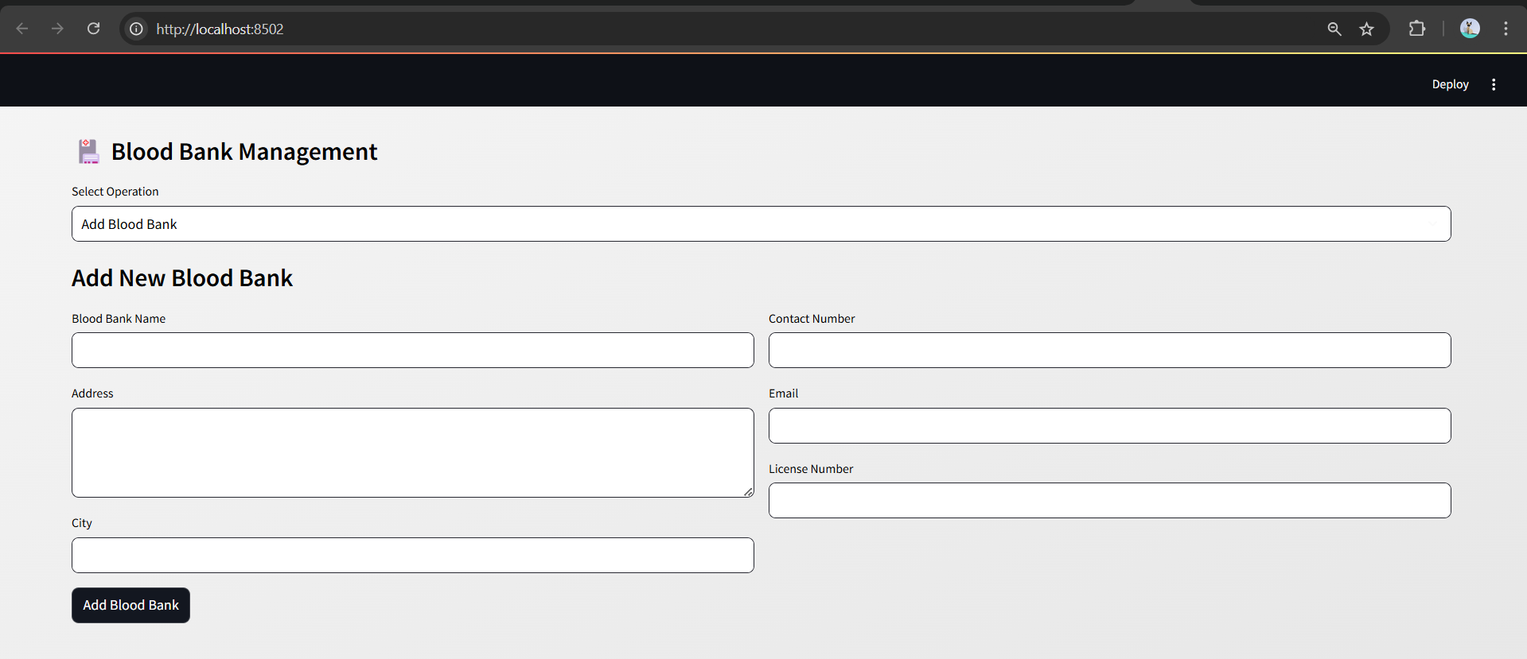
Results

Slide 12
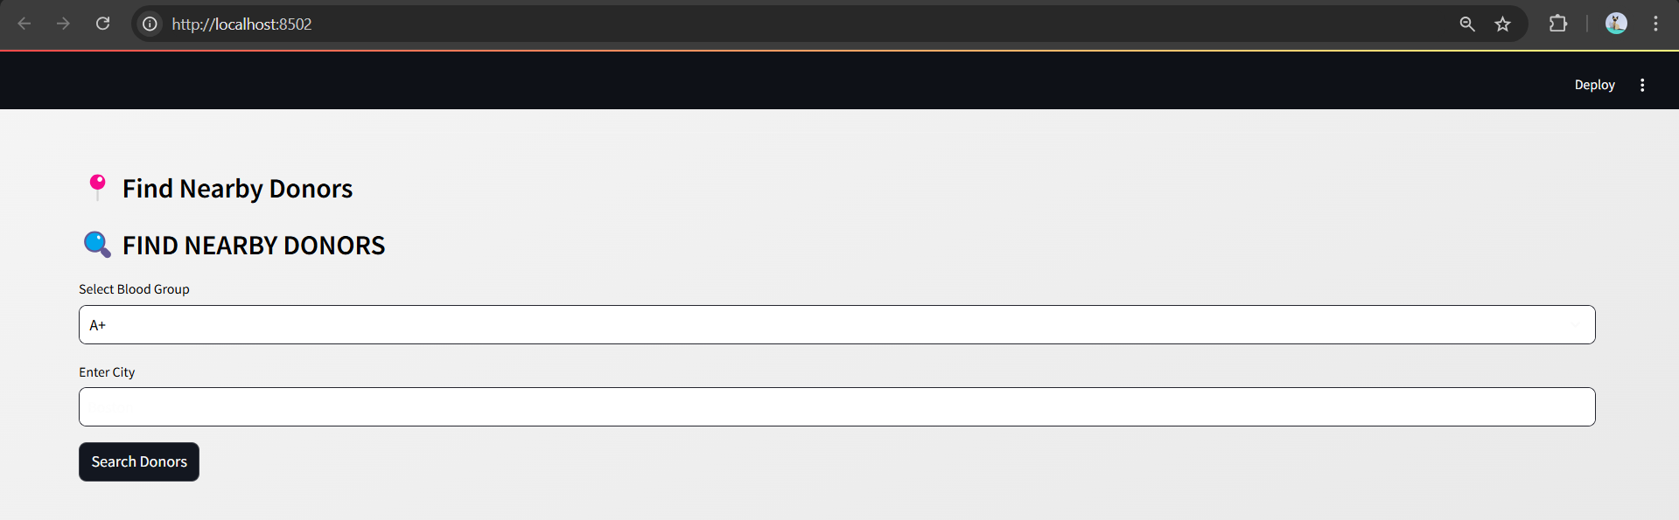
Results

Slide 13
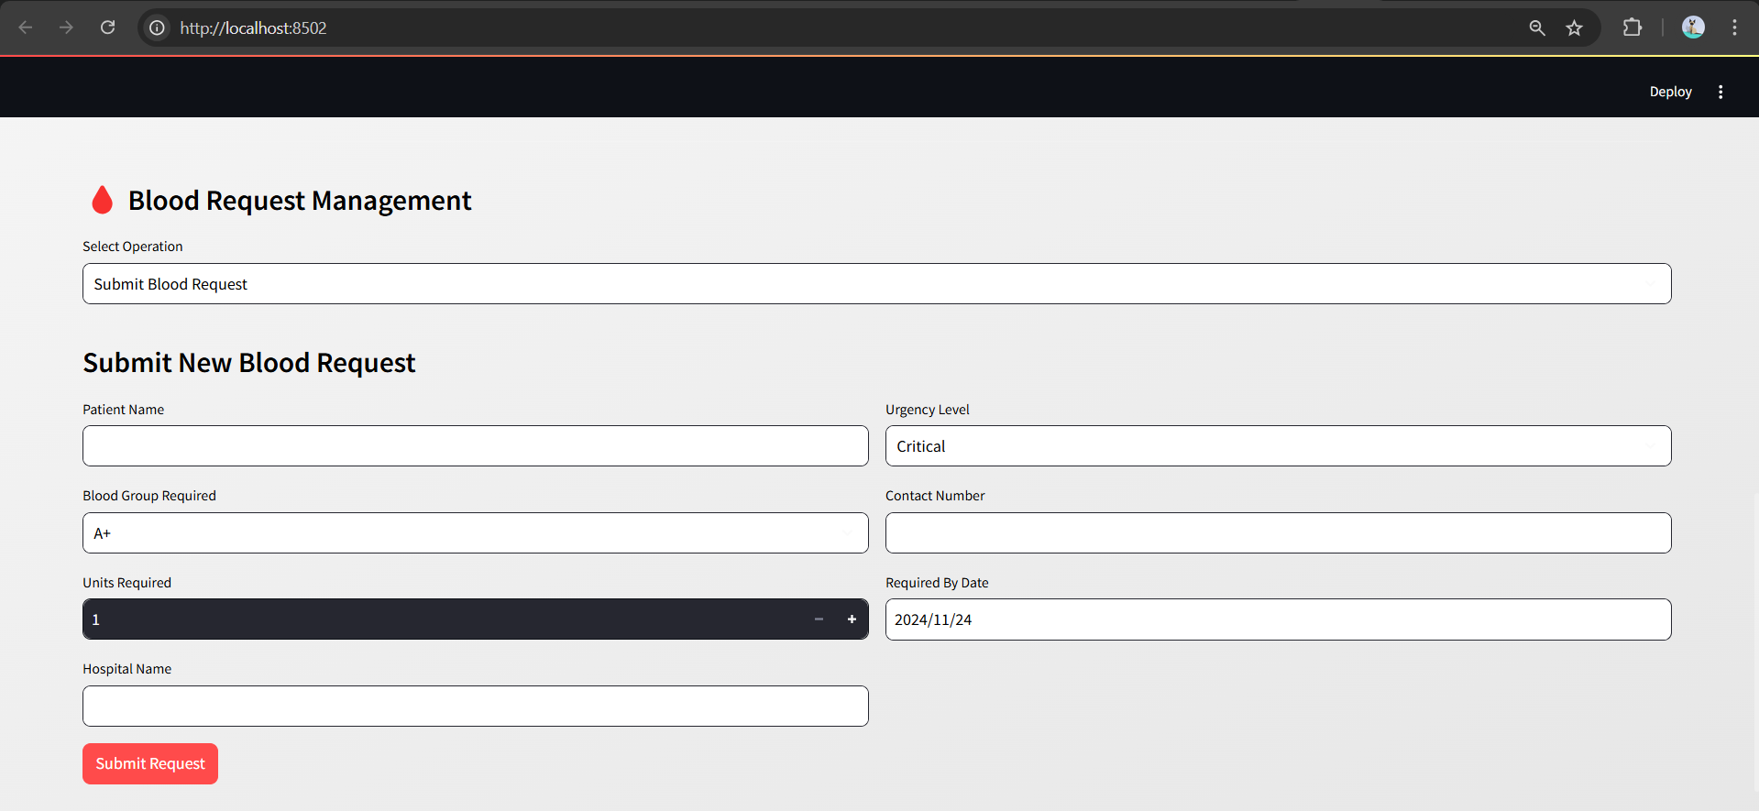
Results

