Slide 1
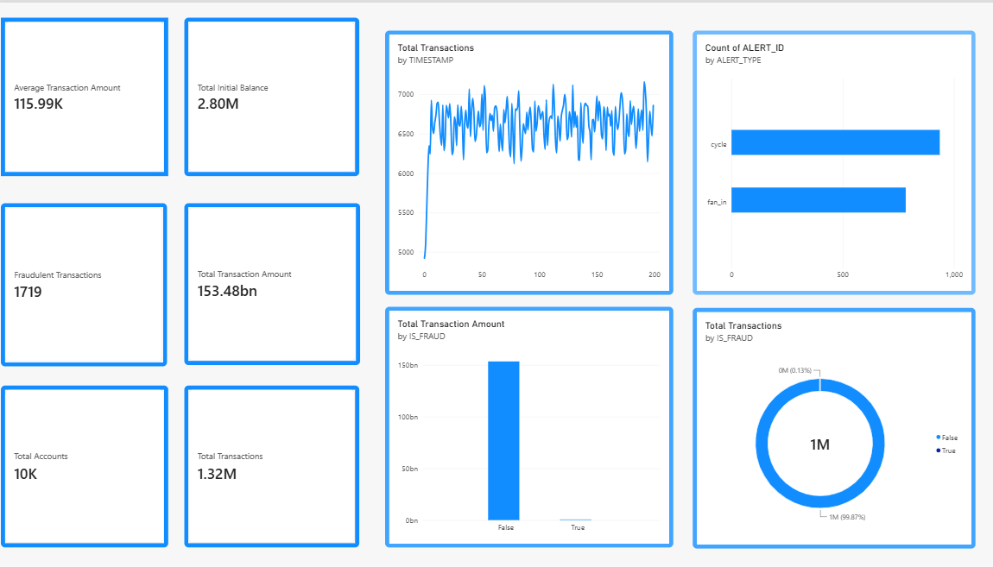
AIML
TRANSACTION &
FRAUD ANALYSIS
Dashboard Insights • Risk Patterns • Recommendations
Prepared by
PAVITHRA
B.Com FinTech with AI
BUSINESS INSIGHT PRESENTATION

Slide 2
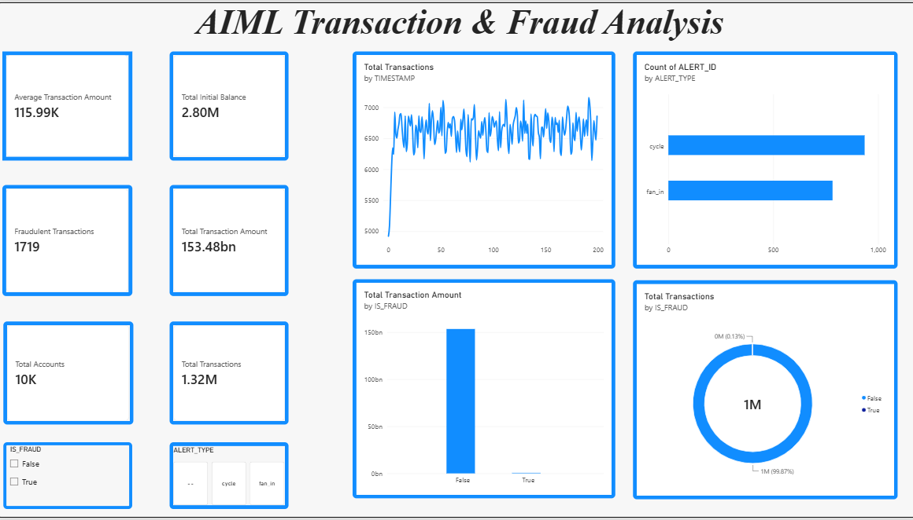
1. Dashboard Overview
A single-page view of transaction activity, alert types and fraud indicators.
The dashboard combines headline KPIs with trend and comparison charts.
KPI cards summarize transaction value, balances, fraud count, accounts and total transactions.
The charts compare activity over the timeline, alert types, and fraud vs. non-fraud transactions.
Filters shown in the reference allow users to focus on fraud status and alert type.
PAVITHRA • AIML TRANSACTION & FRAUD ANALYSIS 02

Slide 3
2. Key Performance Indicators
Values transcribed from the supplied dashboard screenshots.
Average Transaction Amount
Total Initial Balance
Fraudulent Transactions
115.99K
2.80M
1,719
Total Transaction Amount
Total Accounts
Total Transactions
153.48bn
10K
1.32M
Interpretation
These figures give a quick overview of transaction scale and the number of flagged transactions. Amounts are presented exactly as displayed in the screenshots.
PAVITHRA • AIML TRANSACTION & FRAUD ANALYSIS 03

Slide 4
3. Transaction Trend
Total transactions plotted against the timestamp sequence.
The line rises sharply at the beginning, then fluctuates around a relatively steady band.
Most visible values sit approximately between 6,200 and 7,000 on the chart’s vertical scale.
Short-term peaks and dips suggest transaction volume changes frequently across timestamps.
Monitoring unusual deviations from the normal range can help identify periods that need investigation.
PAVITHRA • AIML TRANSACTION & FRAUD ANALYSIS 04

Slide 5
4. Alert Type Analysis
Counts of alert IDs by alert type.
Higher alert count
cycle
Other alert type
fan_in
The screenshot shows cycle alerts as the larger of the two displayed categories, with fan_in lower. The exact values are not printed on the cards, so the comparison is directional.
PAVITHRA • AIML TRANSACTION & FRAUD ANALYSIS 05

Slide 6
5. Transaction Amount by Fraud Status
Total transaction amount split by IS_FRAUD.
The non-fraud (False) bar accounts for nearly all of the displayed transaction amount.
The fraud (True) bar is very small in comparison.
A large amount associated with non-fraud activity does not mean the smaller fraud amount is unimportant; fraud can still create losses and trust risks.
Review flagged transactions individually and compare value, frequency and alert context.
PAVITHRA • AIML TRANSACTION & FRAUD ANALYSIS 06

Slide 7
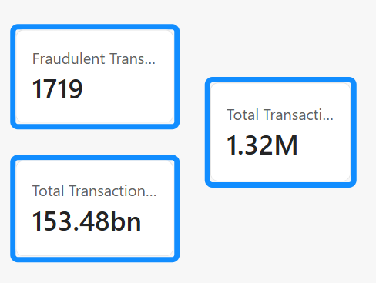
6. Transaction Count by Fraud Status
Donut chart showing the distribution by IS_FRAUD.
Fraudulent transactions
Total transactions
1,719
1.32M
The donut chart labels the False group at about 99.87% and the True group at about 0.13% (rounded labels in the screenshot). This indicates that flagged fraud transactions represent a small share of total volume.
Key point: a small percentage still deserves strong controls, because fraud impact is not measured by count alone.
PAVITHRA • AIML TRANSACTION & FRAUD ANALYSIS 07

Slide 8
7. Key Insights & Recommendations
Practical actions based on the visible dashboard patterns.
KEY INSIGHTS
RECOMMENDATIONS
Transaction volume remains high across the timestamp sequence.
Cycle alerts are more numerous than fan_in alerts in the shown comparison.
The fraud-labelled transaction count is a small share of total transactions.
Most displayed transaction amount belongs to the non-fraud group.
Investigate high-value and unusual transactions flagged by the system.
Review cycle alerts frequently and track repeat patterns.
Use filters to compare alert type and fraud status during investigations.
Monitor false positives and update detection rules as new patterns emerge.
PAVITHRA • AIML TRANSACTION & FRAUD ANALYSIS 08

Slide 9
CONCLUSION
Turning transaction data into clearer risk decisions
The dashboard provides a useful overview of transaction amount, volume, alert types and fraud distribution. Its strongest value is helping analysts identify where to investigate further rather than treating a single KPI as a complete risk assessment.
MONITOR
INVESTIGATE
IMPROVE
Track transaction trends and unusual changes.
Prioritize suspicious alerts and high-value cases.
Use findings to refine controls and detection rules.
Prepared by PAVITHRA • B.Com FinTech with AI

