Slide 1
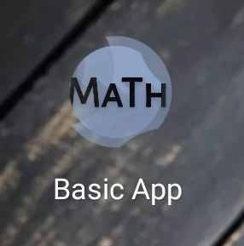
Pavithran_K
2018202036

Slide 2


Opening Splash Screen

Slide 3
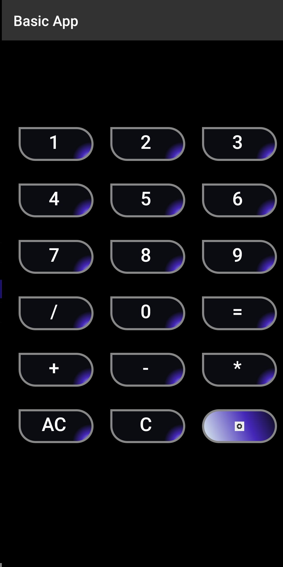
Home Screen

Slide 4
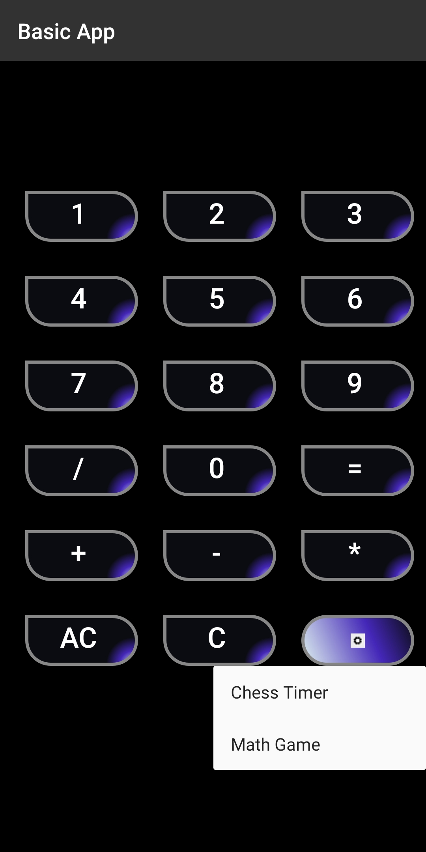
Menu View

Slide 5
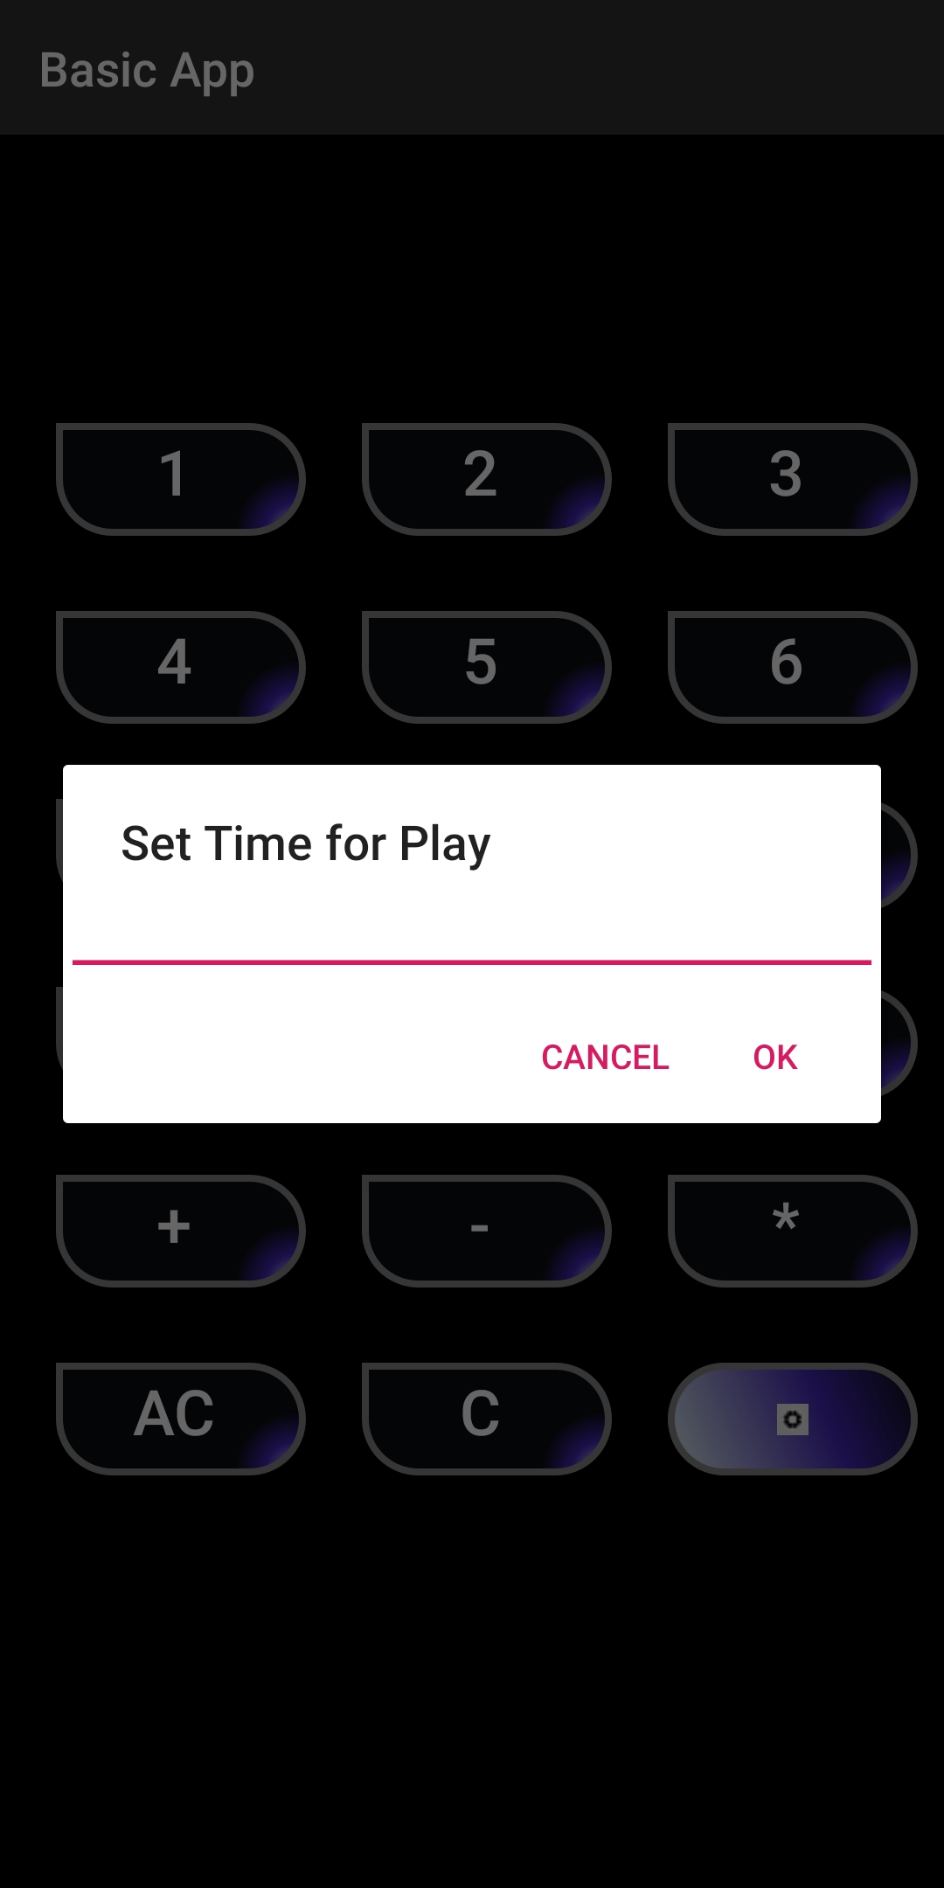
Chess Timer

Slide 6
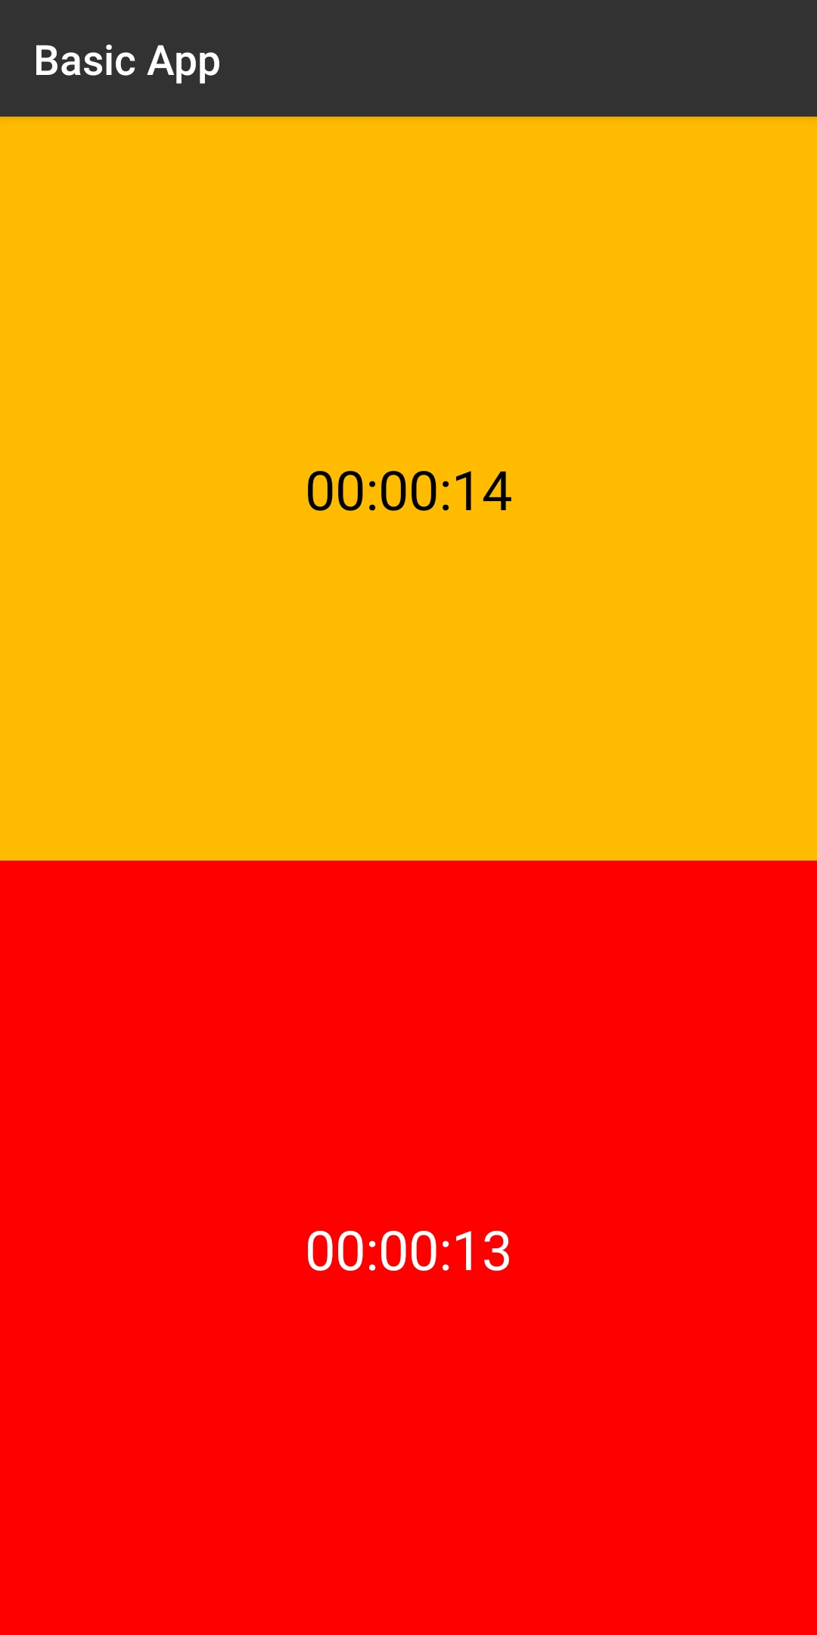
Home Screen

Slide 7

Times Up

Slide 8
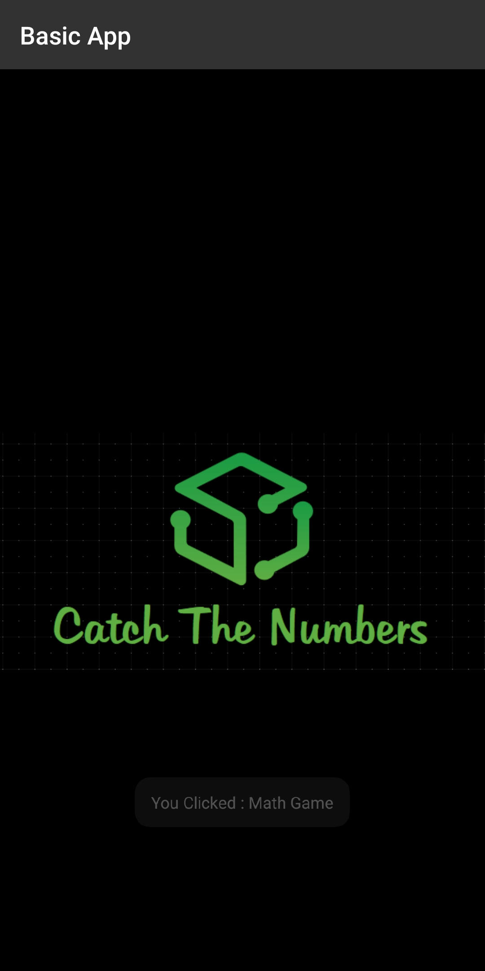
Game Page

Slide 9
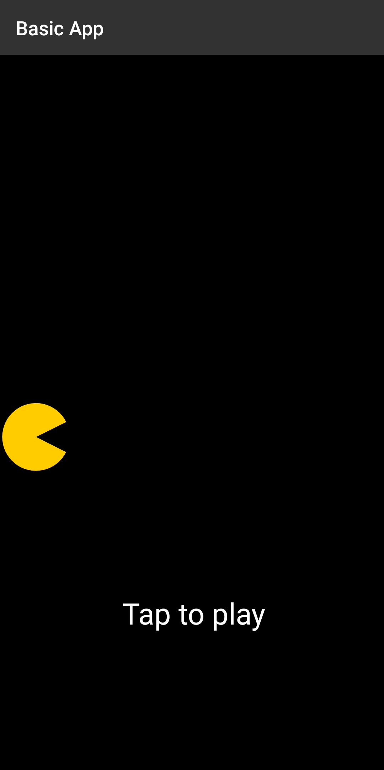
Game Home Page

Slide 10
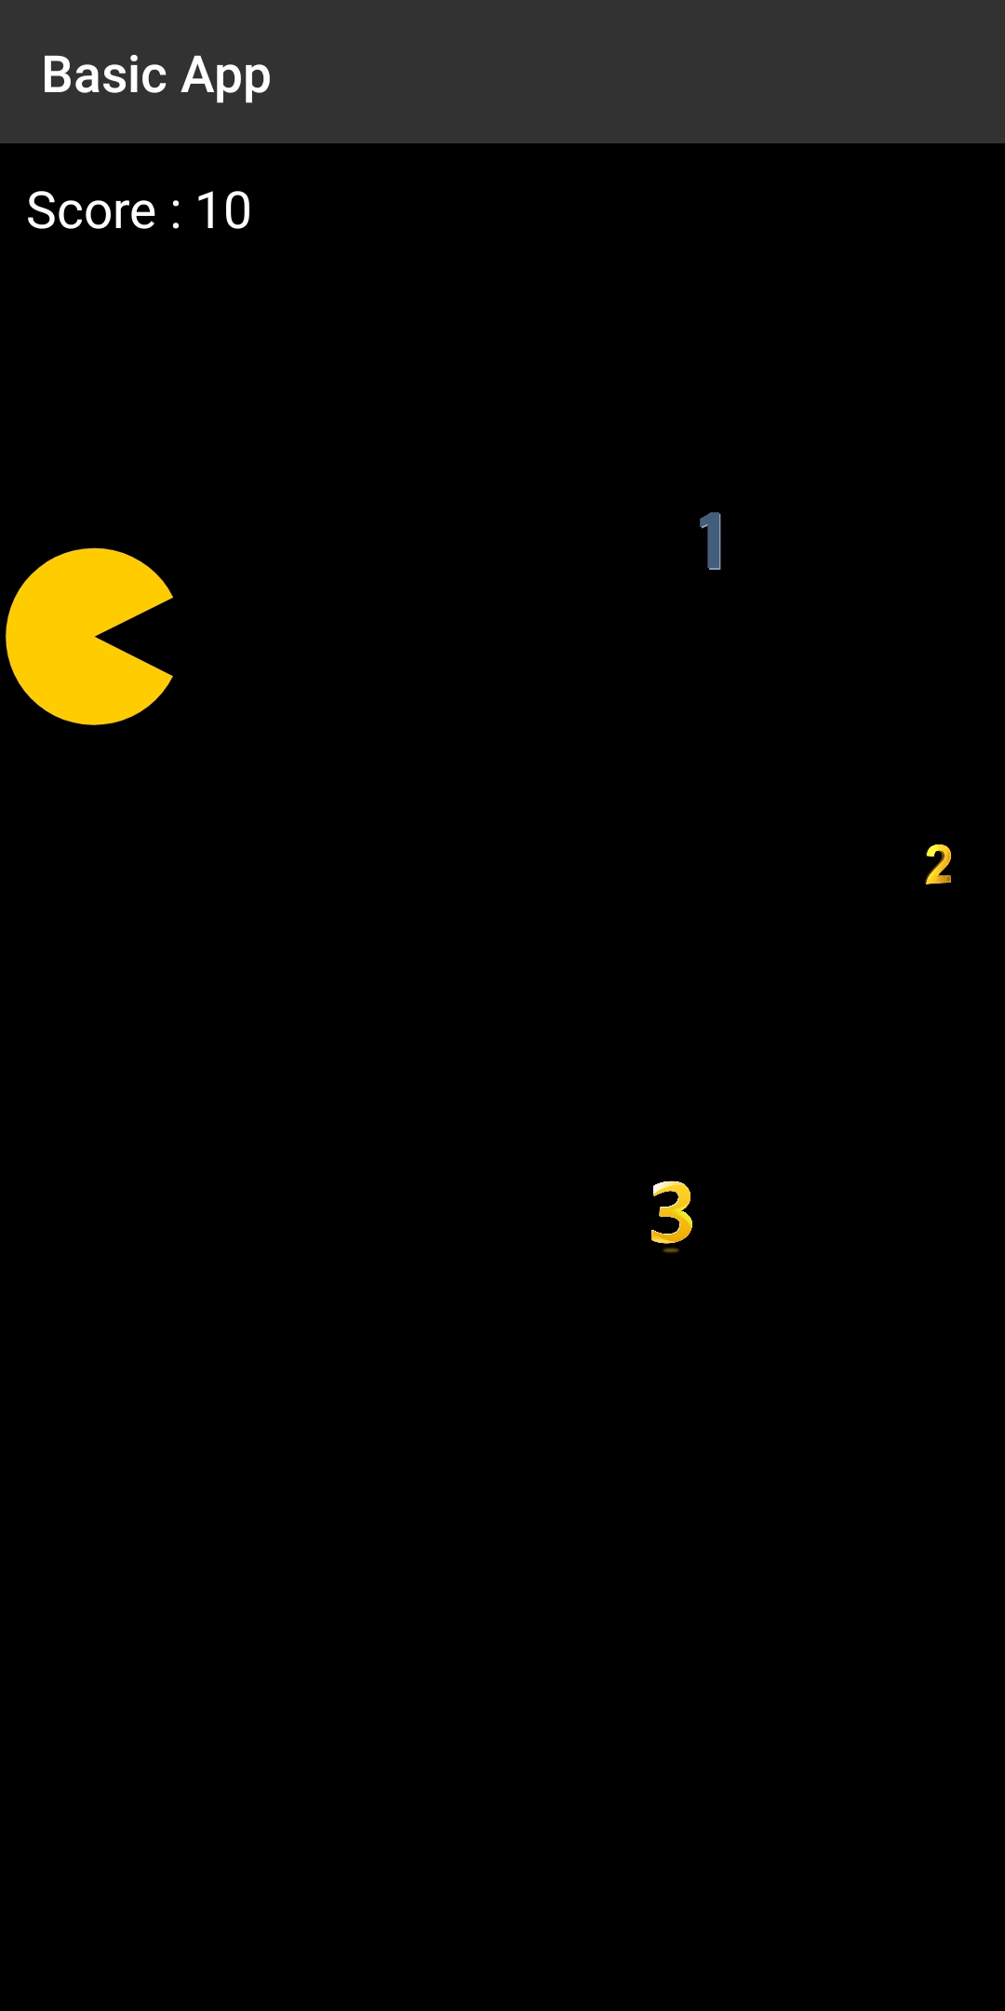
Points Calculate

Slide 11
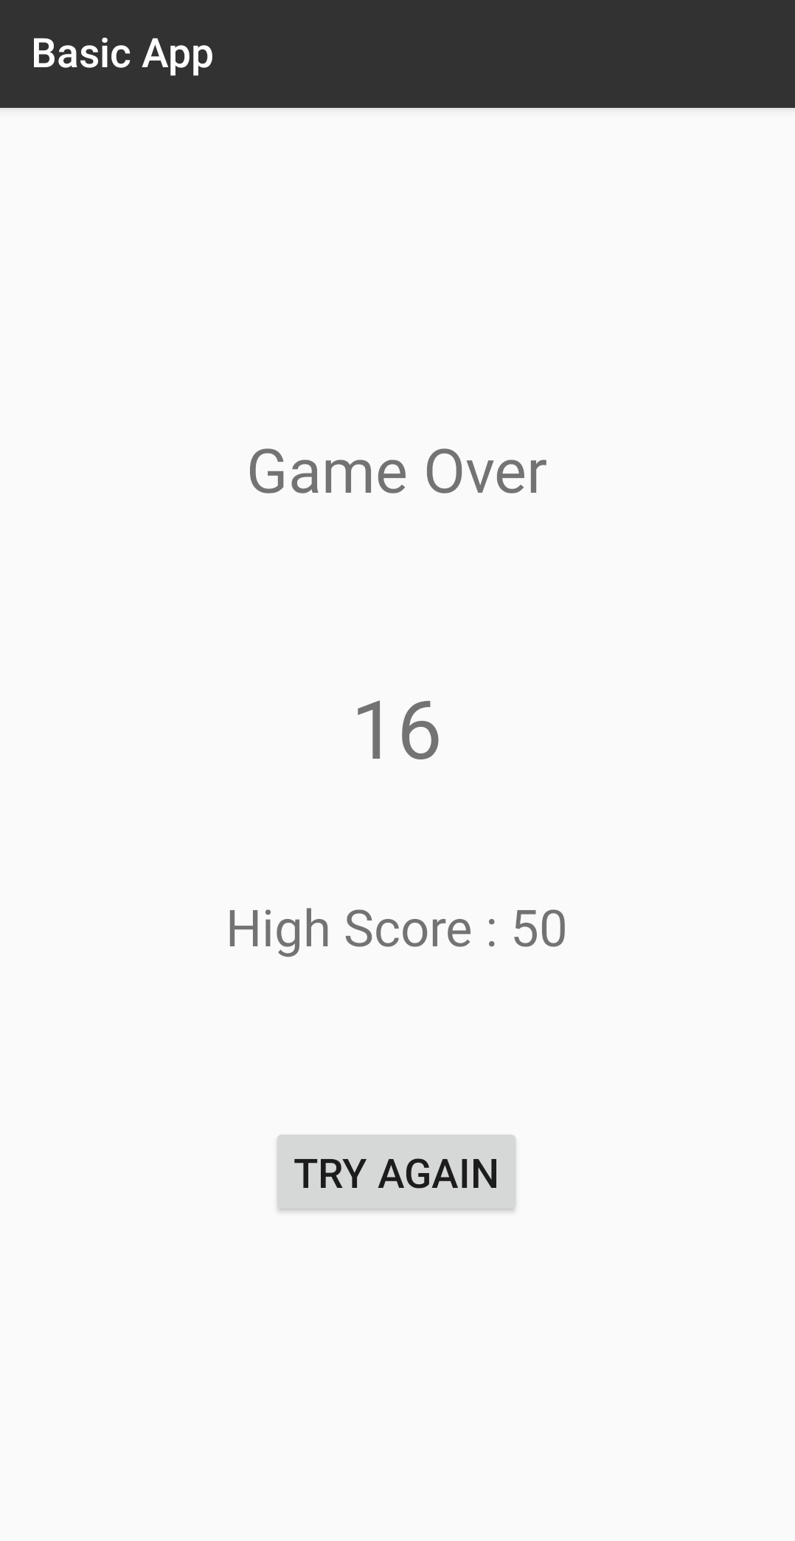
Score

Slide 12
Thank You!..

