Slide 1


IPL ANALYSIS AND DASHBOARD CREATION
20ADC33 – DATA ANALYSIS
TEAM MEMBERS
DEEPAN RAJ. S (21ADR010)
ASWATH. M (21ADR005)
PAVITHRA (21ADL064)
VEENAS KUMAR. S (21ADR058)
Department of AI
Kongu Engineering College, Perundurai

Slide 2
Problem Statement
The Indian Premier League (IPL) is one of the most popular and lucrative cricket leagues in the world.
However, despite its popularity, there is a lack of comprehensive data analysis and visualization tools available for fans and analysts to gain insights into the performance of teams and players.
This problem statement aims to address this gap by creating a data analysis dashboard for IPL that can be used to visualize and analyze key performance metrics and trends from the league's history.
the goal of this project is to provide a valuable tool for understanding and analyzing the performance of teams and players in the IPL, and to enhance the overall fan experience of the league.

Slide 3
Introduction
A data analysis dashboard may be created to evaluate the performance of the teams and players in the IPL. A multitude of data and insights, such as team and player statistics, performance measures, and current data, may be found on this dashboard.
The dashboard may be made to be interactive and user-friendly, enabling users to quickly filter and sort data by several criteria including team, player, season, and kind of match.
To make the data more comprehensible and usable, the dashboard might also incorporate visuals like charts and graphs
On the dashboard, one can evaluate a number of important parameters, such as:
Batting average and bowling average.
strike rate and the economy rate.
Runs scored and wickets taken.
Fielding data.

Slide 4
Business Objective
Analyze data on player recruitment and transfer activity to identify potential acquisition targets and improve team roster composition.
Monitor and evaluate the effectiveness of coaching and training programs to identify areas for improvement and optimize player development.
Identify key trends and patterns in team performance and player statistics to inform strategic decisions and improve team performance.
Track and analyze revenue streams, including ticket sales, merchandise, and sponsorship deals, to optimize revenue generation and maximize profitability.
Monitor and evaluate the effectiveness of league-wide initiatives, such as rule changes or marketing campaigns, to identify areas for improvement and optimize league performance.

Slide 5
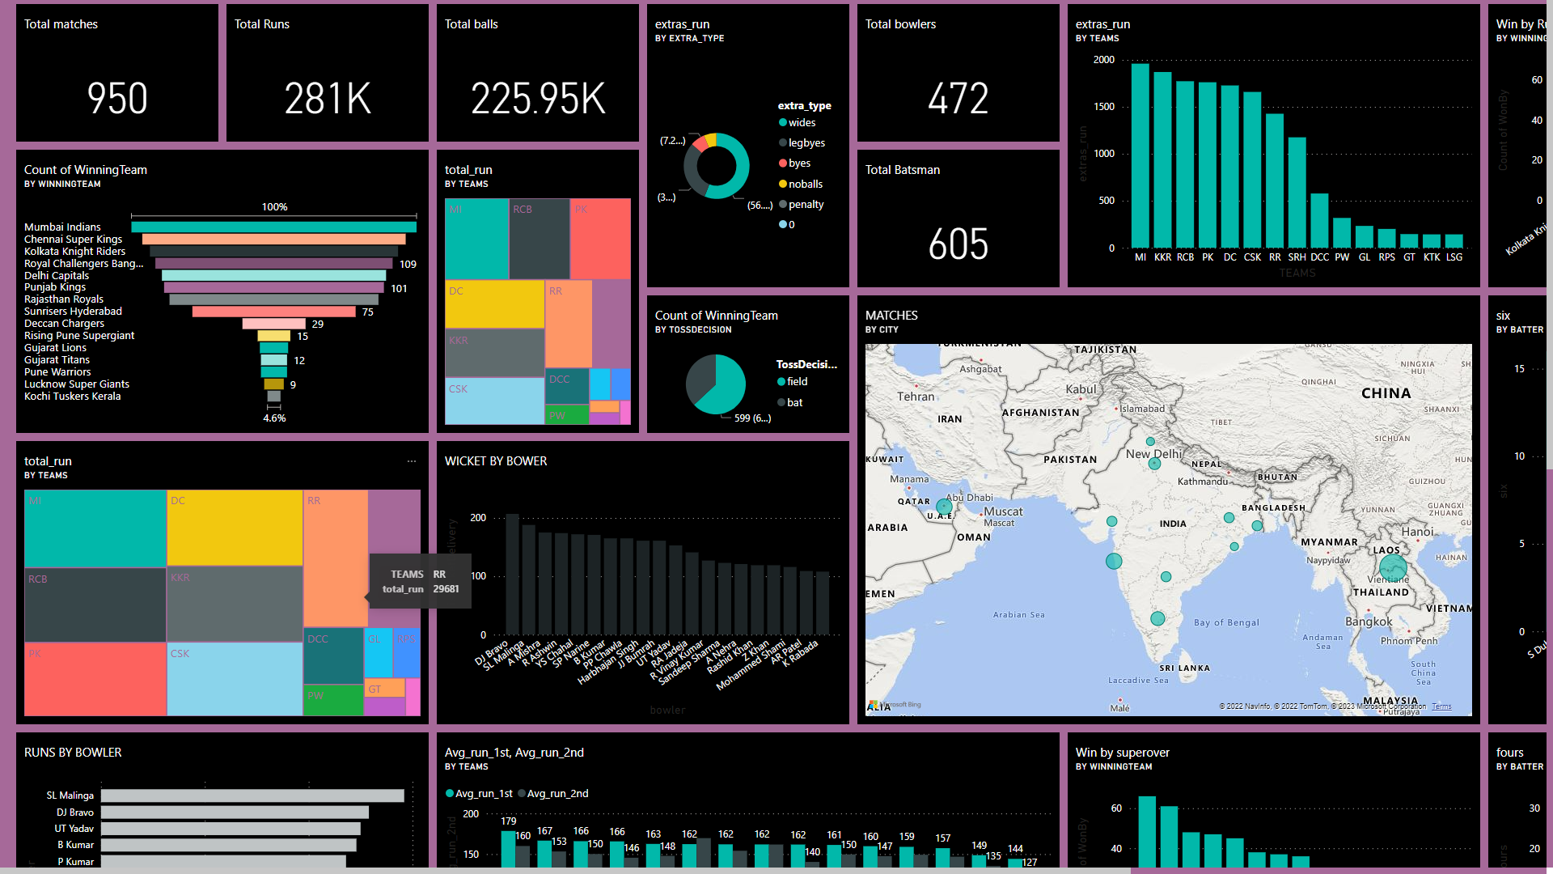
Dashboard

Slide 6
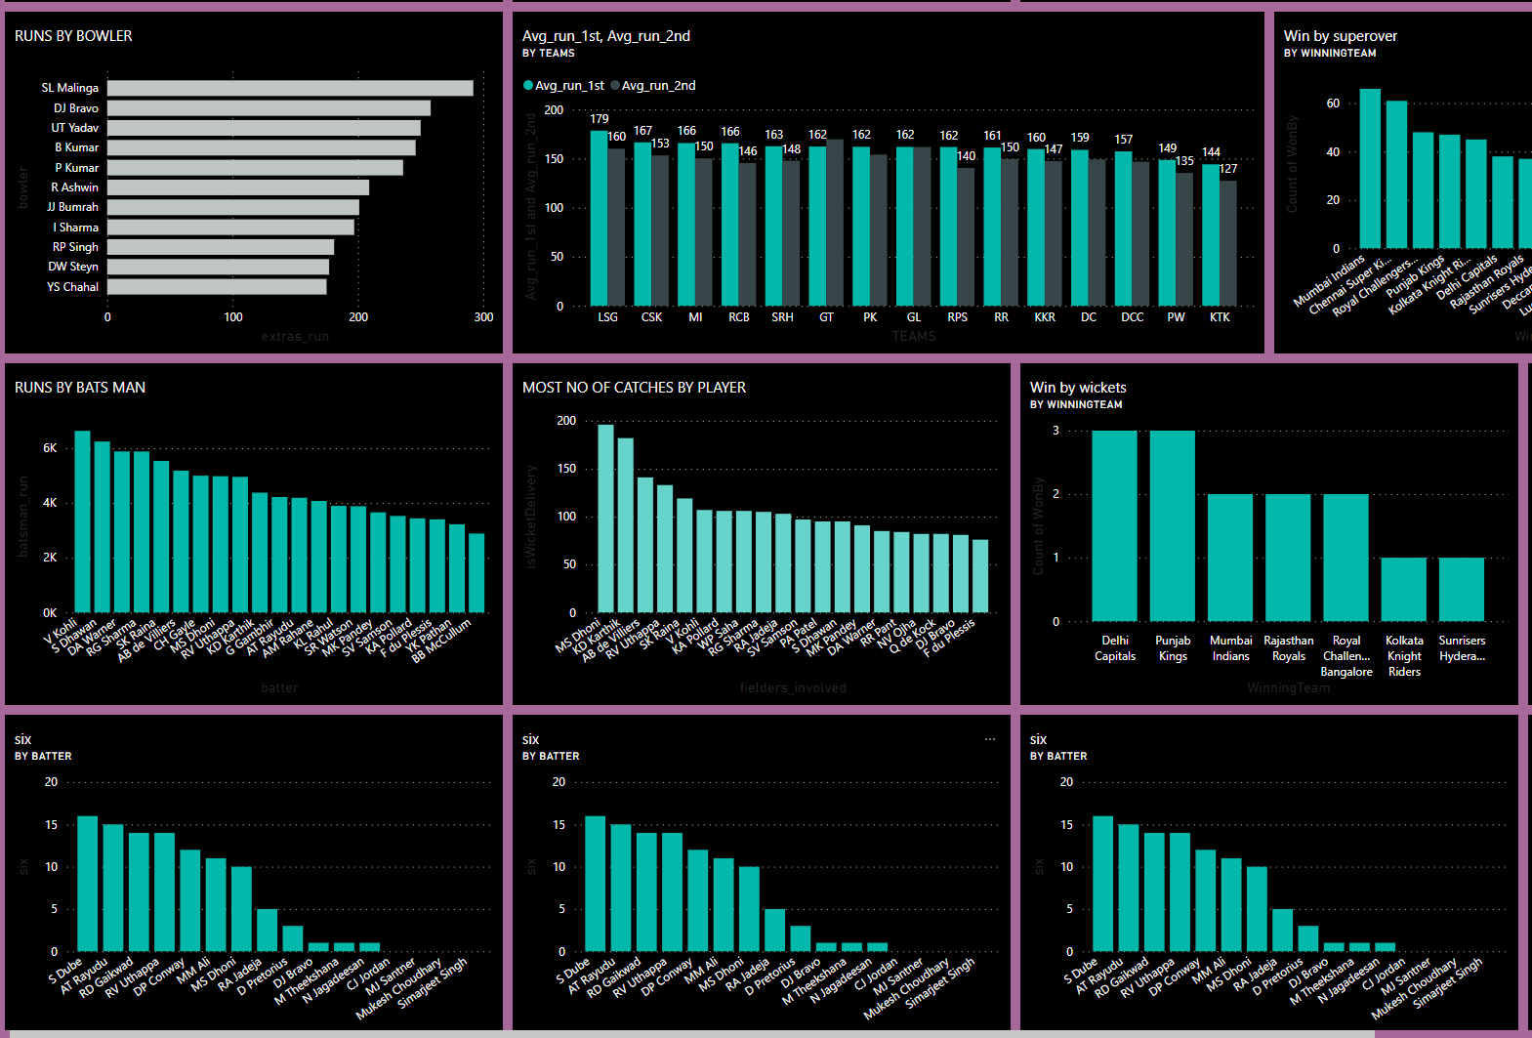
Dashboard

Slide 7
Inference
The average run score by the teams in first innings is Lucknow super giants (LSG) is 179.
The average run score by the teams in second innings is Gujarat titans(GT) 170.
The total balls bowled by Delhi capitals in 2008 is 5988 balls.
Total number of matches played by all team in between 2008 to 2022 is 56 matches.
Number of matches won by Mumbai-Indians are 131 matches.
The team conceded more extra runs is Mumbai Indians(MI).
The toss decision impact the match winning in fielding.
Wide Type of extra runs is more conceded is also about 56.05%
The player who gives more extra runs is Malinga.
The total number of fours scored by SK. Raina is 506 fours
The total number of sixers scored by CH. Gayle is 359.

Slide 8
Conclusion
In conclusion, the Indian Premier League data analysis dashboard provides a wealth of information and insights into the performance of teams and players in the league.
It allows users to easily view and compare statistics, such as player batting and bowling averages, team standings, and match results.
The dashboard also provides a visual representation of the data, making it easy to understand and interpret
Overall, the dashboard serves as a valuable tool for fans, analysts, and coaches to track and understand the league and make informed decisions.

Slide 9
References
[1] A. S. Bhat, V. S. Amit, N. S. Prasad, and D. M. Mohan, “An efficient classification algorithm for music mood detection in western and Hindi music using audio feature extraction,” in 2014 Fifth International Conference on Signal and Image Processing, Juju Island, 2014, pp. 359 –364
[2] A. Lopes, E. De Aguiar, A. De Souza, et al, “Facial Expression Recognition with Convolutional Neural Networks: Coping with Few Data and The Training Sample Order,” Pattern Recognition, vol.61, no.3, pp.610-628, 2017.
[3] Loh, C. S. and Sheng, “Measuring expert-performance for Serious Games Analytics: From data to insights,” Serious Games Analytics: Methodologies for Performance Measurement, Assessment, and Improvement, [Chapter 5], NewYork, NY: Springer, 2015.
[4] David H.S. Chung, et al., “Knowledge-Assisted Ranking: A Visual Analytic Application for Sports Event Data,” IEEE Computer Graphics and Applications, vol. 36, no. 3, 2016.

