Slide 1
STUDENT MANAGEMENT
SYSTEM
Under the Guidance of
Trainer Mrs. Indrakka Mali Mam
Submitted by
Ms. ABINAYA P
Ms. GOMATHI G
Ms. MAHALAKSHMI S
Ms. NANDHINI A
Mrs.PAVITHRA S

Slide 2
CONTENTS
Project Structure
Introduction
Objective
System Overview
Software Requirements
Hardware Requirements
Annotations
Database Table Design
Output Screenshots
Conclusion

Slide 3
SOFTWARE REQUIREMENTS
Database: MySQL
API- Spring Data JPA, spring web, validation,
spring security tools: Postman, IDE-Spring Tool Suite 4
Coding language-Java 1.8

Slide 4
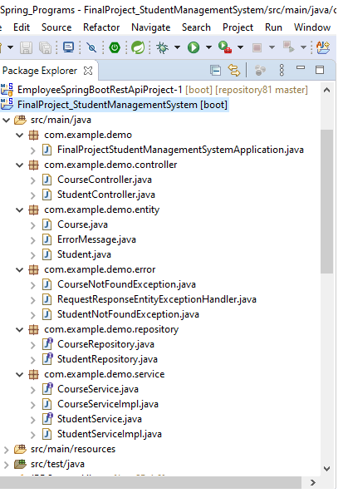
PROJECT STRUCTURE

Slide 5
INTRODUCTION
The project “Student Management System” is developed using spring boot framework, which mainly focuses on basic operations of student information system.
Like Inserting, Deleting, Updating and Getting all records of students information as well as course details.

Slide 6
OBJECTIVE
It provides “better and efficient” service”.
Faster way to get information about the students.
To reduce the unnecessary paper work in maintaining the student information.
All details will be available on a click.

Slide 7
SYSTEM OVERVIEW
The Student management system is automated by the traditional system.
There is no need to use paper and pen.
Checking a student details is very easy.
Adding new student record is very easy.
Deleting, Getting or Updating a record of a particular student is simple.

Slide 8
HARDWARE REQUIREMENTS
Edition : Window 10 Pro
RAM: 8GB
Processor: AMD PRO A4-4350BR4, 5 COMPUTER CORES 2C+3G 2.50GHZ
System type: 64-bit operating system

Slide 9
ANNOTATIONS USED
@Entity- Creates table
@id- Generate primary key
@Generated Value- Generate value automatically
@SequenceGenerator- To set the initial value
@NOTBLANK- Field should not be blank
@NOTNULL- Field should not be null
@OneToMany- Creates one to many hibernate relation
@JoinColumn- Join columns from two different tables
@RestController- It acts as interface between sts & postman
@Autowired- It is used for injecting object
@Configuration- Configure the parameters & initial settings
@Service- Used to mark the class as a service provider

Slide 10
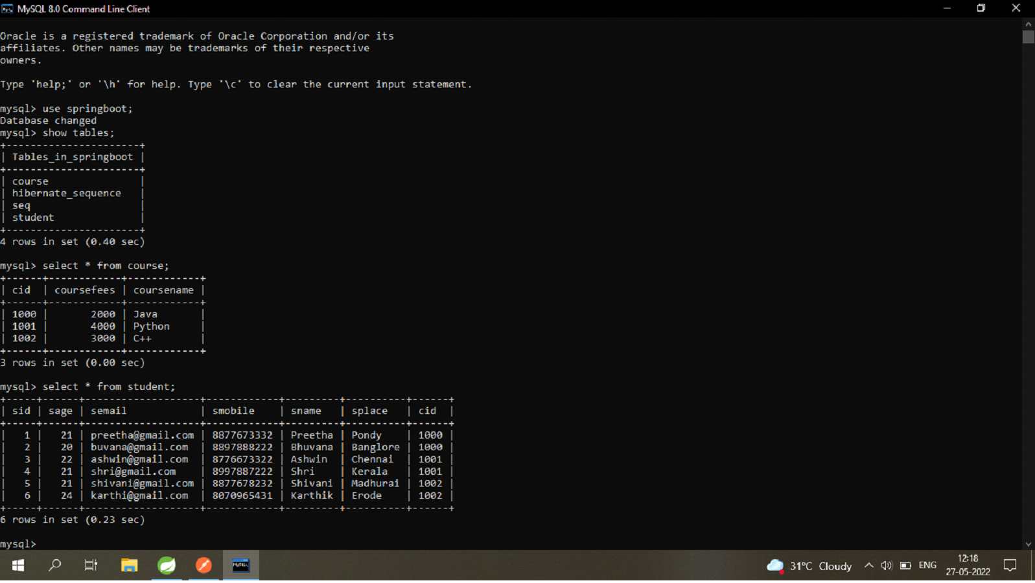
DATABASE TABLE DESIGN

Slide 11
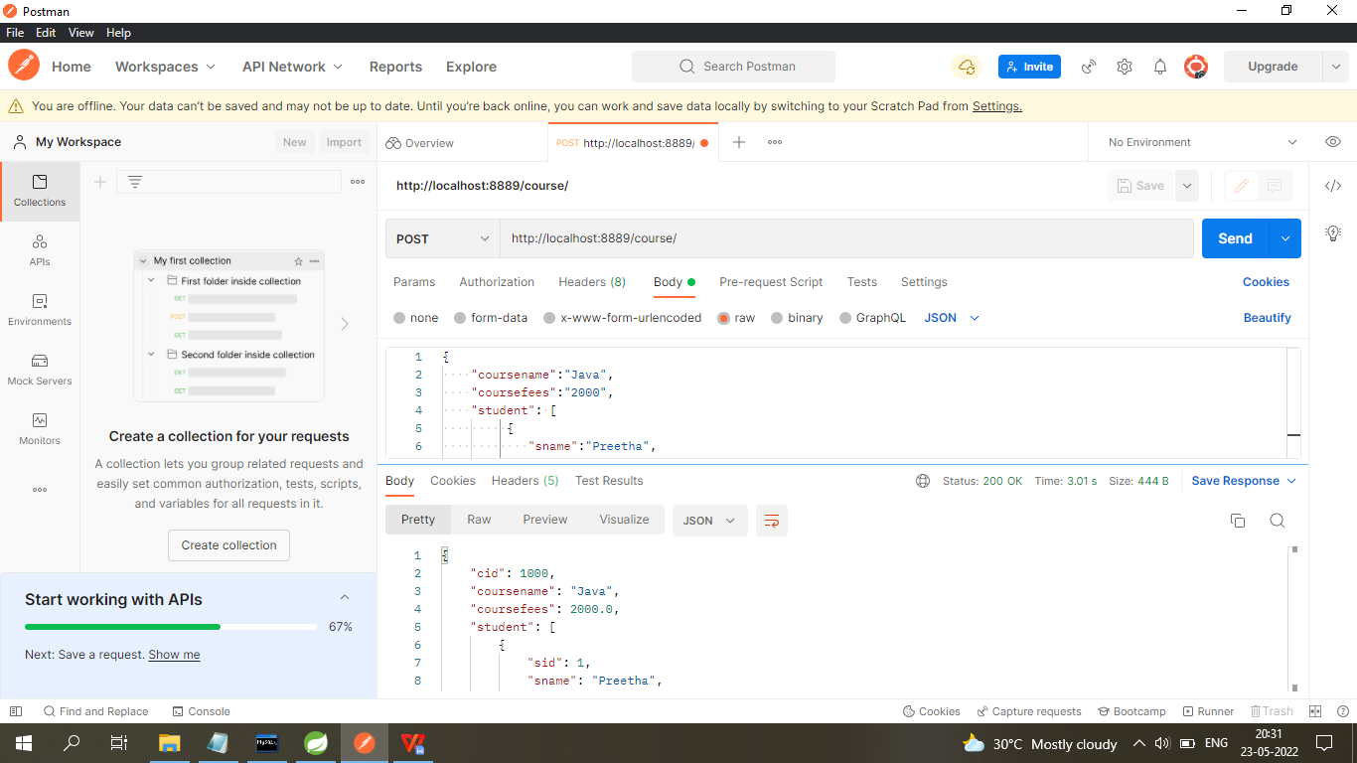
OUTPUT SCREENSHOTS
COURSE
Step 1: Insert record
http://localhost:8889/course/

Slide 12
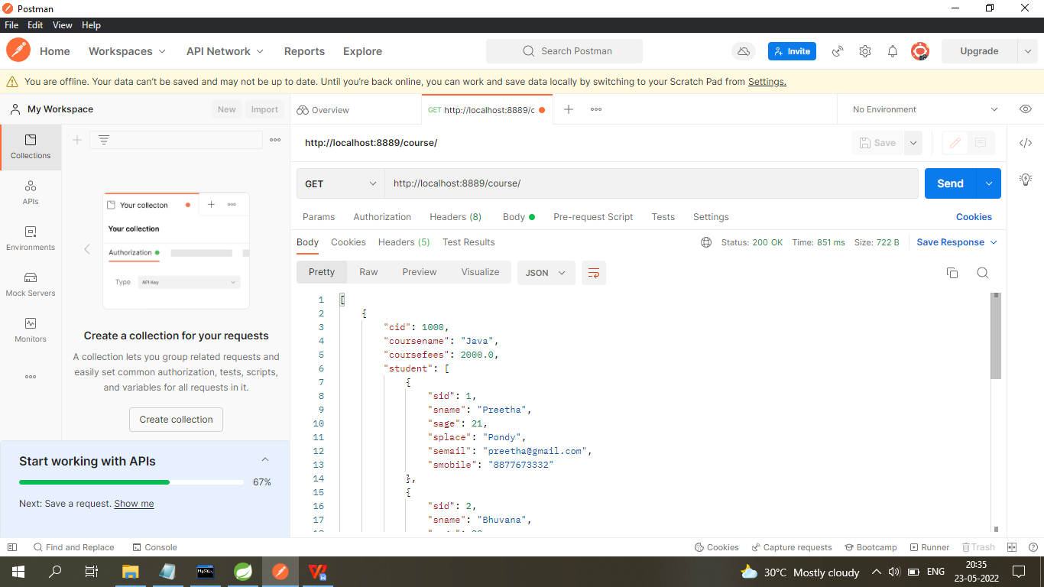
Step 2: Get all course record
http://localhost:8889/course/

Slide 13
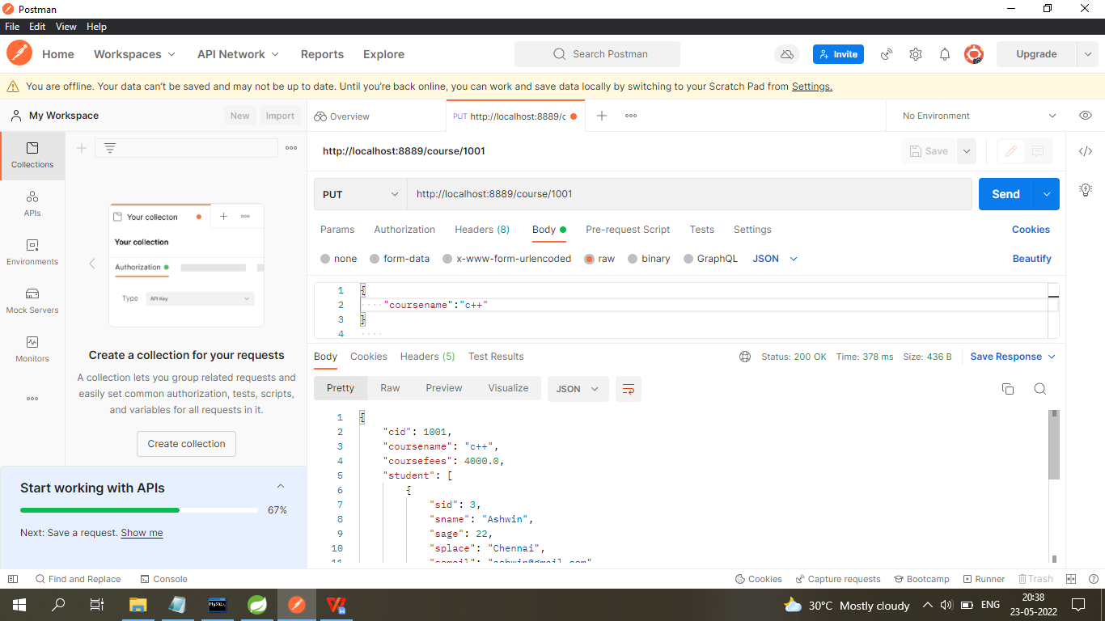
Step 3: Update course record using id
http://localhost:8889/course/1001

Slide 14
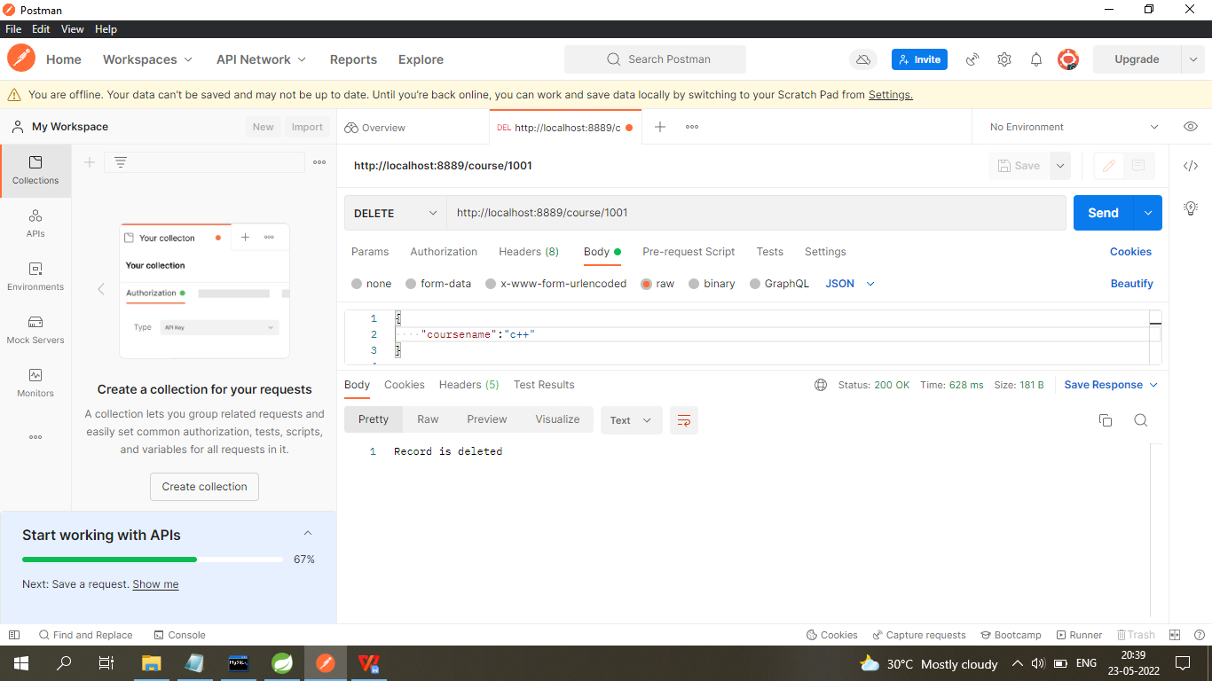
Step 4: Delete course record using course id
http://localhost:8889/course/1001

Slide 15
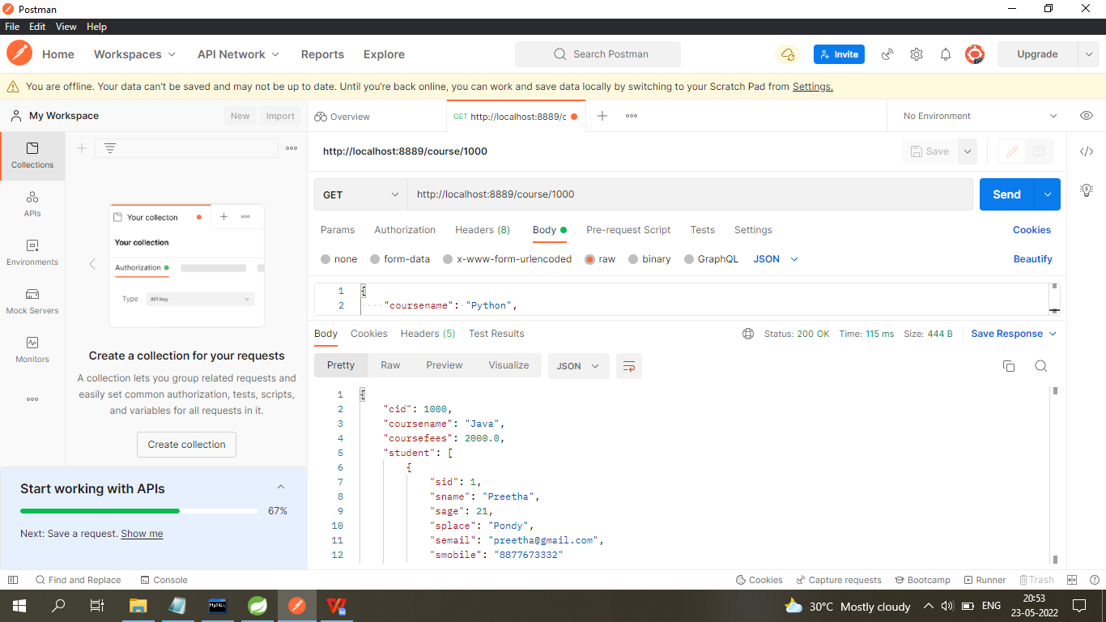
Step 5: Get record by using course id http://localhost:8889/course/1000

Slide 16
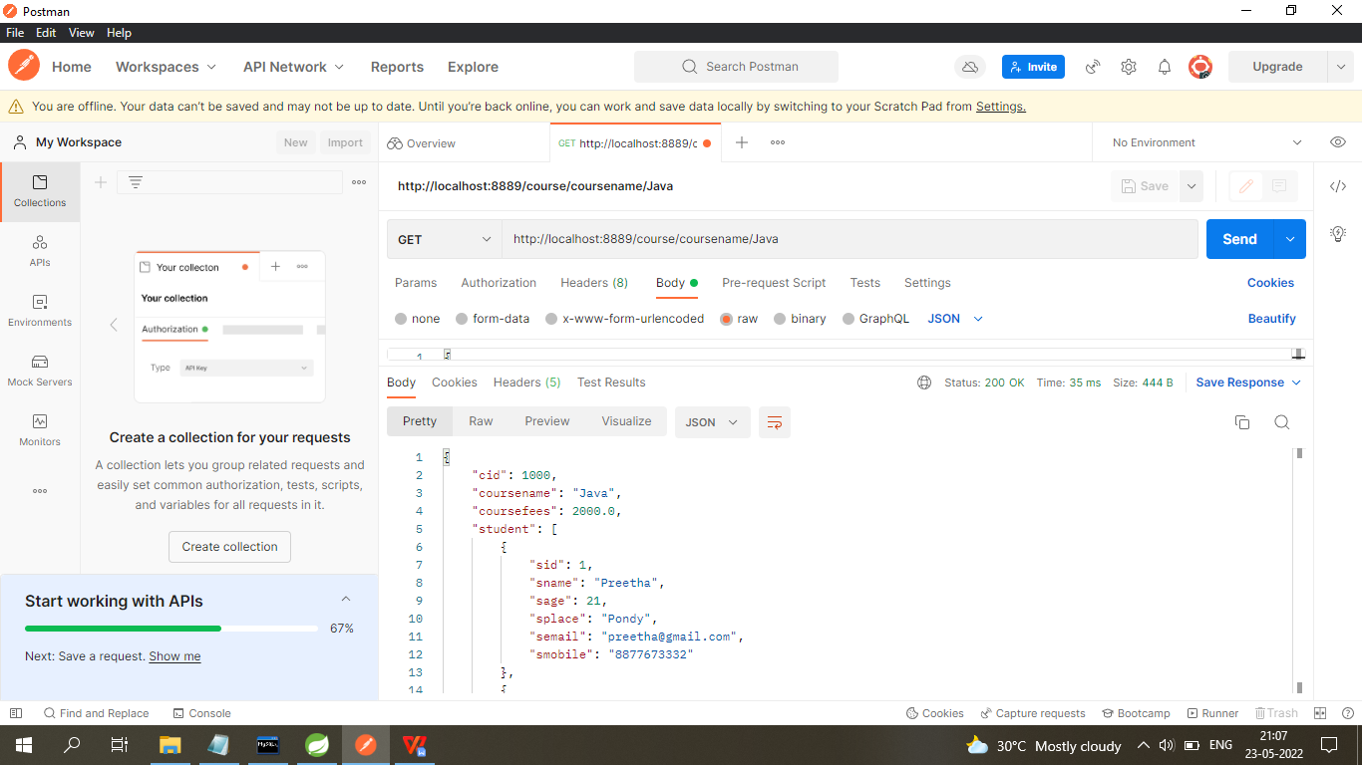
Step 6: Get record by using course name http://localhost:8889/coursename/java

Slide 17
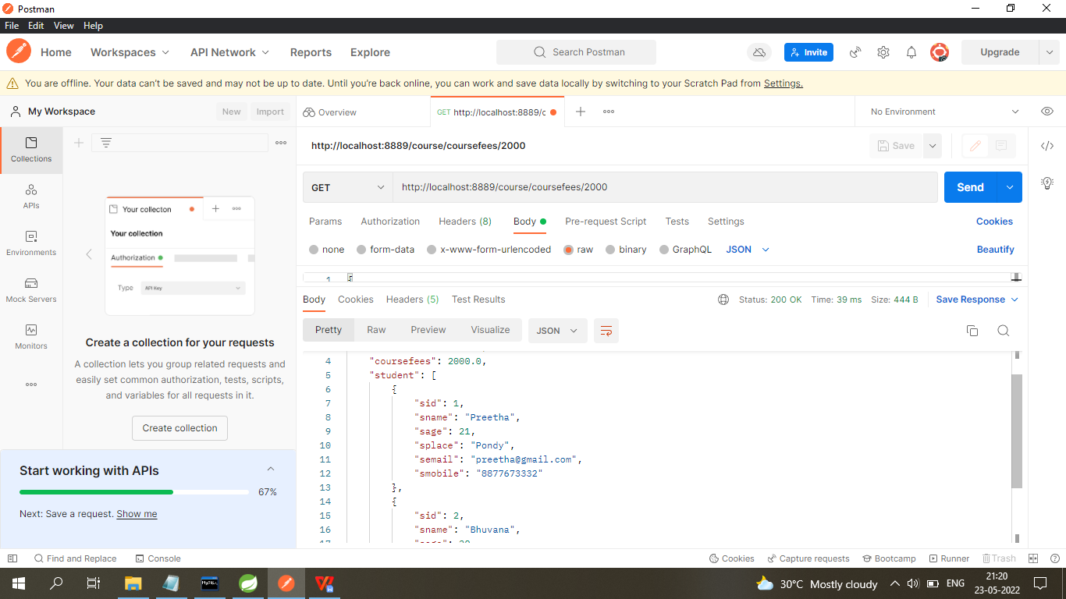
Step 7: Get record by using Course Fees http://localhost:8889/course/coursefees/2000

Slide 18
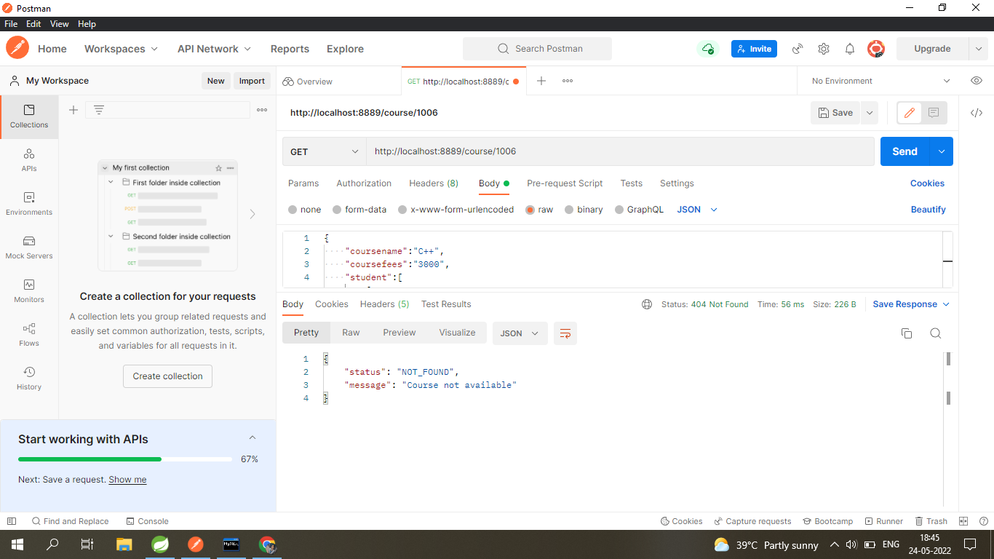
Step 8: Get unknown course record using course id, it will print error message http://localhost:8889/course/1006

Slide 19
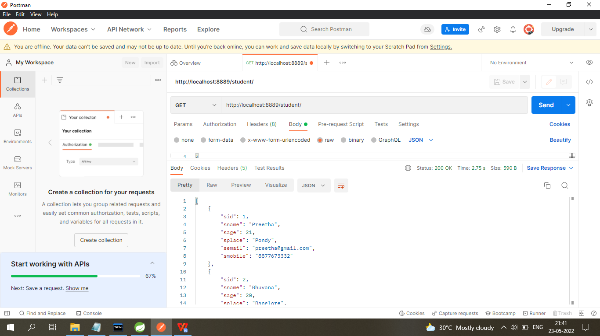
STUDENT Step 9: Get record from student http://localhost:8889/student/

Slide 20
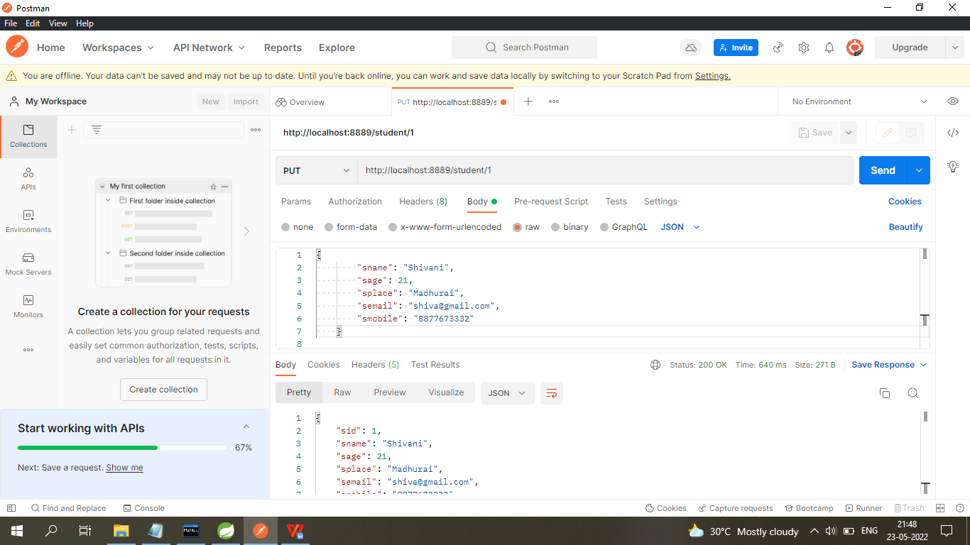
Step 10: Update record using student id http://localhost:8889:/student/1

Slide 21
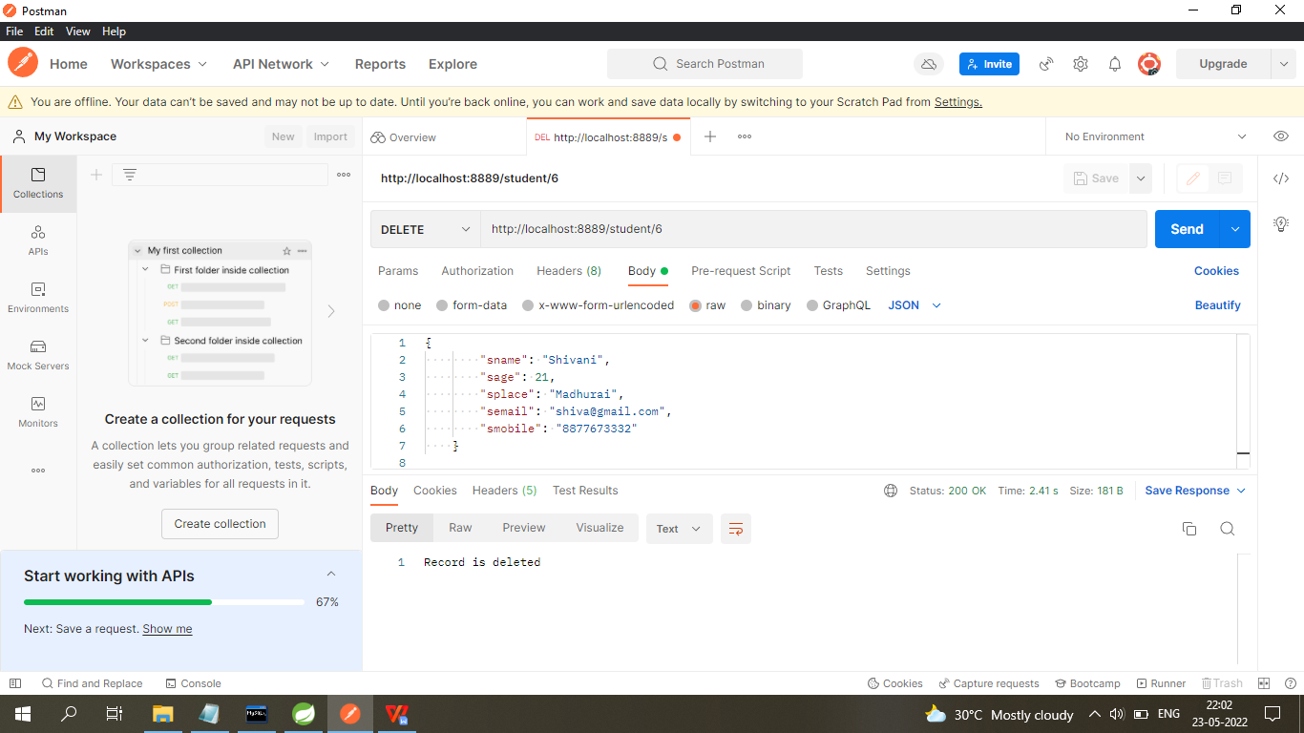
Step 11: Delete student record by using student id http://localhost:8889/student/6/

Slide 22
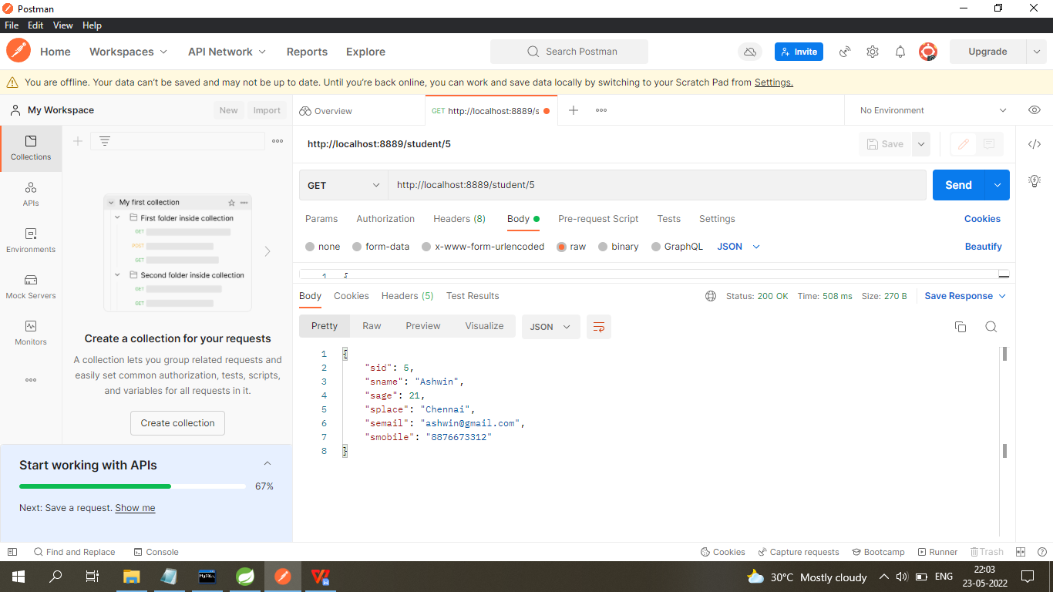
Step 12: Get student record by using student id http://localhost:8889/student/5/

Slide 23
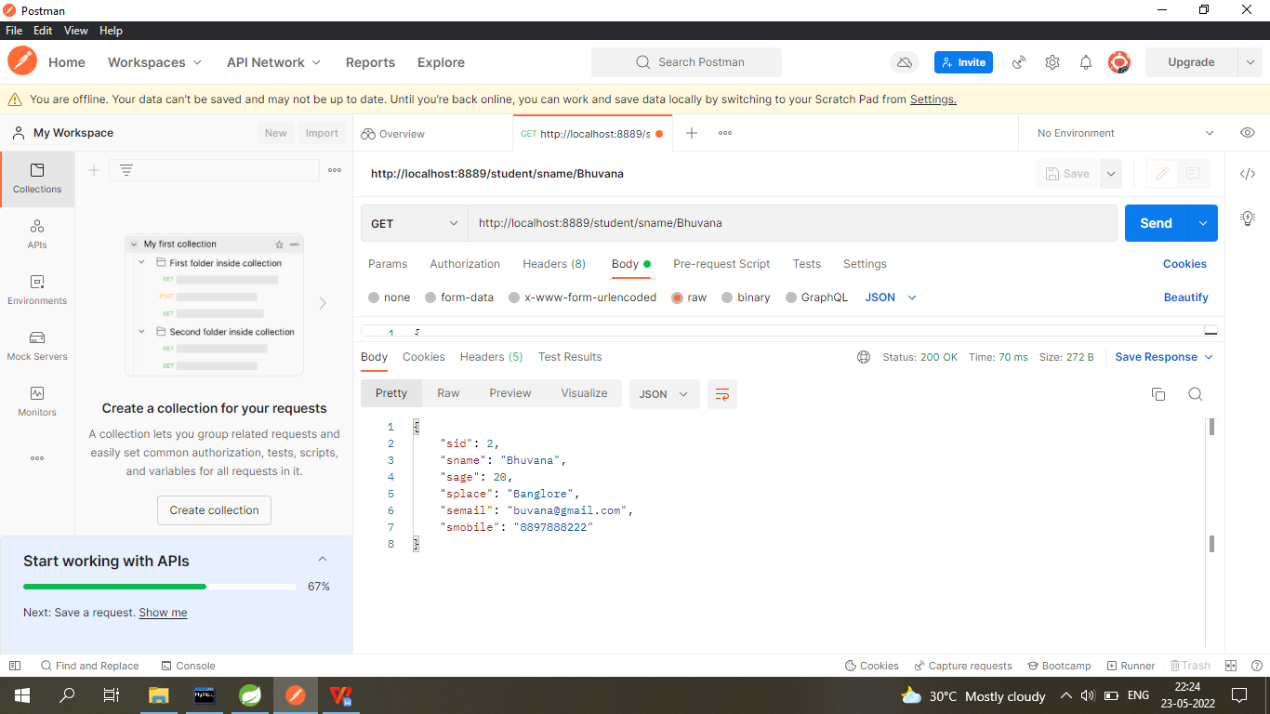
Step 13: Get student record by using student Name http://localhost:8889/student/sname/Bhuvana

Slide 24
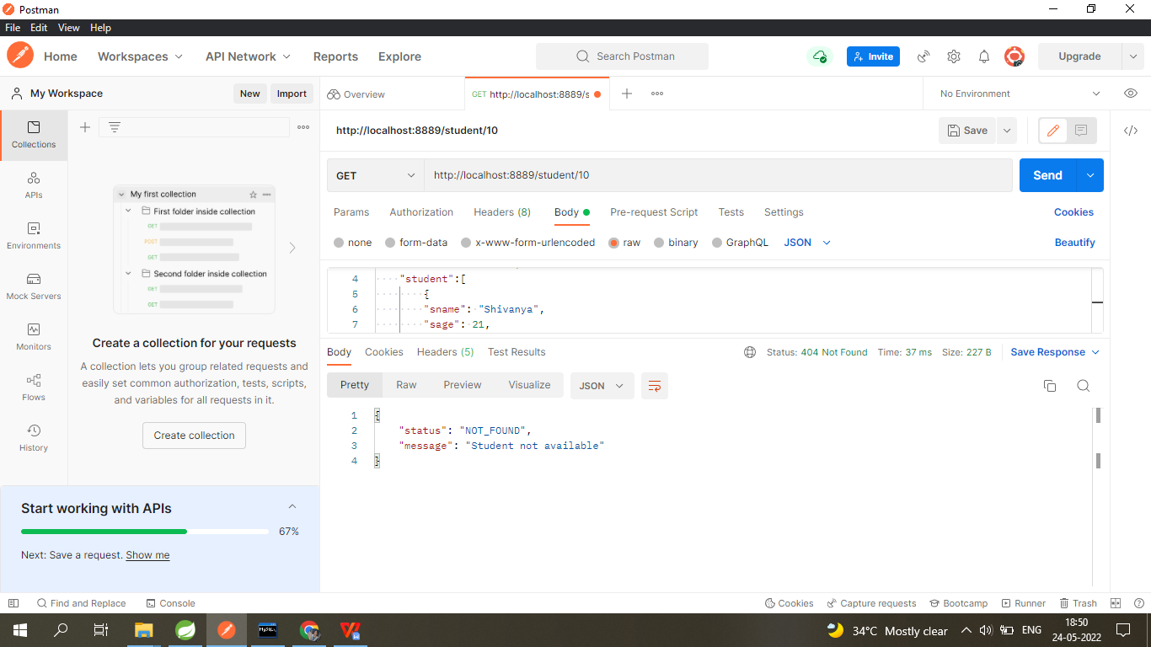
Step 14: Get unknown student detail using student id, it will print error http://localhost:8889/student/10

Slide 25
CONCLUSION
The project makes task more accessible by giving them an easy way to find and sort information related to it.
It allows to view students details as well as course information.
The idea is to create a scenario that makes the students to enroll their details into particular courses.

Slide 26
THANK YOU

