Slide 1
MNIST Handwritten Digit
Recognition Using LeNet-5
Pavithra Sri Turlapati
Department of Industrial Engineering · University of South Florida
EIN 6681: Deep Learning Analytics
99.65%
35
20
948K
Test Accuracy
Misclassifications
Training Epochs
Parameters

Slide 2
MOTIVATION
Why Handwritten Digit Recognition Matters
Banking
Postal Automation
Cheque amounts read automatically, reducing manual processing errors and fraud.
ZIP codes on envelopes scanned and sorted without human intervention.
Doc Digitization
Assistive Tech
Handwritten forms converted to searchable digital records at scale.
Helps visually-impaired users interact with handwritten content digitally.
MNIST: the standard benchmark: 70,000 images · 0–9 digits · 28×28 px · Introduced by LeCun et al. 1998

Slide 3
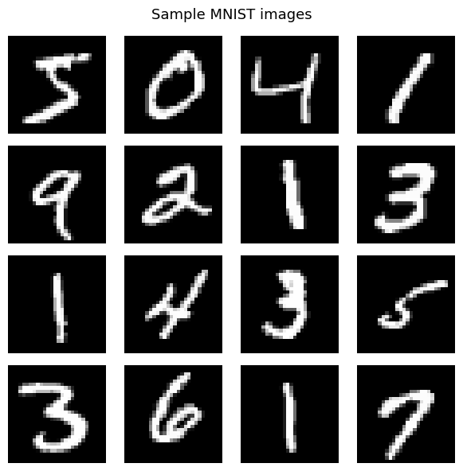
DATASET
MNIST Dataset
70,000
60,000
Class Distribution (Training Set)
Total Images
Training Samples
10,000
28 × 28
Test Samples
Image Resolution (px)
Dataset is well-balanced: ~6,000 samples per digit class in the training set. No resampling required.

Slide 4
RELATED WORK
Original LeNet-5 vs. Enhanced LeNet-5
Component | Original LeNet-5 (1998) | Enhanced LeNet-5 (Ours)
Activation | Sigmoid / Tanh | ReLU (Nair & Hinton 2010)
Pooling | Average Pooling | Max Pooling
Normalization | None | Batch Normalization (Ioffe & Szegedy 2015)
Regularization | None | Dropout 0.5 (Srivastava et al. 2014)
Filter Sizes | 6 → 16 | 32 → 64 → 128
Conv Blocks | 2 blocks | 3 blocks (added 3×3 conv)
Optimizer | SGD | Adam + L2 decay (Kingma & Ba 2015)
LR Schedule | Fixed | Cosine Annealing (Loshchilov & Hutter 2017)
Augmentation | None | Rotation ±10° + Affine transforms

Slide 5
ARCHITECTURE
LeNet-5 Network Architecture
INPUT
28×28×1
CONV1
32 filters
5×5 + BN + ReLU
POOL1
MaxPool 2×2
CONV2
64 filters
5×5 + BN + ReLU
POOL2
MaxPool 2×2
CONV3
128 filters
3×3 + BN + ReLU
FC1
256 units
BN + ReLU + Drop0.5
FC2
10 logits
Softmax
Grayscale
→ 28×28×32
→ 14×14×32
→ 10×10×64
→ 5×5×64
→ 5×5×128
3200→256
→ Classes
948,938
3.62 MB
Dropout 0.5
4× BN Layers
Trainable Parameters
Model Size
Regularization
Normalization
Training Configuration
Optimizer | LR | LR Schedule | Batch Size | Epochs | Loss | Augmentation
Adam | 1×10⁻³ | Cosine Annealing | 128 | 20 | Cross-Entropy | Rotation ±10° + Affine

Slide 6
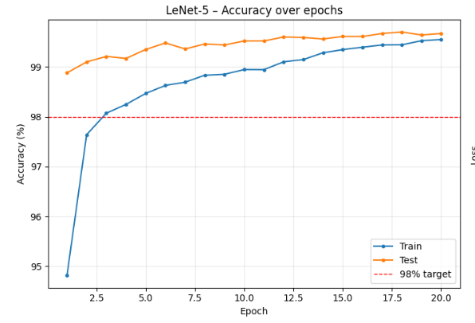
RESULTS
Training Results for 20 Epochs
Test Accuracy Over 20 Epochs
Key Milestones
Epoch 1
98.88%
Already exceeds 98% target in first epoch!
Epoch 17
99.67%
Best test accuracy reached
Epoch 20
99.67%
Final test accuracy
Train Acc
99.67%
Train-test gap = only 0.13%

Slide 7
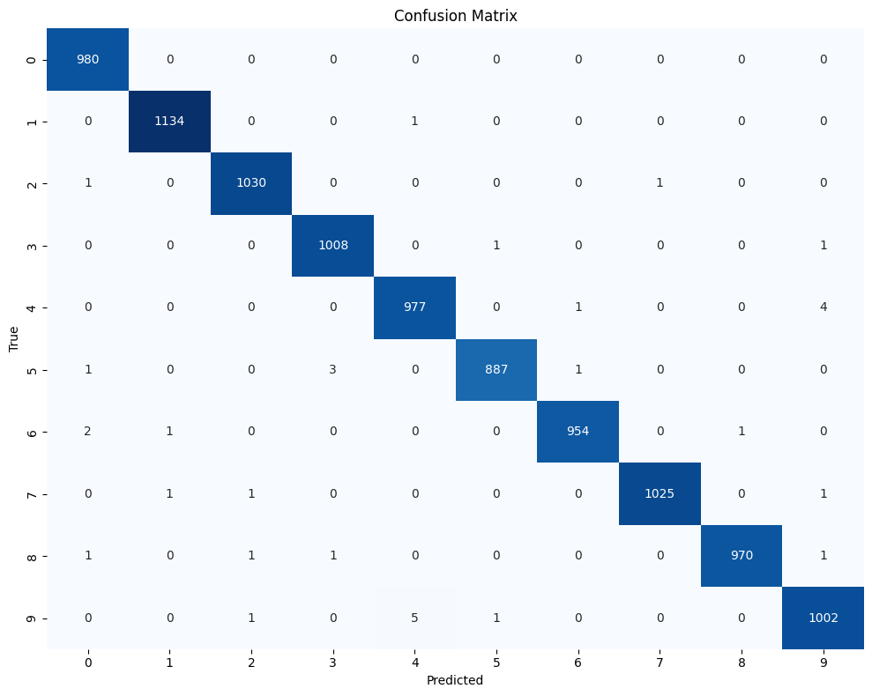
EVALUATION
Confusion Matrix & Error Analysis
What the Matrix Tells Us
Near-Perfect Diagonal
The matrix is strongly diagonal across all 10 classes — near-zero off-diagonal values.
Only 35 Total Errors
Out of 10,000 test images, just 35 are misclassified (0.35% error rate).
Hard Pairs: 5↔6
Share similar upper-curve structure — expected ambiguity even for human annotators.
Hard Pairs: 9↔4
Share similar upper-loop structure — a known MNIST difficulty.
Hard Pairs: 3↔8
Similar bilateral curvature — dataset-level ambiguity, not model weakness.

Slide 8
EVALUATION
Per-Class F1 Scores & Classification Report
Classification Report
Class | Precision | Recall | F1-Score | Support
0 | 1.00 | 1.00 | 1.00 | 980
1 | 1.00 | 1.00 | 1.00 | 1135
2 | 1.00 | 1.00 | 1.00 | 1032
3 | 1.00 | 1.00 | 1.00 | 1010
4 | 1.00 | 1.00 | 1.00 | 982
5 | 0.99 | 0.99 | 0.99 | 892
6 | 1.00 | 1.00 | 1.00 | 958
7 | 1.00 | 1.00 | 1.00 | 1028
8 | 1.00 | 1.00 | 1.00 | 974
9 | 0.99 | 0.99 | 0.99 | 1009
Macro Avg | 1.00 | 1.00 | 1.00 | 10000

Slide 9
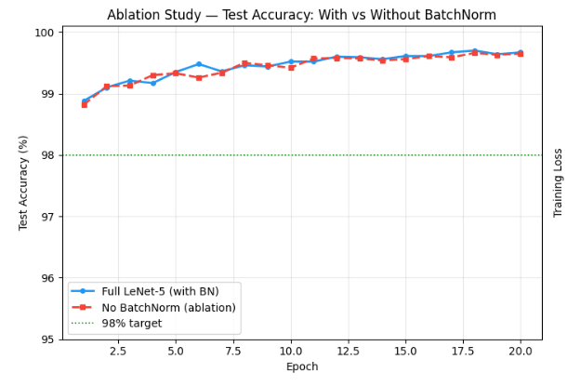
ABLATION STUDY
BatchNorm Ablation : Removing Batch Normalization
Test Accuracy: Full vs. No-BatchNorm
Ablation Results Table
Metric | Full Model (BN) | No BN (Ablation)
Epoch 1 Test Acc | 98.88% | 98.82%
Best Test Acc | 99.70% | 99.60%
Final Test Acc (Ep.20) | 99.67% | 99.65%
Final Train Acc | 99.55% | 99.52%
Accuracy Drop | — | −0.02 pp
Misclassifications | 36 | 39
Train–Test Gap | 0.12% | 0.13%
Key Takeaway: BatchNorm's main advantage is early convergence speed. It drives the model past 98% in Epoch 1. The final accuracy gap is small (0.03%), but the convergence advantage is decisive.

Slide 10
CONCLUSION
Summary & Future Work
Key Achievements
Future Work
99.65% final test accuracy — exceeds 98% target by 1.65 pp
Elastic Distortions + Cutout
Enhanced augmentation for further error reduction
98% accuracy achieved in the very first training epoch
Residual Connections
Skip connections for deeper architecture scaling
Only 35 misclassifications out of 10,000 test images
Label Smoothing
Perfect macro F1 = 1.00 across all 10 digit classes
Soft targets to reduce overconfidence
Ensembling
Ablation confirms BatchNorm drives early convergence speed
Combine independent models to reduce error rate
MNIST-C / EMNIST Evaluation
Clean, reusable PyTorch pipeline with unified training loop
Test generalization beyond standard benchmark
Thank you for listening

