Slide 1
MNIST Handwritten Digit Recognition Using Enhanced LeNet-5 Pavithra Sri Turlapati Department of Industrial Engineering, University of South Florida

Slide 2
What & Why?
Handwritten digit recognition is a fundamental computer vision task with real-world applications in banking, postal automation, document digitization, and assistive technologies.
It enables systems to automatically interpret handwritten content, improving efficiency and accessibility.
This makes it a critical problem widely used in real-world production systems, not just an academic exercise.

Slide 3
About Dataset
The MNIST dataset, introduced by Yann LeCun and colleagues in 1998, contains 70,000 grayscale images of handwritten digits (0–9), split into 60,000 training and 10,000 testing samples.
Each image is 28×28 pixels, and the dataset is well-balanced across classes.
It serves as a standard benchmark for evaluating digit recognition models.

Slide 4
What’s wrong with the existing model
The original LeNet-5 proposed by Yann LeCun in 1998 was groundbreaking, but relies on outdated components like sigmoid activations and average pooling, which limit its performance today.
This project retains its core structure while replacing these elements with modern techniques to significantly improve accuracy on the MNIST dataset.

Slide 5
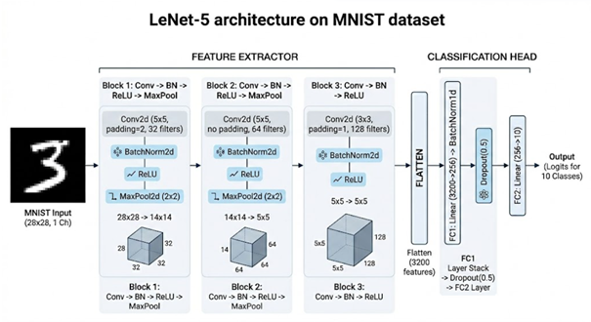
Architecture
CNN with 3 convolutional blocks + fully connected head.
Learns hierarchical features: edges → patterns → digit structures.
Gradually reduces spatial size while increasing feature depth.
Final feature maps are flattened into a 3200-dim vector.
FC layers map features to 10-digit classes.
Batch Normalization improves stability and faster training.
Dropout reduces overfitting and improves generalization.
Designed for robust performance on the MNIST dataset

Slide 6
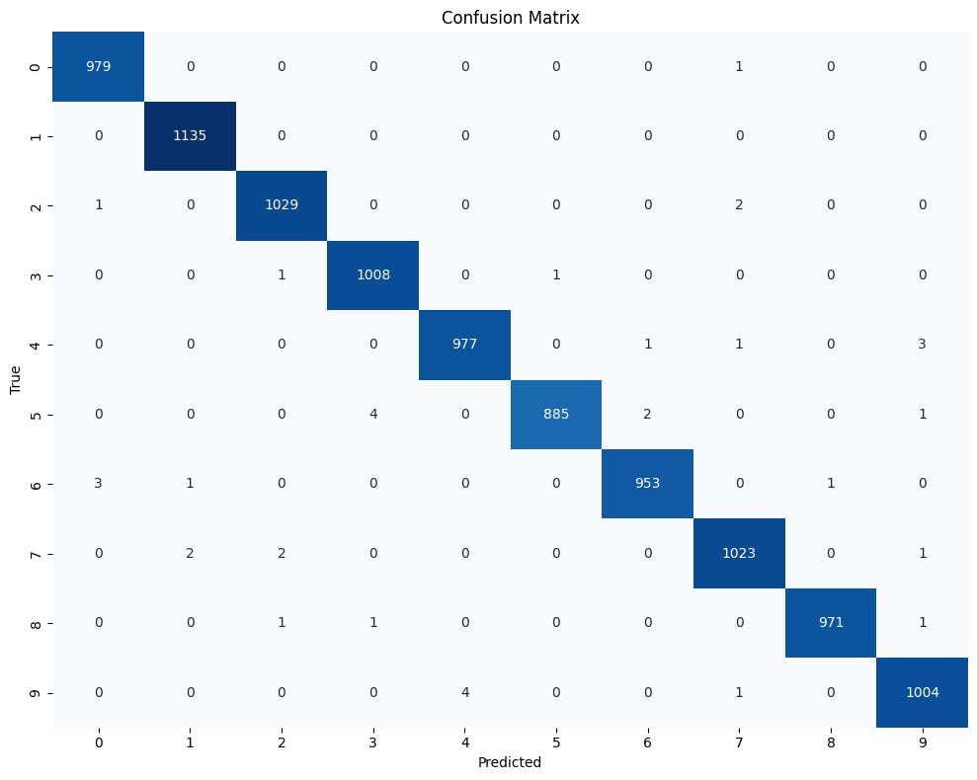
Visualization
Confusion Matrix
The model achieves a 99.65% accuracy on all 10,000 test images, with only 35 misclassifications.
The confusion matrix is strongly diagonal across all ten classes, reflecting near-perfect separation.
The rare errors occur on known ambiguous pairs — 5/6, 9/4, and 3/8 — cases where even human annotators sometimes disagree.

Slide 7
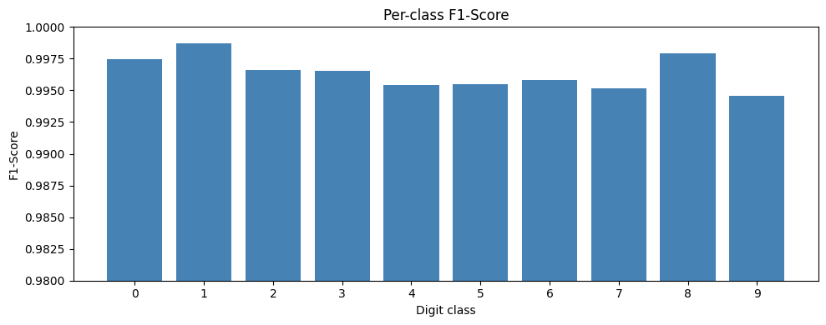
Confusion Matrix
Eight of ten-digit classes achieve a perfect F1 score of 1.00, and the macro-averaged F1 across all classes is 1.00 — confirming uniformly strong performance.
The only minor dips appear in digits 5 and 9, both at 0.99 recall, consistent with the ambiguous pairs discussed earlier.
All precision, recall, and F1 values across the classification report are at or above 0.98.

Slide 8
Ablation Experiment
No Batch Normalization: Ablation Study Results
Early Dominance: BN is the primary driver for exceeding 98% accuracy in Epoch 1 (98.57% vs. 98.91% for No-BN).
Rapid Convergence: BN cuts training loss nearly in half by Epoch 2, significantly accelerating the optimization process.
Stability: The full model maintains consistently lower training loss throughout the 20-epoch budget.
Accuracy Boost: Achieved a higher peak accuracy of 99.67% compared to 99.61% without BN layers.
The Verdict: While the final accuracy gap is 0.03%, BN is essential for speed and efficiency, reaching high-performance milestones much faster than the ablation model.

Slide 9
Conclusion & Future Work
The modernized LeNet-5 architecture achieved a peak test accuracy of 99.65%, surpassing the project target by 1.65 percentage points with only 35 total errors.
By integrating modern techniques like Batch Normalization and Adam optimization, the model demonstrated exceptional efficiency by hitting the 98% accuracy milestone in its very first epoch.
The implementation provides a highly organized and reusable PyTorch pipeline, yielding a perfect 1.00 macro F1 score across all digit classes.
Future improvements will focus on expanding the augmentation strategy with elastic distortions and introducing residual connections to support deeper architectural scaling.
Upcoming research will move beyond standard benchmarks to test model generalization on MNIST-C and EMNIST, while exploring ensembling to further drive down the error rate.

