Slide 1
IGNITE
Pitch Deck
AGRIGUARD

Slide 2

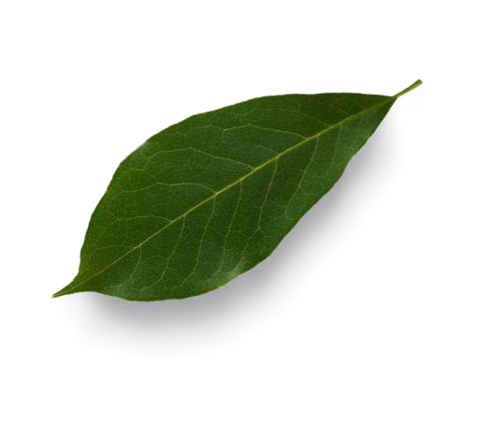
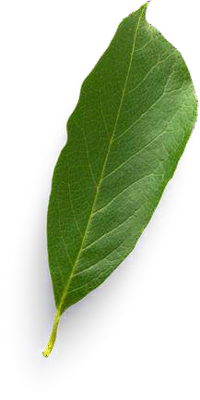

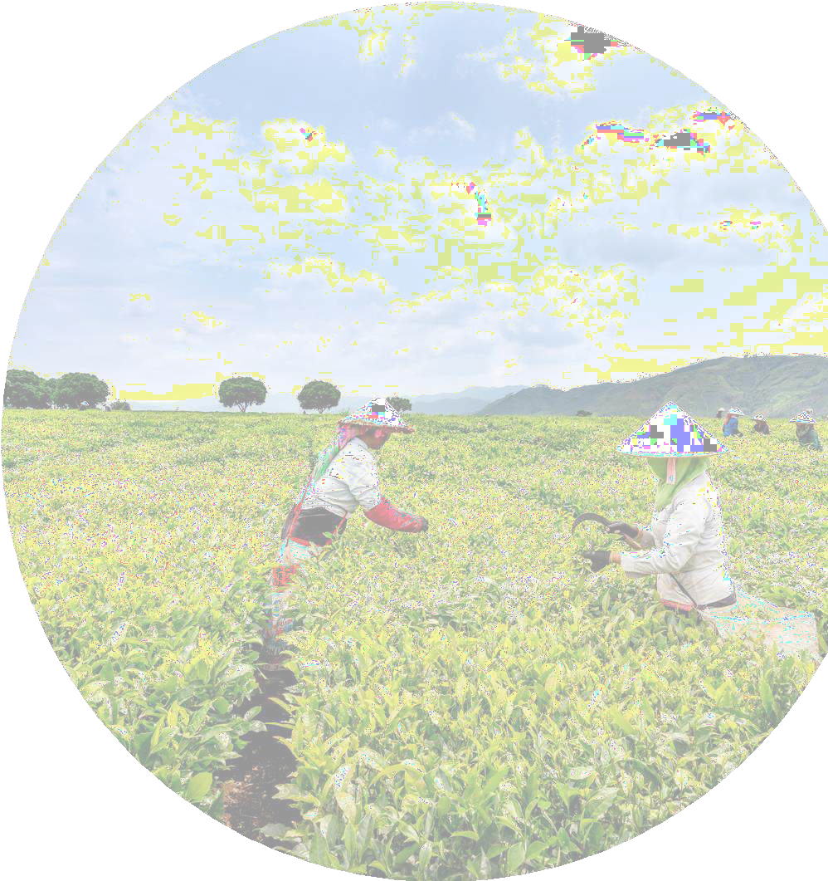

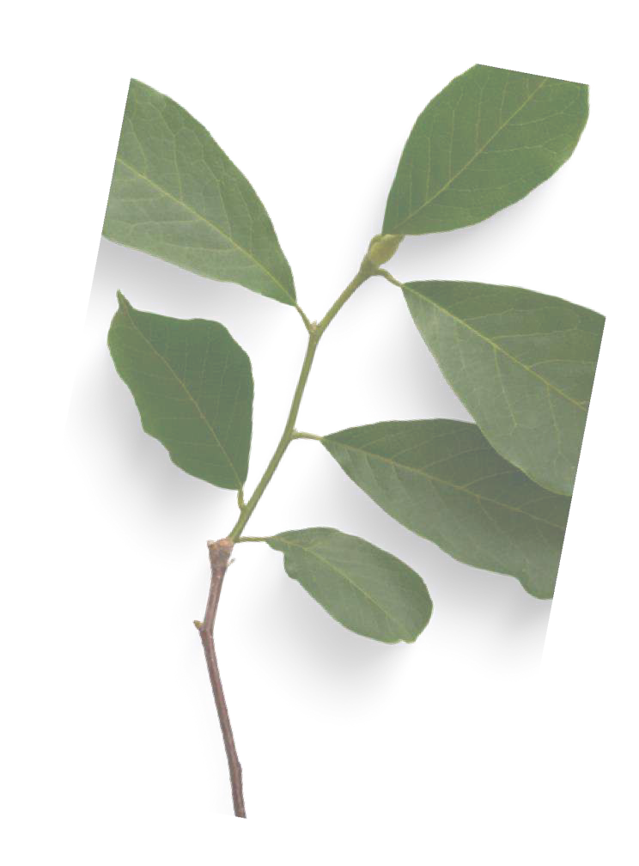

W H O W E A RE
N A M E O F Y O U R V E N T U RE : A G R IG U A RD
W H Y ?
Explain why do you want to pursue this Business Idea
IT A D D R E S S E S T H E C R IT IC A L C H A L L E N G E O F W E A T H E R U N P R E D IC T A B IL IT Y IN
A G R IC U L T U R E . C R O P S A N D V E G E T A B L E C A N S U F F E R F R O M W A T E R L O G G IN G , W H IC H
D A M A G E S R O O T S A N D R E D U C E S Y IE L D S . E X C E S S M O IS T U R E C A N A L S O L E A D T O
F U N G A L D IS E A S E S
W H A T ?
Provide a brief on what does your venture do
Re d uce d C ro p a nd ve g e ta b l e Da ma g e , In cr e a s e d Y ie l d a nd Q ua l ity ,
B o o s te d C ro p a nd ve g e ta b l e s P ro d u ct ivity , Re d uce d Lo s s e s Due
to U np re d ict a b l e W e a the r, P ro mo te s S us ta ina b l e F a rming .
H O W ?
Explain how your venture solves the problem and make its revenue.
A UT O M A T E D S Y S TE M THA T P RO TE C T S C RO P S F RO M EX C E S S IV E RA IN F A LL A ND P RO M O TE S O P T IM A L GRO W TH. W HE N RA IN iS DE T E C T E D, A P RO T E C T IV E S HE ET DE P LO Y S T O P RE V E NT W A TE RLO G G IN G A ND DA M A G E . T HE S Y S TE M A LS O F E A T U RE S SO LA R PA NE LS THA T S T O RE ENE RG Y F O R A RT IF IC IA L LIG HT IN G DURIN G C LO UDY W E A T HE R. TH IS IN NO V A T IV E S O LUTION
E NHA NC E S PRO DUC T IV IT Y , RE DUC E S O P E RA T IO NA L C O S TS , A ND E NS URE S S US TA IN A B LE
F A RM IN G P RA C T IC E S .

Slide 3

Problem/Opportunity
CONTEXT When does the problem occur? Rainy seasons Unpredictable weather conditions Heavy rainfall Low sunlight conditions | PROBLEM What is the root cause of the problem? The agriculture's affect to unpredictable weather, especially excessive rainfall during the rainy season. This leads to waterlogging and crop damage, reducing yields. Farmers struggle to protect their crops due to the inability to control or predict these weather conditions, highlighting the need for a rain detection system. | ALTERNATIVES What do customers do now to ﬁx the problem? Placing sandbags around crops to prevent waterlogging. Creating temporary dikes to divert excess water. Purchasing insurance to compensate for crop damage.
CUSTOMERS Who has the problem most often? | EMOTIONAL IMPACT How does the customer feel? | ALTERNATIVE SHORTCOMINGS What are the disadvantages of the alternatives?
Smallholder farmers Commercial farmers Agricultural cooperatives Organic and precision agriculture farms Greenhouse farmers | Peace of Mind after Knowing crops and vegetables are protected. Well-being in Financial stability and security. QUANTIFIABLE IMPACT What is the measurable impact (include units)? | Risk of damaging plants during covering and uncovering. Requires ongoing maintenance, which can reduce effectiveness.
 | Reduction in crop damage (30% - 50%) Increase in crop yields (20% - 30%) Decrease in waterlogging (90% - 100%)

Slide 4

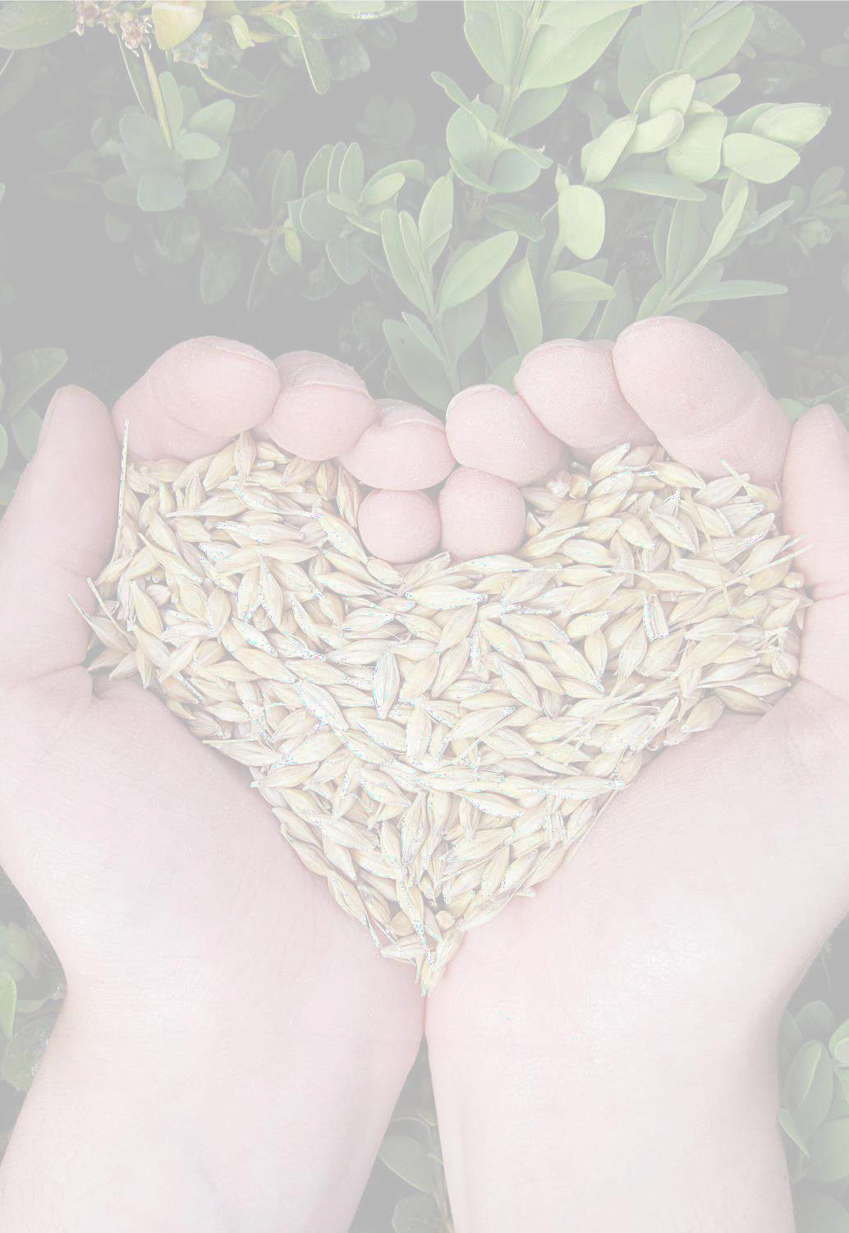
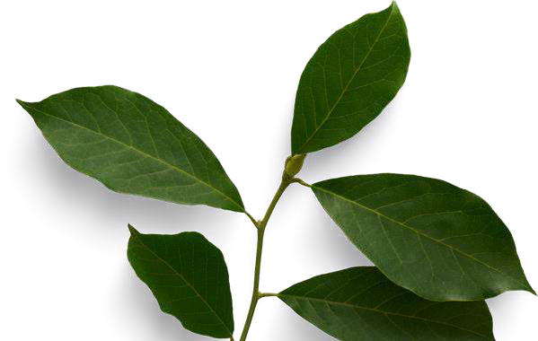
P RO B LE M IN T E RV IE W S A ND S U RV E Y S
RE S U LT S
H O W M A N Y C U S T O M E RS D ID Y O U IN T E RV IE W ? A B O V E 3 0
W H A T W A S T H E IN T E RV IE W M O DE ? O N L IN E
H O W M A N Y O F T H E M A G RE E T H IS IS P RO B LE M A N D W A N T S A S O LU T IO N ? 77 %
H O W M A N Y O F T H E M S A ID T H E Y DO N 'T N E E D A N E W S O LU T IO N ? 10 %

Slide 5


M A RKE T S IZ E E S T IM A T IO N
29 CRORES
290 CRORES
2,990 CRORES
Serviceable Obtainable Market(SOM)
= (SAM x Market Penetration Rate)
= 2,900,000,000 x 0.10
= 290,000,000
Serviceable Available Market (SAM) = (Number of Target
Farmers x Average Revenue per Farmer)
= 100,000 FARMERS X 20,000,000
= 2,900,000,000
Total Addressable market (TAM) = (Number of farms x Adoption Rate x Price per unit)
=146,000,000 x 0.20 x 1,000
= 29,200,000,000
Source: Internet

Slide 6

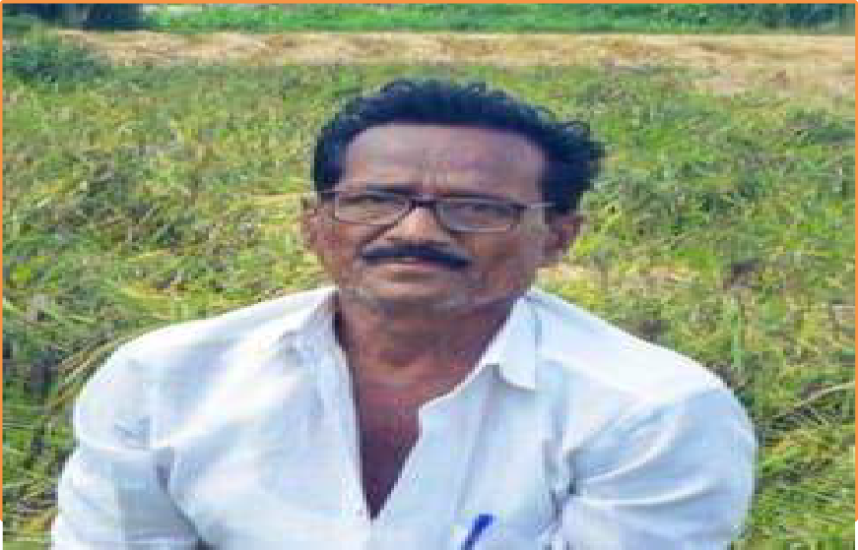

Customer Persona
GOALS
Protect crops from Water Logging in Rainy Seasons
Increase yield and revenue
Sustainable farming and reduce crops damage
Photo
Frustrations
Feeling helpless against unpredictable weather.
Anxiety about crop loss and financial stability.
Frustration with manual labor and inefficiency.
Concerns about environmental impact.
RAMANATHAN
Age: 67
Occupation: Farmer Location: COIMBATORE District
RAMANATHAN, a third-generation farmer from Coimbatore, has been practicing organic farming for 15 years. His 80-acre farm produces rice, millets, vegetables, and fruits, along with native cattle. Committed to sustainability, he uses organic pest control, composting, and water
conservation methods. He actively supports local farming cooperatives and promotes organic farming through workshops. He supplies fresh, chemical- free produce to local markets and believes organic farming is essential for food security and combating climate change. In his free time, he enjoys teaching young farmers and promoting traditional Tamil farming techniques.

Slide 7
.
I would LOVE it if:
What do you offer that makes the customers happy?
We are providing automated rain detection and protect the crop from rain to cover the crops and to give
essential Artificial sun light for the crops via solar energy.
➔? What would make the customer happy?
➔By providing quality product and giving effective solution for their problems.
➔? What do the clients want when facing the problem?
They want clear explanation and solution for their problems
What is the product or service that you are offering?
IoT based rain detection sensor with automatic protective sheet and solar
panel artificial lighting system.
I would WANT:
➔What do the clients do (actions) when facing the problem?
➔Rushing to cover crops manually.
Pumping water out of flooded areas, Adjusting farming strategies for next season.
GAIN CREATORS
PRODUCT/
SERVICE
PAIN KILLERS
FIT
GAINS
JOBS
PAINS
I would HATE it if:
➔What are the pains of the clients when facing the problem?
Clients facing problems like crop damage, finacial losses and losts environmental concerns
➔Which features of your offering relieve the customer's pains?
Waterlogging and Soil
Erosion, Limited Sunlight During Rainy Period, Real- Time Monitoring and Alerts.

Slide 8
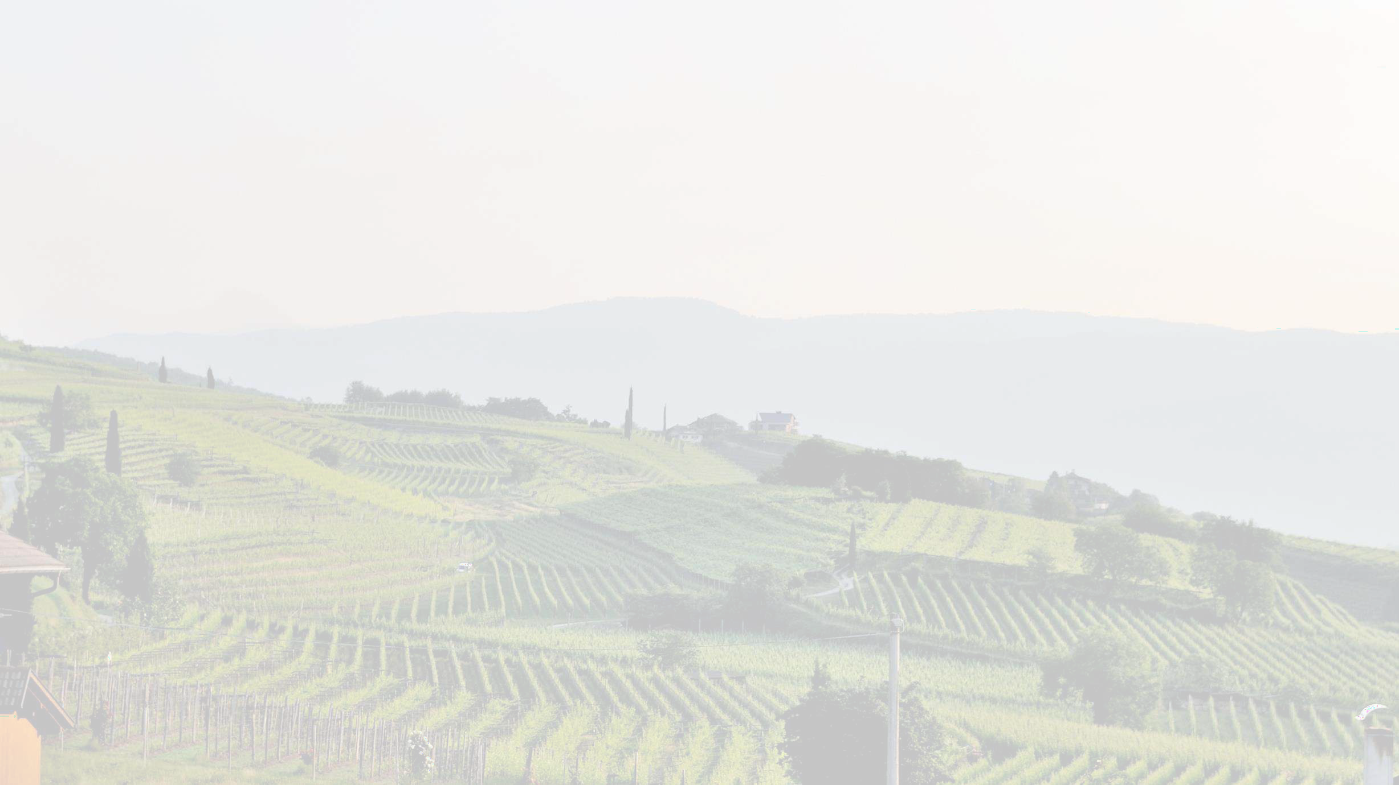
S O LU T IO N
DE S C R IB E Y O U R S O LU T IO N :
W E O F F E R A UT O M A T IC
RA IN A LERT A ND
L IS T T H E B E N E F IT S O F Y O U R S O LU T IO N S
.IN C RE A S E D C RO P S A N D V E G E T A B LE S Y IE LDS
.RE D U C E D C RO P A N D V E G E T A B LE DA M A G E
.S U S T A IN A B LE F A RM IN G
PRO T EC T IO N S Y S T EM W IT H
A RT IF IC IA L
S UNLIG HT F O R HA RV ES T ED C RO PS .
T H E DE T A IL S O F O U R O F F E R IN G C O N S IS T O F :
.A U T O M A T E D RA IN DE T E C T IO N A N D
P RO T E C T IO N S Y S T E M
.S O LA R P O W E R E D E N E RG Y S T O RA G E A N D A RT IF IC IA L S U N L IG H T
.RE A L T IM E A L E RT T O T H E F A RM E RS

Slide 9

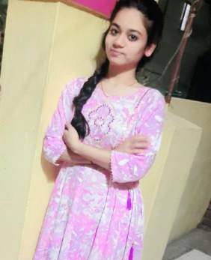
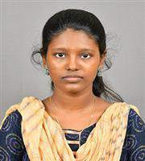
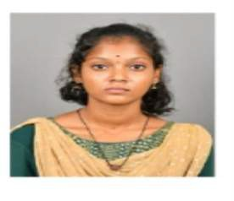
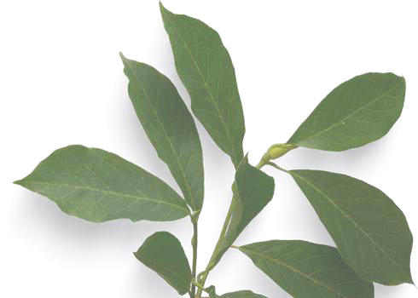
T E A M C O M P O S IT IO N
T e a m me mb e r 1 T e a m me mb e r 2
T e a m me mb e r 3
KA V IY A M C F O /C M O
P A V IT H RA V
C E O
Key Strengths and abilities
1.Problem solver 2.Observer
3.Problem solver
S RE E N A RA Y A N E H C O O /C T O
Ke y S tre ng ths and abilitie s
Ke y S tre ng ths and abi l itie s :
.Po s itive T hinke r
.Pro ble m S o lve r
.F e arle s s co nne ct e r
Dis p ute Re s o lve r
.C re ative Pro ble m s o lve r
.A d ap table and fle xible
.S o ci al co nne ct e r

Slide 10

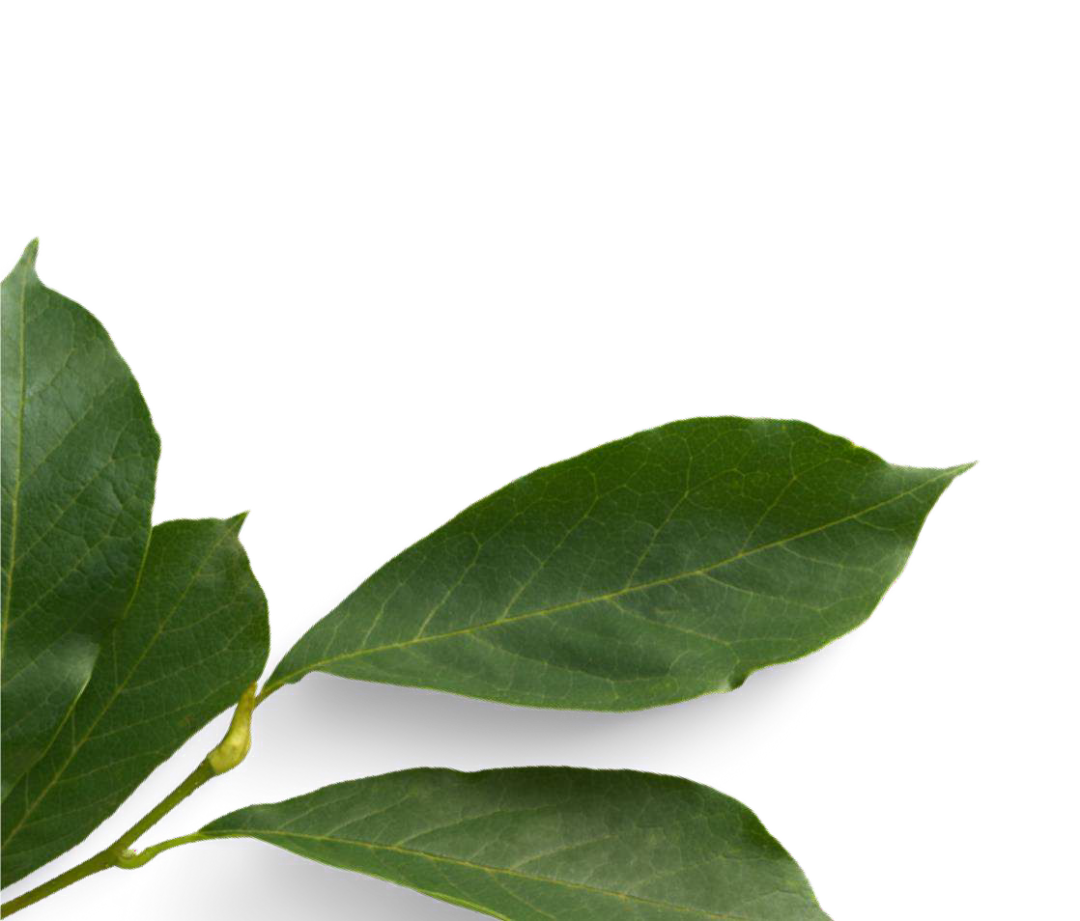
THANK YOU

