Slide 1
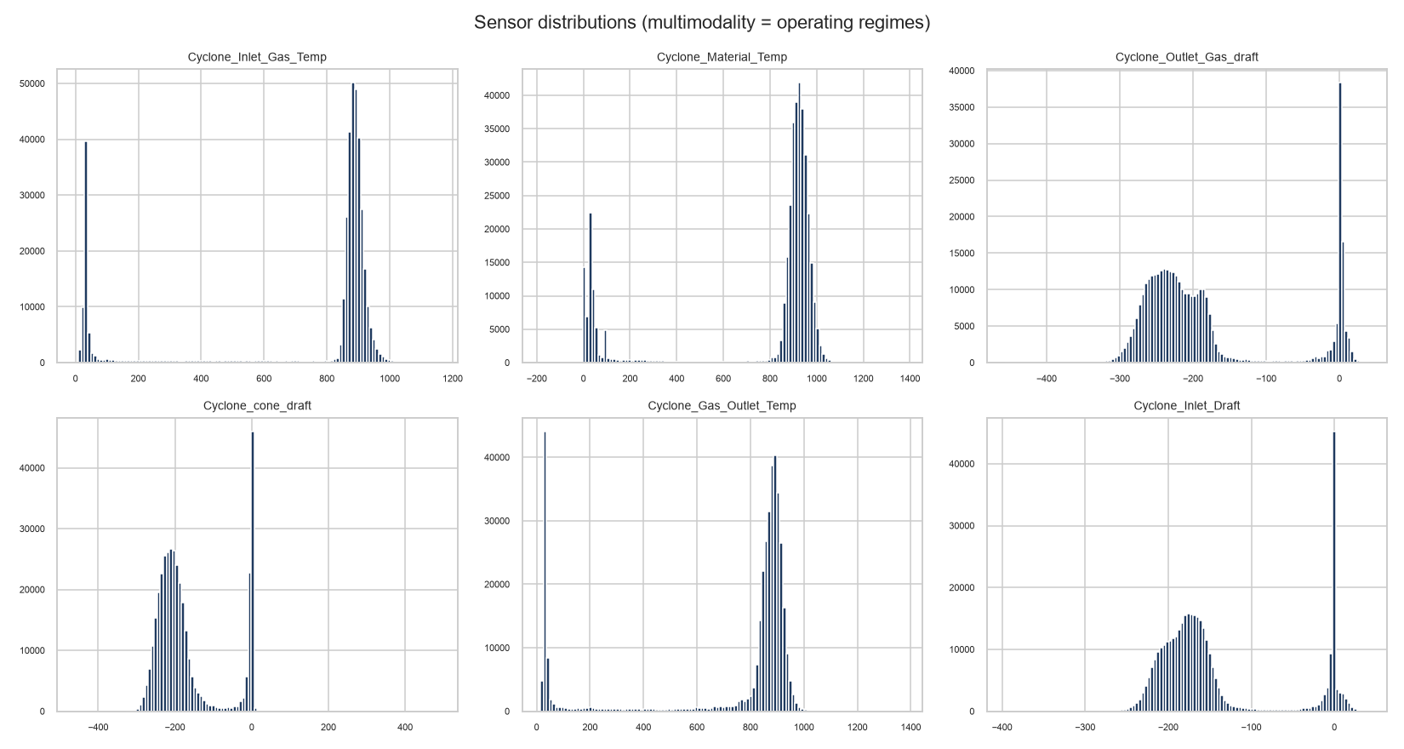
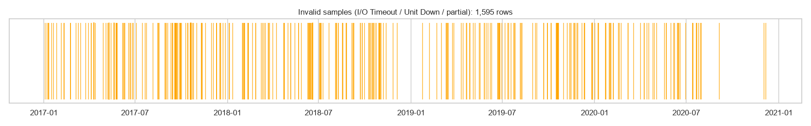
1. Data Preparation & Characteristics
Audit findings, physical multi-modality, and preprocessing decisions
GitHub Repository: https://github.com/pavitra-d-byali/cyclone-preheater-anomaly-detection
Core Dataset Metrics: 377,719 rows x 7 cols (3 temperatures + 3 drafts) over 1,436 days (2017–2020).
• Sampling cadence: 5 min | 14 multi-day acquisition dropouts (> 5 min).
Key Quality Discoveries:
• Dual timestamp locales (DD-MM-YYYY & M/D/YYYY) resolved dynamically.
• File was text-sorted; chronologically re-ordered in preprocessing.
• 1,595 sentinel rows preserved as NaN (reported as outages; never dropped).
Treatment Policy:
• Zero clipping of extremes (preserves true candidate anomalies).
• Median / IQR robust scaling (50% breakdown prevents scaler distortion).

Slide 2
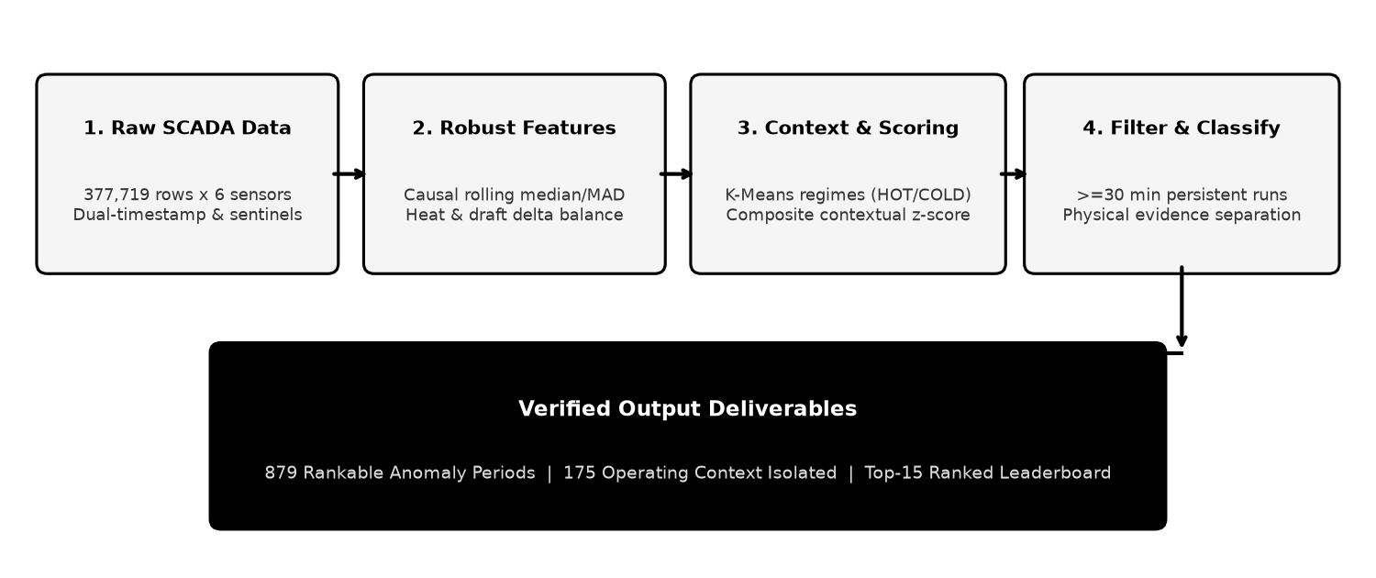
2. Analysis Strategy & Architecture
Fit-for-purpose unsupervised pipeline with temporal persistence filtering
End-to-End Methodological Approach:
• 1. Causal Rolling Features: Trailing median/MAD robust z-scores (no future leakage).
• 2. Operating Regimes: MiniBatchKMeans (k=2) captures HOT (889 °C) vs COLD (33 °C).
• 3. Composite Contextual Scoring: Combines local deviation with regime bounds.
• 4. Temporal Persistence: Requires >=30 min sustained run; bridges <=15 min gaps.
• 5. Context Separation: Physical evidence chains isolate startup/shutdown cycles.
Why This Approach Fits SCADA Data:
• Deep Learning Rejected: Zero ground-truth labels for training; 6 channels do not justify opaque black-box models.
• Isolation Forest as Corroboration: Pointwise IF flags single-sample noise; used strictly as corroborating multivariate evidence.
• Temporal Persistence is Essential: Genuine plant upsets persist; momentary sensor flicker is filtered out.

Slide 3
3. Detected Abnormal Periods
Contiguous persisted events, physical categorization, and top-15 leaderboard
Flagged Points: 39,441 (10.44% of dataset) | Total Detected Periods: 1055
• • Rankable Process/Instrument Anomalies: 879 (Process: 386, Faults: 49, Single-sensor: 348)
• • Operating Context Isolated: 88 Startup + 87 Shutdown + 1 Post-Outage (Scored, never ranked)
• • Duration Profile: Median 75 min | Max 5850 min (97.5 h) | 357 Acquisition outages reported separately
# | Start | End | Min | Sev | Category | Affected Sensors
1 | 2018-07-15 21:15:00 | 2018-07-15 23:35:00 | 145 | 1.000 | instrument_fault | Inlet_Temp; Mat_Temp; Outlet_draft; cone_draf
2 | 2020-05-17 10:30:00 | 2020-05-17 22:20:00 | 715 | 0.973 | process_correlated | Inlet_Temp; Mat_Temp; Outlet_draft; cone_draf
3 | 2017-08-06 16:30:00 | 2017-08-07 01:20:00 | 535 | 0.968 | process_correlated | Inlet_Temp; Mat_Temp; Outlet_draft; cone_draf
4 | 2017-03-30 20:55:00 | 2017-03-30 23:30:00 | 160 | 0.965 | process_correlated | Inlet_Temp; Outlet_draft; cone_draft; Outlet_
5 | 2019-07-04 20:10:00 | 2019-07-04 20:50:00 | 45 | 0.963 | instrument_fault | Inlet_Temp; Mat_Temp; Outlet_draft; cone_draf
6 | 2018-09-07 00:00:00 | 2018-09-08 01:20:00 | 1525 | 0.936 | process_correlated | Inlet_Temp; Mat_Temp; Outlet_draft; cone_draf
7 | 2019-06-30 22:20:00 | 2019-06-30 23:55:00 | 100 | 0.932 | process_correlated | Inlet_Temp; Mat_Temp; Outlet_draft; cone_draf
8 | 2019-01-08 15:45:00 | 2019-01-09 01:20:00 | 580 | 0.924 | process_correlated | Inlet_Temp; Mat_Temp; Outlet_draft; cone_draf
9 | 2017-07-31 04:30:00 | 2017-07-31 17:00:00 | 755 | 0.910 | process_correlated | Inlet_Temp; Mat_Temp; Outlet_draft; Outlet_Te
10 | 2018-08-03 00:00:00 | 2018-08-03 01:20:00 | 85 | 0.898 | process_correlated | Inlet_Temp; Outlet_draft; cone_draft; Outlet_
11 | 2017-09-13 00:00:00 | 2017-09-14 00:30:00 | 1475 | 0.885 | process_correlated | Inlet_Temp; Outlet_Temp
12 | 2019-10-26 15:00:00 | 2019-10-27 06:55:00 | 960 | 0.882 | process_correlated | Inlet_Temp; Mat_Temp; Outlet_draft; cone_draf
13 | 2019-04-14 18:40:00 | 2019-04-16 05:55:00 | 2120 | 0.881 | process_correlated | Inlet_Temp; Outlet_Temp
14 | 2018-06-12 00:00:00 | 2018-06-13 01:20:00 | 1525 | 0.872 | process_correlated | Inlet_Temp; Mat_Temp; Outlet_Temp
15 | 2018-05-31 19:05:00 | 2018-06-01 01:20:00 | 380 | 0.872 | process_correlated | Inlet_Temp; Mat_Temp; Outlet_draft; cone_draf

Slide 4
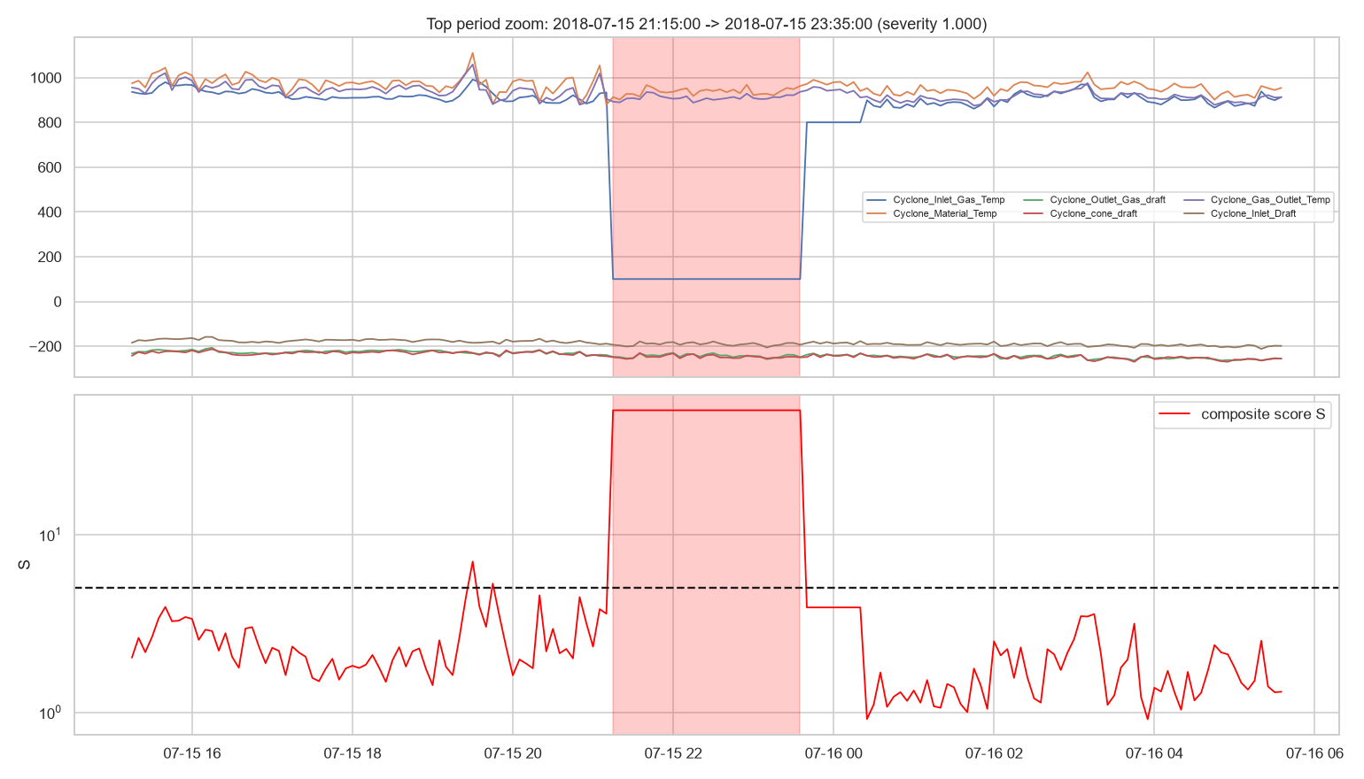
4. Validation & Top Event Inspection
Unsupervised validation checks and detailed sensor behavior during top event
Statistical & Model Validation:
• Method Agreement: Spearman correlation = 0.549 (Robust z vs Isolation Forest).
• Regime Quality: K-Means k=2 achieves Silhouette = 0.852, Davies-Bouldin = 0.213.
• Stability Analysis: 3x3 grid (threshold x window) yields Jaccard 0.71–0.88 across all configs.
Physical & Process Plausibility:
• 53.3% of periods involve >=2 physically coupled sensors deviating in synchrony.
• 95.1% of all flagged samples fall within confirmed >=30 min persistent runs.
Engineering Limitations:
• Unlabeled Data: Absence of ground-truth labels precludes supervised precision/recall.
• Historian Context: 6 SCADA channels available; kiln feed rate & damper positions required for root-cause diagnosis.

