Slide 1
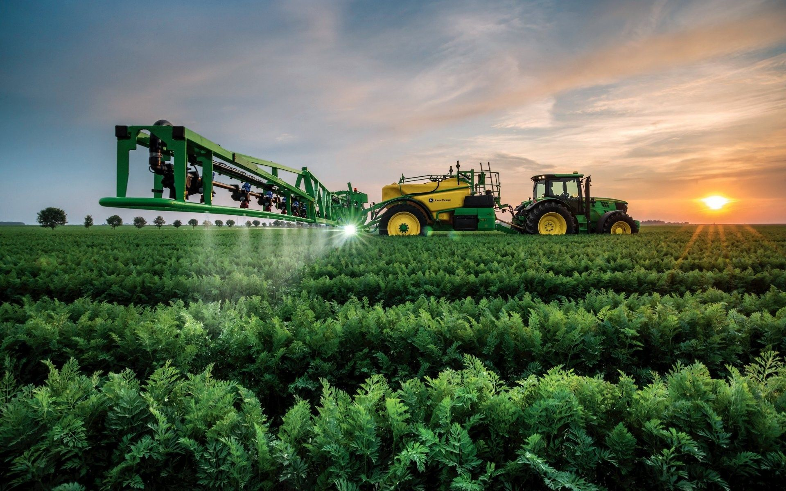

FARMING EQUIPMENT RENTAL SERVICE

Slide 2
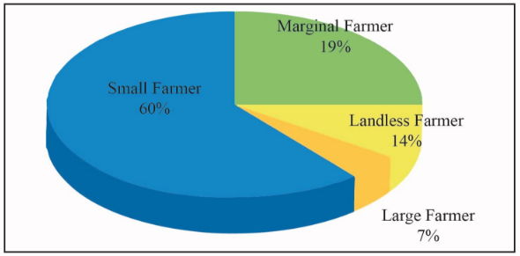
BUSINESS MODEL STATS:

Slide 3
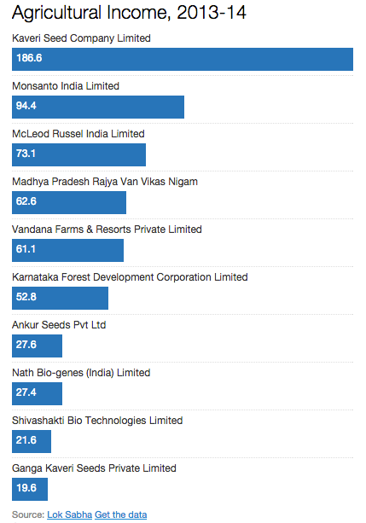

Slide 4
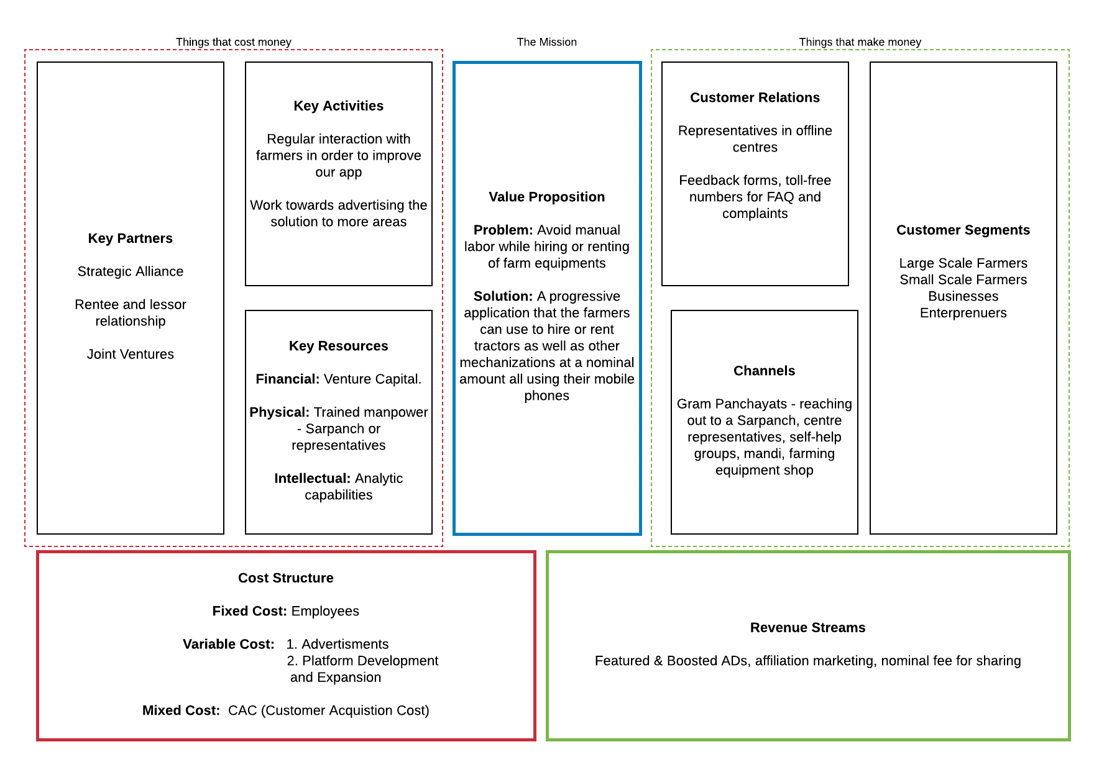

Slide 5
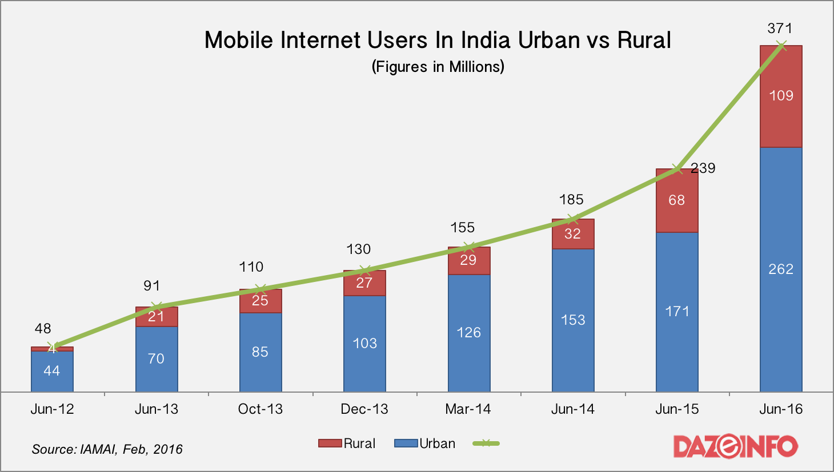

Slide 6
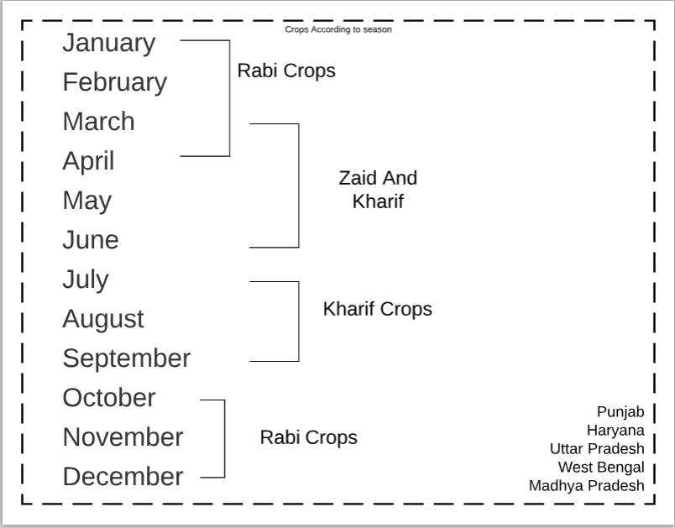
CROPS PRODUCED THROUGHOUT THE YEAR

