Slide 1
FoxoGyan
An official Mozilla Club of GGITS

Slide 2
What we’ll study today
CSS Syntax and Selectors
Introduction to Bootstrap
Creating a front-page using bootstrap
If time allows,
Introduction to php
Handling form data using php
Validation using if else statements
TASK 3

Slide 3
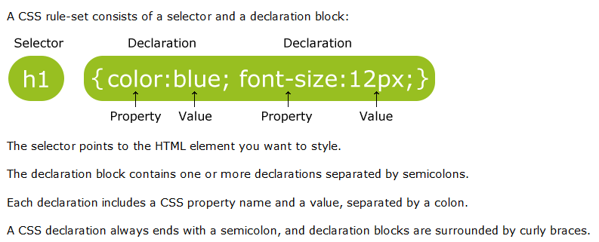
CSS Syntax

Slide 4
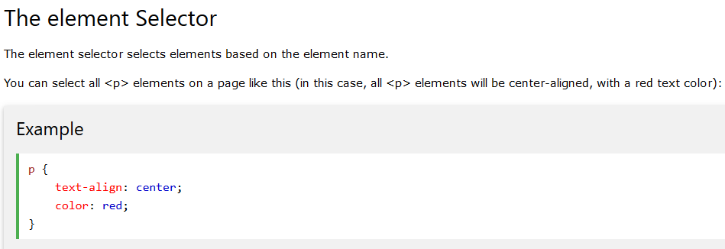
CSS Selectors CSS selectors are used to "find" (or select) HTML elements based on their element name, id, class, attribute, and more.

Slide 5
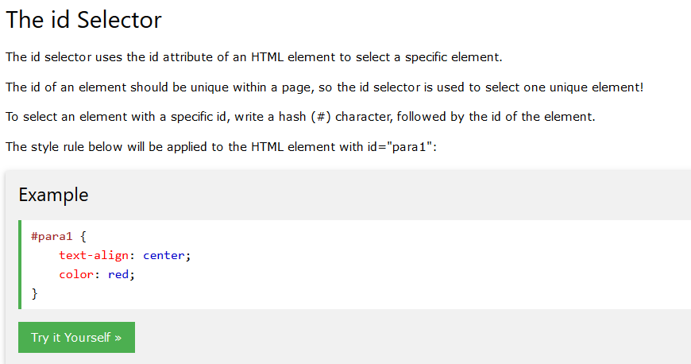
HTML example : <p id=“para1”> Content </p>
Note: An id name cannot start with a number!

Slide 6
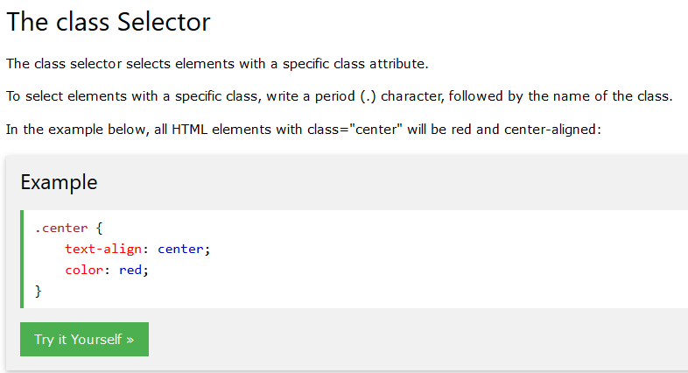
HTML example : <p class=“center”> Content </p>

Slide 7
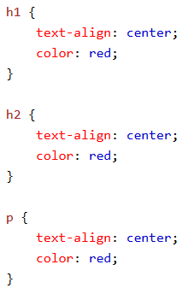
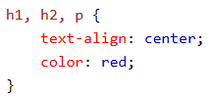
Grouping Selectors If you have elements with the same style definitions, like this:
They can be
Written like
this

Slide 8
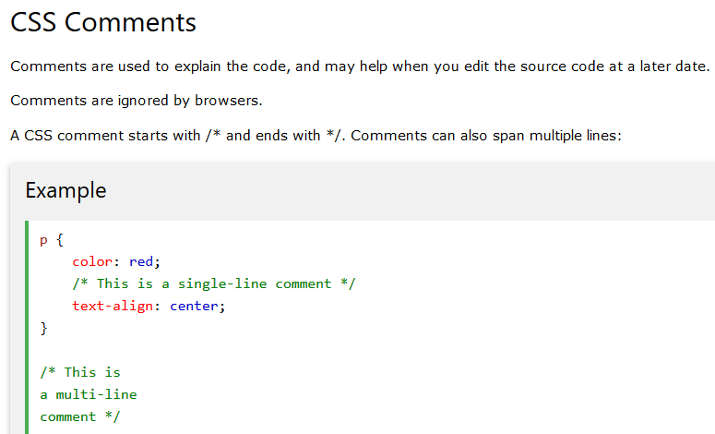

Slide 9
Introduction to Bootstrap
What is Bootstrap?
Bootstrap is a powerful front-end framework for faster and easier web development. It includes HTML and CSS based design templates for common user interface components like Typography, Forms, Buttons, Tables, Navigations, Dropdowns, Alerts, Modals, Tabs, Accordion, Carousel and many other as well as optional JavaScript extensions.
Bootstrap also gives you ability to create responsive layout with much less efforts.

Slide 10
Advantages of Bootstrap
Save lots of time — You can save lots of time and efforts using the Bootstrap predefined design templates
and classes and concentrate on other development work.
Responsive features — Using Bootstrap you can easily create responsive designs.
Bootstrap responsive features make your web pages to appear more appropriately on
different devices and screen resolutions without any change in markup.
Consistent design — All Bootstrap components share the same design templates and
styles through a central library, so that the designs and
layouts of your web pages are consistent throughout your development.
Easy to use — Bootstrap is very easy to use. Anybody with the basic working knowledge of
HTML and CSS can start development with Bootstrap.
Compatible with browsers — Bootstrap is created with modern browsers in mind and
it is compatible with all modern browsers such as Mozilla Firefox, Google Chrome,
Safari, Internet Explorer, and Opera.
Open Source — And the best part is, it is completely free to download and use

Slide 11
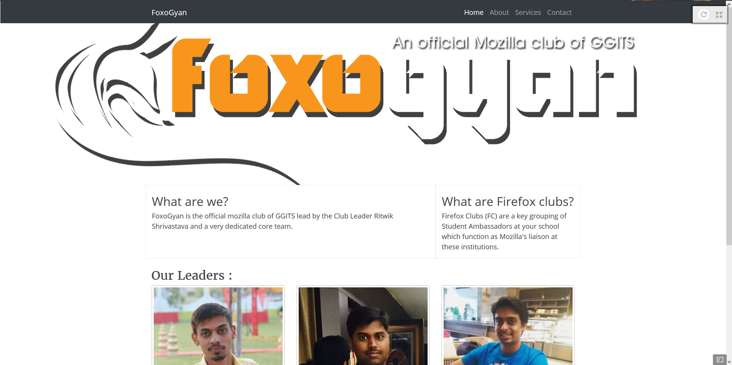

Slide 12
Getting started
Go to http://getbootstrap.com
Open Thimble
Include the bootstrap css before style.css and scripts before the </body> tag (Optional)
Use w3schools as a reference

