Slide 1
Title: DroidSentinel: An Android Anti-Forensics Detection Framework Subtitle: Automated Multi-Vector Detection with Rule-Based Analysis and Machine Learning Presented by: Pavitra Kulkarni (PES1UG24CS817) Supervisor: Prof. Preet Kanwal Research Centre: PESU-ISFCR — AI/ML for Cybersecurity Duration: June–July 2026

Slide 2
Title: Mobile Forensics — Overview
Key Areas of Mobile Forensics:
Data acquisition (physical, logical, file system)
Data recovery (deleted files, SQLite WAL)
Network forensics (call logs, SMS, internet)
App forensics (WhatsApp, social media)
Anti-forensics detection ← This project
Why Android?
72% global smartphone market share
Most targeted platform in criminal investigations
Open architecture makes it both vulnerable and analyzable

Slide 3
Title: Anti-Forensics on Android
Anti-Forensics Categories on Android:
Category | Techniques
Data Destruction | File wiping, secure deletion, DB vacuuming
Trace Concealment | App uninstall, Clear Data, factory reset, timestamp manipulation
Encryption | Full disk encryption, encrypted containers, steganography
Network | VPN, Tor, ephemeral messaging
Physical | Remote wipe, kill switch, duress passwords
App-level | Vault apps, decoy apps, disappearing messages
This Project Focuses On: Data Destruction + Trace Concealment

Slide 4
Title: Research Gap — Why DroidSentinel?
What Existing Tools Do:
Tool | Type | Gap
Autopsy | Open source | General forensics, not anti-forensics specific
Cellebrite UFED | Commercial | Expensive, no confidence score, proprietary
Oxygen Forensics | Commercial | No anti-forensics detection
AFLogical OSE | Open source | Extraction only, no detection
Manual ADB | Manual | Time-consuming, skill-dependent
What Does Not Exist:
No open-source automated framework that detects multiple Android anti-forensic attack vectors simultaneously with a weighted confidence score on Android 10.
Novel Contribution: notification_log.db as a ghost trace artifact surviving app uninstall on Android 10 — not documented in prior literature.

Slide 5
Literature Review
# | Paper | Key Finding | Relevance
1 | Oh et al., Wiley J. Forensic Sciences 2025 | File wiping apps leave artifacts in system logs | Core gap paper
2 | DFIR Review 2022 | factory_reset file as timestamp artifact | R05 rule basis
3 | Magnet Forensics 2026 | Wasted, Secure Folder artifact signatures | App-specific rules
4 | Belkasoft 2024-25 | Normal artifact baselines — usagestats, dropbox | Baseline design
5 | digital-forensics.it Nov 2025 | Under-researched Samsung artifacts | Android 10 context
6 | arXiv 2014 | Foundational anti-forensics theory | Forensic paradox
Gap Identified Across All 6 Papers: All papers study individual techniques manually on pre-Android 10 devices. None build an automated detection framework.

Slide 6
DroidSentinel — System Architecture
Android Device (API 29) -> ADB artifact_collector.py -> Scan Folder (timestamped) -> rule_engine.py ml_detector.py (R01–R11 rules) (Isolation Forest) -> scorer.py (Confidence Score) -> app.py Dashboard (Streamlit UI) -> PDF Forensic Report
Components:
Artifact Collector — Automated ADB extraction
Rule Engine — 11 detection rules
ML Detector — Isolation Forest anomaly detection
Scorer — Weighted confidence scoring
Dashboard — Streamlit visualization
PDF Report — Court-ready output

Slide 7
Experimental Setup
Environment:
Device: Android Studio AVD — Medium Phone
Android Version: 10 (API 29, Android Q)
Architecture: x86
Root Access: via ADB
3 Wiping Apps Tested:
App | Package | Method
iShredder 7.0.11 | com.projectstar.ishredder.android.standard | Random overwrite
Shreddit 5.40.260501 | com.palmtronix.shreddit.v1 | Zero fill
Secure Eraser 1.2.6 | com.aiuspaktyn.secureeraser | Free space wipe
4 Attack Vectors:
V1: File Wiping Apps
V2: App Uninstall (Ghost Trace)
V3: Manual Log Clearing (Clear Data)
V4: Factory Reset

Slide 8
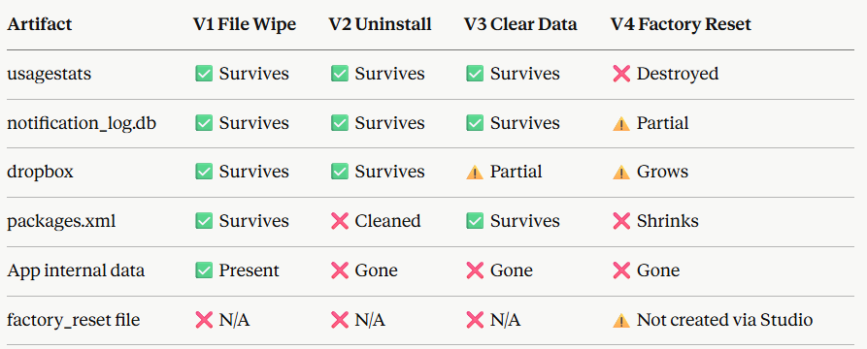
Artifact Survival Matrix
Key Finding: notification_log.db is the most reliable ghost trace artifact — survives all 3 vectors with 100% precision and 100% recall.

Slide 9
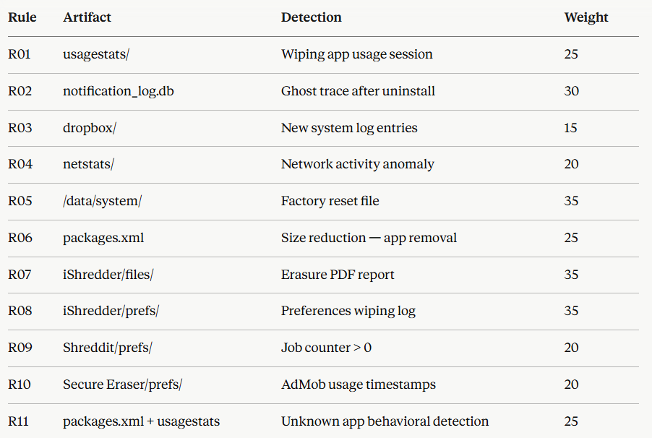
Rule Engine — 11 Detection Rules
Max Score: 285

Slide 10
Weighted Confidence Scoring System
How It Works:
Rules fire → scores accumulate (out of 285)
Grouped by 4 attack vectors
Multi-vector bonus applied:
1 vector = 1.0x
2 vectors = 1.15x
3 vectors = 1.30x
4 vectors = 1.50x
Final confidence % calculated
Example — All 3 Apps Running:
Rules Fired: 7/11
Base Score: 180/285 (63.2%)
Vectors Detected: 3/4
Multiplier: x1.30
Final Confidence: 82.1% — HIGH

Slide 11
Machine Learning Layer — Isolation Forest
Why Isolation Forest?
Unsupervised — no need for labelled anomaly data during training
Trains only on normal samples → learns what normal looks like
Flags deviations as anomalies
Ideal for forensics where normal behavior is well-defined
Dataset:
Total samples: 51 (19 real + 32 synthetic)
Normal: 22 samples
Anomaly: 29 samples
Features: 12 numerical features extracted from artifacts
Results:
Overall Accuracy: 84%
Anomaly Recall: 93.1% (27/29 anomalies caught)
False Negatives: 2 (both weak anomalies also caught by rule engine)
Key Point: Rule engine + ML complement each other — if one misses, the other catches it.

Slide 12
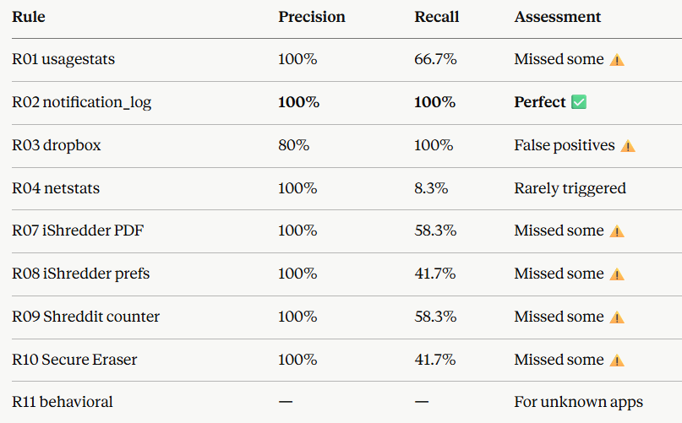
Validation Framework — Per-Rule Performance
System Average:
Precision: 95.2%
Recall: 74.2%

Slide 13
Novel Research Findings
Finding 1 — notification_log.db as Ghost Trace Artifact
notification_log.db survives app uninstall, file wiping, and Clear Data on Android 10 with 100% precision and recall. This artifact has not been specifically documented as a cross-vector ghost trace indicator in prior literature.
Finding 2 — packages.xml Fully Sanitised on Uninstall
On Android 10, packages.xml entries are completely removed upon app uninstall — contradicting pre-Android 10 literature which reported residual entries.
Finding 3 — Factory Reset via Development Tools
Android Studio Wipe Data does not create the factory_reset timestamp file unlike Settings-based reset — a forensically significant distinction for investigators examining development devices.
Finding 4 — Cross-Vector Artifact Correlation
System-level artifacts (usagestats, notification_log.db, dropbox) are cross-vector indicators — a single anti-forensic action leaves traces detectable across multiple attack vectors simultaneously.

Slide 14
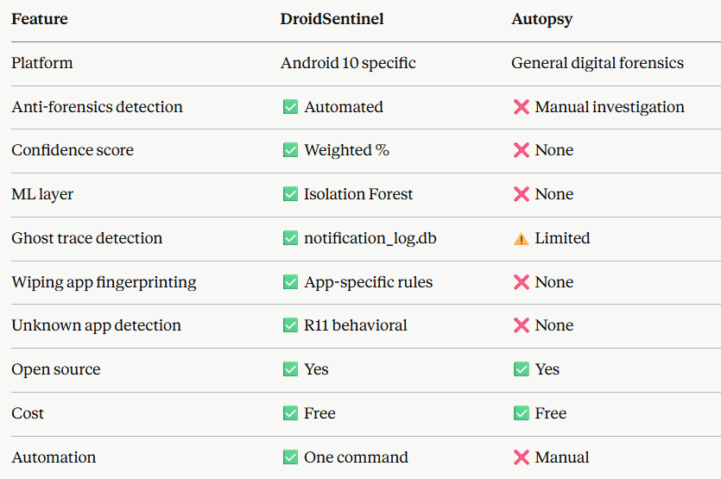
DroidSentinel vs Autopsy
Conclusion: DroidSentinel detects anti-forensic activity that Autopsy misses — specifically ghost traces, wiping app fingerprints, and behavioral anomalies.

Slide 15
Limitations and Future Work
Current Limitations:
Tested on emulator only — real device testing needed
Small dataset (51 samples) — needs expansion
R11 misses apps with non-descriptive package names
factory_reset detection only works via Settings reset
Secure Eraser admob.xml colon filename issue on Windows
Future Work:
Test on physical Android devices
Expand to Android 12/13/14
Add detection for encryption-based anti-forensics
Expand R11 to detect more behavioral patterns
Add network traffic analysis layer
Expand dataset with real-world device scans
Publish findings — notification_log.db ghost trace finding

Slide 16
Thank You

